Slide 1
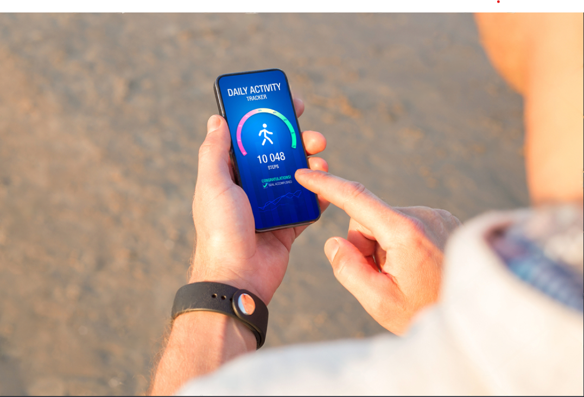

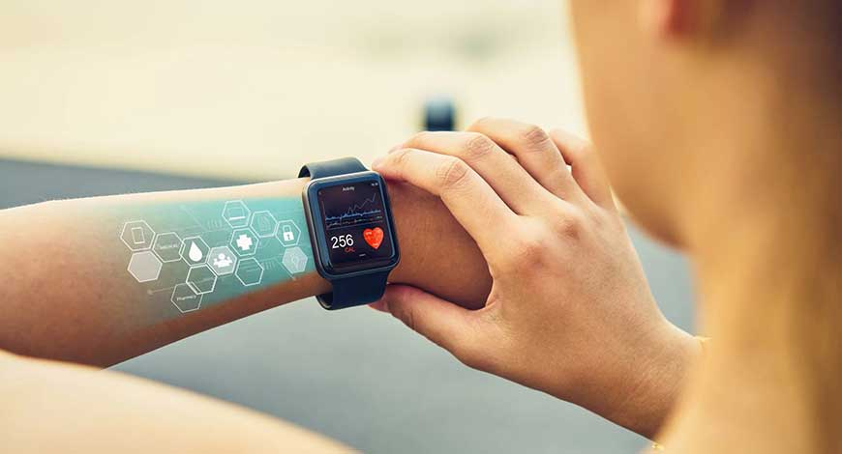
Parul University
Institute of Engineering & Technology
B.Tech 6th Semester Minor project Presentation
“CarePulse: Instant Disease Detection”
Presented by:
1. Pandey Sanjit Vinod 2303051057094 2. Dhruv Motaval 2303051247009 3. Baisampayan Dey 2303051247023 4. Aryan Patil 2303051247002
Supervisors:
Mrs. Arpita Meet Vaidya
PARUL INSTITUTE OF TECHNOLOGY, PARUL UNIVERSITY

Slide 2

Content of Presentation
Sr No | Content
01 | Abstract
02 | Existing System
03 | Introduction
04 | Project Module
05 | Use case diagram and Flow diagram
06 | Requirements
08 | Limitation
09 | Future scope
10 | Conclusion
11 | References
PARUL INSTITUTE OF TECHNOLOGY, PARUL UNIVERSITY

Slide 3
Abstract
CAREPULSE is disrupting the healthcare industry by making use of wearables/smartphone and machine learning for real-time detection of disease. These smartwatches accumulate enormous amounts of health data, which ML algorithms analyze to recognize predetermined patterns of risks and then give alerts concerning critical matters such as heart attacks. The app monitors consumers' health data and will even notify them of possible problems, giving alerts.
PARUL INSTITUTE OF TECHNOLOGY, PARUL UNIVERSITY

Slide 4
Existing System
Wearable Devices: Track fitness metrics (e.g., heart rate, steps) but lack disease detection.
Medical Devices: every tracking is taken by different different device.
Health Apps: Collect data but offer limited analysis without predictive capabilities.
Telemedicine: Relies on manual data entry, lacks real-time integration.
PARUL INSTITUTE OF TECHNOLOGY, PARUL UNIVERSITY

Slide 5
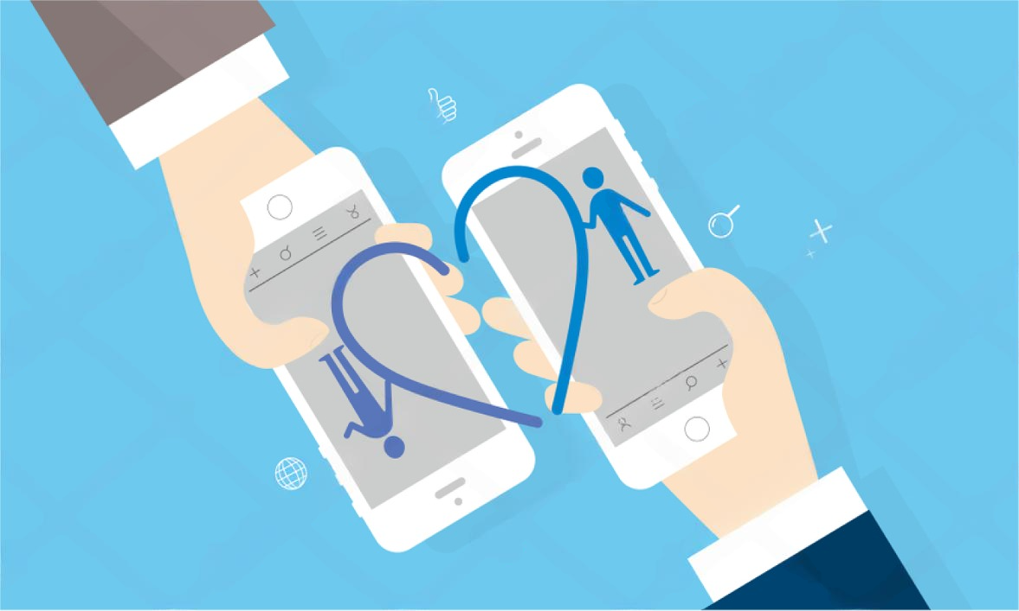
Project Title
5
CarePulse:Disease Detection

Slide 6
Introduction
Wearable AI technologies like smartwatches and health monitors help a user in keeping track of very vital health parameters such as heart rate and SpO₂ levels. However, these devices are not often used for real-time disease detection. This is where CarePulse comes into play-it leverages machine learning to extract valuable indicators from smartwatch data to identify people at risk of heart disease, arrhythmia, hypertension, and stress. The mobile application sends instant alert notifications to the user and gives personalized insights to motivate the user to seek preventive steps towards healthier living.
PARUL INSTITUTE OF TECHNOLOGY, PARUL UNIVERSITY

Slide 7
Problem Statement
Many diseases go undetected due to a lack of continuous monitoring and early warning systems. Traditional healthcare relies on periodic checkups and patient-reported symptoms, leading to delays in diagnosis, especially for conditions like cardiovascular diseases and chronic illnesses.
Current monitoring systems, like fitness trackers, are often limited in scope, making them inadequate for comprehensive disease detection. Geographic constraints and inefficiencies in record-keeping further complicate early diagnosis.
There is an urgent need for a system that utilizes mobile app technology for continuous health monitoring, enabling early disease detection and providing individuals with actionable insights to improve health outcomes.
PARUL INSTITUTE OF TECHNOLOGY, PARUL UNIVERSITY

Slide 8
Literature Review
Many studies indicate that wearable/fitness app devices can effectively detect health issues by monitoring heart rate, blood oxygen levels, and activity patterns. Devices like the Apple Watch , Fitbit and google fit track specific conditions such as arrhythmias and sleep apnea through features like ECG monitoring and SpO2 tracking.
However, there is limited integration of wearables with real-time machine learning (ML) models, often focusing on one disease at a time and lacking complex data analysis. Most existing tools review data after the fact instead of providing real-time feedback.
By combining continuous data collection from wearables with ML insights, we can enhance ongoing health monitoring. This integration could facilitate early detection of health problems and ultimately improve healthcare outcomes.
PARUL INSTITUTE OF TECHNOLOGY, PARUL UNIVERSITY

Slide 9
Proposed Methodology
Data Collection: Gather real-time data from smartwatch/ mobile sensors.
Data Preprocessing: Clean and normalize the data using machine learning.
ML Model Development: Train models to detect diseases.
Deployment: Integrate models into a mobile app.
Real-Time Feedback: Provide instant health insights.
PARUL INSTITUTE OF TECHNOLOGY, PARUL UNIVERSITY

Slide 10
Project Modules
Data Integration Module
Machine Learning Model Module
Real-Time Analysis Module
User Interface Module
PARUL INSTITUTE OF TECHNOLOGY, PARUL UNIVERSITY

Slide 11
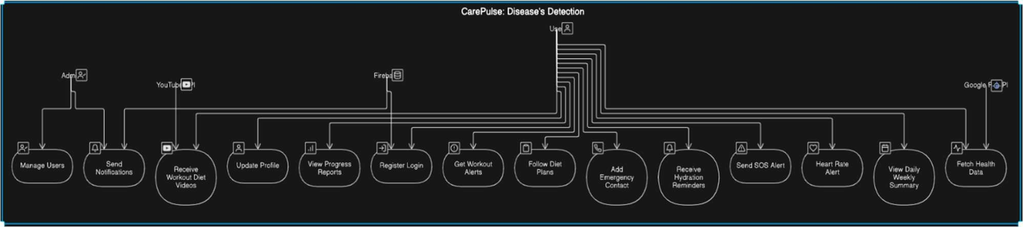
Use Case Diagram
PARUL INSTITUTE OF TECHNOLOGY, PARUL UNIVERSITY

Slide 12
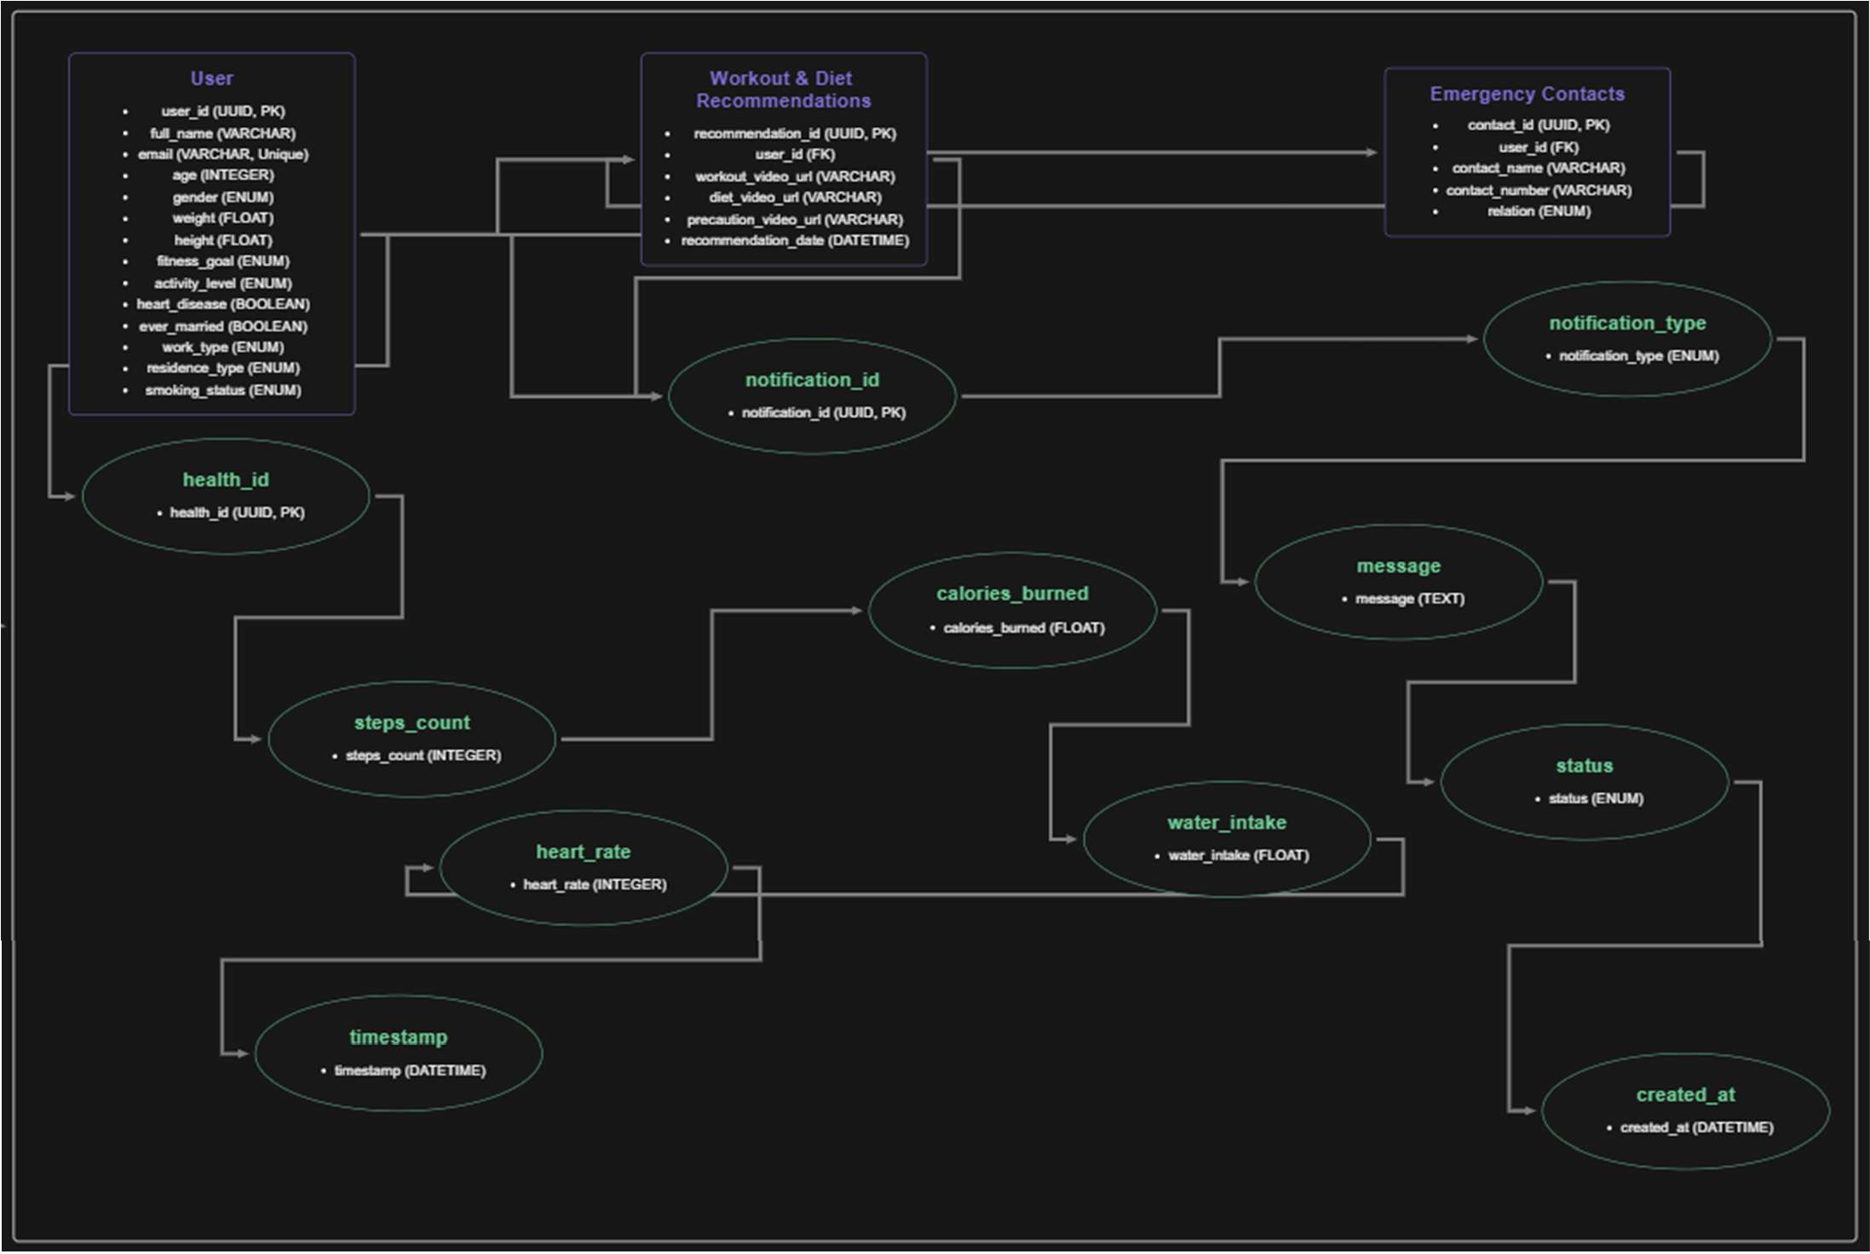
ER Diagram
PARUL INSTITUTE OF TECHNOLOGY, PARUL UNIVERSITY

Slide 13
Requirements
Software Requirements:
Operating System: Android 8.0 (Oreo) or later
Development Framework: FlutterFlow (Dart)
Backend: Firebase (Real-time Database & Authentication)
Machine Learning Frameworks: TensorFlow Lite (for on-device AI processing)
Storage Requirement: 200MB–500MB (including cached health data)
APIs & SDKs:
Google Fit API (for health data access)
PARUL INSTITUTE OF TECHNOLOGY, PARUL UNIVERSITY

Slide 14
Requirements
Hardware Requirements:
Minimum Requirements:
Operating System: Android 8.0 (Oreo) or later
Processor: Quad-Core (1.8 GHz or higher)
RAM: 3GB
Storage: 200MB free space.
Display: Minimum 5.0-inch screen (to ensure readability of health insights)
Connectivity: Internet access for real-time data sync.
Sensors: Basic health tracking sensors (Heart rate monitor support, if available)
PARUL INSTITUTE OF TECHNOLOGY, PARUL UNIVERSITY

Slide 15
Expected Outcome of the Project
The Outcome of this project aims to create an easy-to-use mobile app that detects health issues in real-time using data from smartwatches. The app will use advanced machine learning to analyze metrics like heart rate and SpO2 levels to spot health risks.
Key outcomes include:
Real-Time Alerts:
Users will get immediate notifications for irregularities, allowing for early detection of problems like heart issues and stress.
Preventive Insights:
The app will provide actionable advice to help users manage their health proactively.
Easy Integration:
It will work with popular smartwatch brands to ensure wide accessibility.
Enhanced Health Outcomes:
Early intervention will help reduce delays in diagnosis and improve healthcare quality.
PARUL INSTITUTE OF TECHNOLOGY, PARUL UNIVERSITY

Slide 16
Limitations
Data Privacy and Security Concerns:
Handling sensitive health data from smartwatches raises issues with following rules like GDPR and HIPAA. If data breaches occur, they can damage user trust and lead to misuse of personal information.
Potential for False Positives or Negatives:
Machine learning models may incorrectly interpret data, causing false alarms or miss detections. This can lead to user anxiety or delays in getting medical treatment.
Variability in Data Quality Across Smartwatch Brands:
Different smartwatch brands use various sensors and algorithms, which can affect how consistent and accurate the data is. Standardizing this data is complicated and impacts reliability.
PARUL INSTITUTE OF TECHNOLOGY, PARUL UNIVERSITY

Slide 17
Conclusion
This project showcases the transformative potential of combining mobile application and machine learning to revolutionize healthcare.
By utilizing application data for real-time disease detection, it addresses significant gaps in early diagnosis and continuous health monitoring.
The system empowers users with actionable insights, allowing for timely interventions and promoting a proactive approach to health management.
This innovation not only enhances accessibility but also connects technology with preventive care, ultimately making healthcare more efficient and user-centered.
PARUL INSTITUTE OF TECHNOLOGY, PARUL UNIVERSITY

Slide 18
Future Works
Expanding Detection Capabilities:
Incorporate the detection of additional diseases, such as neurological disorders and chronic conditions.
Integrating Advanced AI Models:
Utilize deep learning and ensemble methods to enhance accuracy and effectively analyze complex patterns in health data.
Enhancing User Experience:
Develop mobile and web applications featuring intuitive interfaces, along with seamless integration for smartwatches.
Strengthening Data Privacy and Security:
Implement strong encryption methods and ensure compliance with global data protection standards to build user trust.
Scalability and Interoperability:
Adapt the system for integration with other healthcare platforms and devices to create a connected health ecosystem.
PARUL INSTITUTE OF TECHNOLOGY, PARUL UNIVERSITY

Slide 19
References
Chollet, F. (2018). Deep Learning with Python. Manning Publications. (Useful for understanding deep learning concepts and applying them in mobile apps.)
Zhang, Y., & Zheng, Y. (2020). Artificial Intelligence in Healthcare. Springer. (Relevant for developing healthcare-related apps with AI integration.
Kelleher, J. D., Mac Carthy, M., & Korvir, P. (2015). Fundamentals of Machine Learning for Predictive Data Analytics. MIT Press. (Provides a foundation for implementing machine learning algorithms in apps.)
Kingma, D. P., & Ba, J. (2015). Adam: A Method for Stochastic Optimization. arXiv preprint arXiv:1412.6980. (Important for understanding optimization techniques used in app-based AI models.)
TensorFlow Lite Documentation. (https://www.tensorflow.org/lite) (The mobile version of TensorFlow, designed for deploying machine learning models on mobile devices.)
PyTorch Mobile Documentation. (https://pytorch.org/mobile) (For integrating PyTorch models into mobile applications.)
Wang, Y., & Zhang, J. (2021). AI-Powered Mobile App Development. Springer. (Focuses on the integration of AI in mobile app development.)
Raschka, S. (2015). Python Machine Learning. Packt Publishing. (Provides insights into implementing machine learning models that can be used in mobile apps.)
Google Developers. (2020). ML Kit for Firebase. (https://developers.google.com/ml-kit) (A mobile SDK that brings Google's machine learning expertise to Android and iOS apps.)
Keras Documentation. (https://keras.io/) (Keras is a high-level neural networks API that works well for integrating machine learning into mobile apps.)
Bishop, C. M. (2006). Pattern Recognition and Machine Learning. Springer. (For implementing machine learning algorithms that can be deployed in apps.)
Sze, V., Chen, Y., & Yang, T. (2017). Efficient Processing of Deep Neural Networks: A Tutorial and Survey. Foundations and Trends® in Electronic Design Automation. (Provides techniques for optimizing deep learning models for mobile devices.)
PARUL INSTITUTE OF TECHNOLOGY, PARUL UNIVERSITY

Slide 20
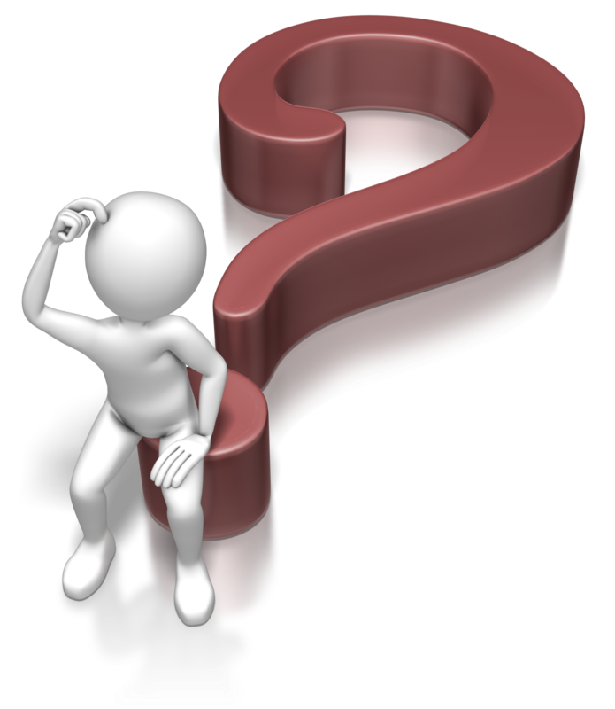
Thank You
&
Any Queries!!
NAME OF THE INSTITUTE, PARUL UNIVERSITY
PARUL INSTITUTE OF TECHNOLOGY, PARUL UNIVERSITY

