Slide 1
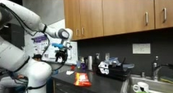
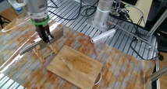
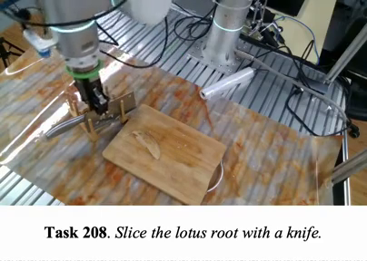

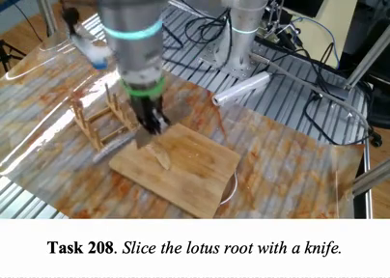
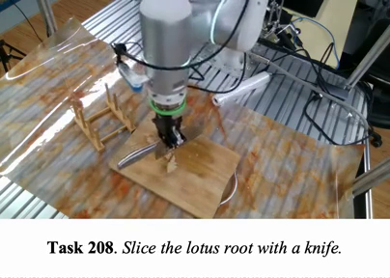
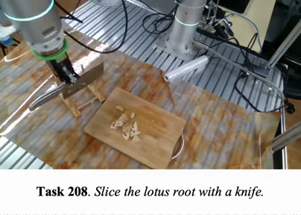
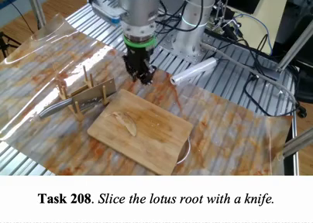
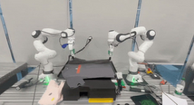
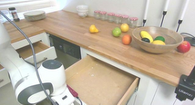
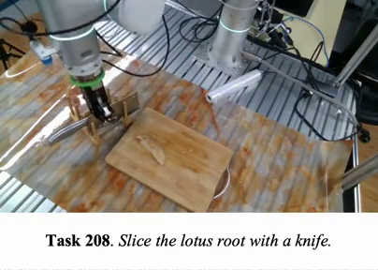
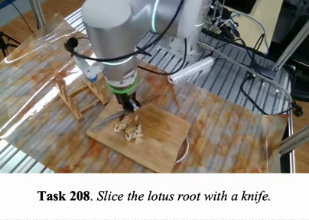
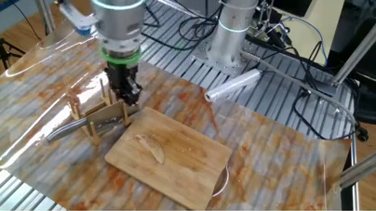

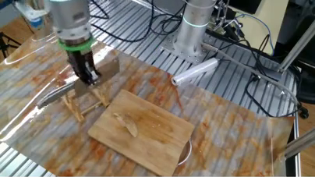
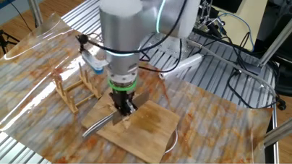
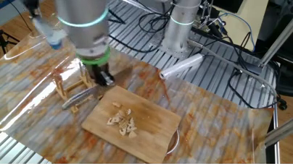
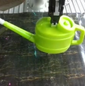
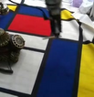
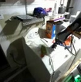
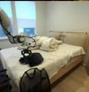
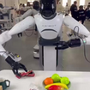
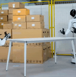
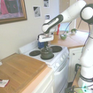
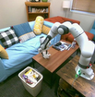
(a) Action-aligned dataset construction
1
Filter & normalize
2
Candidate boundaries
3
Interaction evidence
4
Segment refinement
Text
Action
GroundingDINO-B
SAM 3.1
DROID
RH20T
Images
Gripper
knife
Approach
Grasp
Transfer
Slice
Withdraw
Actions
Vision
S1
S2
S3
S4
S5
AgiBot-World
MolmoAct
Action change + curvature
Mid
High
Mid
High
Mid
Tracks + motion
Gripper + contact
Low
Mid
High
RGB + 32-D state / action
Smooth + merge short segments
Active object / target / phase
Phase + roles + space + actions
Action-aligned segment records
5
Grade-conditioned rewrites
6
Sampling metadata
7
Multimodal review
Qwen3.8-27B
GPT-5.6-luna
A
T
V
A Atomic motion
Low
Move downward.
Task
Subtask
Mid
T Local task
Phase
Approach
Approach the knife.
Family
A / T / V
Language
Visual target
Action scope
High
V Visual prompt
Scope
Mid
w1
w2
w3
Keep / expand supported labels
Approach the object in the red box.
Weights
Disable inconsistent labels
(b) Dataset overview
(c) Instruction examples
RH20T
DROID
Task: Slice the lotus root with a knife.
A
Atomic motion
T
Task rewrite
V
Visual prompt
S1
Approach
Mid
S2
Grasp
High
S3
Transfer / align
Mid
S4
Slice
High
S5
Withdraw
Mid
5.8%
9.0%
145,179
A
A
A
A
A
Move downward.
N/A
Keep the gripper
closed and move right.
N/A
Keep the gripper
closed and move right.
Inner: trajectories
52.0%
858,915
Approach the knife.
T
Grasp the knife.
T
Align the knife above
T
Slice the lotus root.
T
Withdraw the held knife.
T
33.2%
Outer: segments
the root.
V
V
V
V
V
AgiBot-World
MolmoAct
Grasp the object
in the red box.
Move the object
toward the red point.
Slice the object
in the red region.
Move the object away
from the red box.
Approach the object
in the red box.
Notes:
Sources: user-supplied seven-stage Chinese description (all visible text is translated and condensed into English); original output/ppt/figure.pptx; sections/method.tex; sections/appendix_data_construction.tex; tables/table_data_pipeline.tex; tables/table_grade_policies.tex; tables/table_rewrite_policies.tex; figures/appendix_action_aligned_pipeline_v12.pdf; figures/fig2_data_construction_from_overleaf_20260924.pdf. Stage sequence follows the manuscript's A-G table: filtering/normalization; candidate boundaries; object and interaction evidence; action-first refinement; grade-conditioned rewrites; sampling metadata; multimodal review/expansion. Complementary local and original-task supervision is an output, not an additional numbered stage. DINOv3 belongs to cross-frame evidence, not language generation. Qwen3.8-27B and GPT-5.6-luna names follow the local manuscript. Applicability: Low A/T, Mid A/T/V, High T/V; no grade excludes a segment. Original 32-D state/action containers preserve embodiment-specific valid-dimension masks. The RH20T photographs are reused from the author's figures; overlays illustrate the documented detector/mask/target evidence and are not new model results. The signal curves and sampling-weight bars are schematic and contain no measured values. A/T/V examples concern the same eligible approach segment. Actual photographic pixels remain separately embedded images; text, curves, masks, boxes, timeline segments and connectors are native editable objects. Icons: Lucide 1.8.0, ISC license, https://lucide.dev. Original artwork proportions and single-slide canvas dimensions are retained.
Layout revision: panels (a), (b) and (c) share left/right boundaries. The pipeline has 29% less vertical spacing than the supplied grouped layout. The dataset overview retains the native double-ring sectors, four source labels, 145,179 trajectories and 858,915 segments. The five original instruction examples retain their photos, spatial marks and A/T/V labels. Photographs and icons preserve aspect ratios. All panel labels use English and ASCII punctuation. The canvas is extended to include all three panels fully, since the supplied top and bottom groups were both outside the original canvas.

