Slide 1
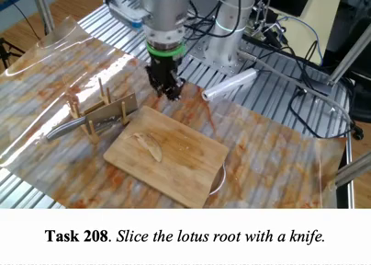
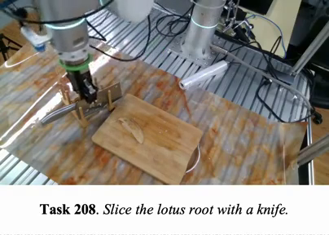

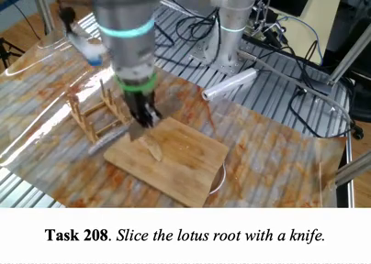
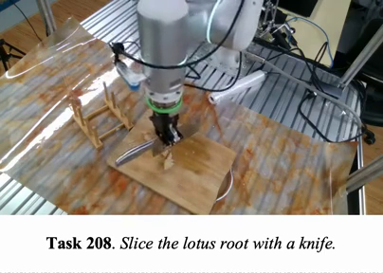
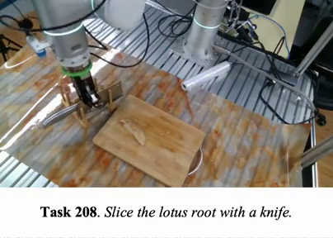
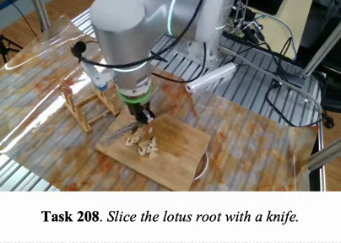
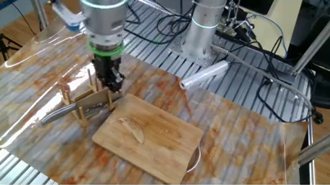

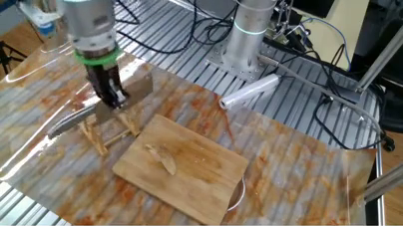
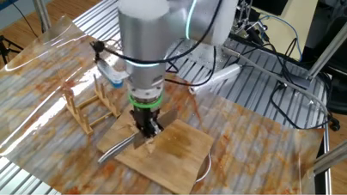
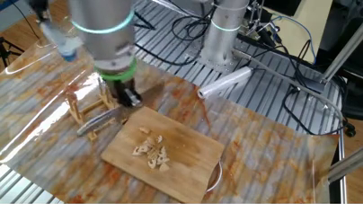
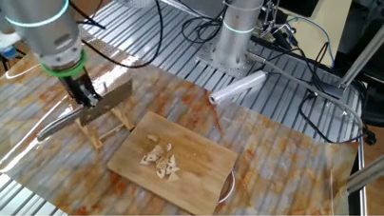
Action-aligned data construction
Task: Slice the lotus root with a knife.
1
Input
RGB · state · actions
2
Detect
GroundingDINO-B · Swin-B
3
Object masks
SAM 3.1
4
Segment
DINOv3 ViT-L/16
S1 Approach
S2 Grasp
knife
lotus root
S3 Transfer
S4 Slice
Phase · object / target · interaction grade
5
Segment record
Mid
6
Grade-conditioned rewrites
Qwen3.8-27B
7
Review
GPT-5.6-luna
Approach the knife
A
Move downward.
Semantic consistency
Target: knife · Object box
T
Approach the knife.
Visual consistency
Action window + state
A
T
V
V
Approach the object in the red box.
Action alignment
Instruction examples
A
Atomic motion
T
Task rewrite
V
Visual prompt
S1
Approach
Mid
S2
Grasp
High
S3
Transfer / align
Mid
S4
Slice
High
S5
Withdraw
Mid
A
A
A
A
A
Move downward.
N/A
Keep the gripper closed
N/A
Keep the gripper closed
and move right.
and move left.
Approach the knife.
T
Grasp the knife.
T
Align the knife above
T
Slice the lotus root.
T
T
the root.
Withdraw the held knife.
V
V
V
V
V
Approach the object in
Grasp the object in the
Move the object toward
Slice the object in the
Move the object away
the red box.
red box.
the red point.
red region.
from the red box.
Notes:
Reconstructed from the author-provided Figure 6: figures/appendix_action_aligned_pipeline_v12.pdf. All text, frames, arrows, target annotations, masks, and color blocks are native editable PowerPoint objects. The 27 original demonstration photographs remain separate embedded images with editable cropping. Source: local manuscript Figure 6, Action-aligned data construction, RH20T knife-and-lotus-root example.

