Slide 1
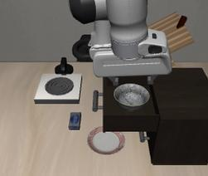
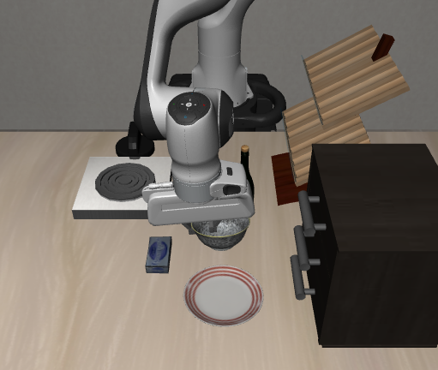
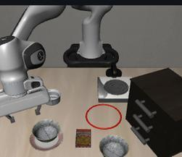
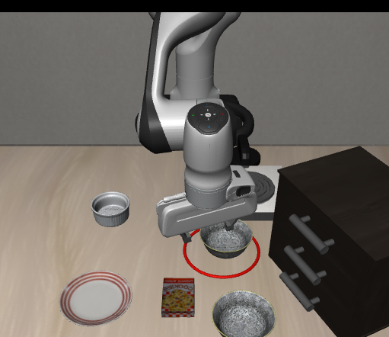
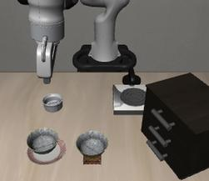
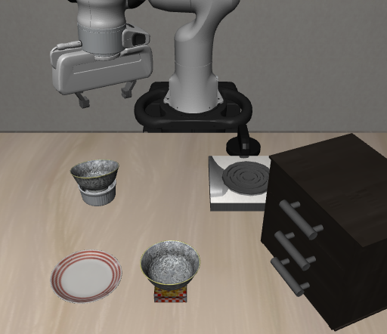
Fine-grained semantic following
Multimodal instruction understanding
Mid-execution corrective control
ORIGINAL
CHANGED
ORIGINAL
CHANGED
ORIGINAL
Put
bowl
in drawer
Approach the bowl
UPDATED
Put bowl
Put bowl
in red circle
Put bowl on
plate
No, don't put the bowl on the plate
99
Put it in the ramekin instead
98
96
99
99
96
100
98
98
35
33
44
31
21
25
26
6
1
2
5
4
14
17
11
6
19
2
Original
Changed
Original
Original
Changed
Original
Original
Changed
Original
π
0.5
GR00T
StarVLA
High task success does not necessarily mean a
“smart”
policy
Notes:
Source: author-provided Figure 1, figures/1-fig1_overview_compact_v32_editable.pdf. Quantitative values and original labels are retained. The six scene images are separately embedded, while labels, numerical values, bars, arrows and frames are editable PowerPoint objects. The rightmost corrective-control image is a controlled target-state illustration, not a model rollout or evidence of model success. Source provenance: figures/figure1_data_and_sources.json.

