Slide 1
News Summarization & Bias Detection
Leveraging NLP to Analyze Media Content
Presented By: Ayurda Dhar
Baiyari Debbarma
Bhagyashree Kapate

Slide 2
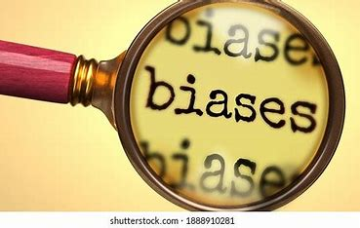
Introduction & Objectives
The Problem:
Modern news is overwhelming; readers struggle to process information.
Identifying bias in media is challenging.
Our Solution: NLP-powered Bias Detection Pipeline to:
Summarize articles quickly.
Detect potential bias via sentiment analysis.
Key Objectives:
Process a large news dataset.
Compare summarization techniques.
Develop and fine-tune a bias detection model.
Evaluate performance quantitatively and qualitatively.

Slide 3
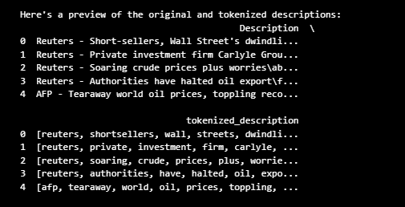
Dataset:
Source: Kaggle News Corpus
Content: 120,000+ articles across 4 categories (World, Sports, Business, Sci/Tech)
Preprocessing Steps:
Lowercasing and punctuation removal
Tokenization and cleaning
Code snippet(output): Tokenized data

Slide 4
Data Collection and Preprocessing
Lowercasing
Removing Punctuations
Stop word removal
Lemmatization/Stemming
Handling missing values
Adding any custom keywords
Tokenization
1)Ensures Accurate Sentence Extraction.
2)Reduces Irrelevant Information.
3)Improves Model Understanding.
4)Supports Consistency Across Dataset.
5)Enhances Evaluation Metrics.
Cleaned & Preprocessed Text → Ready for Summarization & Bias Detection

Slide 5
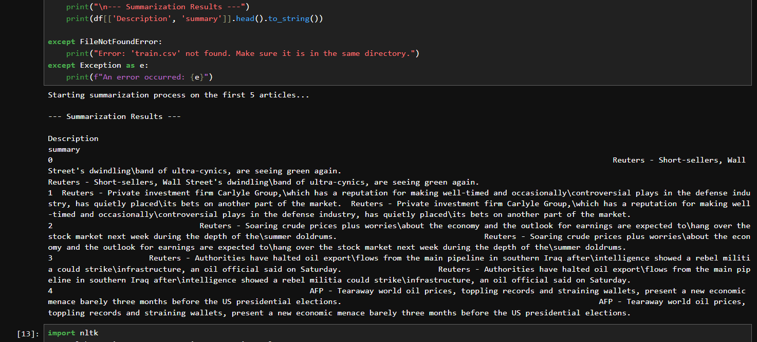
News Summarization Method
Goal: Condense long articles into concise, informative summaries.
Approach: Extractive summarization using word frequency:
Split text into sentences
Score sentences by word importance
Select top sentences for the summary
. Extractive Summarization: This is the key characteristic. The method extracts complete, unaltered sentences from the original text. It doesn't write new sentences. It works like a highlighter, picking out what it determines to be the most important sentences and piecing them together to form the summary.
Code snippet:

Slide 6
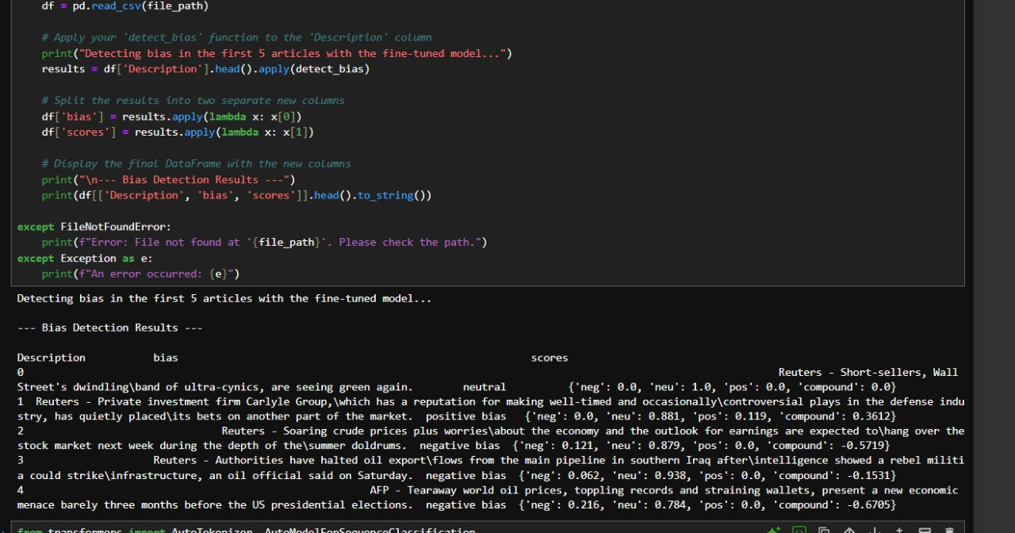
Bias Detection Method
Goal: Classify article sentiment as a proxy for bias.
Method: Sentiment Analysis with NLTK’s VADER.
Lexicon-based approach: scores from -1 (negative) to +1 (positive)
Categories: Positive Bias, Negative Bias, Neutral
Fine-Tuning: Updating VADER's Lexicon, the idea is to add new words or adjust the sentiment scores of existing words to better fit the context of news and finance.
Added domain-specific words (e.g., “bullish,” “plummet”)
Improved accuracy for news-specific content.
Code Snippet:

Slide 7
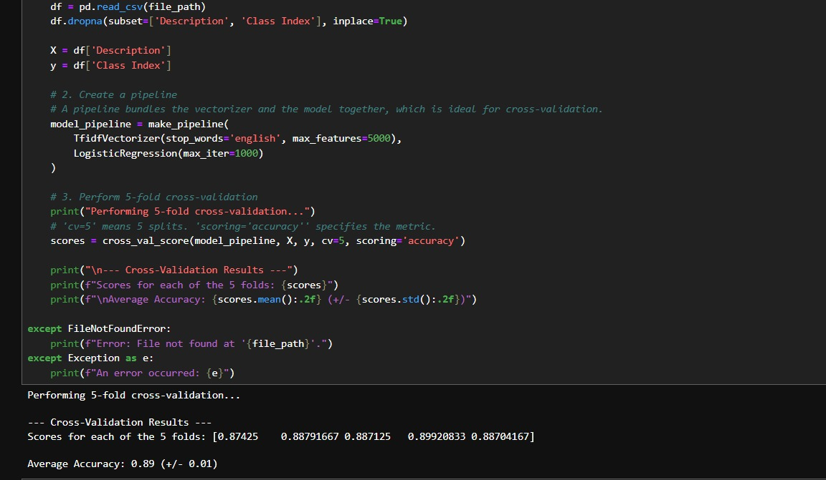

Slide 8
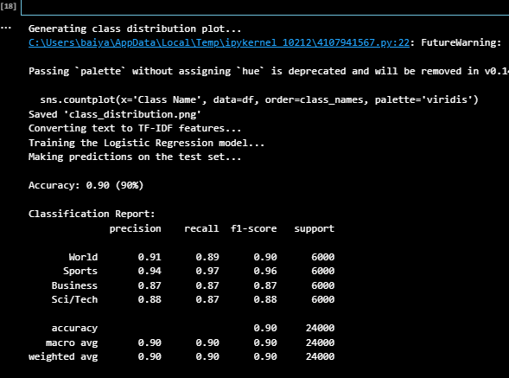
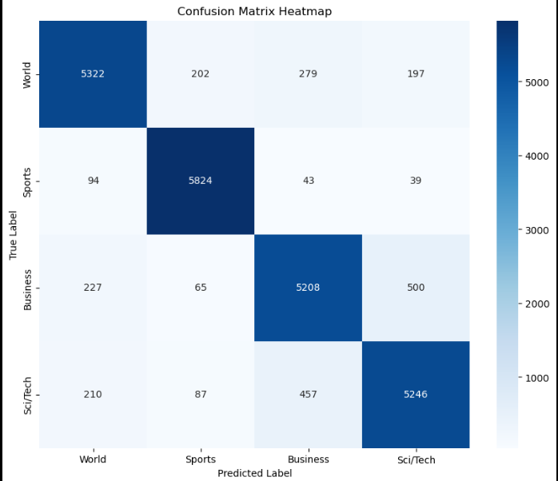
Results & Evaluation
Output table with article text, bias label, and sentiment score.
Model accuracy and performance improvements.

Slide 9
Conclusion & Future Work: Project Summary: Built and evaluated models for summarization and topic classification Fine-tuned bias detection model using sentiment analysis Topic classification model achieved 89% accuracy Future Work: Abstractive summarization using Transformer models (e.g., BART) Advanced bias detection with dedicated news bias datasets Deployment as a web application via API (Flask or similar)

