Slide 1
College Information System
Baiyu Li 001569441 Floyed Pinto 001346150
Leiqi Wei 001561748 Yanping Fu 001569536
Yiqing Wang 001563190

Slide 2
1
Introduction
Outline
2
UML
3
Database
4
Knowledge Involved

Slide 3
1
Introduction

Slide 4
Work Arrangement
Teacher – Yiqing Wnag
Student – Leqi Wei
Course – Yanping Fu
Course
Vaccine
UI
Vaccine – Floyed
UI – Baiyu
Teacher
Student

Slide 5
Basic Function
Retrieve data from database
Realize Create, Delete, Update, Query
Student
Course
Course Registration
Student Enrolled List
Student Detail
Teacher
Immunization
Course Involved
Student Involved in Course
View & Update Student Records

Slide 6
2
System UML

Slide 7
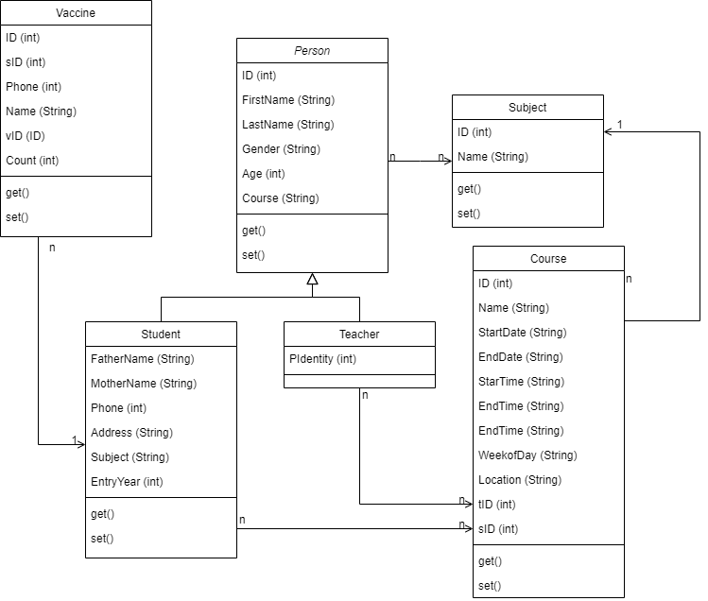
System UML

Slide 8
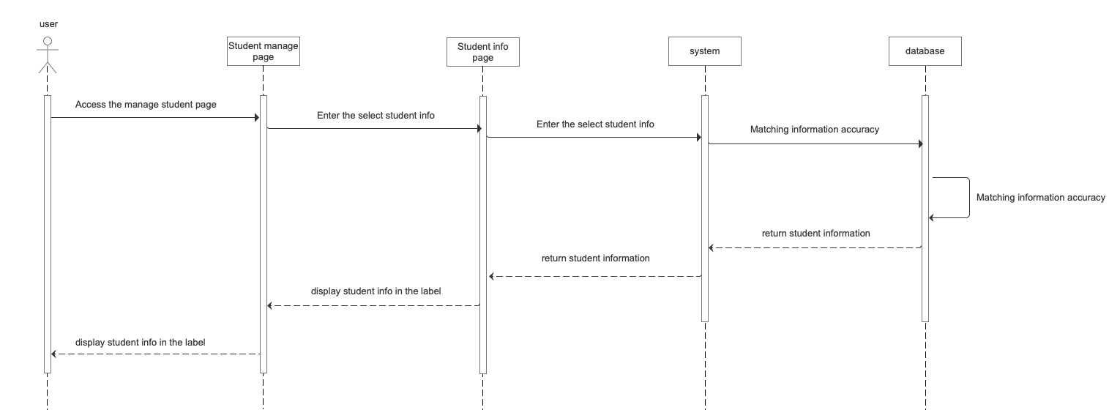
System UML

Slide 9
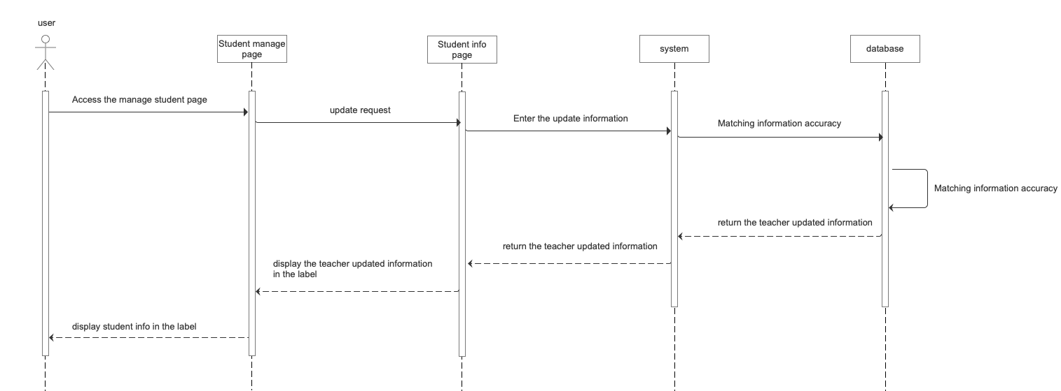
System UML

Slide 10
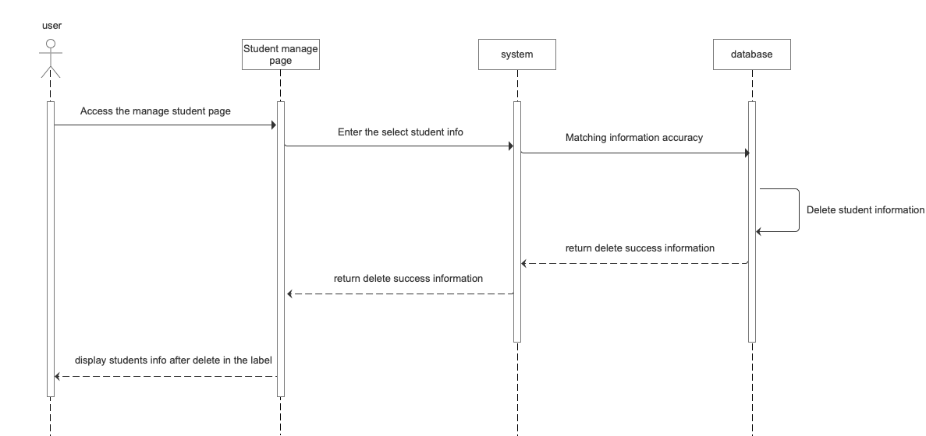
System UML

Slide 11
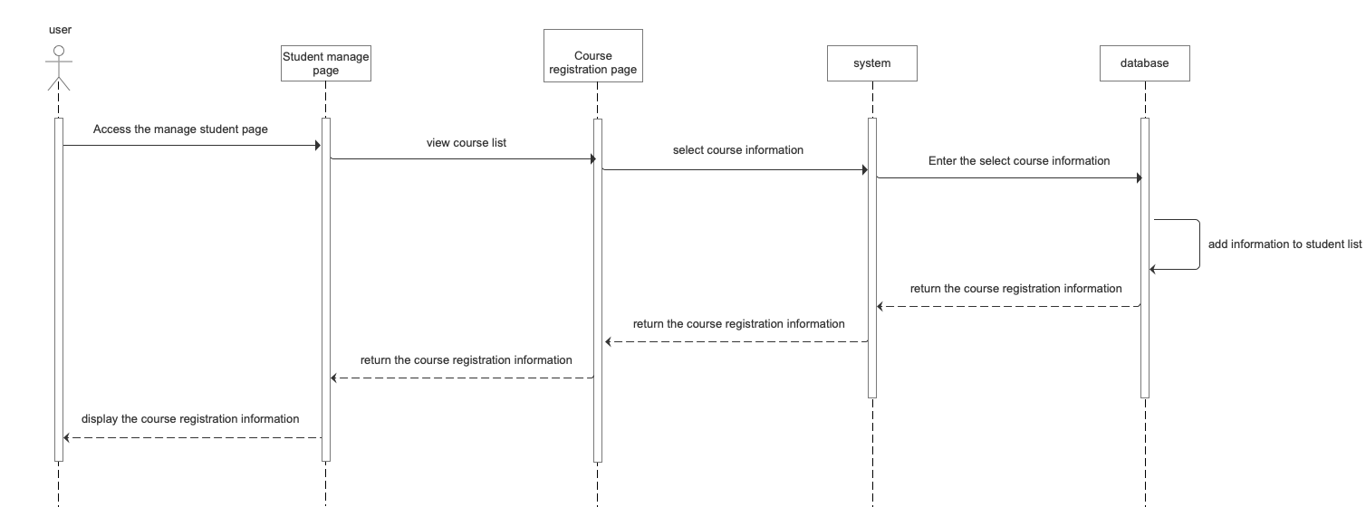
System UML

Slide 12
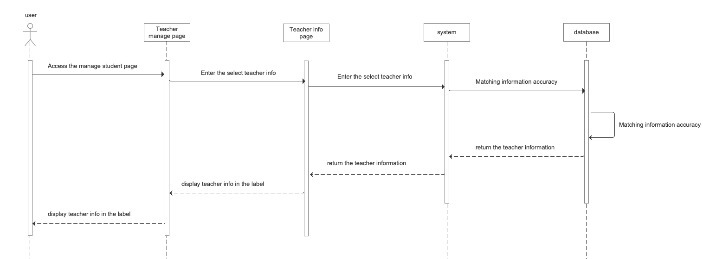
System UML

Slide 13
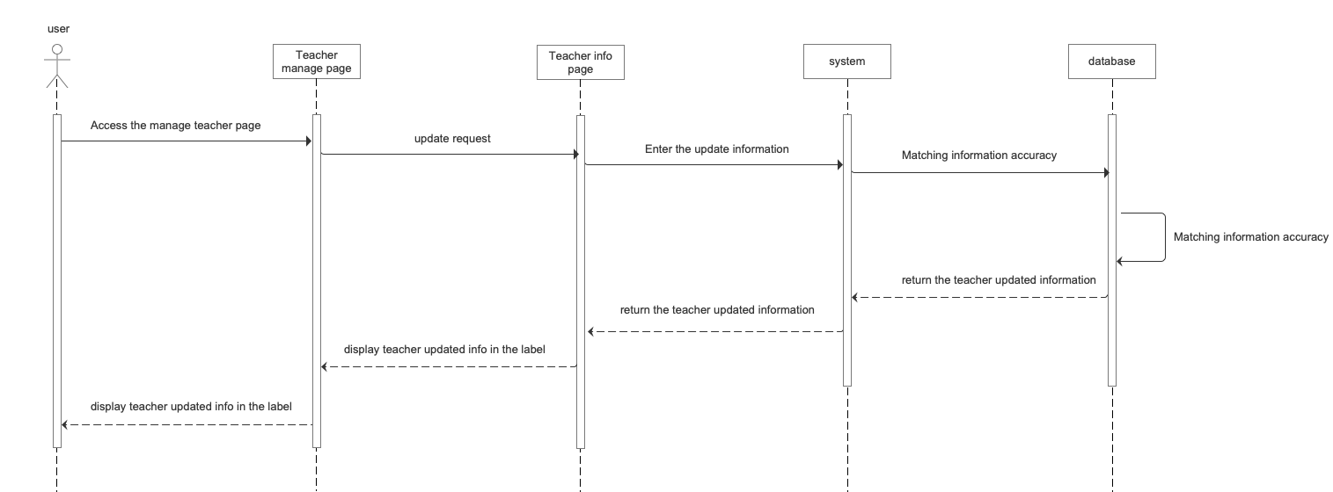
System UML

Slide 14
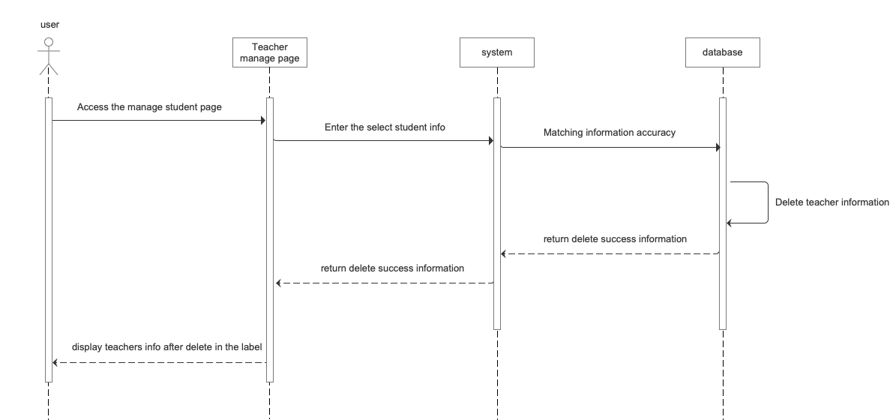
System UML

Slide 15
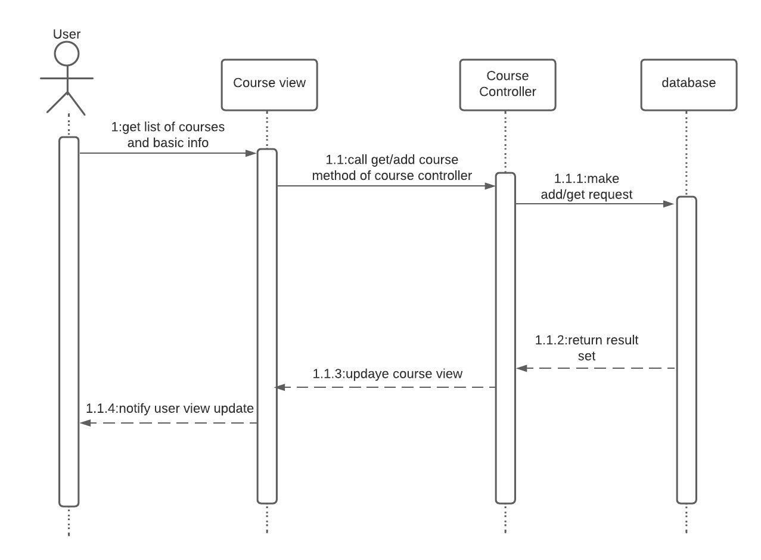
System UML

Slide 16
3
Database

Slide 17
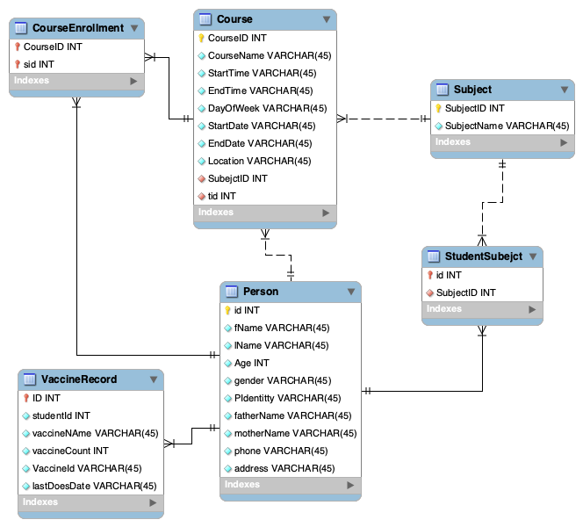
Database & ERD
Sqlite provide local data storage for this application
Why choose Sqlite:
Easy to learn
No need to install
Light weight
ERD →

Slide 18
4
Knowledge Involved

Slide 19
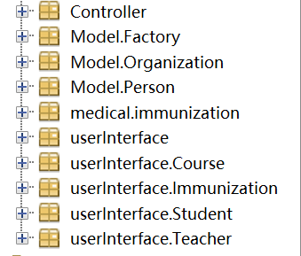

Design Patterns & Libraries
MVC
Sqlite
Factory Method Design Pattern

Slide 20
THANKS FOR YOUR
ATTENTION
Baiyu Li 001569441 Floyed Pinto 001346150
Leiqi Wei 001561748 Yanping Fu 001569536
Yiqing Wang 001563190

