Slide 1
Hybridizing High Performance Computing and Neural Networks for Optimal Investment Portfolio Management
Done by: Group(31)
Members:
Nawroze Baizid Mohammed (20201108)
Nahin Hossain (20201047)
Azmain Morshed (22141050)
Mohammad Tajrian Arafat Alvi (23241134)

Slide 2
Outline:
1.Abstract………………………………………………………………………………………………………………………………………………..1
2.Introduction……………………………………………………………………………………………………………………………………..2
3. Methods…………………………………………………………………………………………………………………………………………….3
4. Results and Analysis……………………………………………………………………………………………………….4-6
5. Future Work………………………………………………………………………………………………………………………………..7
6.Conclusion……………………………………………………………………………………………………………………………………….8

Slide 3
Abstract:
Importance of Portfolio Optimization: Highlight the significance of optimizing investment portfolios for better returns and reduced risk.
Technological Synergy: Emphasize the transformative potential when combining HPC, Distributed Systems, and Neural Networks.
Goals of the Paper: Summarize the objectives of exploring these technologies in portfolio management.
1

Slide 4
Introduction:
Evolving Market Dynamics: Discuss how technological advancements are reshaping the investment landscape and necessitating advanced management strategies.
Technology Roles: Detail the individual roles of HPC, Distributed Systems, and Neural Networks in portfolio management.
Advantages of Integration: Highlight the potential benefits of integrating these technologies for a comprehensive solution.
2

Slide 5
Methods:
HPC in Financial Analysis: How HPC accelerates the processing of extensive financial datasets and complex computational models.
Neural Networks' Predictive Analysis: How neural networks analyze financial data, recognize market trends, and predict asset performance.
Testing and Simulation: Methodology used to test the integrated approach using historical financial data.
3

Slide 6
Results and Analysis:
LSTM's Forecasting Ability
The Long Short-Term Memory (LSTM) model displayed robust forecasting capabilities for Apple Inc.'s stock closing prices.
Leveraging historical price sequences, the LSTM captured intricate patterns crucial for precise predictions.
The model's adaptability to historical data enabled it to forecast stock prices effectively.
Visual Representation
Visualization of the LSTM's performance depicted a high degree of alignment between predicted and actual closing prices.
Overlapping lines in the graph highlighted the model's accuracy, particularly towards the timeline's end.
The graph showcased a close match, capturing the market's general trend and fluctuations accurately.
4

Slide 7
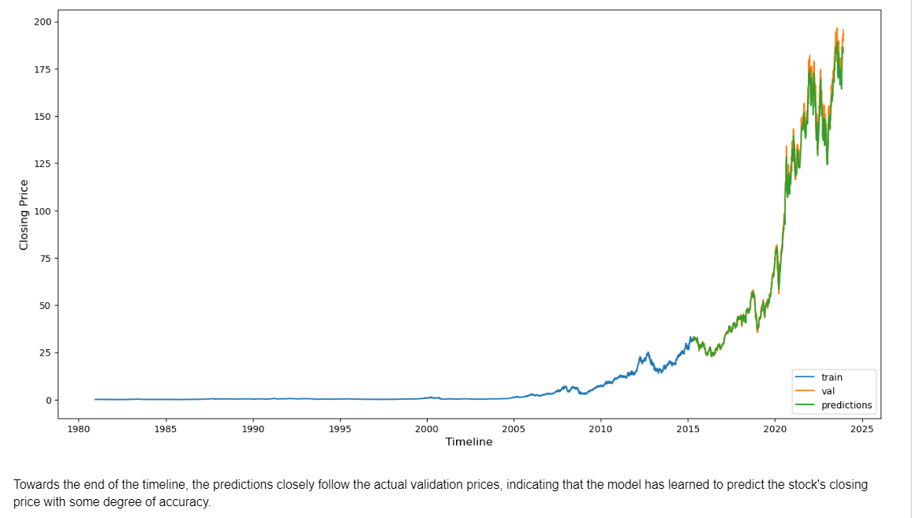
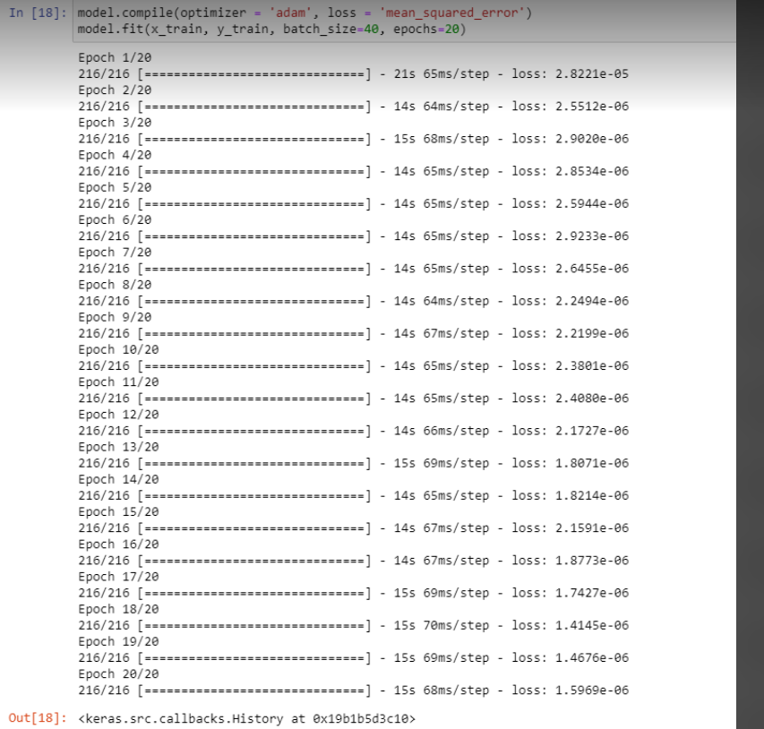
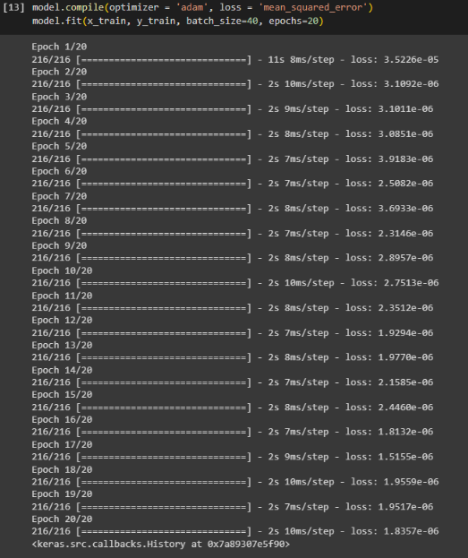
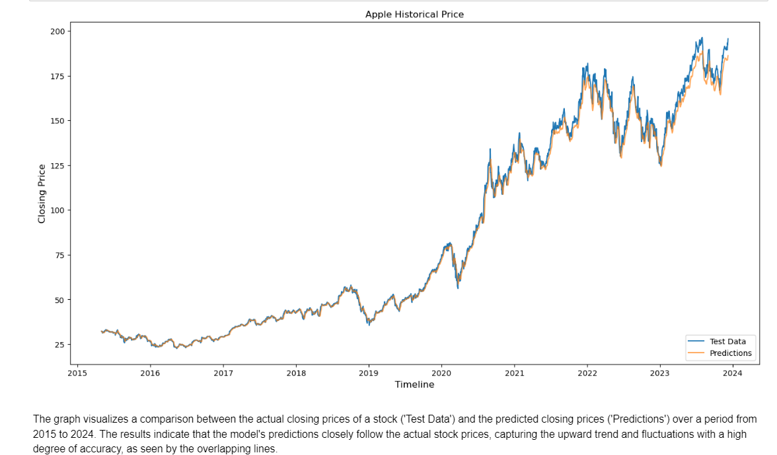
5

Slide 8
Quantitative Evaluation
A Root Mean Squared Error (RMSE) of approximately 77.33 units quantitatively supported the LSTM's predictive accuracy.
This metric highlighted the average deviation of predictions from actual closing prices.
The RMSE reinforced the LSTM model's consistency in forecasting Apple Inc.'s stock prices.
6

Slide 9
Future Work:
Advancing AI Integration: Discuss the possibilities of further integrating AI advancements for enhanced prediction and adaptability.
Real-time Data Processing: Explore the potential of processing real-time data for more immediate decision-making.
Emerging Technologies: Discuss the potential impact of incorporating quantum computing in portfolio management strategies.
7

Slide 10
Conclusion:
Technology's Role in Future Strategies: Summarize how the integration of HPC, Distributed Systems, and Neural Networks will shape future portfolio management strategies.
Key Takeaways: Reiterate the benefits of this approach and its potential for AI-driven advancements in the field.
Closing Thoughts: End with a reflection on the significance of technological integration in optimizing investment portfolios.
8

