Slide 1

University of Chittagong
Department of Computer Science & Engineering
CSE 800- Final Thesis Presentation
Deep Learning Based Driver Drowsiness Detection
Supervised by
Dr. Rashed Mustafa
Professor
Department of Computer Science & Engineering
University of Chittagong , Chattogram-4331, Bangladesh.
Presenter
Md. Shakhawat Hossain Hridoy
ID: 18701056
Session: 2017-18
Department of Computer Science & Engineering
University of Chittagong

Slide 2




CONTENTS
Problem Statement
Motivation
Objective
Related Works
Methodology
Result Analysis
Conclusion
2

Slide 3

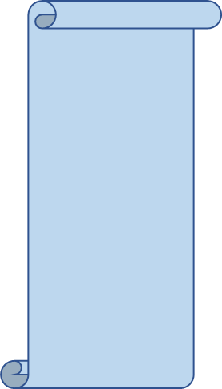
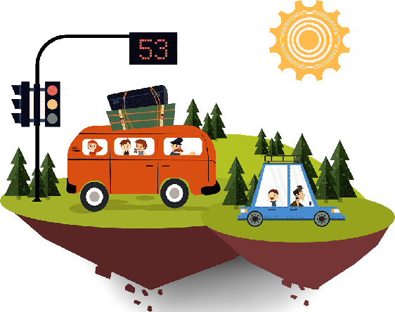

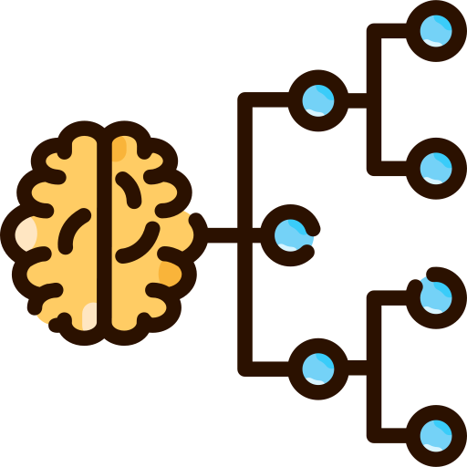

Problem Statement
What exactly are we looking for?
Applying CNN Classifier
Monitoring the state of the driver
Images collected from driving seat
Fig: Overview of the task
3

Slide 4

Motivation
Alarming Effects of Drowsiness
Road accidents have greater mortality than any other phenomena in Bangladesh
Millions of fatal & non-fatal injury cases throughout the year
Traditional solutions are not sufficient to deal with such problem
4

Slide 5
Objectives
General Objective
To propose a computer-aided method emphasizes the efficient detection and classification of drowsy signs.
Particular Objectives
To evaluate our dataset on drowsiness that are accessible to researchers.
To suggest a new Convolutional Neural Network (CNN) architecture that can recognize Drowsiness.
To correctly classify the types of drowsy signs, including yawn, no_yawn, open and closed.
5

Slide 6

RELATED WORKS
Deep Learning Method
A Driver Drowsiness Detection Model
using Convolutional Neural Network.
Author: Rateb Jabbar et al.
Model: CNN
Year: 2020
Real-time Driver fatigue Monitoring System
based on Visual Cues.
Author: Tanvir Ahmed et al.
Model: MobileNet
Year: 2021
Driver fatigue detection Method based on Eye states.
Author: Quanyang Zhuang et al.
Model: U-Net
Year: 2020
Smart Driver Monitoring Syatem using Machine Learning.
Author: Shaily et al.
Model: ML
Year: 2021
6

Slide 7

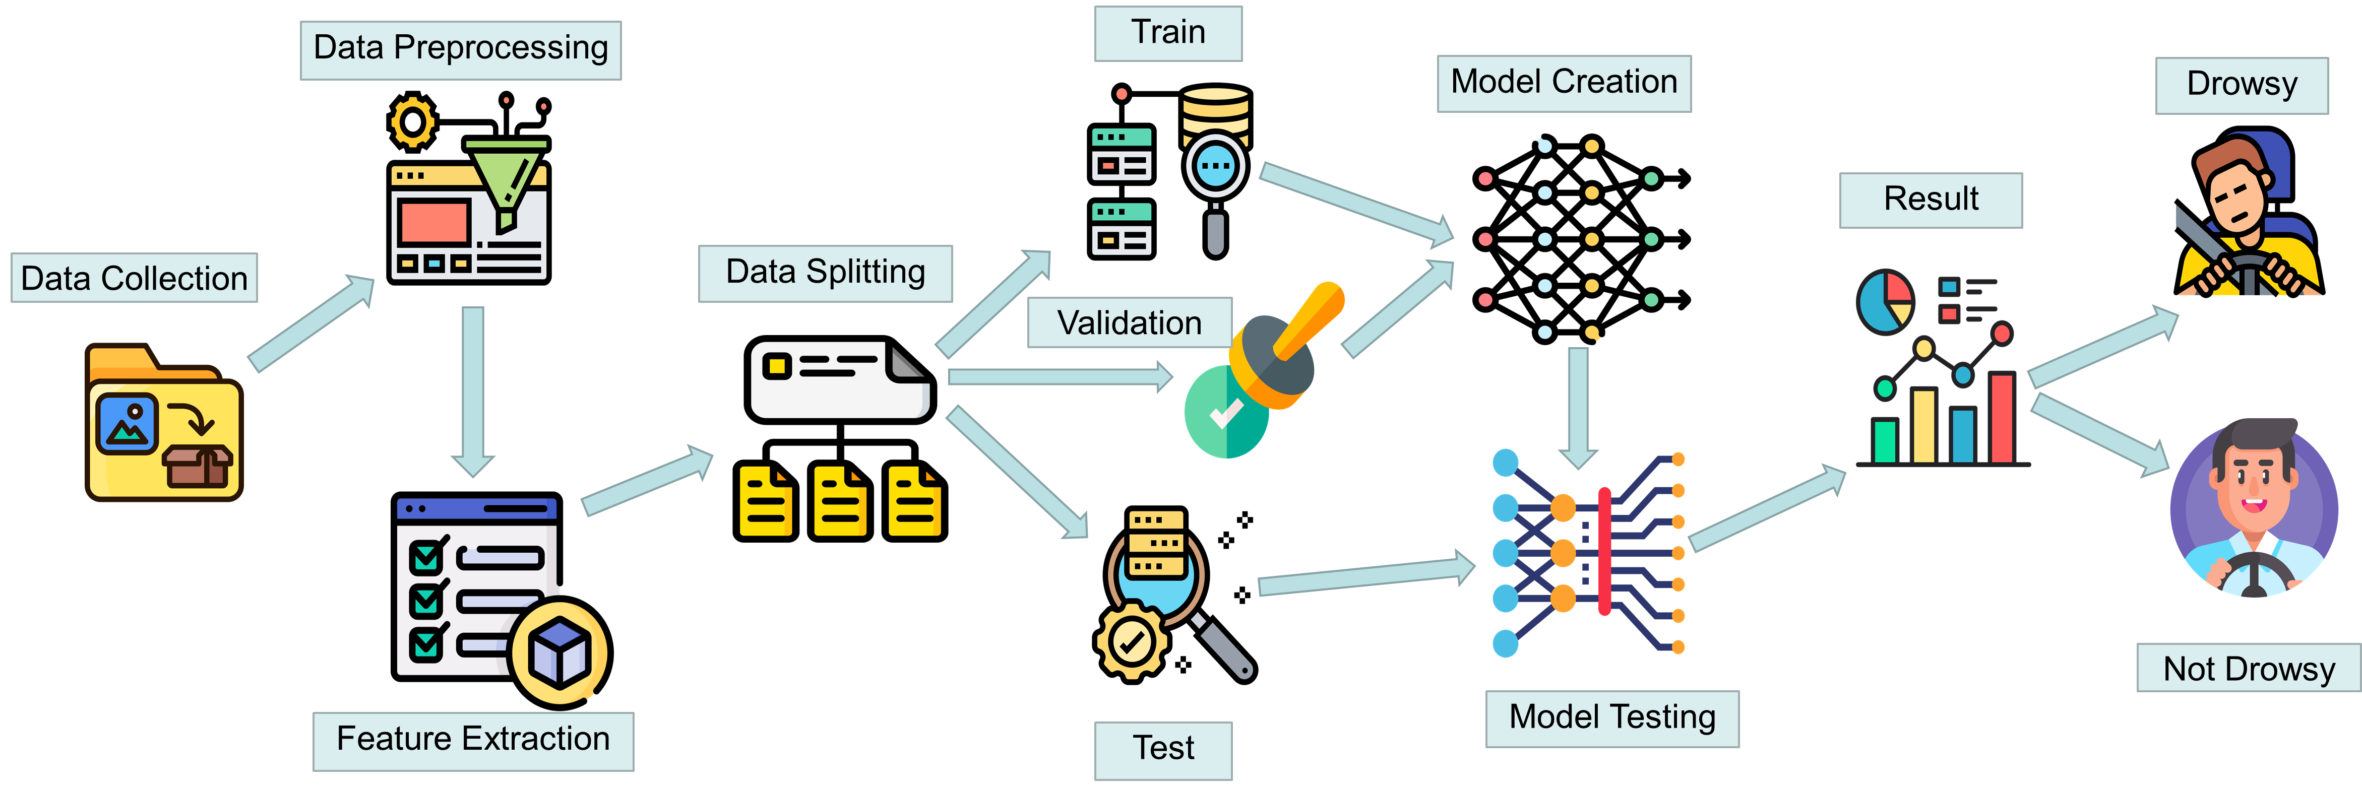
METHODOLOGY
Framework of the proposed method
Fig.1 Method overview of the whole work
7
Model Testing

Slide 8

METHODOLOGY
Dataset details:
Folder | Images
Open | 726
Closed | 726
Yawn | 723
No Yawn | 725
Preprocessing:
Label
Flip
Preprocessing
Scale
Rotation and Shift
Brightness
Split
8

Slide 9
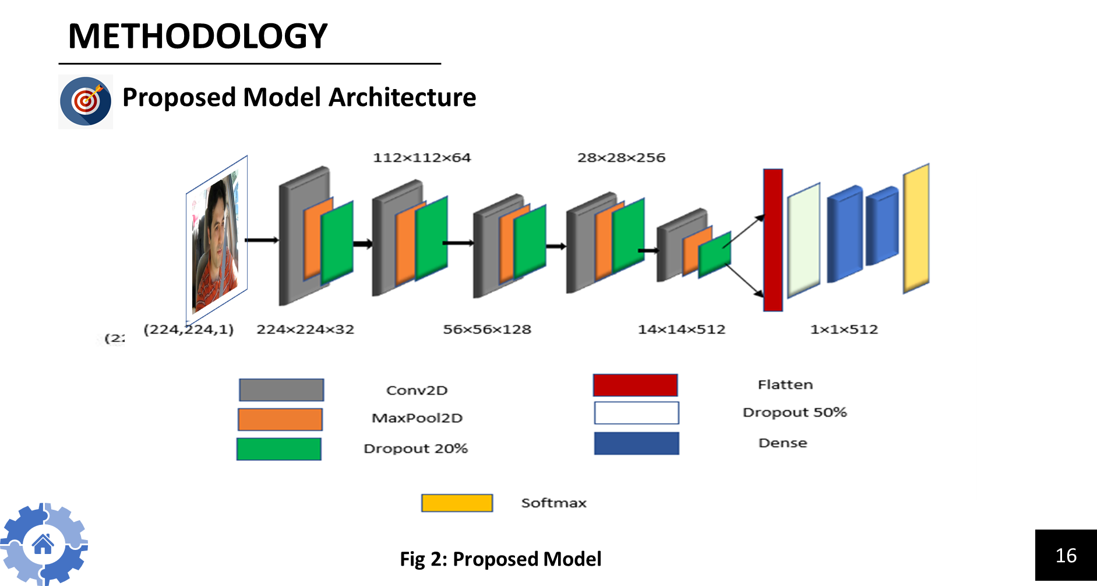
9

Slide 10
METHODOLOGY
Proposed Method
Input Sequence
Convolution+ReLU
MaxPooling
Dropout
Flatten
Fully Connected Layer
Softmax
Output Sequence
Fig: Proposed Method
10

Slide 11

METHODOLOGY
Pre-trained Models
VGG16
Inception_V3
11

Slide 12

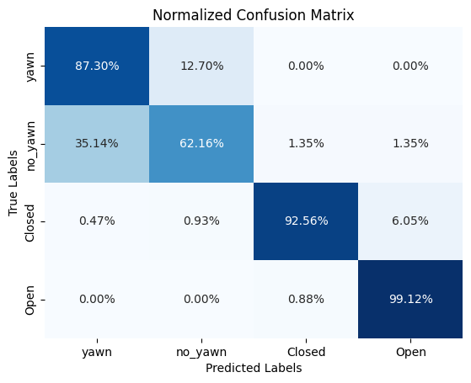
RESULT ANALYSIS
Proposed Model
Table: Classification Report for proposed model
Class | precision | Recall | F1 score | Support
Yawn | 0.67 | 0.87 | 0.76 | 63
No_yawn | 0.82 | 0.62 | 0.71 | 74
Closed | 0.99 | 0.93 | 0.95 | 215
Open | 0.94 | 0.99 | 0.97 | 226
Accuracy |  |  | 0.91 | 578
Macro avg. | 0.85 | 0.85 | 0.85 | 578
Weighted avg. | 0.91 | 0.91 | 0.91 | 578
Fig. 4 Confusion Matrix
12

Slide 13

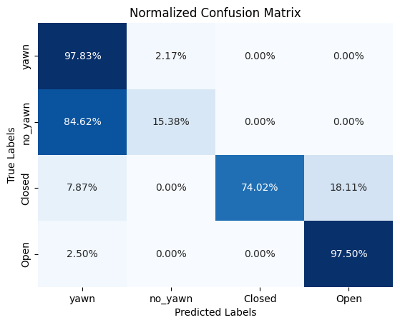
RESULT ANALYSIS
Pretrained Model: VGG16
Table: Classification Report of VGG16
Class | precision | Recall | F1 score | Support
Yawn | 0.44 | 0.98 | 0.60 | 46
No_yawn | 0.89 | 0.15 | 0.26 | 52
Closed | 1.00 | 0.74 | 0.85 | 127
Open | 0.87 | 0.97 | 0.92 | 160
Accuracy |  |  | 0.79 | 385
Macro avg. | 0.80 | 0.71 | 0.66 | 385
Weighted avg. | 0.86 | 0.79 | 0.77 | 385
Fig: Confusion Matrix
13

Slide 14
RESULT ANALYSIS
Pretrained Model: Inception_V3
Table: Classification Report of Inception_V3
Class | precision | Recall | F1 score | Support
Yawn | 0.02 | 0.02 | 0.02 | 63
No_yawn | 0.34 | 0.84 | 0.48 | 74
Closed | 0.39 | 0.60 | 0.47 | 215
Open | 0.00 | 0.00 | 0.00 | 226
Accuracy |  |  | 0.33 | 578
Macro avg. | 0.19 | 0.36 | 0.24 | 578
Weighted avg. | 0.19 | 0.33 | 0.24 | 578
Fig: Confusion Matrix
14

Slide 15

RESULT ANALYSIS
Proposed Model VS Pretrained Model
15

Slide 16
CONCLUSION
In this research work, a deep convolutional network was implemented on our dataset. Here, we determined whether the driver is drowsy or not. This is categorized as either yawn, no_yawn, open, or closed. Where yawn and closed classes are interpreted as drowsy.
To detect the drowsiness , proposed model’s accuracy was 91%.
So, while our accomplishment can be considered a success, there is still space for improvement.
16

Slide 17

CONCLUSION
Future Work
We will use various classifiers and loss function to detect drowsiness.
We will use other dataset on this model.
We will use other layers to make the result better
17

Slide 18
THANK
YOU
18

