Slide 1

VEENA ONLINE CLOTH STORE WEBSITE CREATION

Slide 2

Introduction:
This report provides an overview of the collaborative effort undertaken by five team members in the creation of the Veena online cloth store website. The project aimed to combine individual strengths to achieve a cohesive and successful outcome.
Team Members:
1.Bajaj Manjit
2.Borse Vaishnavi
3.Bhakare Tanishka
4.Bhosale Snehal
5.Auti Arti

Slide 3
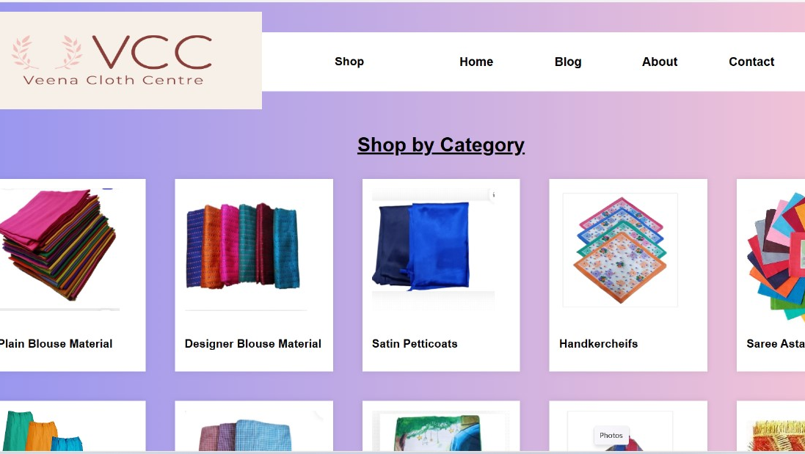
Content Creation:
Home Page:
In crafting our website's homepage, employed HTML and internal CSS to create a structured outline and visually appealing design. Utilizing containers for images and strategically placed buttons, navigation is intuitive. The addition of a dropdown function for the shop button enhances user experience. This dynamic approach ensures a cohesive and engaging homepage for our visitors.

Slide 4
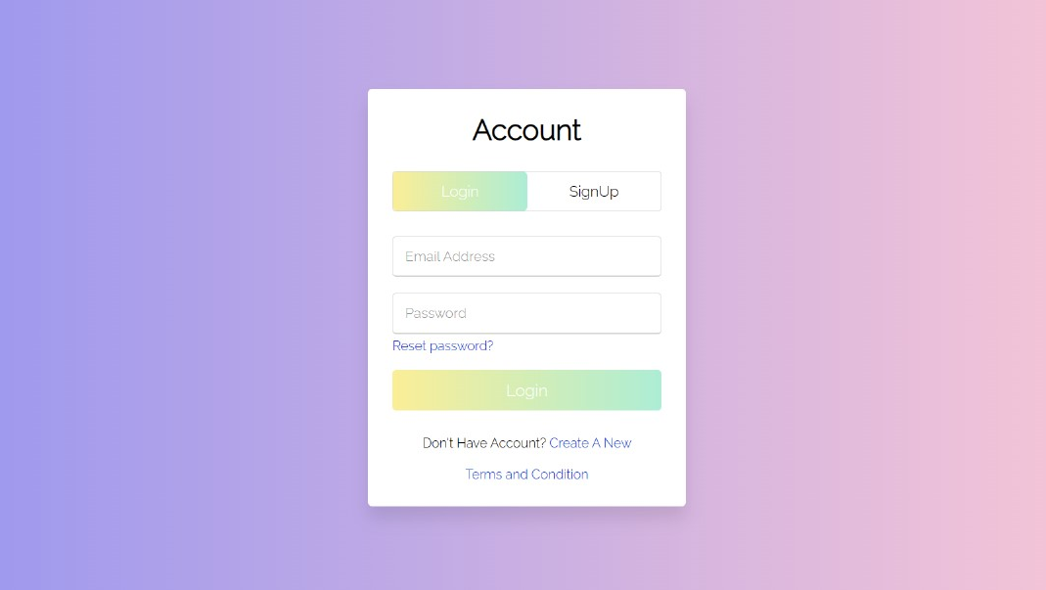
Login/Sign Up Page:
In crafting our Login and Sign-Up page, we've prioritized a seamless user experience with intuitive form transitions, responsive design, and subtle animations. The integration of essential features ensures both functionality and visual appeal, creating an engaging interface for our users.

Slide 5
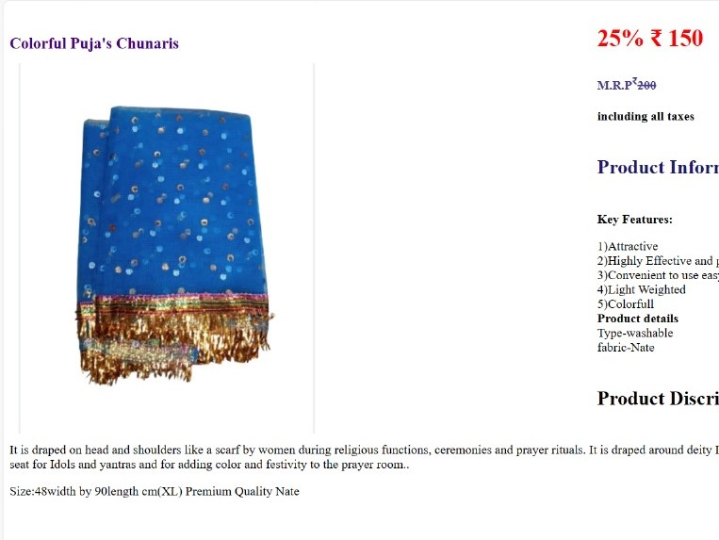
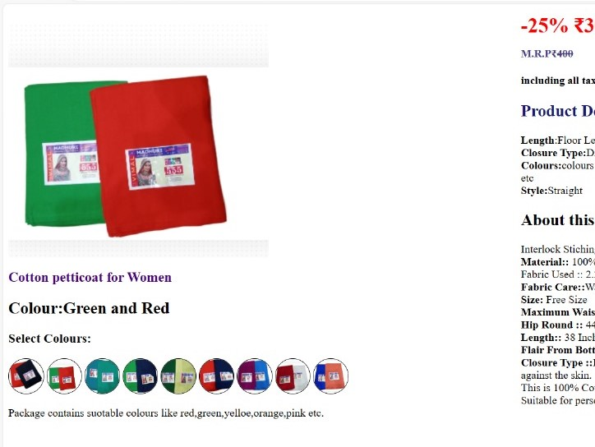
Product Details
The Product Detail Page serves as a crucial element in Veena Cloth Store website providing users with comprehensive details about a particular product. The HTML and CSS implementation follows best practices for responsiveness and aesthetics.

Slide 6
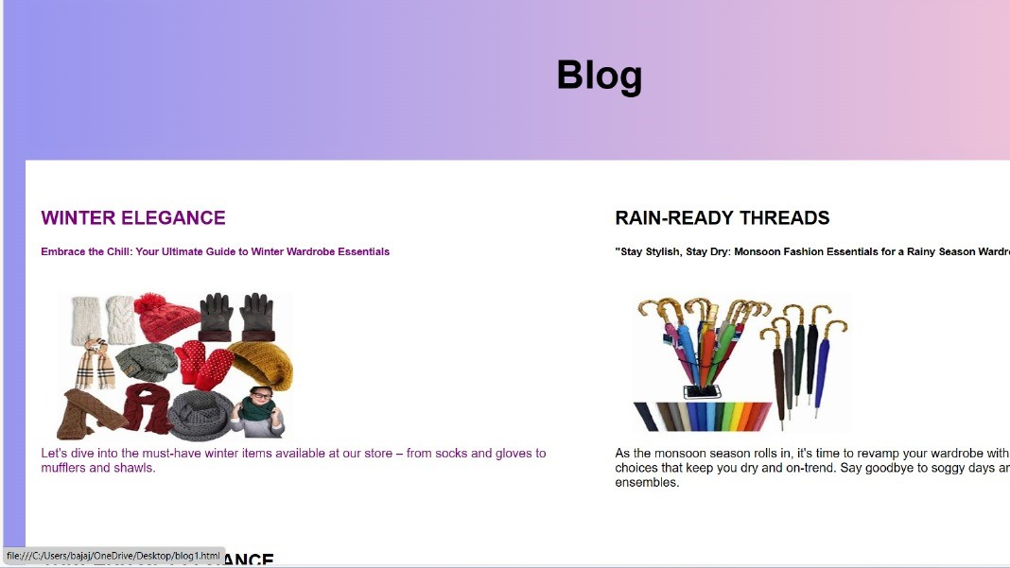
BLOG:
This report delves into the essential components of designing a block page on a website, emphasizing the use of HTML and CSS to create an effective and visually appealing user experience.
Purpose of a Block Page:
A block page serves as a notification to users when access to certain content or features is restricted.
It communicates important information about why the block has occurred.

Slide 7
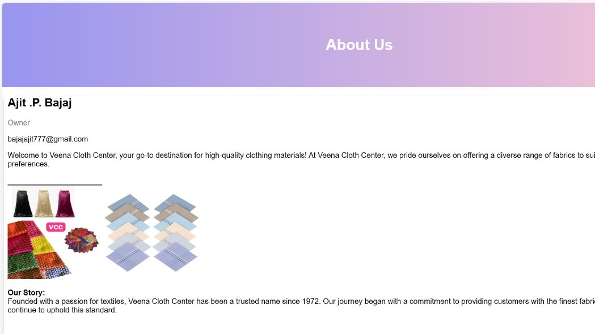
About Page:
This report focuses on the significance of an engaging and informative "About" page in a website, emphasizing the effective utilization of HTML and CSS for optimal design and user experience.
Key Components of an About Page:
Store Overview
Team Members
Mission and Values

Slide 8
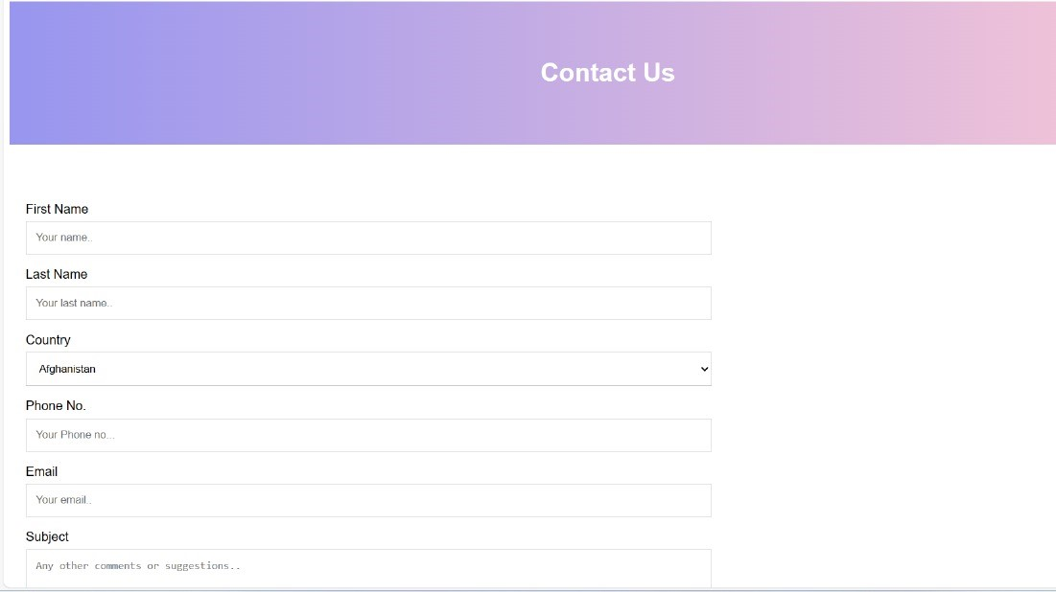
Contact Page :
This report explores the significance of an effective contact page on a website and provides insights into the implementation of HTML and CSS for an optimal user experience.
Importance of Contact Page:
The contact page serves as a crucial bridge between users and the website.
Facilitates communication, feedback, and customer inquiries.

Slide 9

Conclusion:
The collaborative effort of the five-member team resulted in the successful creation and launch of the Veena online cloth store website. By leveraging each member's expertise, the project achieved a balance between design, functionality, and engaging content, providing a strong foundation for the website's success in the online marketplace.

Slide 10
Thank You

