Slide 1
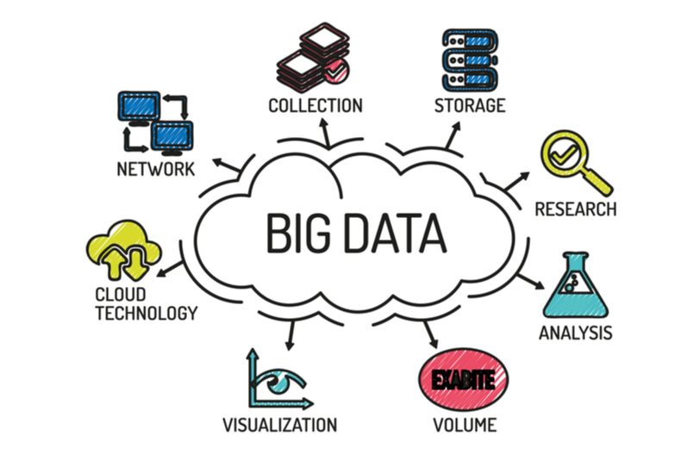
AML-3303 Big Data, Libraries and Multithreading in AI/ML Systems

Slide 2
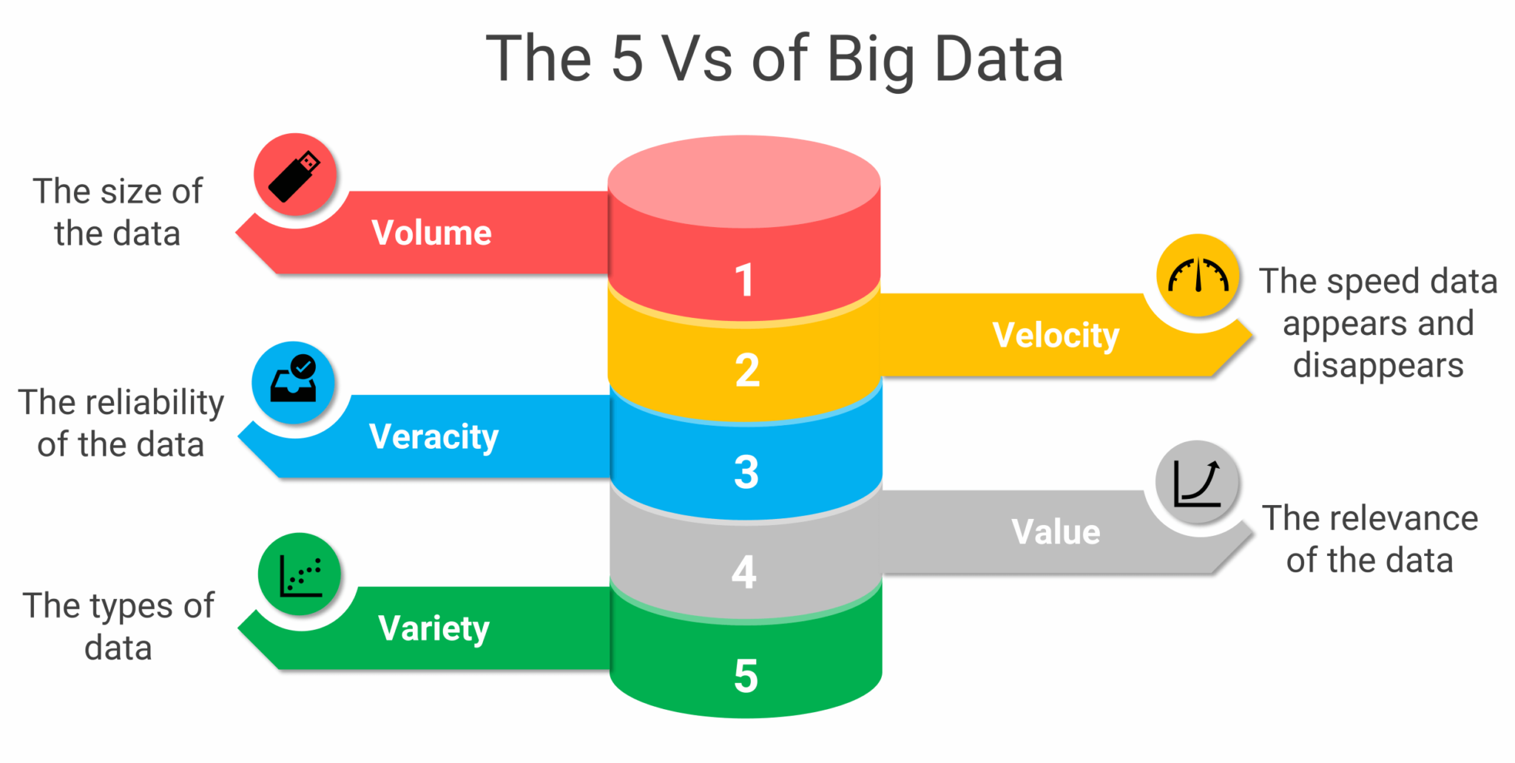
Introduction to Big Data
Big Data refers to datasets that are too large or complex for traditional systems to capture, store, and analyze efficiently.
The 5 V’s:
Volume: Scale of data (terabytes to petabytes)
Velocity: Speed of data generation (real-time streams)
Variety: Structured, semi-structured, unstructured
Veracity: Data quality and accuracy
Value: Business or analytical insight gained
Notes:
YouTube collects and processes petabytes of video and user data for personalized recommendations.

Slide 3
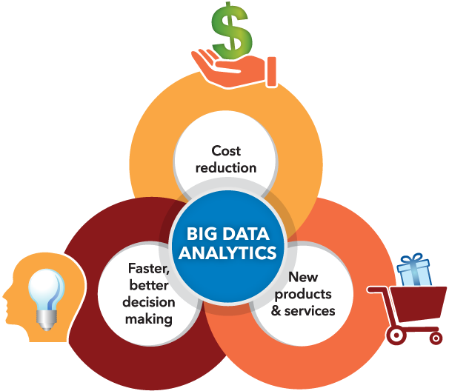
Importance of Big Data in AI/ML
Large, diverse datasets improve model accuracy and fairness.
Enables data-driven decision-making across industries.
Essential for building recommendation engines, fraud detection systems, predictive analytics.

Slide 4
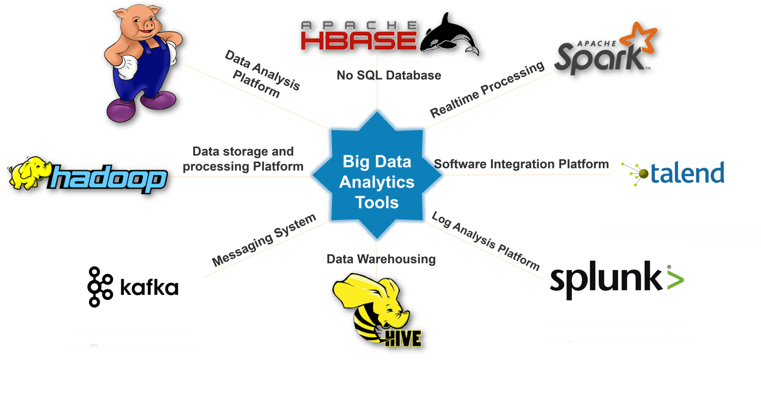
Big Data Ecosystem Overview
End-to-End Flow:
Data Sources → Ingestion → Storage → Processing → Analytics → Visualization
Components:
Ingestion: Kafka, Flume, Sqoop
Storage: HDFS, S3, Google Cloud Storage
Processing: Spark, Hadoop, Flink, Dask
Analytics: Hive, Presto, Drill
Visualization: Power BI, Tableau, Superset

Slide 5
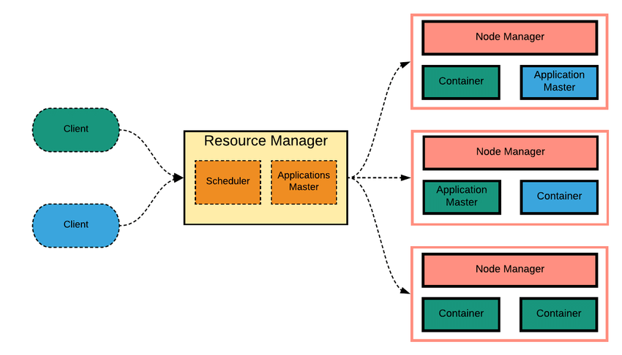
Hadoop Framework and Fault Tolerance
HDFS (Hadoop Distributed File System): stores large files across multiple machines.
MapReduce: processes data in parallel by mapping and reducing tasks.
YARN: resource manager that handles job scheduling.
Fault Tolerance:
Data is replicated across multiple nodes in HDFS (default replication factor = 3).
If one node fails, data can be recovered from replicas.
MapReduce automatically restarts failed tasks on other nodes.
Notes:
Be ready to explain how replication and task re-execution achieve fault tolerance in distributed systems.

Slide 6

Apache Spark Overview
Fast, general-purpose cluster computing system.
Performs in-memory data processing (faster than Hadoop MapReduce).
Supports batch, streaming, machine learning, and graph workloads.
Spark Core Components:
Spark Core: handles task scheduling, memory, and fault recovery.
Spark SQL: structured data queries using Data Frames.
Spark Streaming: real-time data processing.
MLlib: built-in machine learning library.
GraphX: graph computations (e.g., social network analysis).

Slide 7
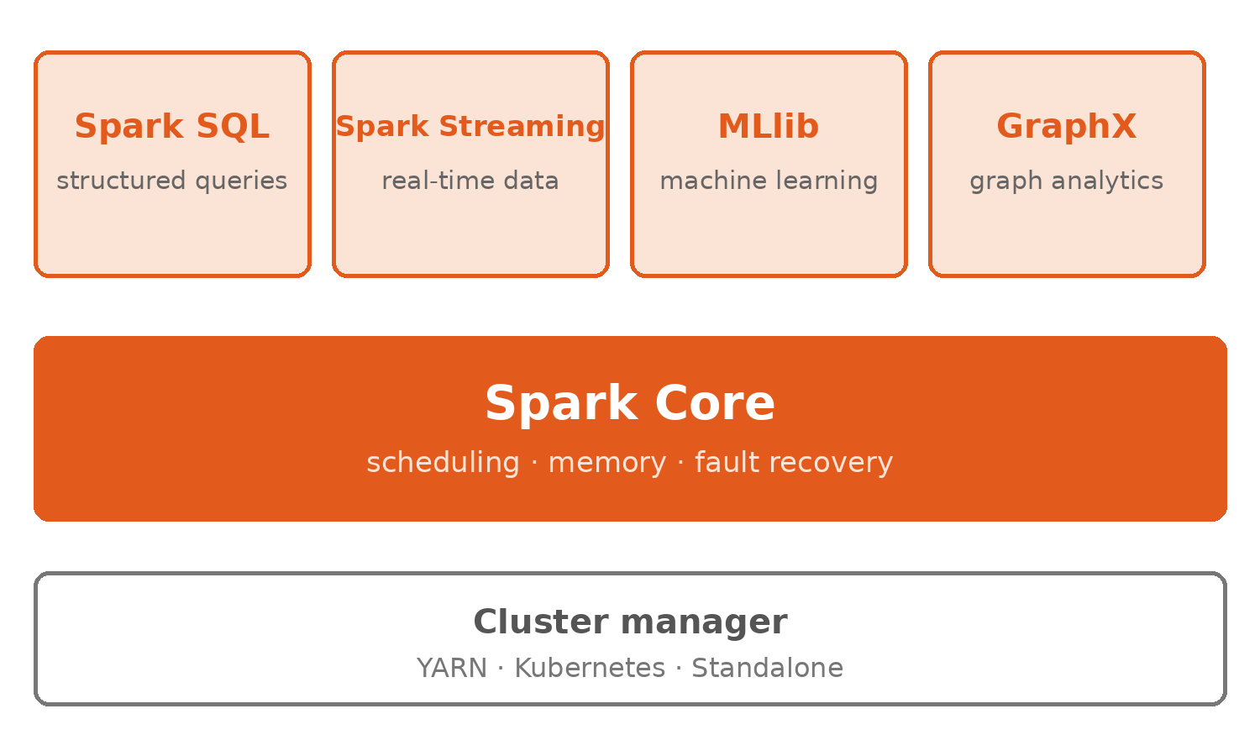
Spark Components
Spark Core handles scheduling, memory and fault recovery.
Spark SQL: query structured data with SQL or DataFrames.
Spark Streaming: process data as it arrives.
MLlib: distributed machine learning.
GraphX: graph computations such as social networks.

Slide 8
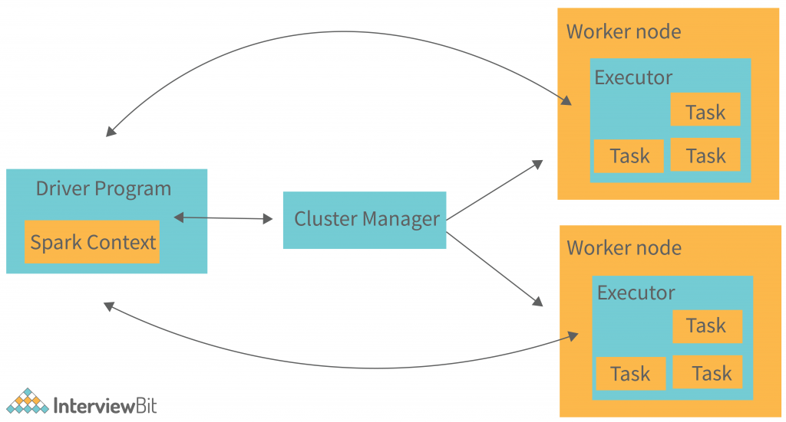

Slide 9
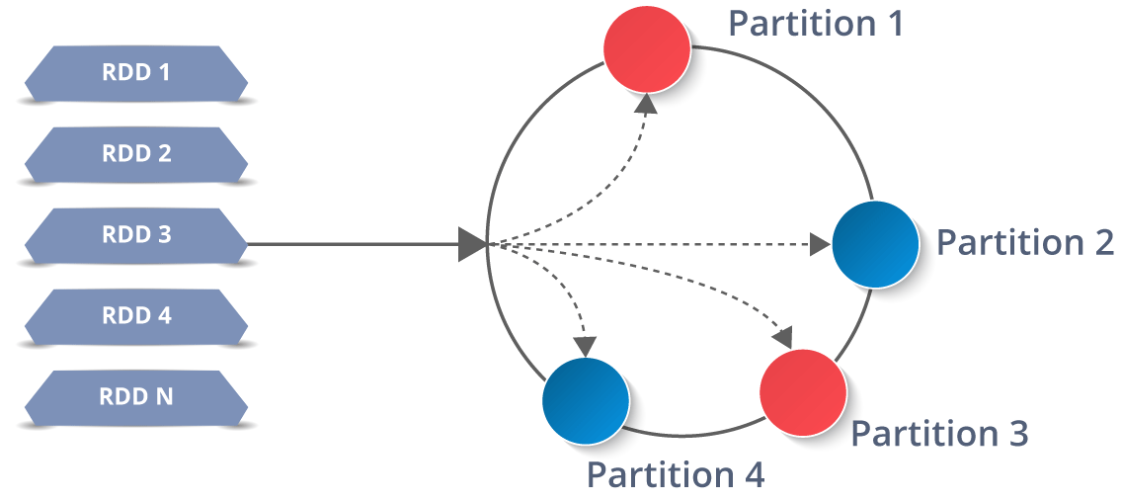
RDD (Resilient Distributed Dataset)
The fundamental data structure in Spark.
An immutable, distributed collection of objects that can be processed in parallel.
Supports two operations:
  Transformations: create new RDDs (map, filter, flatMap).
  Actions: return results (count, collect, save).
RDD Features:
Fault Tolerance: Spark rebuilds lost partitions using lineage (the history of transformations).
Lazy Evaluation: transformations are not executed until an action is called.
Persistence: RDDs can be cached in memory for faster reuse.
Notes:
Question often asked — “How does Spark achieve fault tolerance?”
Answer — “Through lineage and recomputation of RDDs instead of replication.”

Slide 10
Spark Fault Tolerance and Execution
Lineage: each RDD remembers the operations that created it.
If a node fails, Spark recomputes only the lost partitions from that lineage.
No replication needed for intermediate results, unlike HDFS.
DAG: the logical graph of computations Spark builds before running anything.
Shuffle: redistributes data between partitions during operations like groupByKey or reduceByKey.
Notes:
Uber uses Spark Streaming for near real-time analytics of trip data with automatic recovery from node failures.

Slide 11
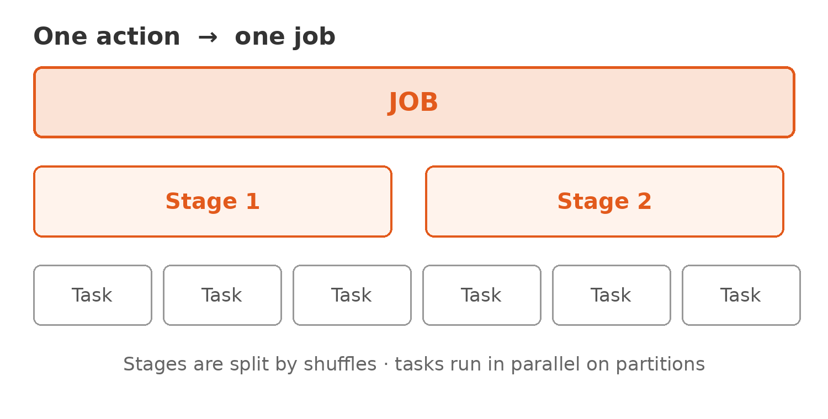
How Spark Runs a Job
Action triggers a job. Nothing runs until you call show(), count() or save().
Job to Stage to Task: Spark splits work into these three levels.
Shuffle: moving data between partitions (groupByKey, joins). Stages break here.
Cluster managers: YARN, Kubernetes or Standalone distribute the tasks.
Watch the Spark UI to see stages, tasks and where time goes.

Slide 12
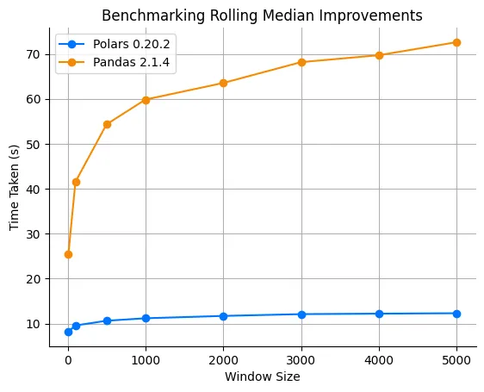
Modern Big Data Tools and Libraries
Polars: fast DataFrame library written in Rust; pandas-like API, much faster on large files.
  Handles data larger than memory through lazy, streaming execution.
Apache Arrow: the in-memory columnar format these tools share, so data moves between them without copying.
Dask / Ray: Python-native distributed computing for larger ML workloads.

Slide 13
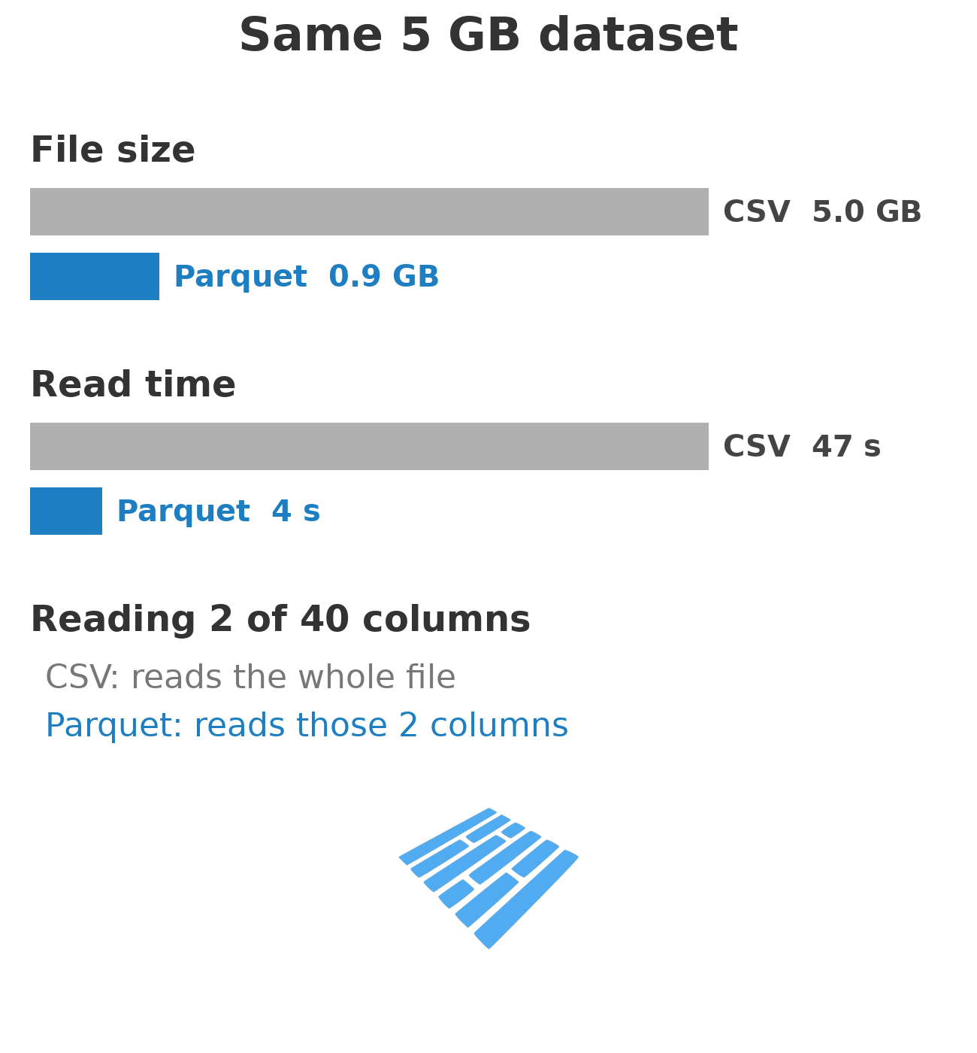
Storage Formats: CSV vs Parquet
Row vs column storage: CSV stores rows, Parquet stores columns.
Columnar wins for analytics: read only the columns you need.
Compression and types are built in, so no re-parsing strings.
Partitioning (by date, region) lets engines skip whole files.
Rule of thumb: CSV to exchange data, Parquet to analyse it.

Slide 14
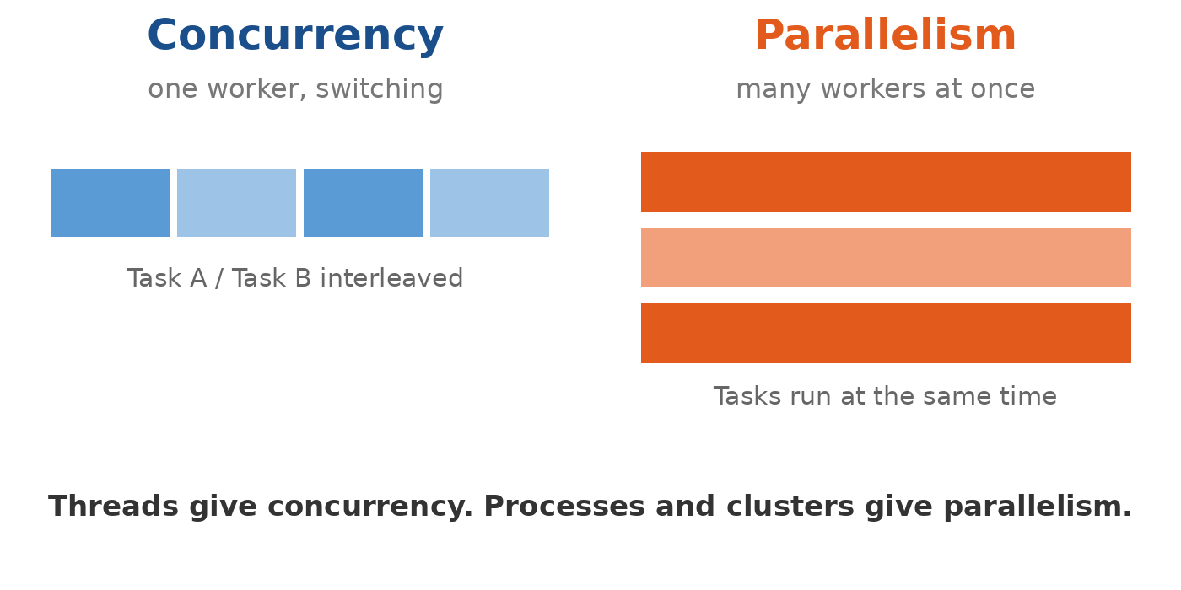
Concurrency vs Parallelism
Concurrency: several tasks in progress, one worker switching between them.
Parallelism: several tasks executing at the same instant on different cores or machines.
Threads give you concurrency; processes and clusters give you parallelism.
Why it matters: choosing the wrong one gives no speed-up at all.

Slide 15
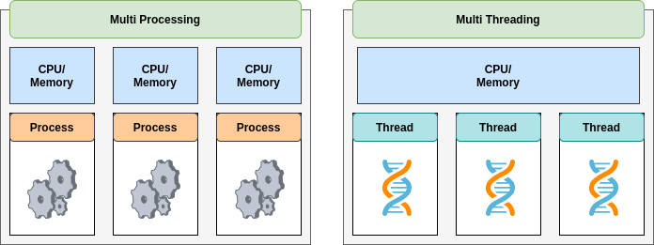
Multithreading and Big Data Processing
Multithreading: multiple threads run concurrently within a process.
Best for I/O-bound work (reading files, API calls).
In Python the GIL blocks true CPU parallelism in threads: use multiprocessing, or libraries like NumPy and Dask that release it. Spark and Dask parallelise across processes and machines.
Key Concepts:
Thread lifecycle: New → Runnable → Running → Waiting → Terminated
Thread safety and synchronization: avoid race conditions.
Concurrency vs Parallelism:
  Concurrency = multiple tasks managed at once.
  Parallelism = multiple tasks executed at the same time.

Slide 16
Big Data and AI/ML Workflow
Data Sources → Storage (HDFS/S3) → Processing (Spark) → Feature Store → Model Training → Model Serving → Monitoring
Spark prepares training data and features.
Feature Store ensures consistent features between training and production.
Multithreading improves performance in ETL and inference pipelines.

Slide 17
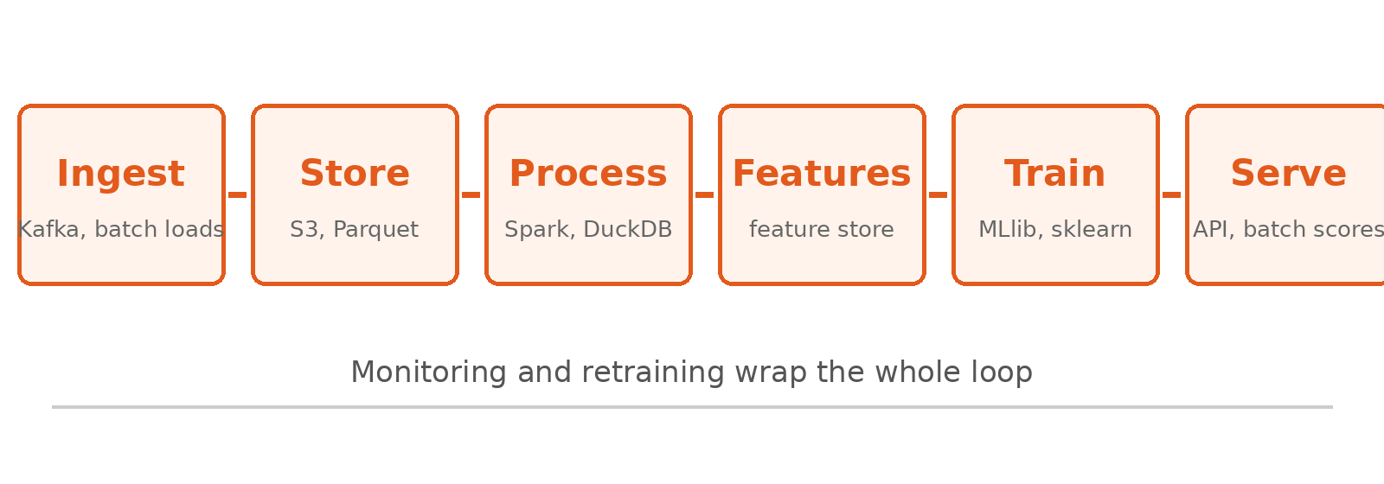
The Workflow Around the Model
Most of the work is not modelling. Ingestion, storage and processing dominate.
Feature store: the same feature definitions for training and serving.
Serving: real-time API or scheduled batch scoring.
Monitoring and retraining close the loop when data drifts.

Slide 18
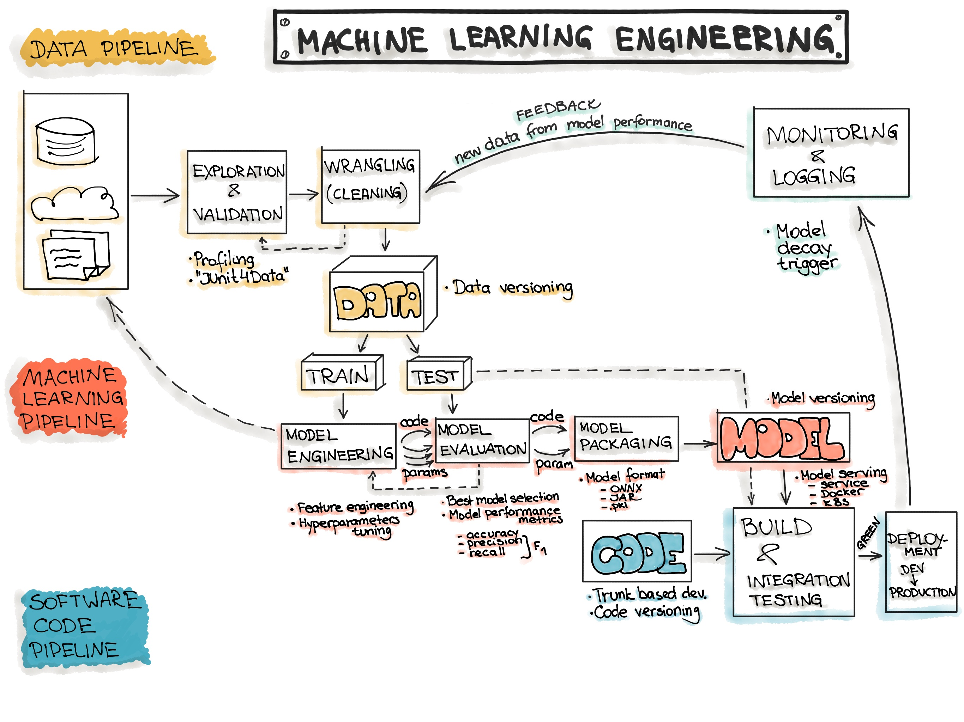
Notes:
https://ml-ops.org/content/end-to-end-ml-workflow#data-engineering

Slide 19
Best Practices and Trends
Move from batch to real-time streaming pipelines.
Use columnar formats (Parquet, ORC) for analytics.
Combine Spark + Polars / DuckDB for modern data lakes.
Leverage multithreading for concurrent feature extraction or model scoring.
Design systems with fault tolerance and scalability in mind.

Slide 20
Conclusion
Big Data and distributed computing are the foundation of modern AI systems.
Spark remains the most important tool for large-scale ML data processing.
Understanding RDDs, lineage, fault tolerance, and concurrency prepares students for both interviews and real-world systems.

