Slide 1
EASicab CASE Study

Slide 2
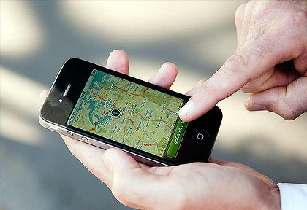
AGENDA
Project Overview
Block Diagram
Technology
Features
Project Flow Diagram

Slide 3
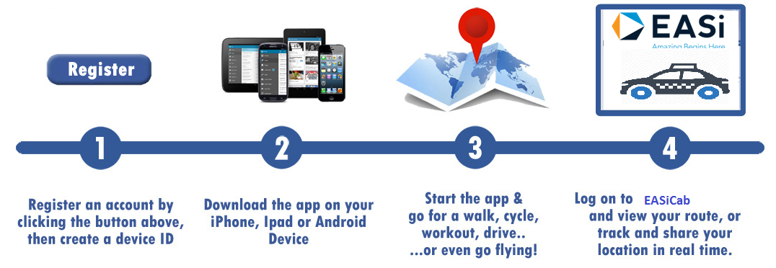
Project Overview
The application is mainly for managing the employees cab facility in the office. The application consists of three roles – Admin, Driver & Employee.
Objectives :
To generate the quick reports & to make accuracy and efficient log reports
To provide data security and employee safety
The use the application to reduce the dummy(duplicate) log sheets and back to back sheets, reports and repeated work for admin/finance team and many more
User-friendly application to manage and control the EASi(Allegis) cab facilities

Slide 4
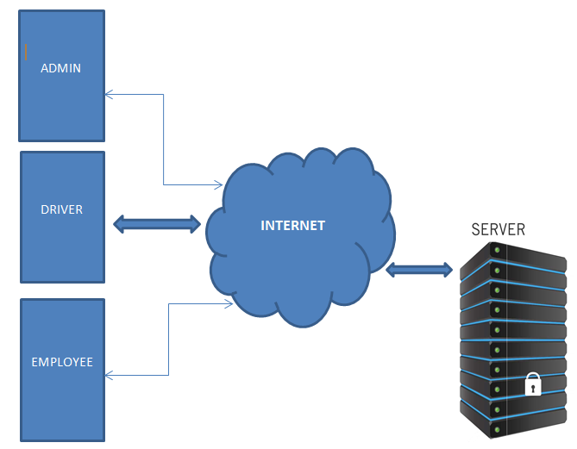
Block diagram

Slide 5
Technology [Software / Hardware]
Tool & Software :
Android Studio – Android Development
Xcode-- iOS Development
SQLite-- Mobile Database
Eclipse, Apache Tomcat Server
& MySQL Database – Web Service Development
SVN -- Source control
Simulator – For application Testing
Testing Tool-- Bugzilla
Protocols-- Restful Api (JSON)
Other Protocol-- Google Proto Buffer
Programming Languages :
Java (Web Service & Android)
Objective C & Swift for iOS development
Hardware
Android Devices
iOS Devices

Slide 6
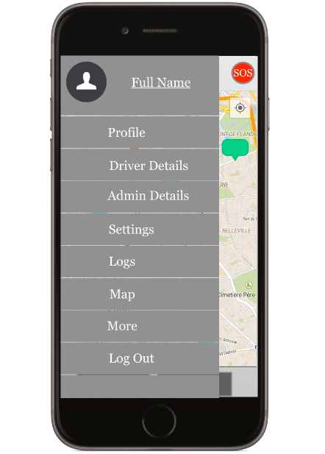
Features
UI for three different role ( Admin, Driver, Employee) with supporting multiple screen sizes
Log in, Registration, settings and Check-in and Check-out functionalities
Cab/Employee monitoring & Google map
Call and SMS service from app
SOS (Emergency Button)
Web service Development and integration
GPS Tracking, Push notification
Export travel log reports in required format

Slide 7
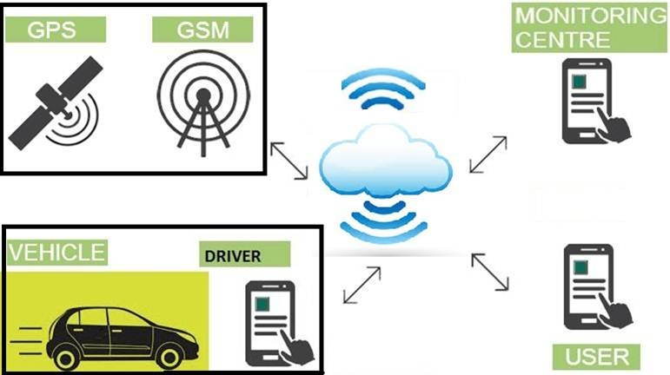
Project Flow

Slide 8
Thank you
For more details, please contact:
EASi Embedded
Bangalore

