Slide 1
EASICAB

Slide 2
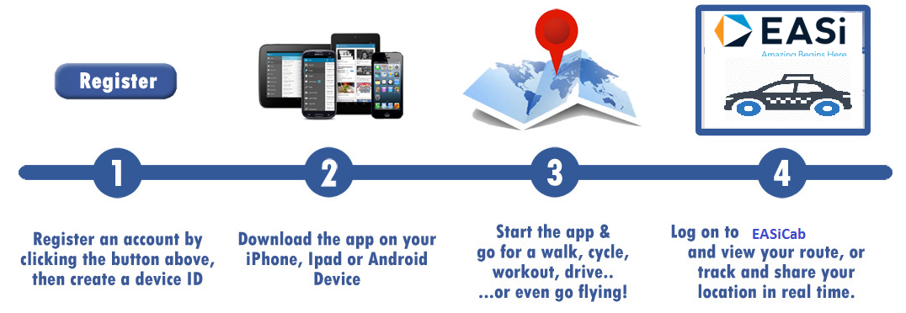
PROJECT OVERVIEW
      The application manages the employees’ cab facility at EASi.
      Objectives :
User-friendly application to manage and control the EASi cab facilities while maintaining data security and employee safety
Notifications through beacons of employees’ entry or exit from cabs via bluetooth
Efficient maintenance of data (log sheets, usage etc)

Slide 3
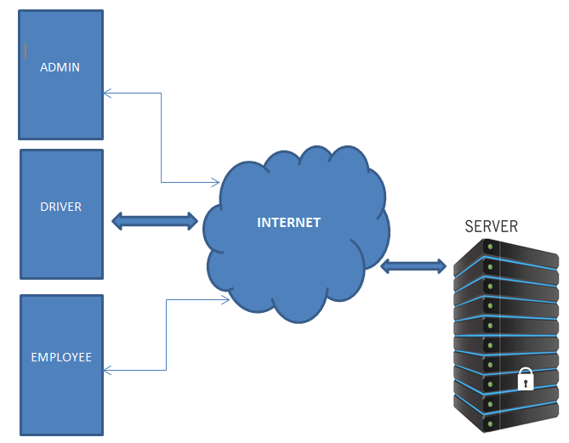
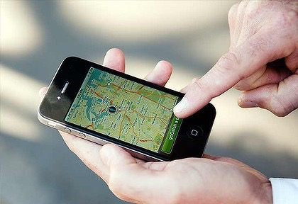
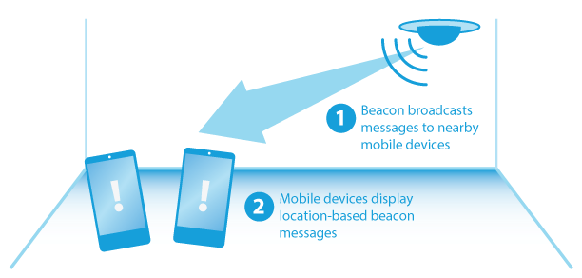
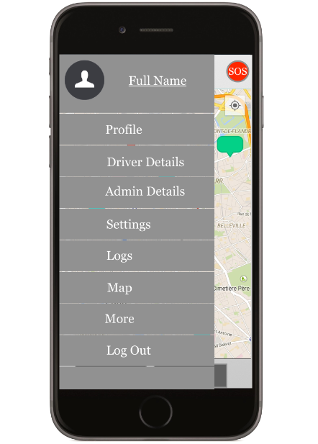
DIAGRAMS
Block Diagram
Live Tracking
Beacon
Application

Slide 4
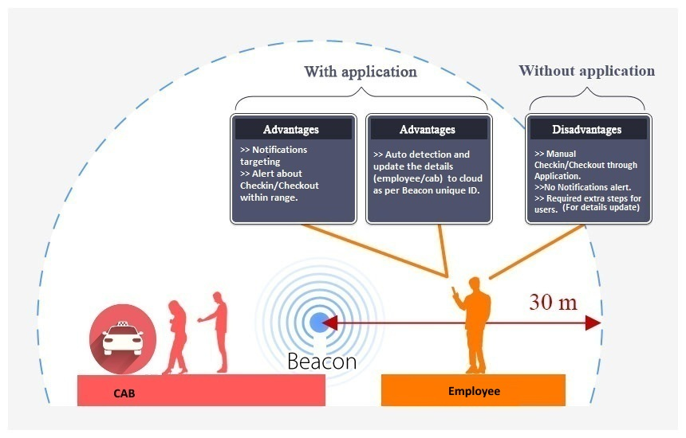
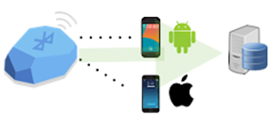
How it Works?
When the device comes with in the range or goes out of range from the beacons(30 meters), a notification will be given to the user to check-in or check-out.
Each Beacon will have unique ID which can be assigned to each cab. As per the ID, all details like the check in & check out status cab details , address, travel details & user details will be updated to server via internet.
All user are connected to server& with each other via internet.
NOTE: The Beacons work through the Bluetooth and sending the status is through the internet.

Slide 5
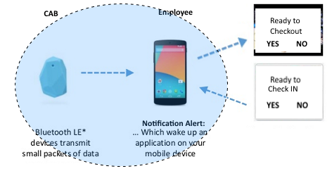
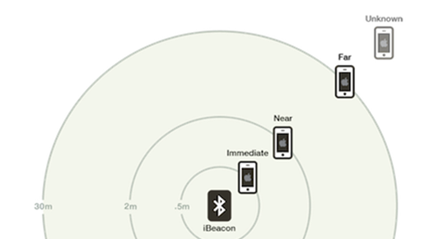
FEATURES
IOT - Check-in and Check-out functionalities by using Beacon
Cab/Employee monitoring & Google map, Setting, Registration etc.
Call and SMS service from app
SOS (Emergency Button)
Web service Development and integration
GPS Tracking, Push notification
Travel log reports in required format
UI for three different role (Admin, Driver, Employee) with supporting multiple screen sizes
The client server Communication works in present of internet.
Check-in/Check-Out
Beacon range

Slide 6
THANK YOU
For more details, please contact:
EASi Embedded
Bangalore

