Slide 1
Micro Credit Loan
A project submitted by:-
Pallavi Bajpai
(pallavi678@gmail.com)

Slide 2
Libraries
import pandas as pd
import numpy as np
import matplotlib.pyplot as plt
from sklearn import preprocessing
from sklearn.model_selection
import cross_val_score from sklearn
import linear_model, svm from sklearn.ensemble
import GradientBoostingRegressor as xgb
from sklearn.metrics import confusion_matrix,accuracy_score,f1_score
from scipy import stats
import seaborn as sns

Slide 3
Missing values
None.

Slide 4
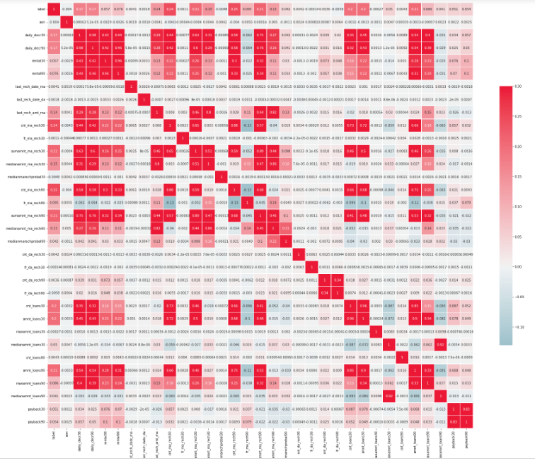
Correlation Heatmap
Here GarageArea, TotalRmsAbvGrd, 1stFlrSF, KitchenQual, ExternalQual were dropped because they correlated less with sales price compare to the other variables they correlated with

Slide 5
Outliers

Slide 6
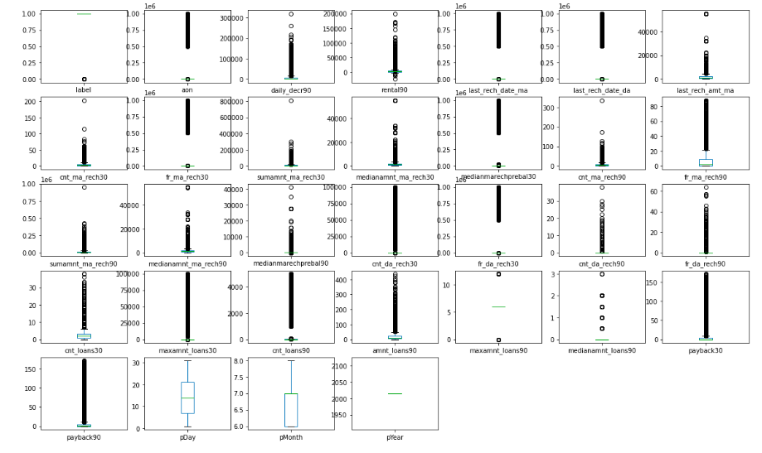

Slide 7
Normality and linearity

Slide 8
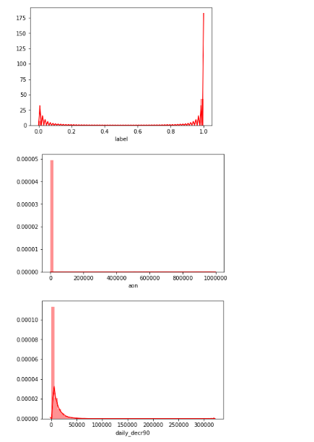

Slide 9
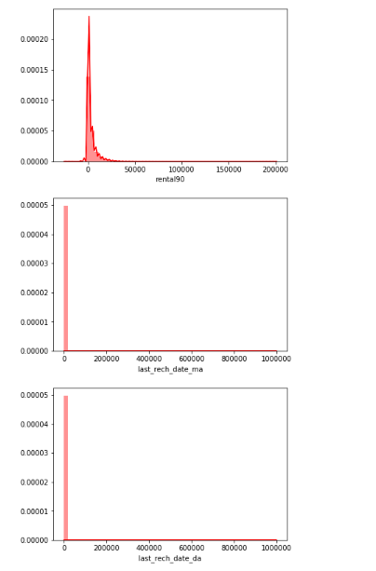

Slide 10
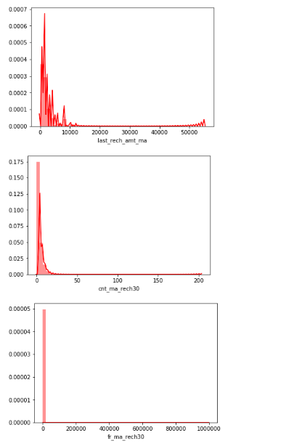

Slide 11
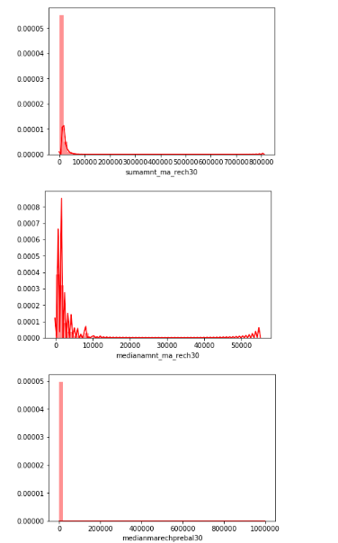

Slide 12
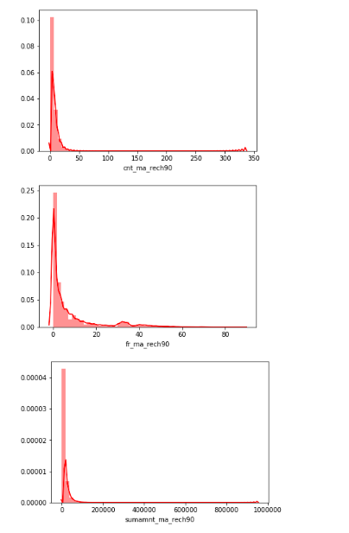

Slide 13
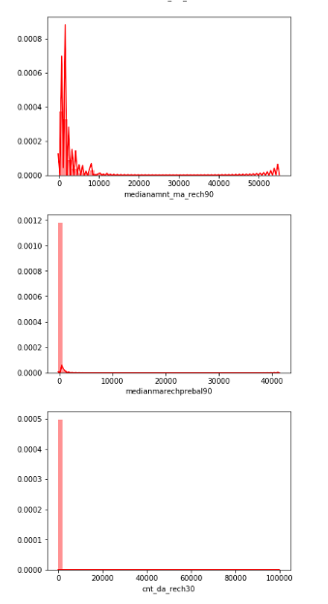

Slide 14
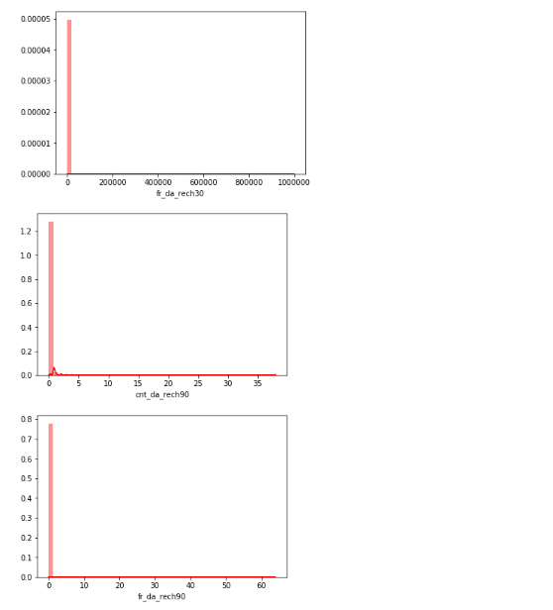

Slide 15
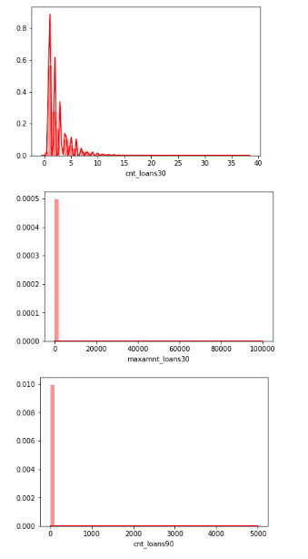

Slide 16
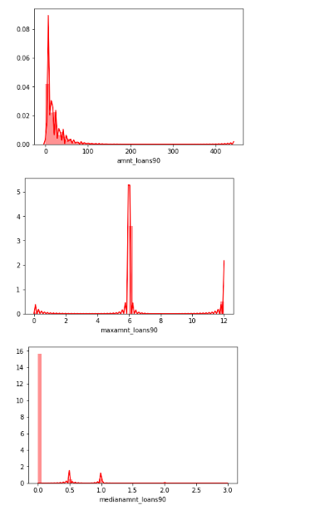

Slide 17
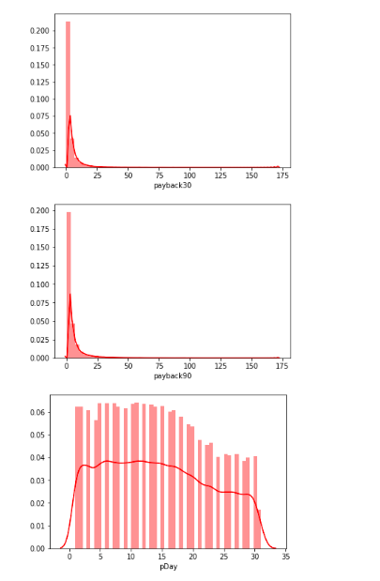

Slide 18
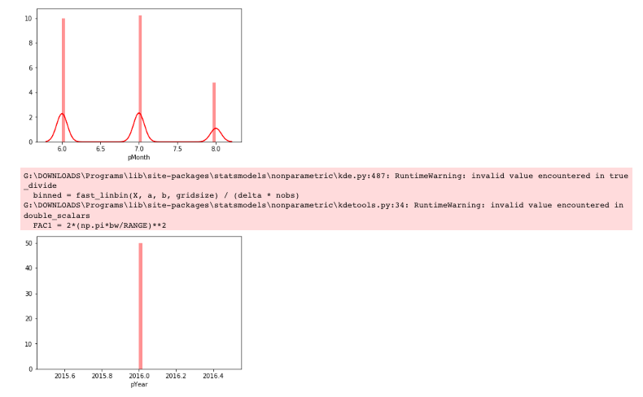

Slide 19
Cleaning test data

Slide 20
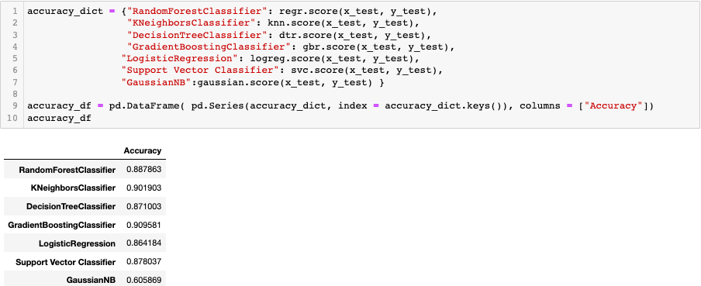
Modelling Result

