Slide 1
House price prediction
A project submitted by:-
Pallavi Bajpai
(pallavi678@gmail.com)

Slide 2
Libraries
import pandas as pd
import numpy as np
import matplotlib.pyplot as plt
from sklearn import preprocessing
from sklearn.model_selection
import cross_val_score from sklearn
import linear_model, svm from sklearn.ensemble
import GradientBoostingRegressor as xgb
from sklearn.metrics import confusion_matrix,accuracy_score,f1_score
from scipy import stats
import seaborn as sns

Slide 3
Missing values
PoolQC 99.5 MiscFeature 96.3
Alley 93.8 Utilities 0.0
Fence 80.8 Electrical 0.1
FireplaceQu 47.3 MasVnrType 0.5
LotFrontage 17.7 MasVnrArea 0.5
GarageCond 5.5 BsmtQual 2.5
GarageType 5.5 BsmtCond 2.5
GarageYrBlt 5.5 BsmtFinType1 2.5
GarageFinish 5.5 BsmtFinType2 2.6
GarageQual 5.5 BsmtExposure 2.6

Slide 4
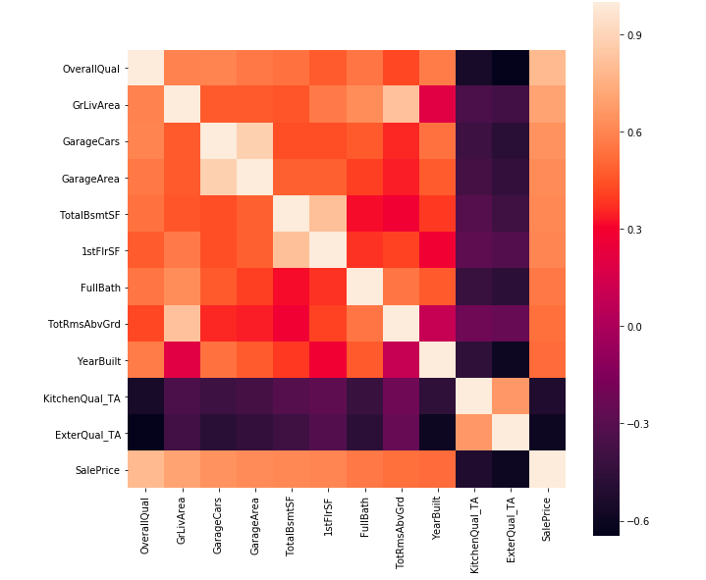
Correlation Heatmap
Here GarageArea, TotalRmsAbvGrd, 1stFlrSF, KitchenQual, ExternalQual were dropped because they correlated less with sales price compare to the other variables they correlated with

Slide 5
Outliers

Slide 6
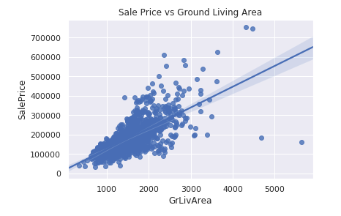

Slide 7
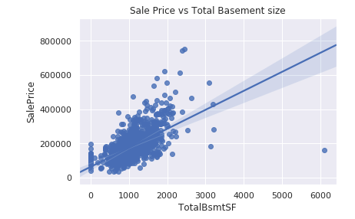

Slide 8
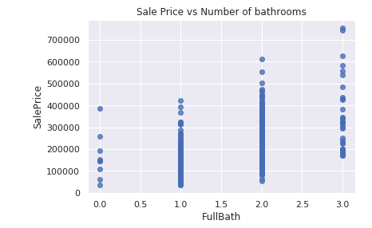

Slide 9
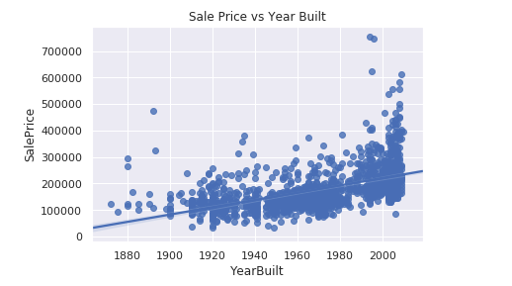

Slide 10
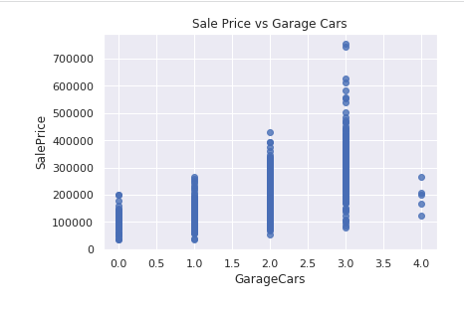

Slide 11
Four outliers in the graphs above will be dropped. These corresponding to ground living area > 4500 and sales price between 7000 and 8000 in Year Built graph.The isolated TotalBsmtSF point > 6000 is also included as part of these outliers which will be removed.

Slide 12
Normality and linearity

Slide 13
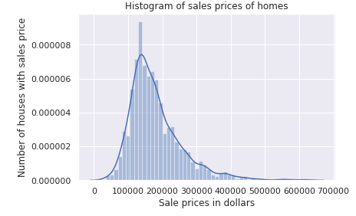

Slide 14
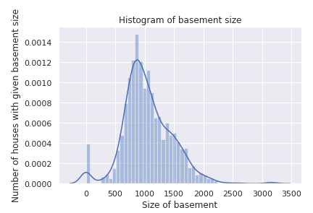

Slide 15
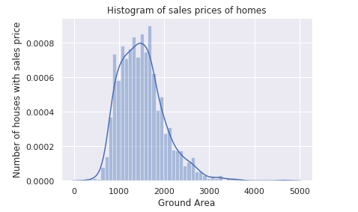

Slide 16
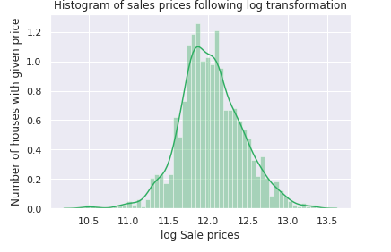

Slide 17
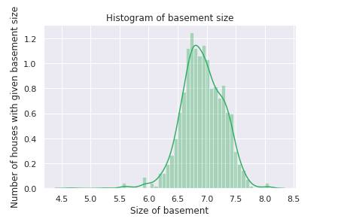

Slide 18
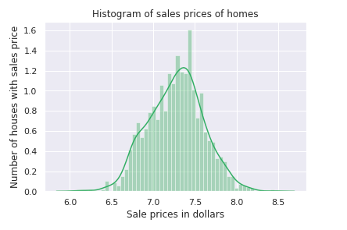

Slide 19
The distrbutions are now centred and more normally distributed and less skewed.

Slide 20
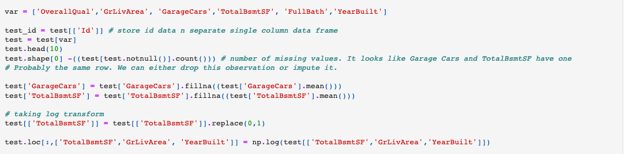
Cleaning test data

Slide 21

Modelling Result

