Slide 1
Malignant Comment Project
A project submitted by:-
Pallavi Bajpai
(pallavi678@gmail.com)

Slide 2
Libraries
import pandas as pd
import numpy as np
import matplotlib.pyplot as plt
from sklearn import preprocessing
from sklearn.model_selection
from sklearn.model_selection import train_test_split
from sklearn.metrics import accuracy_score, confusion_matrix, classification_report,roc_curve,roc_auc_score,auc,f1_score
from sklearn.linear_model import LogisticRegression
from sklearn.model_selection import cross_val_score,GridSearchCV
from sklearn.naive_bayes import MultinomialNB
from sklearn.tree import DecisionTreeClassifier
from sklearn.neighbors import KNeighborsClassifier
from sklearn.ensemble import RandomForestClassifier,AdaBoostClassifier,GradientBoostingClassifier
from sklearn.naive_bayes import GaussianNB
from sklearn.svm import SVC
from sklearn.tree import DecisionTreeClassifier

Slide 3
Missing values
None.

Slide 4
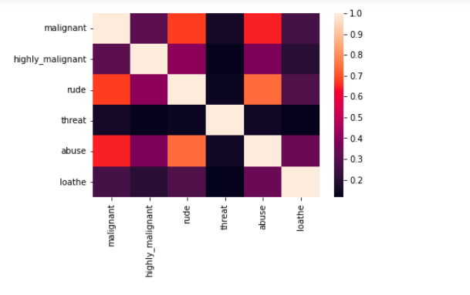
Correlation Heatmap

Slide 5
Outliers
None

Slide 6
Normality and linearity

Slide 7
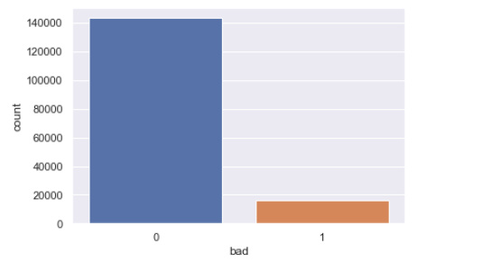
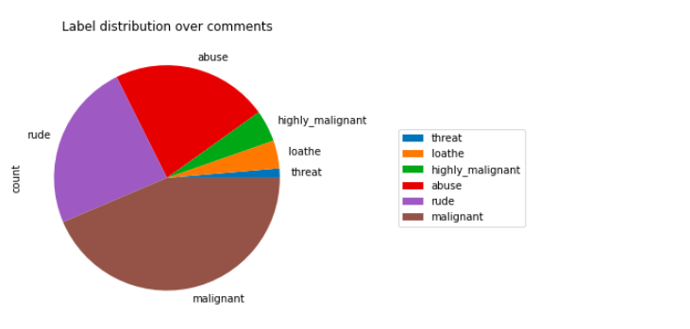

Slide 8
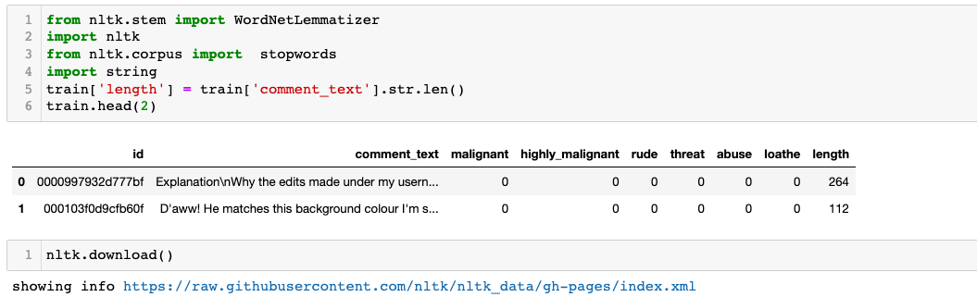
Cleaning test data

Slide 9
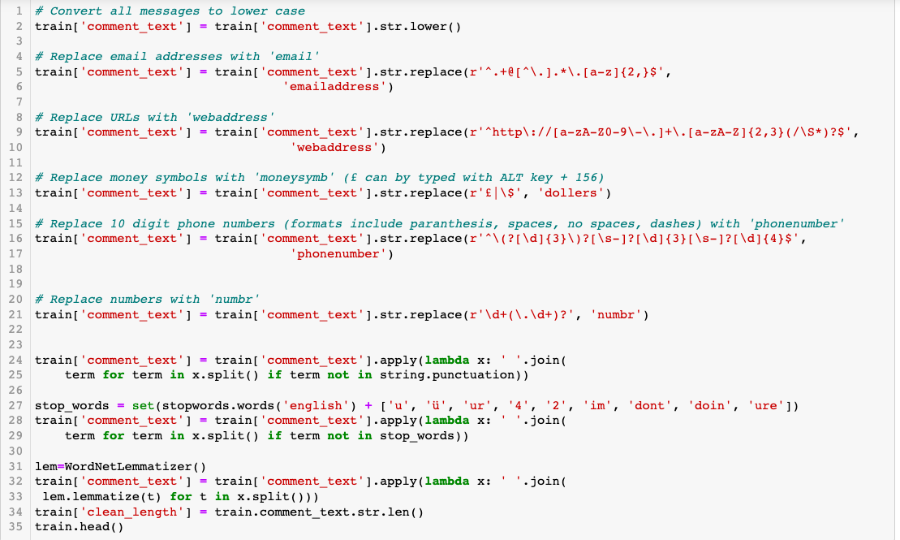

Slide 10
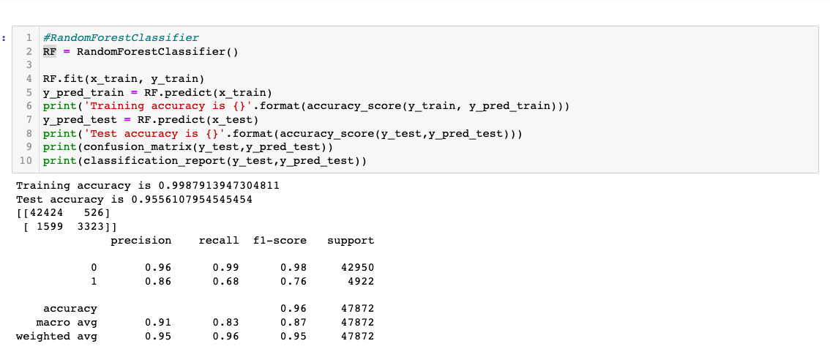
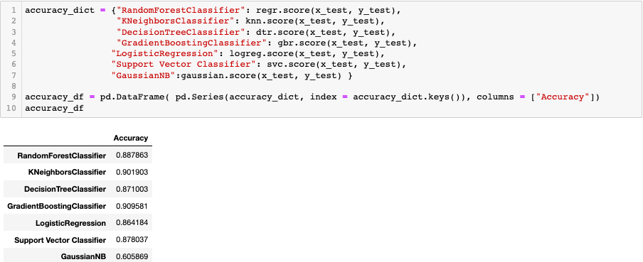
Modelling Result

