Slide 1
Telco Customer
Churn Analysis
Understanding why customers are leaving — and where to focus retention efforts.
Total Customers
Churned Customers
Churn Rate
7,043
1,869
26.54%
Customers in dataset
Customers who left
About 1 in 4 customers
Business Analytics Case Study

Slide 2
Problem Statement
The business needs to understand which customer groups are leaving and why.
Core business question
Why are customers leaving the company, and which factors contribute most to customer churn?
Analysis goals
Measure overall churn.
Compare churn across contract, payment, service, and tenure groups.
Identify practical actions to reduce customer loss.
Business impact
Lost revenue from customers who cancel.
Higher cost to replace customers who leave.
Need to focus retention on the highest-risk groups.
Outcome: a clear retention plan based on the strongest churn signals.
Telco Customer Churn Analysis

Slide 3
Dataset Overview
Each record represents one telco customer and whether they stayed or left.
Records
Columns
Target field
Main KPI
7,043
21
Churn
26.54%
Customer rows
Customer and service fields
Yes = left, No = retained
Overall churn rate
Key fields used in the analysis
Data preparation
Customer profile: gender, senior citizen, partner, dependents.
Services: internet service, online security, tech support.
Account: tenure, contract type, payment method, paperless billing.
Charges: monthly charges and total charges.
Checked for missing values and format issues.
Created a customer status field: churned vs retained.
Grouped tenure into ranges to compare new and long-term customers.
Created measures for churn rate, churned customers, and average charges.
Telco Customer Churn Analysis

Slide 4
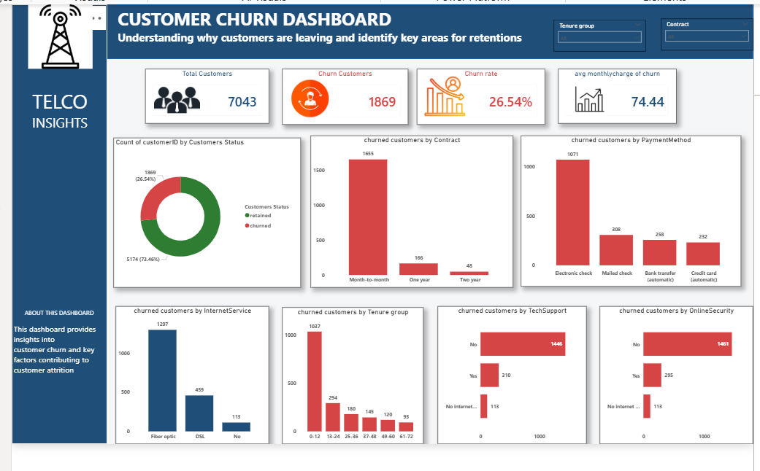
Key Visualizations: Dashboard Overview
The dashboard summarizes churn performance and shows where customer loss is concentrated.
What the dashboard tells us
Overall churn is 26.54%.
Month-to-month contracts have the largest churn count.
Electronic check users are a high-risk payment group.
Fiber optic, no tech support, and no online security are strong churn signals.
New customers in the first 12 months leave most often.
These visuals help stakeholders move from “how many left” to “which groups need action first.”
Telco Customer Churn Analysis

Slide 5
Major Churn Drivers: Contract, Payment, and Tenure
These three areas reveal the clearest patterns behind customer churn.
Churned Customers by Contract
Churned Customers by Payment Method
Churned Customers by Tenure Group
Simple takeaway: churn is highest among customers who are less committed, use electronic check, and are still early in their customer journey.
Telco Customer Churn Analysis

Slide 6
Major Churn Drivers: Service Experience
Customers without support or protection services are more likely to leave.
Churned by Internet Service
Churned by Tech Support
Churned by Online Security
Service takeaway: churn is concentrated among fiber optic customers and customers without tech support or online security.
Telco Customer Churn Analysis

Slide 7
Major Findings
The data shows a clear pattern of who is leaving and why it matters.
Churn is significant
Contract is the strongest signal
Early-life churn is high
26.54% churn rate
1,655 month-to-month churned
1,037 churned in 0–12 months
About one in four customers have left the company.
Customers without long-term contracts are easier to lose.
The first year is a critical period for retention.
Support matters
Price pressure is visible
Service experience needs review
1,446 churned with no tech support
$74.44 average monthly charge
1,297 fiber optic churned
Customers without technical support are more likely to leave.
Churned customers pay more than retained customers on average.
Fiber optic customers are the largest churn group by internet service.
Telco Customer Churn Analysis

Slide 8
Recommendations
Focus retention efforts on the highest-risk customer groups first.
Priority actions
Offer incentives for month-to-month customers to move to one-year or two-year plans.
Create a first-year retention program with welcome calls, check-ins, and simple service guides.
Review monthly pricing for high-charge customers and provide better-value bundles.
Investigate fiber optic complaints, speed issues, and customer expectations.
Promote tech support and online security as value-added services.
Encourage more stable payment options where appropriate.
Suggested retention focus
1
Month-to-month customers
2
New customers in 0–12 months
3
Fiber optic customers
4
Customers without tech support
Telco Customer Churn Analysis

Slide 9
Conclusion
The business can reduce churn by acting early, improving value, and supporting high-risk groups.
Main insight
Business action
Expected impact
Customers leaving are mainly new, month-to-month, paying higher charges, and missing support services.
Build retention campaigns around contract upgrades, first-year support, pricing reviews, and better service help.
Targeted action can reduce avoidable customer loss and protect recurring revenue.
Thank you

