Slide 1
Data Visualisation:
Let The Data Do The Talking
Andy West
RRS Summer Olympics 2023

Slide 2
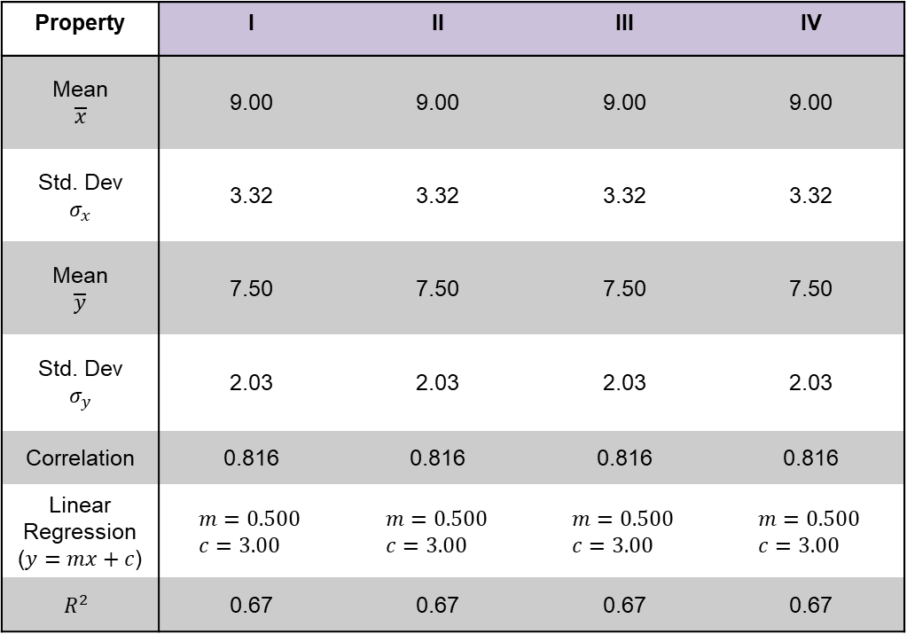
Tables Are Rubbish
I |  | II |  | III |  | IV
x | y | x | y | x | y | x | y
10 | 8.04 | 10 | 9.14 | 10 | 7.46 | 8 | 6.58
8 | 6.95 | 8 | 8.14 | 8 | 6.77 | 8 | 5.76
13 | 7.58 | 13 | 8.74 | 13 | 12.74 | 8 | 7.71
9 | 8.81 | 9 | 8.77 | 9 | 7.11 | 8 | 8.84
11 | 8.33 | 11 | 9.26 | 11 | 7.81 | 8 | 8.47
14 | 9.96 | 14 | 8.1 | 14 | 8.84 | 8 | 7.04
6 | 7.24 | 6 | 6.13 | 6 | 6.08 | 8 | 5.25
4 | 4.26 | 4 | 3.1 | 4 | 5.39 | 19 | 12.5
12 | 10.84 | 12 | 9.13 | 12 | 8.15 | 8 | 5.56
7 | 4.82 | 7 | 7.26 | 7 | 6.42 | 8 | 7.91
5 | 5.68 | 5 | 4.74 | 5 | 5.73 | 8 | 6.89
Property | I | II | III | IV
Mean $$\overline{x}$$ | 9.00 | 9.00 | 9.00 | 9.00
Std. Dev $$σ_{x}$$ | 3.32 | 3.32 | 3.32 | 3.32
Mean $$\overline{y}$$ | 7.50 | 7.50 | 7.50 | 7.50
Std. Dev $$σ_{y}$$ | 2.03 | 2.03 | 2.03 | 2.03
Correlation | 0.816 | 0.816 | 0.816 | 0.816
Linear Regression ($y=mx+c$) | $$m=0.500 \\ c=3.00$$ | $$m=0.500 \\ c=3.00$$ | $$m=0.500 \\ c=3.00$$ | $$m=0.500 \\ c=3.00$$
$$R^{2}$$ | 0.67 | 0.67 | 0.67 | 0.67
Table 1 - Anscombe's Quartet
Table 2 – Statistical descriptions of Table 1, all identical at given precision

Slide 3
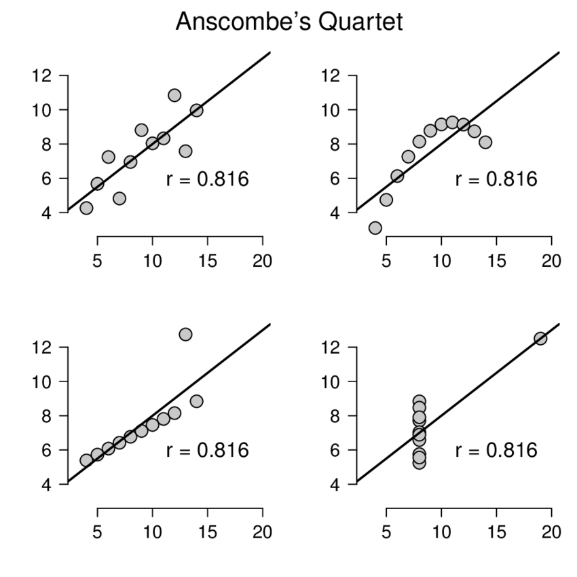
Tables Are Rubbish
I |  | II |  | III |  | IV
x | y | x | y | x | y | x | y
10 | 8.04 | 10 | 9.14 | 10 | 7.46 | 8 | 6.58
8 | 6.95 | 8 | 8.14 | 8 | 6.77 | 8 | 5.76
13 | 7.58 | 13 | 8.74 | 13 | 12.74 | 8 | 7.71
9 | 8.81 | 9 | 8.77 | 9 | 7.11 | 8 | 8.84
11 | 8.33 | 11 | 9.26 | 11 | 7.81 | 8 | 8.47
14 | 9.96 | 14 | 8.1 | 14 | 8.84 | 8 | 7.04
6 | 7.24 | 6 | 6.13 | 6 | 6.08 | 8 | 5.25
4 | 4.26 | 4 | 3.1 | 4 | 5.39 | 19 | 12.5
12 | 10.84 | 12 | 9.13 | 12 | 8.15 | 8 | 5.56
7 | 4.82 | 7 | 7.26 | 7 | 6.42 | 8 | 7.91
5 | 5.68 | 5 | 4.74 | 5 | 5.73 | 8 | 6.89
I
II
III
IV
Table 1 - Anscombe's Quartet

Slide 4
Tables Are Rubbish
I |  | II |  | III |  | IV
x | y | x | y | x | y | x | y
10 | 8.04 | 10 | 9.14 | 10 | 7.46 | 8 | 6.58
8 | 6.95 | 8 | 8.14 | 8 | 6.77 | 8 | 5.76
13 | 7.58 | 13 | 8.74 | 13 | 12.74 | 8 | 7.71
9 | 8.81 | 9 | 8.77 | 9 | 7.11 | 8 | 8.84
11 | 8.33 | 11 | 9.26 | 11 | 7.81 | 8 | 8.47
14 | 9.96 | 14 | 8.1 | 14 | 8.84 | 8 | 7.04
6 | 7.24 | 6 | 6.13 | 6 | 6.08 | 8 | 5.25
4 | 4.26 | 4 | 3.1 | 4 | 5.39 | 19 | 12.5
12 | 10.84 | 12 | 9.13 | 12 | 8.15 | 8 | 5.56
7 | 4.82 | 7 | 7.26 | 7 | 6.42 | 8 | 7.91
5 | 5.68 | 5 | 4.74 | 5 | 5.73 | 8 | 6.89
Visualisation =
insight into data
I
II
III
IV
Table 1 - Anscombe's Quartet

Slide 5
Choosing the right layout

Slide 6
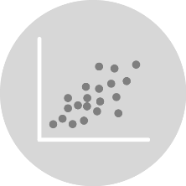

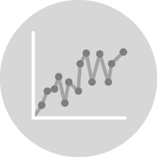
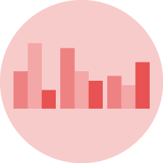
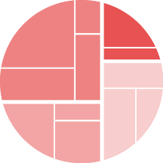
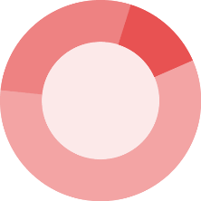
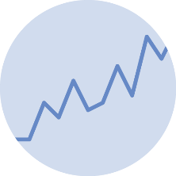



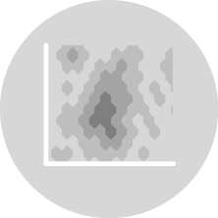
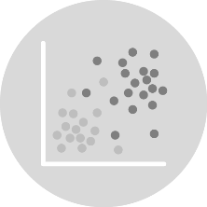
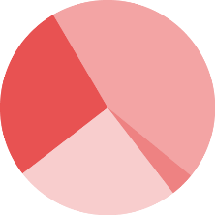

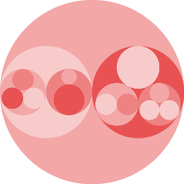



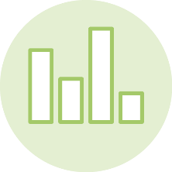



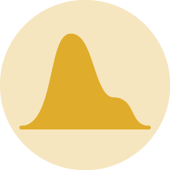
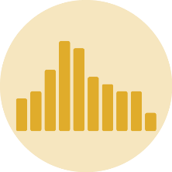
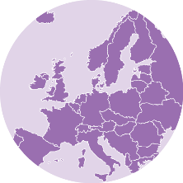
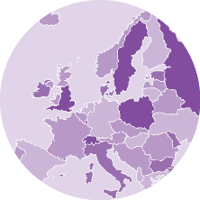






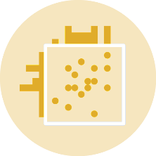
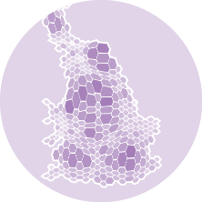


Types of Visualisation
Correlation
Part of a whole
Evolution
Ranking
Distribution
Map
data-to-viz.com

Slide 7
Examples

Slide 8
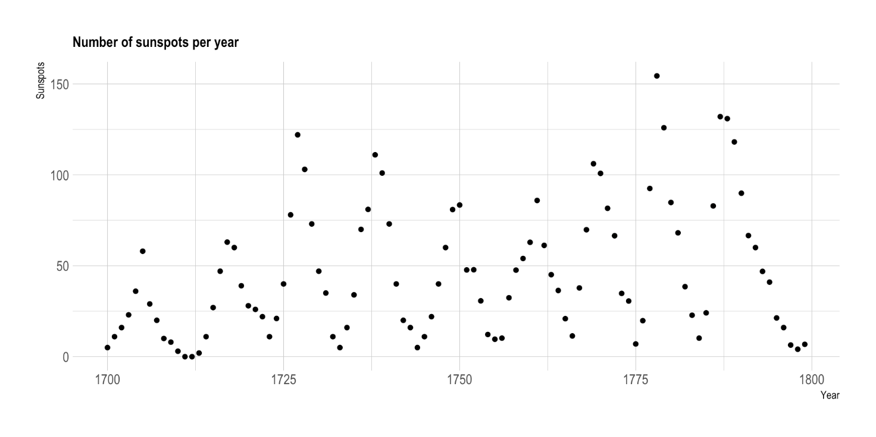
11-year Sunspot Cycle
Does this visualisation help support the conclusion?

Slide 9
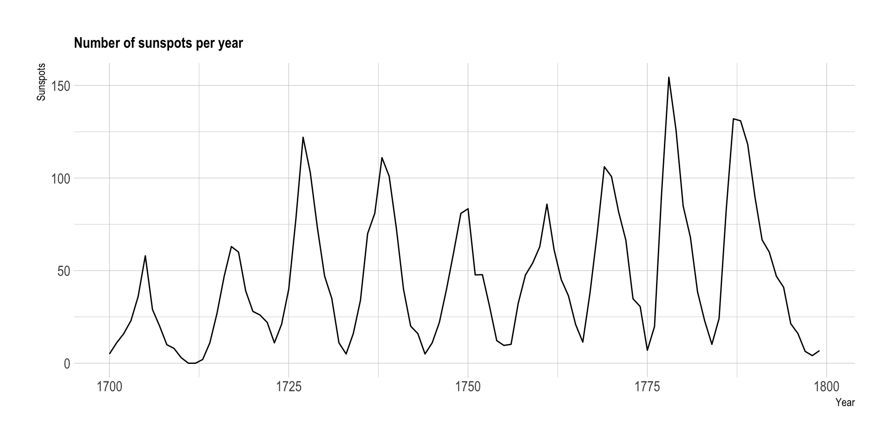
11-year Sunspot Cycle
Does this visualisation help support the conclusion?

Slide 10
Not all visuals are created equal

Slide 11
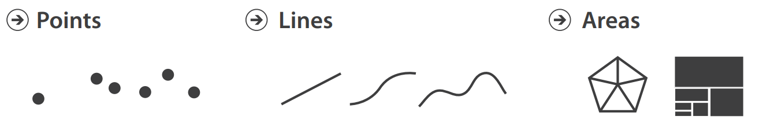
Effective Communication
Mark
Communicate an observation exists
Visualization Analysis and Design – Tamara Munzner (2014)

Slide 12
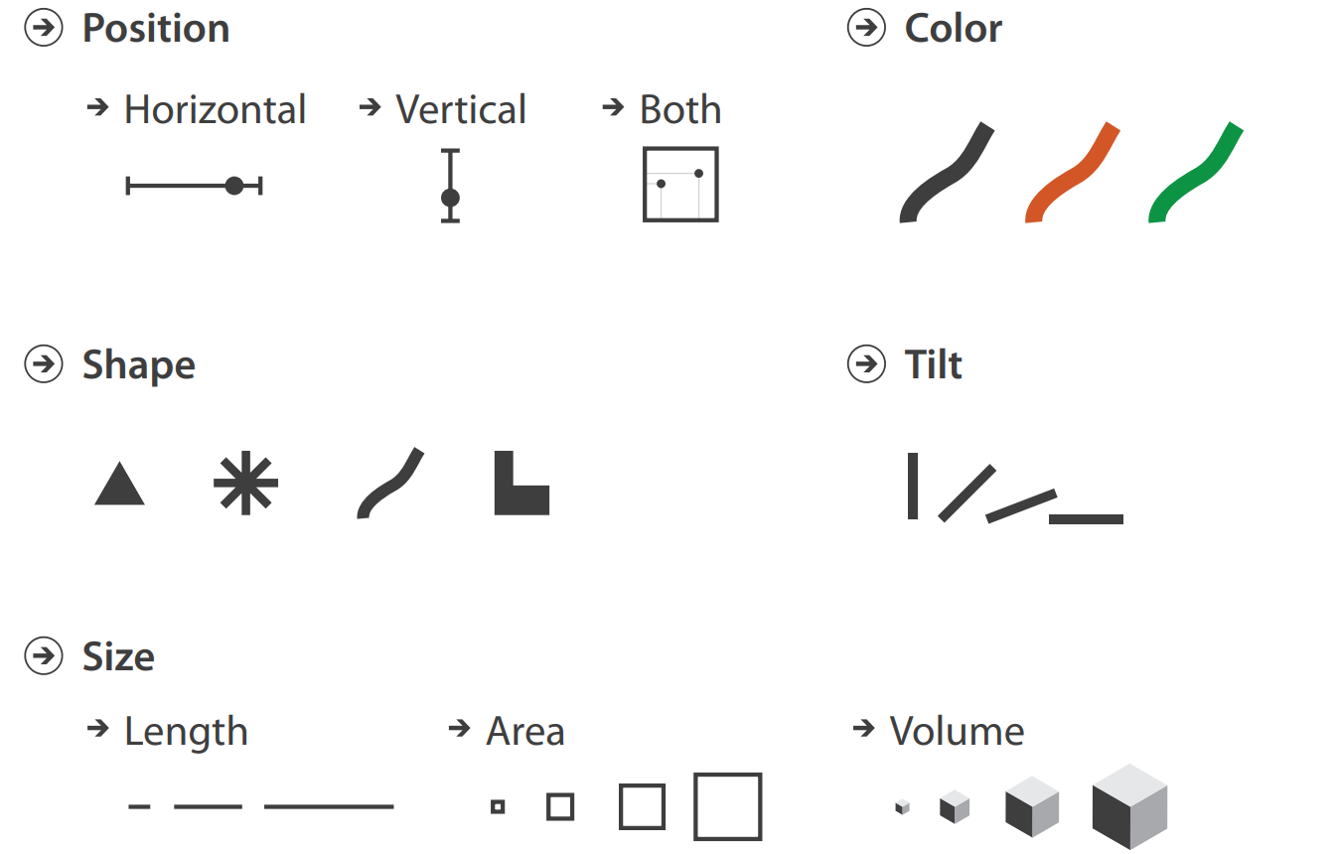
Effective Communication
Mark
Communicate an observation exists
Channel
Modify a Mark to indicate value or attribute
Visualization Analysis and Design – Tamara Munzner (2014)

Slide 13
Effective Communication
Index | Measurement
1 | 8.04
2 | 6.95
3 | 7.58
4 | 8.81
5 | 8.33
6 | 9.96
7 | 7.24
8 | 4.26
9 | 10.84
10 | 4.82
11 | 5.68

Slide 14
Effective Communication
Index | Measurement
1 | 8.04
2 | 6.95
3 | 7.58
4 | 8.81
5 | 8.33
6 | 9.96
7 | 7.24
8 | 4.26
9 | 10.84
10 | 4.82
11 | 5.68
MARK
1
2
3
4
5
6
7
8
9
10
11

Slide 15
Effective Communication
Index | Measurement
1 | 8.04
2 | 6.95
3 | 7.58
4 | 8.81
5 | 8.33
6 | 9.96
7 | 7.24
8 | 4.26
9 | 10.84
10 | 4.82
11 | 5.68
MARK
Position
Area
Saturation
12
1
1
1
2
2
2
3
3
3
4
4
4
5
8
5
5
10
6
11
6
6
7
7
7
2
8
7
8
8
3
1
9
5
9
9
4
10
10
10
6
11
11
11
9
0

Slide 16
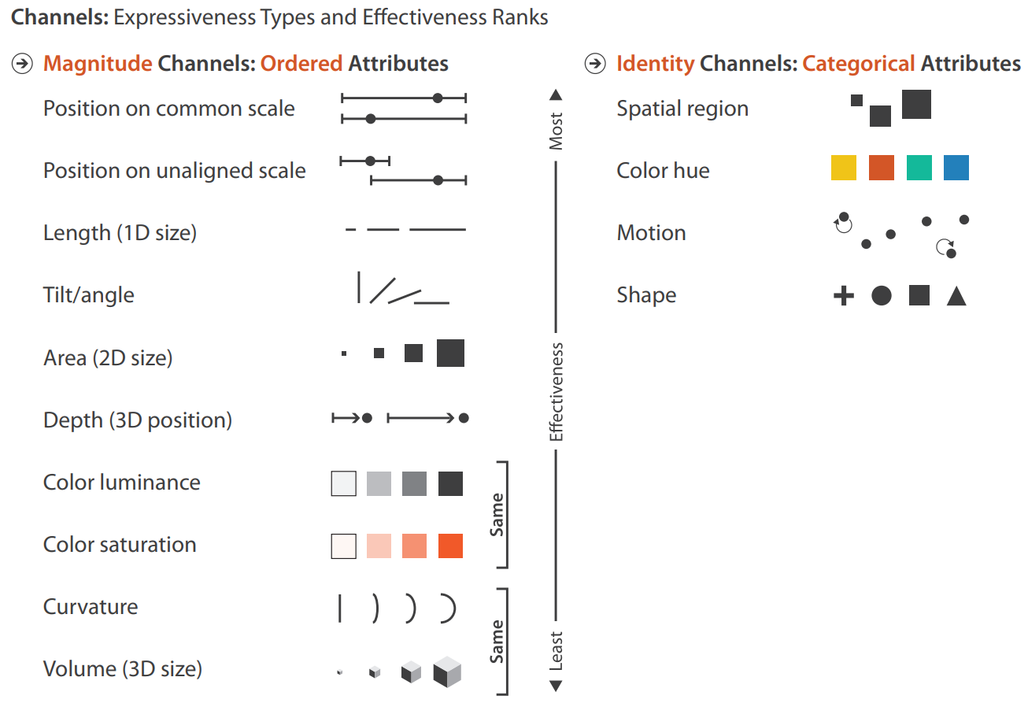
Effective Communication
Visualization Analysis and Design – Tamara Munzner (2014)

Slide 17
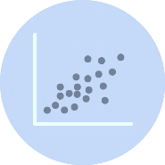
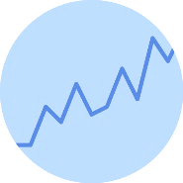
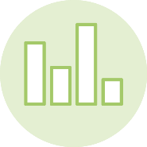

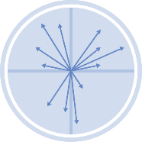


Effective Communication
Visualization Analysis and Design – Tamara Munzner (2014)

Slide 18


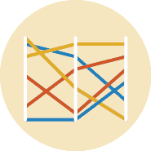
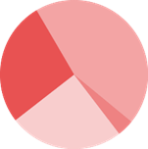
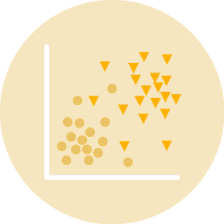
Effective Communication
B
A
A
B
Visualization Analysis and Design – Tamara Munzner (2014)

Slide 19
Same data, different conclusions

Slide 20
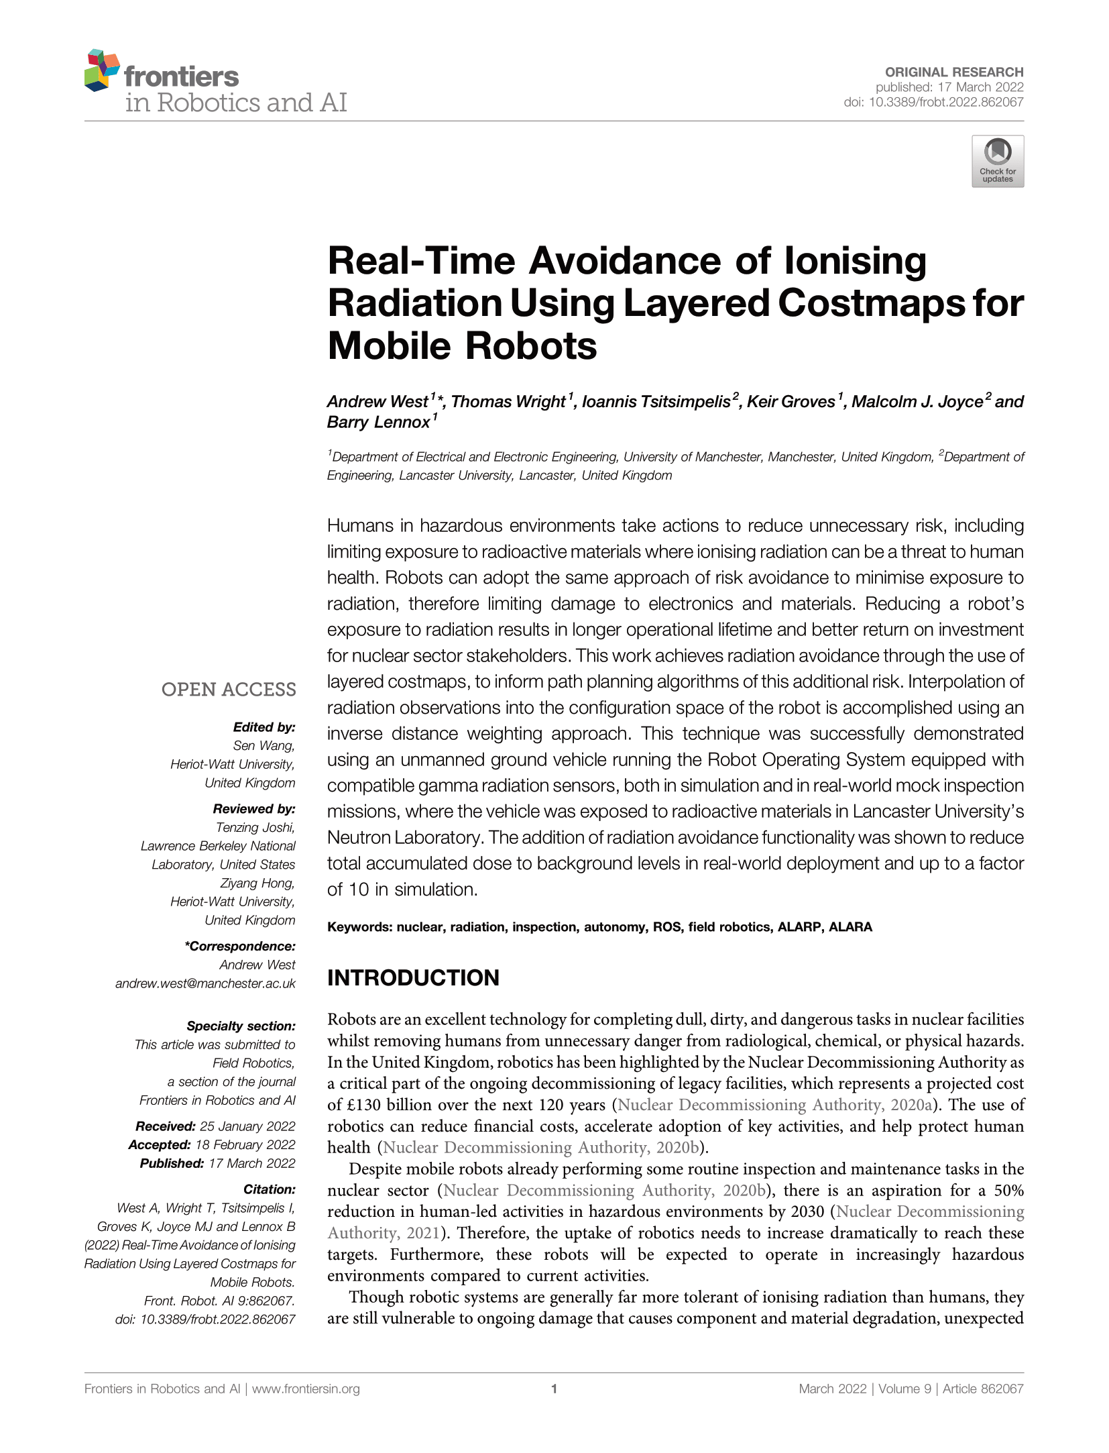
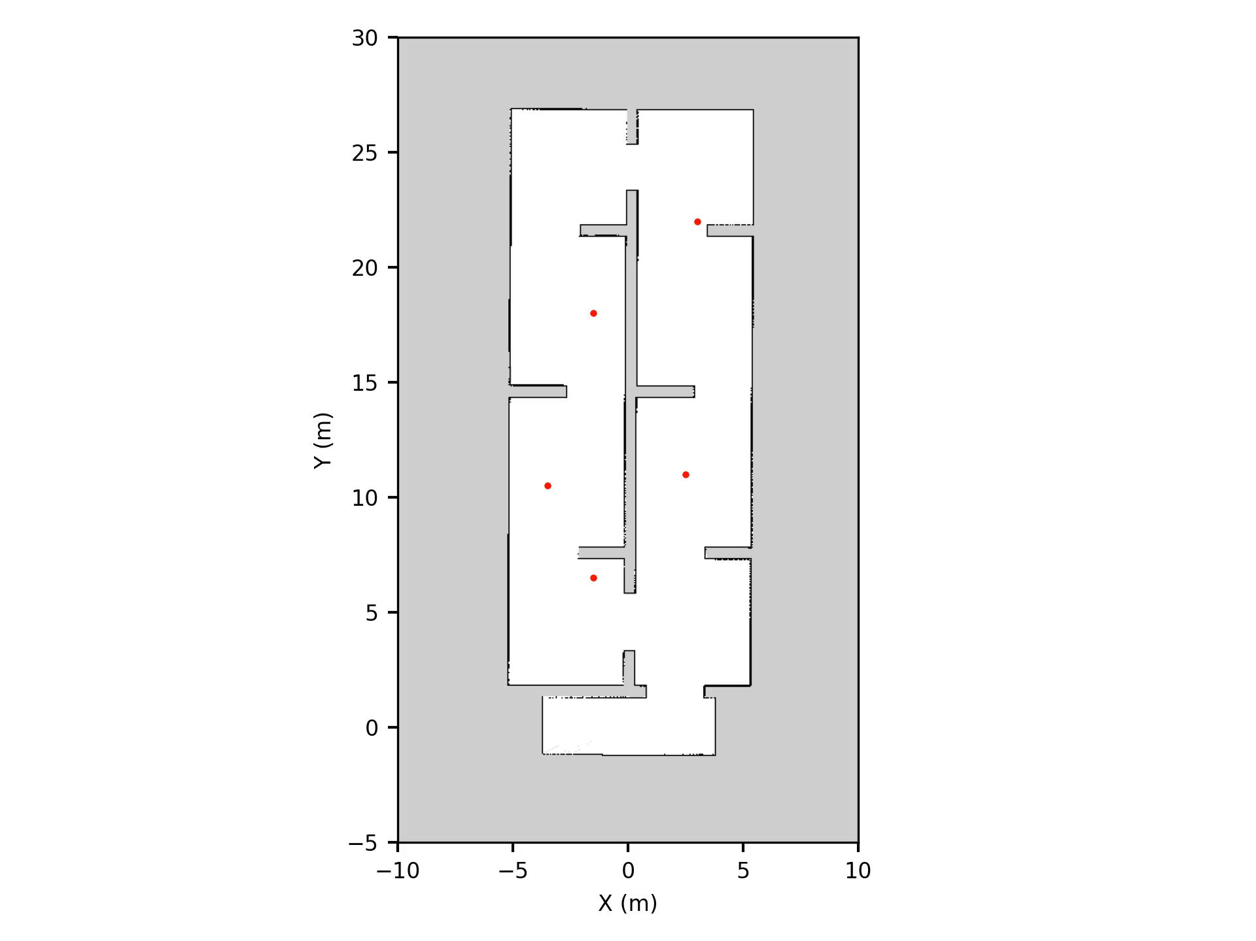
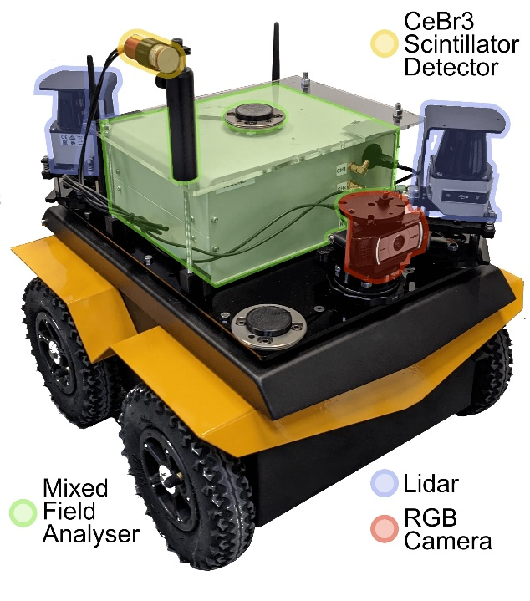
Real Data
Autonomous Exploration

Slide 21
Real Data
Hypothesis:
“A mobile robot with autonomous behaviour to avoid
ionising radiation will reduce its accumulated dose”
Data:
Accumulated dose
Time taken
Avoidance enabled/disabled

Slide 22
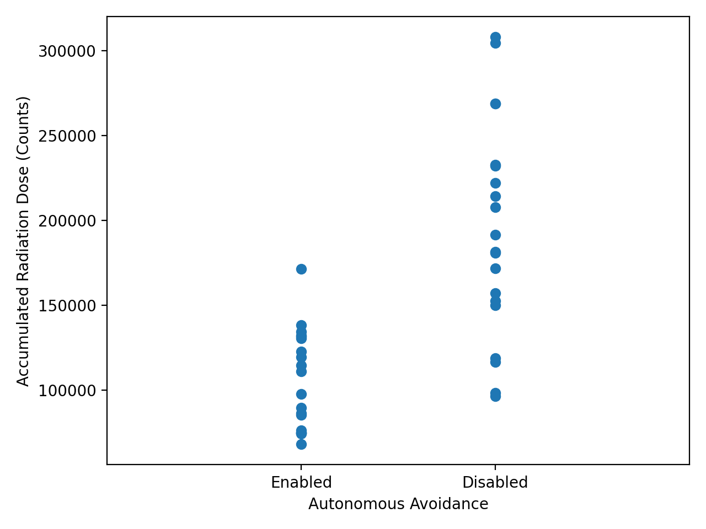
Real Data

Slide 23
Real Data
Ugly!
Can this be better?

Slide 24
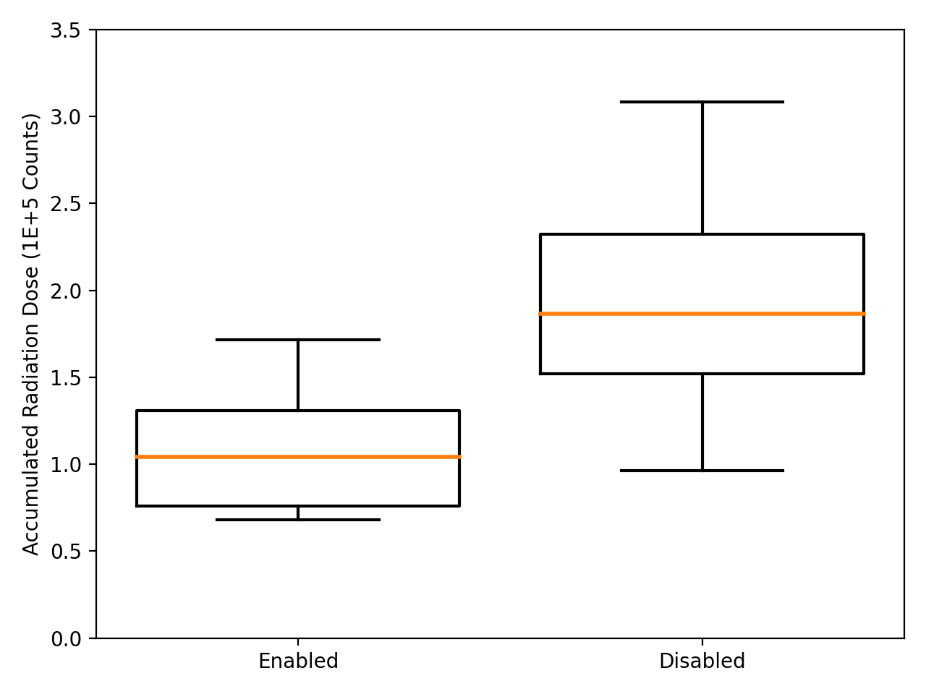
Real Data

Slide 25
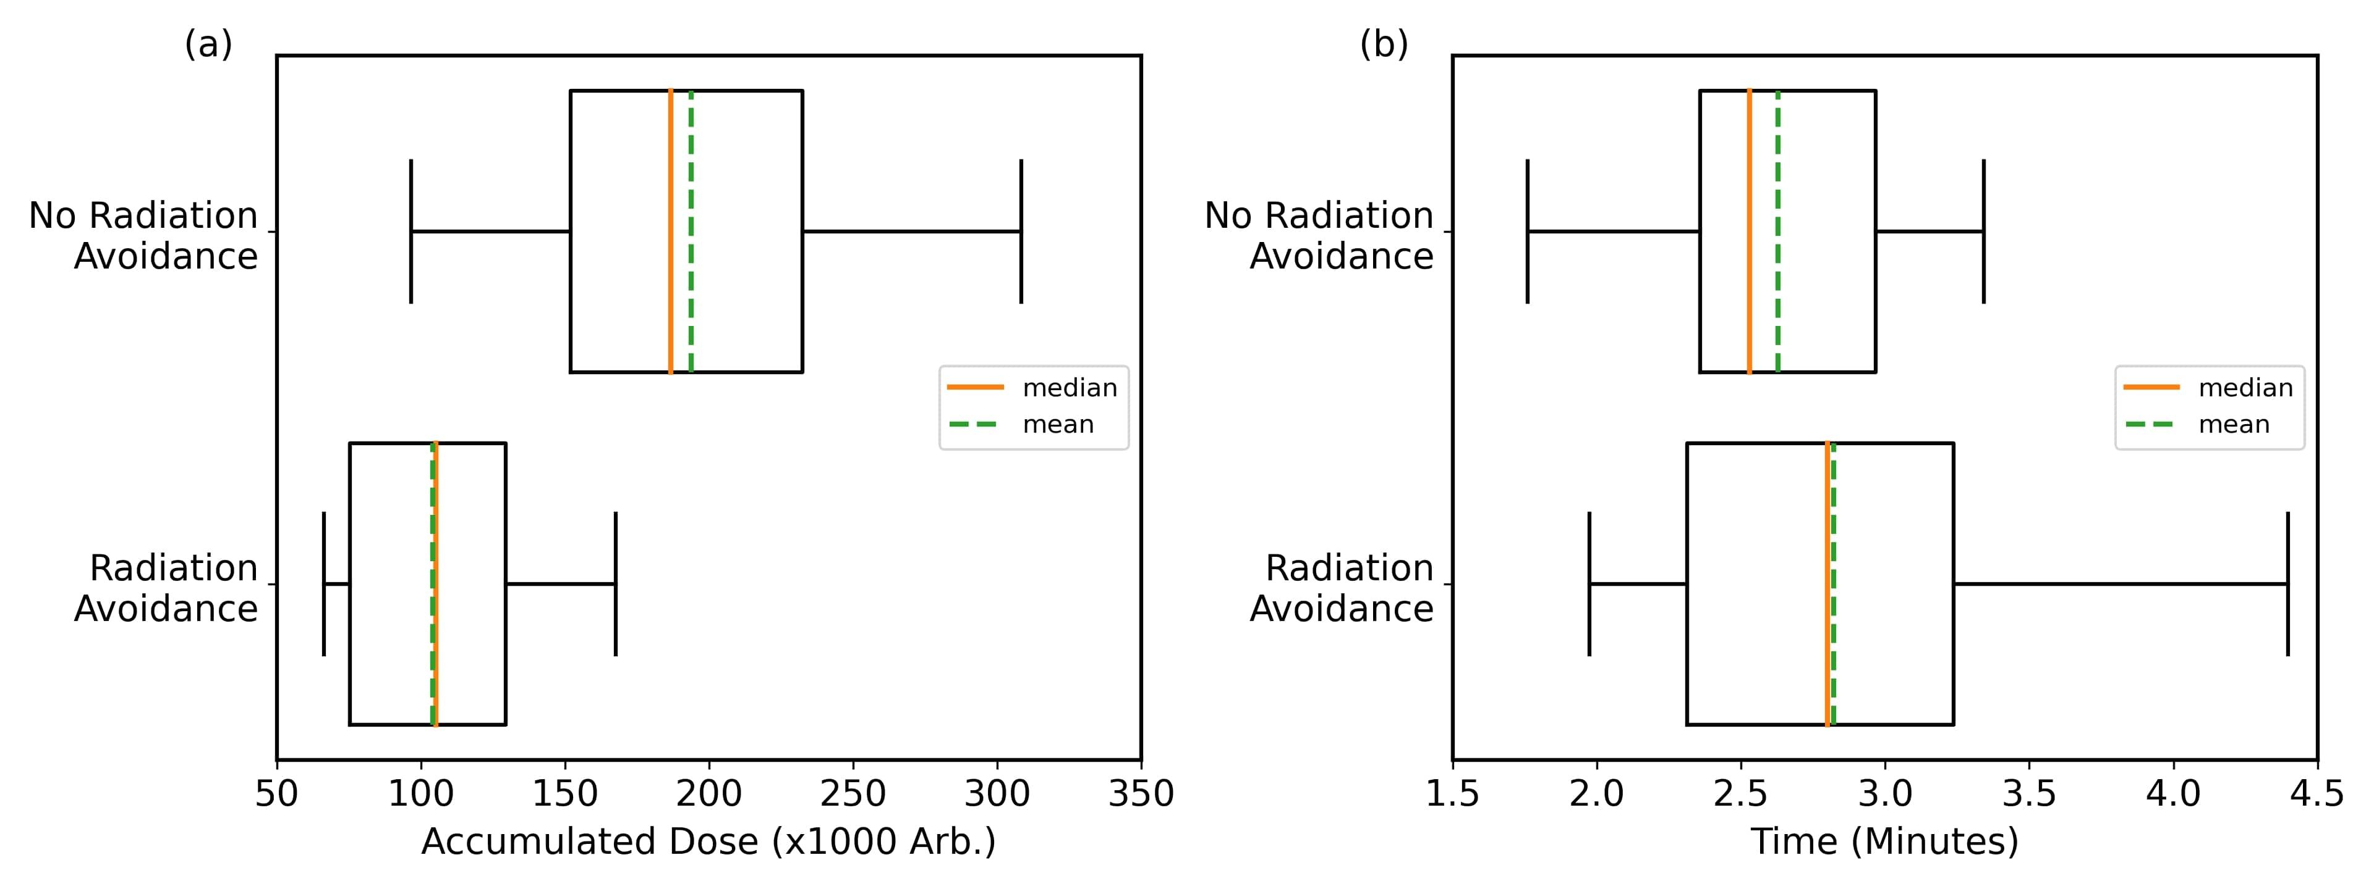
Real Data

Slide 26
Real Data
Hypothesis supported! – Accumulated dose is reduced

Slide 27
Real Data
Hypothesis supported! – Accumulated dose is reduced
But… impact on exploration time

Slide 28
Real Data
Conclusion:
“A mobile robot with autonomous behaviour to avoid
ionising radiation will reduce its accumulated dose,
at the expense of longer mission time”

Slide 29
Real Data
Is this actually the case?
Conclusion:
“A mobile robot with autonomous behaviour to avoid
ionising radiation will reduce its accumulated dose,
at the expense of longer mission time”

Slide 30
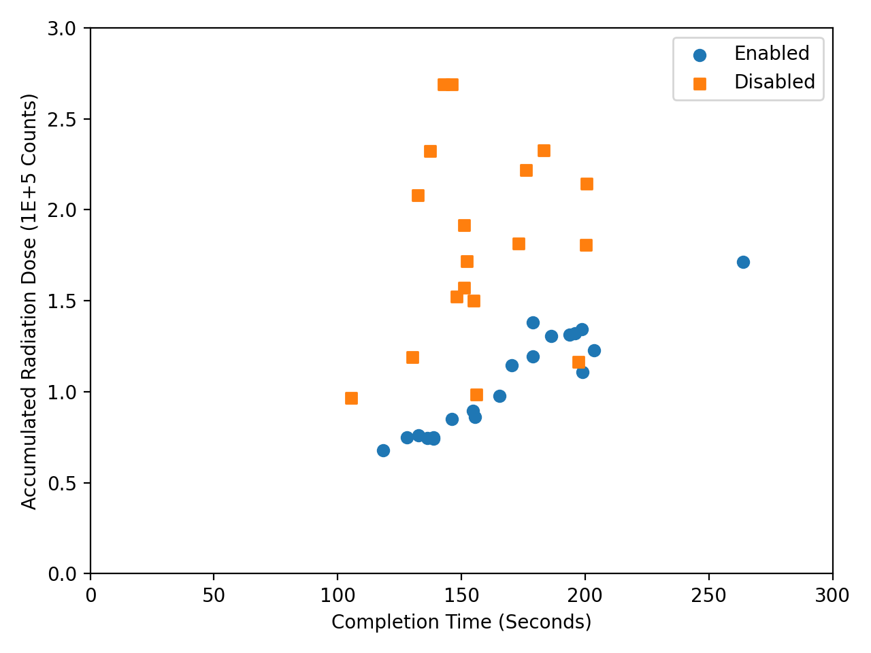
Real Data
Back to scatter plot

Slide 31
Real Data
BETTER VISUALISATION = BETTER INSIGHT
Back to scatter plot
Impact on time not as bad as it seems?

Slide 32
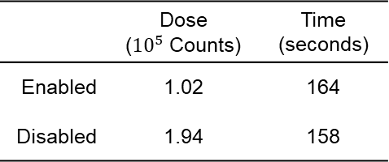
Real Data
BETTER VISUALISATION = BETTER INSIGHT
Back to scatter plot
 | Dose (${10}^{5}$ Counts) | Time (seconds)
Enabled | 1.02 | 164
Disabled | 1.94 | 158
Table 3 – Averaged values with removed outlier
Impact on time not as bad as it seems?

Slide 33
Real Data
Conclusion:
“A mobile robot with autonomous behaviour to avoid
ionising radiation will reduce its accumulated dose,
with minimal impact mission time”

Slide 34
Aesthetics

Slide 35
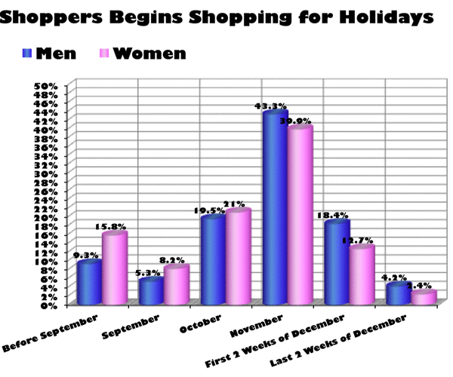
Aesthetics
Declutter as much as possible
Pick a better colour palette
Be intuitive and consistent
Highlight the story

Slide 36

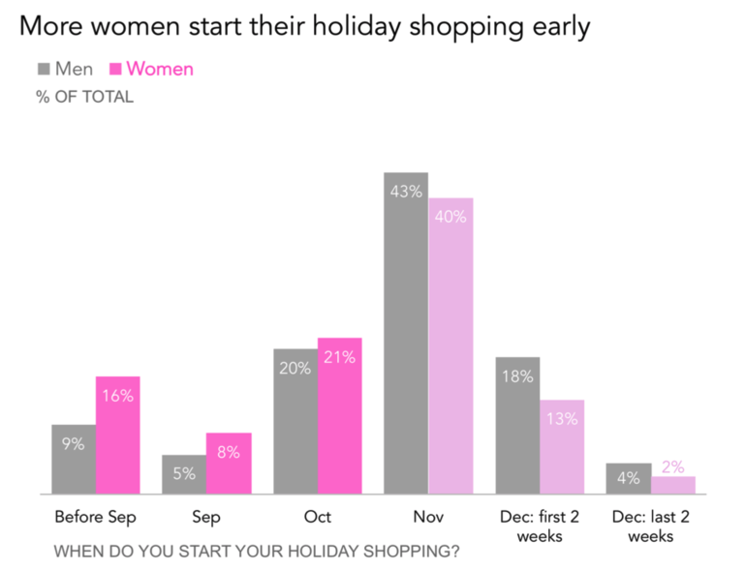
Aesthetics
Before
Declutter as much as possible
Pick a better colour palette
Be intuitive and consistent
Highlight the story
After

Slide 37
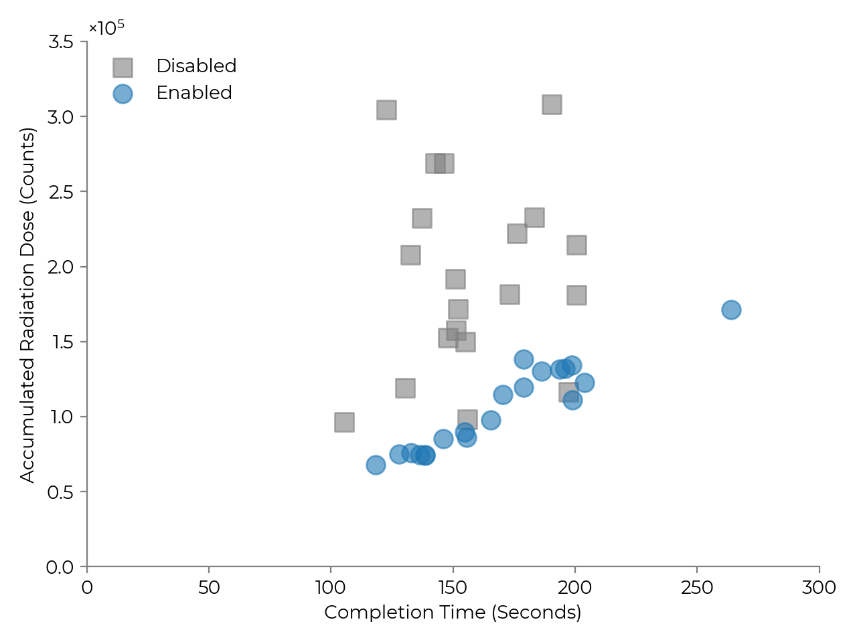
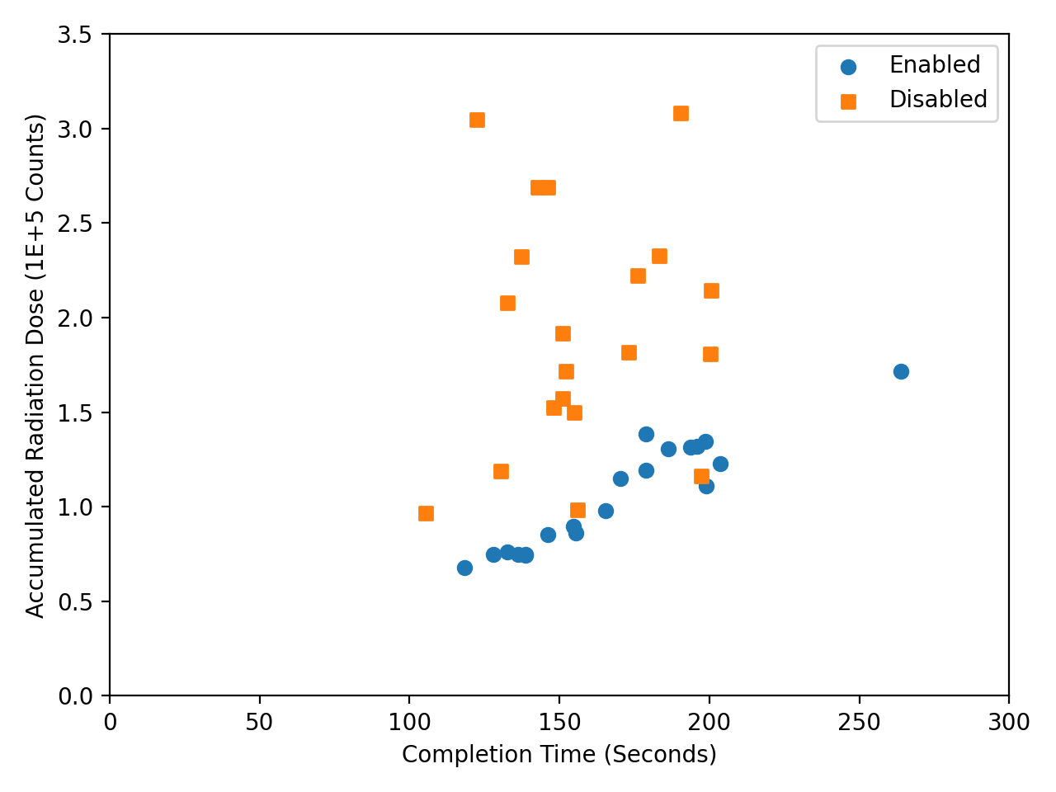
Making Things Pretty

Slide 38
Making Things Pretty
Removed:
Unnecessary marker colour
Unnecessary borders
Changed:
Font (still sans-serif)
Legend position
Axis labels
Marker transparency
Marker size

Slide 39
Final Remarks

Slide 40
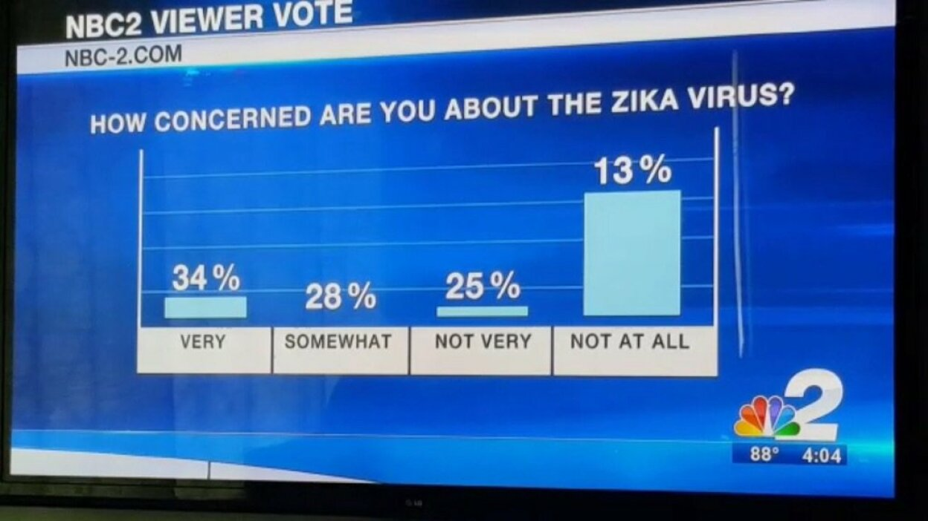
With great power comes great responsibility
People will see what you want them to see…

Slide 41
Ask Yourself…
What message are you trying to communicate?
  What plot(s) would be suitable?
  What channel(s) of the data needs to be highlighted?
  The reader should not have to decipher anything
Is it readable in the expected format?
  Journal vs Presentation vs Web | Colour vs B&W | Image format
Have you kept it simple?
  There is never a good time for 3D plots
Do the visuals tell the story for you?

Slide 42
Thank you for your attention

Slide 43
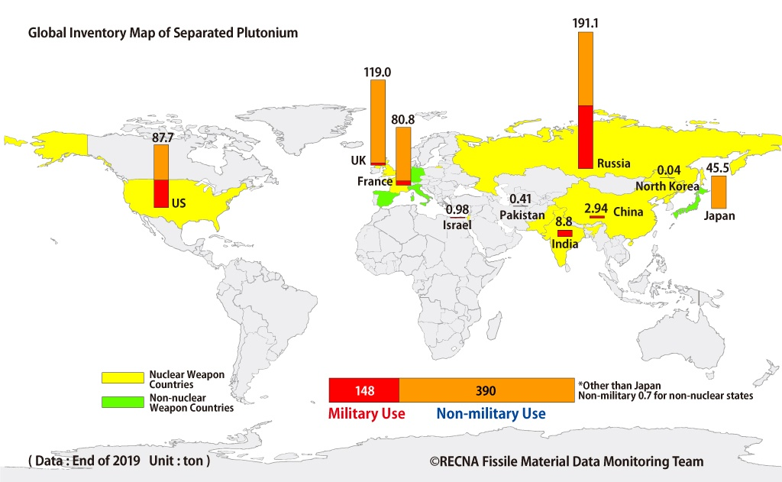
Global Plutonium Stockpiles
Your challenge is to make this data communicate better…
Research Center for Nuclear Weapons Abolition (RECNA) – Nagasaki University
https://www.recna.nagasaki-u.ac.jp/recna/en-fmdata/map-pu-2021

Slide 44
Types of Visualisation
Correlation
Part of a whole
Evolution
Scatter | Heatmap | Connected Scatter
Bubble | Density | Group Scatter
Grouped & Stacked Barplot | Treemap | Doughnut
Pie Chart | Dendrogram | Circular Packing
Line Plot | Area | Parallel
Streamchart | Stacked Area | Time
Ranking
Distribution
Map
Barplot | Spider / Radar | Wordcloud
Parallel | Lollipop | Circular Barplot
Violin | Density | Histogram
Boxplot | Ridgeline | Joint Histogram
Map | Choropleth | Hexbin Map
Cartogram | Connection | Bubble Map
data-to-viz.com

