Slide 1
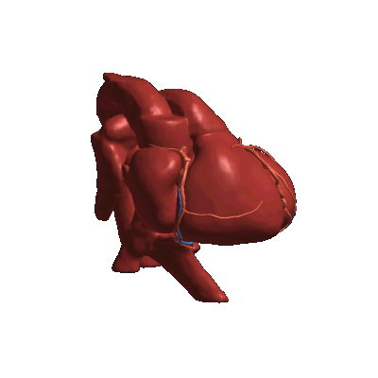
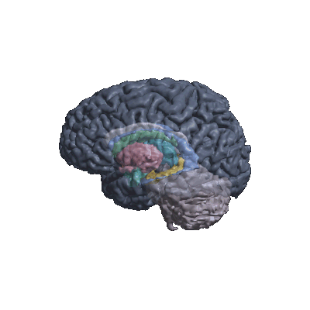
HEALTHCARE & BIOTECH
COR Studio
Guideline-graded 3D heart & brain from patient records.
AI explains, code checks every cited number.
3D heart from CT
TotalSegmentator s0270 · CC BY 4.0
3D brain from MRI
Mindboggle-101 · CC BY 4.0
Decision support for physicians and a transparent analysis tool for researchers.
Not a medical device · no diagnosis · synthetic and open data only.
Rendered from the app's own models · the record decides what changes
Team COR · Bakdaulet O. · Mukhamed K. · Islam K.
Notes:
[0:00-0:08 · 8 s]
Hi, we're team COR. COR Studio grades heart and brain records by guidelines in 3D, and code checks the AI.

Slide 2
THE PROBLEM
0:08 – 0:25
AI can sound right and still be impossible to check
0 / 4
guideline grades right when Claude read the raw records on its own
…and 1 of 6 replies contained an invented number.
First smoke run, 5 cases, 1 run each: a small sample, not a clinical study.
Clinicians
Can't tell a correct grade from an invented number. Which value, which threshold, which guideline?
Researchers
No audit trail when hundreds of records go through a model, so results are hard to reproduce or publish.
Real records
Missing units, incomplete fields, and free-text notes that can carry hidden instructions to the AI.
COR Studio · Healthcare & Biotech · synthetic and open data · not a medical device
2 / 8
Notes:
[0:08-0:25 · 17 s]
AI describes heart studies fluently, but nobody can check where its claims came from. In our first test, Claude alone on raw records got zero of four grades right and invented a number. Records are messy, and notes can hide instructions.

Slide 3
HOW IT WORKS
0:25 – 0:45
Code computes, the AI explains, code checks
Structured record
Echo, CT angiography, ECG, brain MRI volumes. Synthetic patients.
Diagnosis engine
Deterministic TypeScript, no AI. 41 rules, each with a threshold and a guideline DOI.
Claude explains
Gets only the engine result, never the raw record or its notes.
Code guard
Every number and [R#] citation must match the engine, or the reply is blocked.
3D heart & brain
The view moves to the finding being discussed.
Output for every case: findings · differential · missing data · red flags
Covered: aortic stenosis incl. low-gradient (ACC/AHA 2020) · regurgitation & prolapse · LV function & size (ASE/EACVI 2015, ESC 2021, AHA/ACC/HFSA 2022) · chambers · coronary (CAD-RADS 2.0) · ECG & QTc · brain atrophy vs published ageing and Alzheimer's ranges
Safety: red flags only ever say "urgent specialist review". Missing data is listed, never guessed.
COR Studio · Healthcare & Biotech · synthetic and open data · not a medical device
3 / 8
Notes:
[0:25-0:45 · 20 s]
So code does the grading: 41 rules, each with a threshold and a guideline DOI, no AI. Claude only explains that result and never sees the raw record. Code checks every number and citation before a reply is shown, and the 3D view follows.

Slide 4
RESULTS
0:45 – 1:00
Same cases, split roles, different outcome
Claude alone, raw record
0 / 4 grades right
1 / 6 replies with an invented number
5 / 6 replies passed the guard
Engine + Claude + guard
4 / 4 grades right
0 / 6 replies with an invented number
6 / 6 replies passed the guard
Engine alone
94 / 94
rule cases match the expected grade
0
changes to the result from injected text
102
open, sourced test cases for anyone to benchmark their own AI
Honest limits: the end-to-end numbers come from a first smoke run (5 cases, 1 run each). All cases are synthetic and written by us. This is not clinical validation.
COR Studio · Healthcare & Biotech · synthetic and open data · not a medical device
4 / 8
Notes:
[0:45-1:00 · 15 s]
With that split: four of four grades right, nothing invented, every reply passed the check. These are our own synthetic cases, not clinical validation.

Slide 5
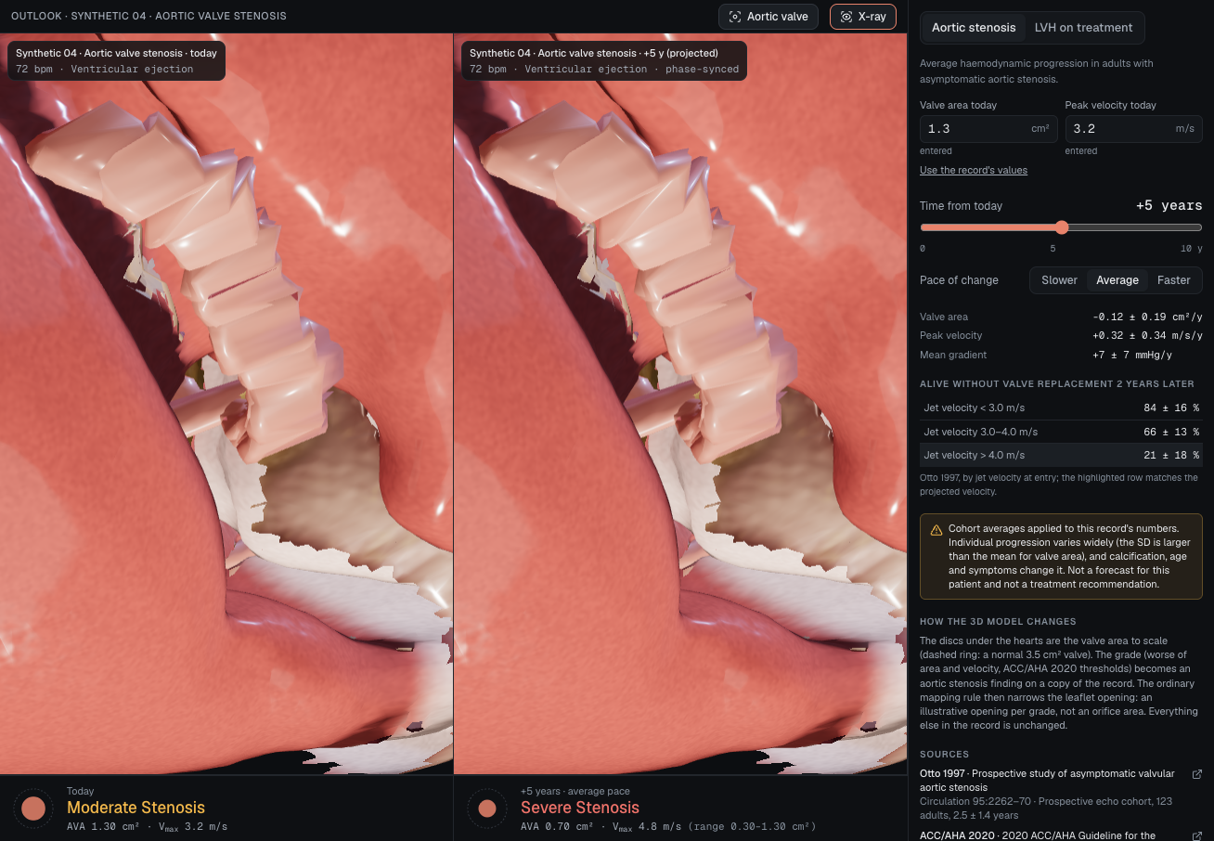
LIVE DEMO · 40 S
1:00 – 1:40
One synthetic patient, end to end
1
Grade & ask 15 s
Synthetic 04 (aortic stenosis): moderate, with rule id + DOI. "Why moderate?" The view jumps to the valve; the answer cites [R#].
2
Outlook 12 s
+5 years: cohort average with a range. Not a forecast for this patient.
3
Brain 13 s
Hippocampus volume vs published ageing ranges, with linked MRI slices.
On screen: synthetic patient · data sources credited · not a medical device. Backup recording ready.
Backup screenshot: Outlook, Synthetic 04, today vs +5 years (cohort average)
COR Studio · Healthcare & Biotech · synthetic and open data · not a medical device
5 / 8
Notes:
[1:00-1:40 · 40 s · LIVE DEMO]
Say first: 'Everything you'll see is a synthetic patient; data sources are credited on screen.'
1. Open Synthetic 04 (aortic stenosis): graded moderate with rule + DOI. Ask 'Why is this moderate?' and the view jumps to the valve with an [R#] citation. (15 s)
2. Outlook at +5 years: cohort average with a range, labelled 'not a forecast for this patient'. (12 s)
3. Brain: hippocampus volume vs published ageing ranges, with linked MRI slices. (13 s)
If anything stalls, switch to the backup recording. Don't debug on stage.

Slide 6
DATA & ETHICS
1:40 – 2:05
Where the data comes from, and its limits
Behind a login?
No. Only datasets published for reuse with no registration. Gated and registration-only sets were left out.
Terms & licences?
Licence checked before every source (team rule). TotalSegmentator v1, Mindboggle-101, Rodero 2021: CC BY 4.0. BodyParts3D: CC BY-SA.
Official export, not scraping?
Official dataset releases (Zenodo, OSF). No site is scraped. Guidelines: our own rule summaries + DOI, no copied text.
Personal info?
No real patients; all records are synthetic. Open imaging is de-identified by its publishers. The AI never gets the raw record.
Credit & link back?
The viewer names the dataset and licence (e.g. "Healthy adult volunteer · CC BY 4.0"). Every finding links its guideline DOI.
Changes later?
Dataset versions are pinned. Each rule names its guideline + year. When a guideline changes, we update the rule and boundary tests show what moved.
Limits we state in the demo: not a medical device, gives no diagnosis · red flags only say "urgent specialist review" · outlook = cohort averages with ranges, never an individual forecast · one 3D template is illustrative and is labelled that way.
COR Studio · Healthcare & Biotech · synthetic and open data · not a medical device
6 / 8
Notes:
[1:40-2:05 · 25 s]
Our ethics in one slide. Nothing behind a login, nothing scraped: only official, openly licensed releases, licence checked first. No real patients, and the AI never sees the raw record. Every dataset and guideline is credited on screen, and when a guideline changes, our tests show what moved.

Slide 7
BUILT WITH KIRO
2:05 – 2:20
Spec-first, so every number traces to a source
Specs
diagnosis-engine: 12 EARS requirements, 41 rule ids, each with a DOI
assistant-chat: run task by task (44 recorded executions)
One shared contract (types.ts) on day one, so we built in parallel
Steering
Always on: the "not a diagnosis" boundary, folder ownership
Engine-only: never read free text, no digits without evidence
On request: how to verify a guideline threshold
Hooks & tests
Engine tests run on save; data dictionary regenerates
Boundary tests on both sides: Vmax 3.99/4.00, EF 40/41, QTc 449/450
Property tests found a real AS staging bug before it shipped
Everything Kiro used is committed in .kiro/: specs, steering, hooks. Kiro Web also ran the pull → typecheck → test → push loop.
COR Studio · Healthcare & Biotech · synthetic and open data · not a medical device
7 / 8
Notes:
[2:05-2:20 · 15 s]
We built it spec-first with Kiro: a spec each, one shared contract, every threshold tested on both sides, and property tests that caught a real bug.

Slide 8
WHAT'S NEXT
2:20 – 2:30
From demo to something clinicians can trust
Next steps
Clinician review of every rule and threshold
Full evaluation: all 102 cases, both models, 3 runs
Management options: only the verified ones (1 of 12 so far)
More guidelines, each with a verified threshold table
For researchers, today
Grade whole cohorts the same way every time, with an audit trail
Benchmark your own AI on 102 open, sourced cases
Flag incomplete datasets: each missing field and why it matters
Teach guideline grading with every threshold visible
COR Studio · the AI explains, code checks every number. Thank you!
COR Studio · Healthcare & Biotech · synthetic and open data · not a medical device
8 / 8
Notes:
[2:20-2:30 · 10 s]
Next: clinician review and a full evaluation. COR Studio: the AI explains, code checks every number. Thank you.

