Slide 1

SATAL Survey
[CLASS + NUMBER]
Please provide your perspective to improve your class experience!

Slide 2
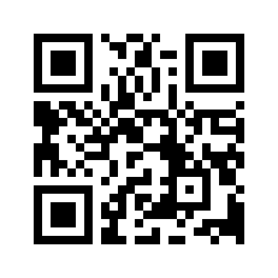
Individual Survey
Good Example:
“Homework provides a good practice to lecture topics”
Bad Example:
“Homework is Good”
Tiny url

Slide 3
Group Survey
Tiny url

Slide 4
What helps your learning?

Slide 5
What Suggestions do you have for your instructor?

Slide 6
What actions will you take to improve your learning?

Slide 7
Thank you!
Contact: asignorini@ucmerced.edu
If you have further comments and questions,or want to recommend SATAL in any other class.

