Slide 1
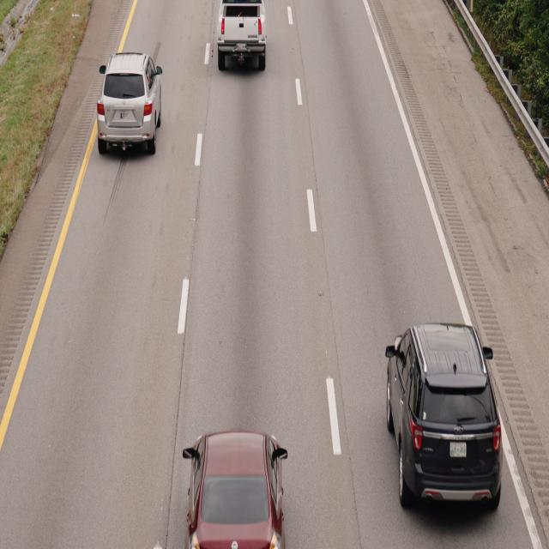
Task 1 Capture Image or Existing Dataset
import time
import picamera
# Initialize the camera
camera = picamera.PICamera()
# Set image resolution
camera.resolution = (640, 480)
# Wait for the camera to initialize
time.sleep(2)
# Capture image and save to file
camera.capture('traffic_image.jpg')
print("Image Captured!")
camera.close()

Slide 2
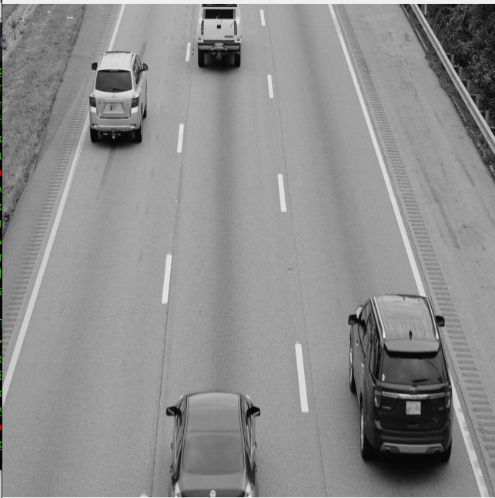
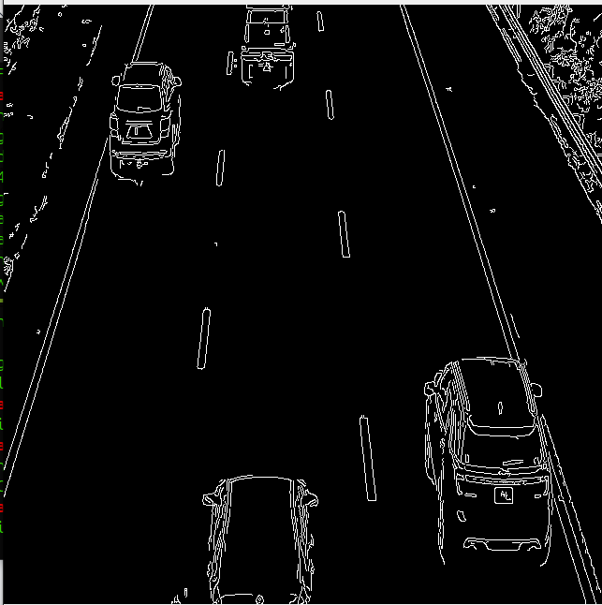
Task 2 Apply grayscale conversion and edge detection
import cv2
import os
# Folder containing your images
image_folder = 'dataset_test/'
# List all images in the folder
image_files = os.listdir(image_folder)
# Loop through all images in the folder
for image_file in image_files:
# Check if the file is an image
if image_file.endswith('.jpg') or image_file.endswith('.png'):
# Load the image
image_path = os.path.join(image_folder, image_file)
image = cv2.imread(image_path)
# Convert to grayscale
gray_image = cv2.cvtColor(image, cv2.COLOR_BGR2GRAY)
# Apply Canny edge detection
edges = cv2.Canny(gray_image, 100, 200)
# Display the edge-detected image
cv2.imshow(f"Edges: {image_file}", edges)
cv2.waitKey(0)
# Close all OpenCV windows
cv2.destroyAllWindows()

Slide 3
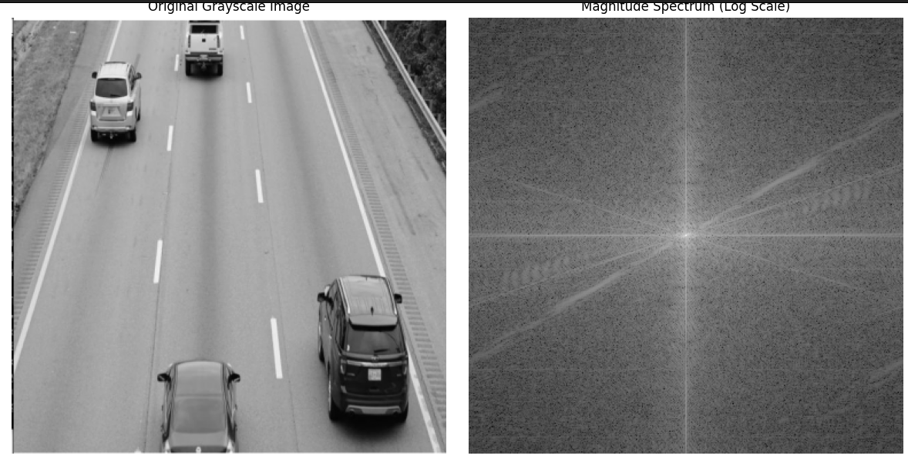
Task 3 Fourier Transforms to analyze pattern
import numpy as np
import cv2
from scipy.fft import fft2
import matplotlib.pyplot as plt
# Load the image in grayscale mode
gray_image = cv2.imread('grayimage.png', cv2.IMREAD_GRAYSCALE)
# Check if image is loaded properly
if gray_image is None:
raise FileNotFoundError("Image 'grayimage.png' not found or could not be loaded.")
# Perform 2D Fourier Transform on the grayscale image
f_transform = fft2(gray_image)
# Shift the zero-frequency component to the center
fshift = np.fft.fftshift(f_transform)
# Get the magnitude spectrum
magnitude_spectrum = np.abs(fshift)
# Display the magnitude spectrum
plt.imshow(np.log(magnitude_spectrum + 1), cmap='gray')
plt.title('Magnitude Spectrum')
plt.axis('off')
plt.show()

