Slide 1
Baker Group <> Infleqtion
Exploration Direction and Potential Challenges
Sayam Sethi, Maxwell Poster, Aditi Awasthi
Jonathan Baker

Slide 2
Summary
Generate the circuit that we want to run without being “hacky”
  Ideally the circuit should not optimize anything across the oracle
  No mid-circuit measurements
Explore different Quantum Error Detection (QED) codes and compute efficient implementations of logical operations
Once we have 1 and 2 working, perform mapping and compilation in the joint search space

Slide 3
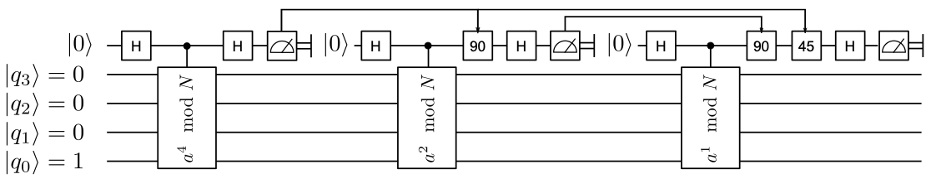
Circuit Generation
The circuit from [1] has conditional gates on the control
Not (currently) supported on the NA architecture
One trick might be post-select only one branch of the measurement
  But this still needs more qubits
  Is this considered a hack?
Needs further exploration to find an n-qubit g-depth circuit with smallest n, g

Slide 4
Quantum Error Detection Space Exploration
There is no well-known method to explore the space of QED codes for their logical operations
Works by D. Gottesman (https://arxiv.org/abs/quant-ph/9705052) and M. Wilde (https://arxiv.org/abs/0903.5256) have proposed techniques to search for logical operations
Plan is to translate these techniques to an algorithmic search
  For the current constraints, a brute force search should also work
  However, it needs to be verifiable
In the long term, this can translate to a direction of efficient code space exploration

Slide 5
Some Questions Regarding the Shor Circuit
Is the output of the measurement on the first qubit always 50%?
How sensitive is this measurement to errors on the other qubits?
  It should depend on the oracle
If the measurement results are biased one way more than the other, would it be okay to only post-select the more probable branch?

Slide 6
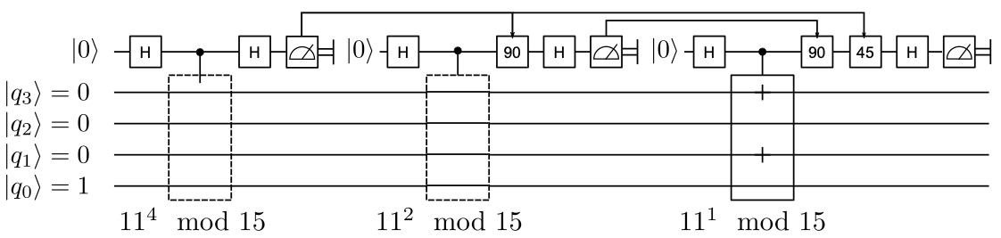
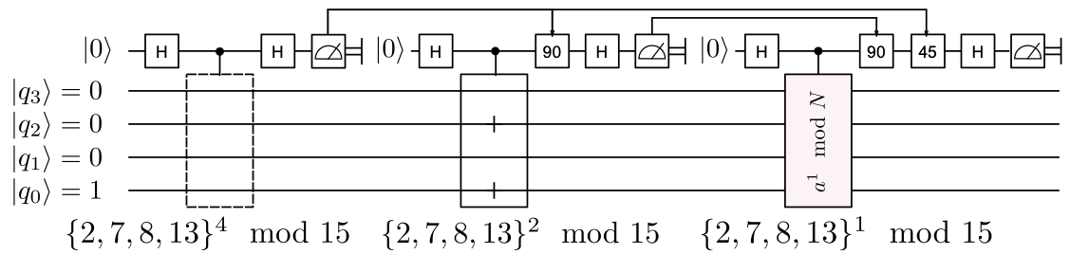
Some Questions Regarding the Shor Circuit

Slide 7
Estimates on Number of Shots Needed
“Errors” can arise due to:
  Assumed measurement result of first qubit
  Noise in system during gate execution
  Faulty preparation of resource states
  Measurement errors

Slide 8
Estimates on Number of Shots Needed
“Errors” can arise due to:
  Assumed measurement result of first qubit
Assuming a 50% success rate, this requires ~2³ = 8 shots.

Slide 9
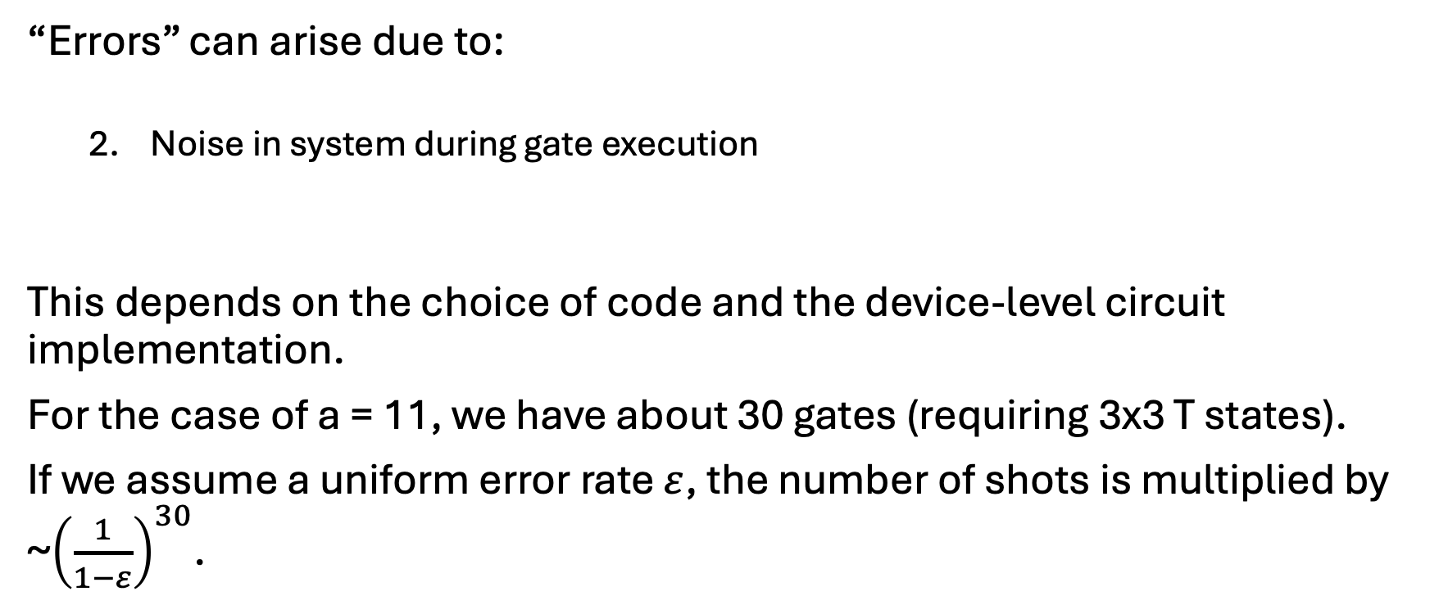
Estimates on Number of Shots Needed
“Errors” can arise due to:
  Noise in system during gate execution
This depends on the choice of code and the device-level circuit implementation.
For the case of a = 11, we have about 30 gates (requiring 3x3 T states).
If we assume a uniform error rate $ε$, the number of shots is multiplied by ~${\left(\frac{1}{1−ε}\right)}^{30}$.

Slide 10
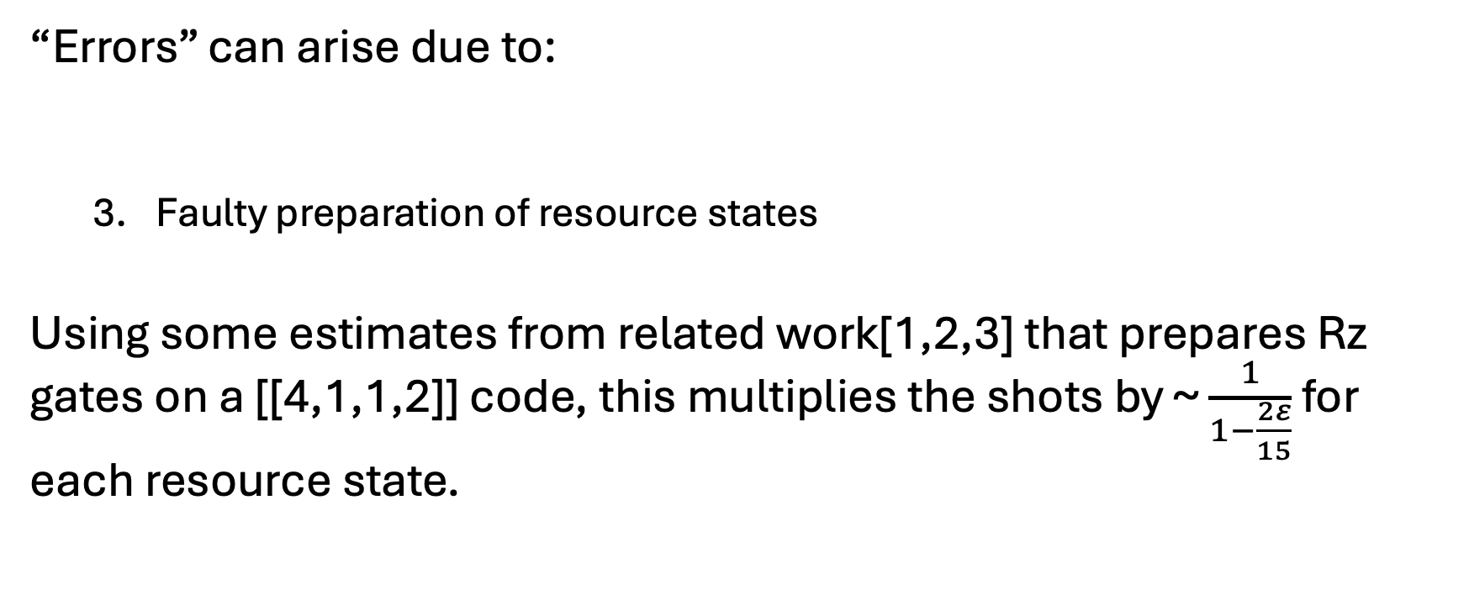
Estimates on Number of Shots Needed
“Errors” can arise due to:
  Faulty preparation of resource states
Using some estimates from related work[1,2,3] that prepares Rz gates on a [[4,1,1,2]] code, this multiplies the shots by ~ $\frac{1}{1−\frac{2ε}{15}}$ for each resource state.
[1] https://doi.org/10.1103/PRXQuantum.5.010337
[2] https://doi.org/10.48550/arXiv.2303.17380
[3] https://doi.org/10.1145/3676641.3716018

Slide 11
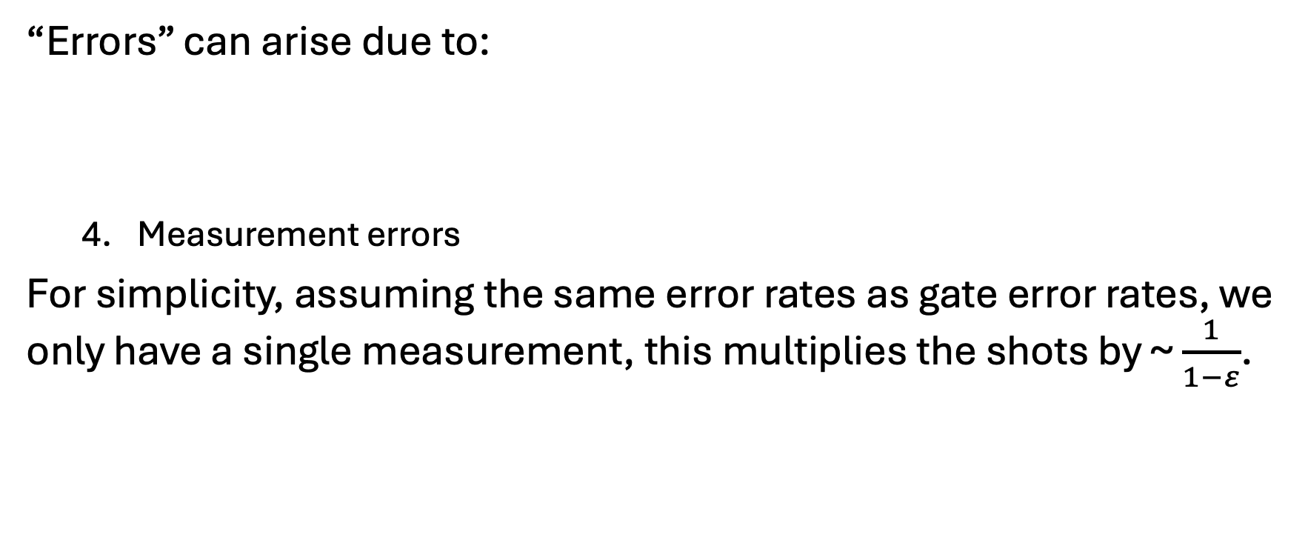
Estimates on Number of Shots Needed
“Errors” can arise due to:
  Measurement errors
For simplicity, assuming the same error rates as gate error rates, we only have a single measurement, this multiplies the shots by ~ $\frac{1}{1−ε}$.

Slide 12
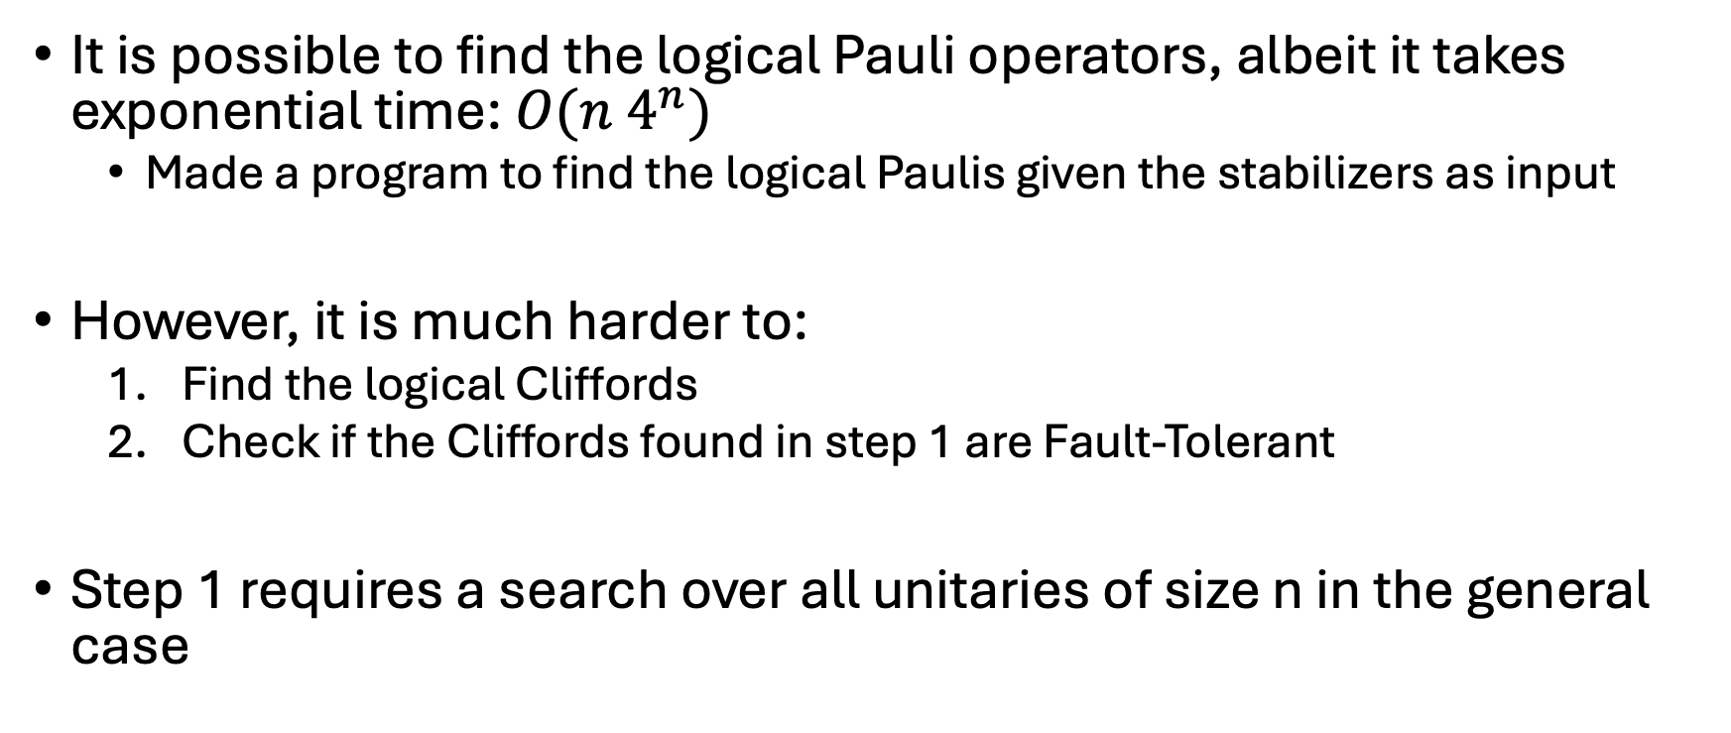
Logical Operators
It is possible to find the logical Pauli operators, albeit it takes exponential time: $O(n 4^{n})$
  Made a program to find the logical Paulis given the stabilizers as input
However, it is much harder to:
  Find the logical Cliffords
  Check if the Cliffords found in step 1 are Fault-Tolerant
Step 1 requires a search over all unitaries of size n in the general case

Slide 13
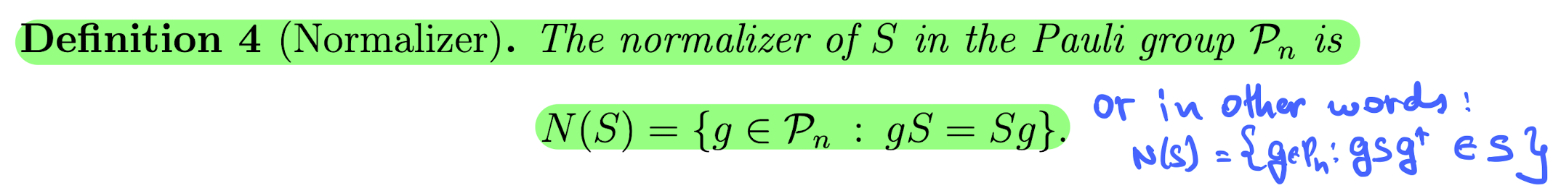
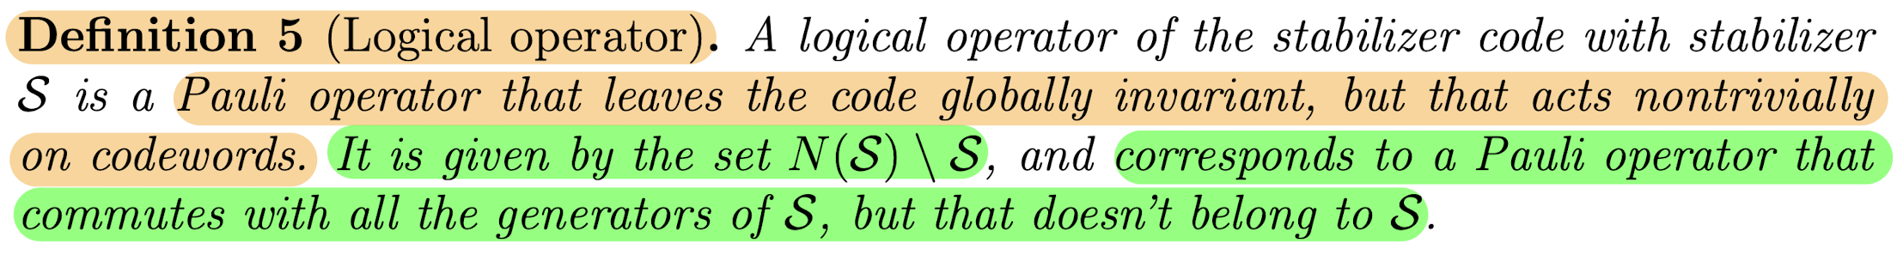
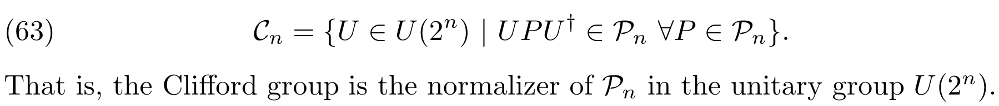
Logical Operators

Slide 14
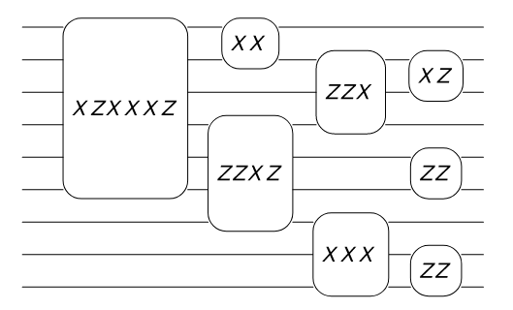
Logical Operators
Alternatively, since finding the Paulis is easy, we can design surgery-like techniques + state injection for arbitrary gates
However, this requires either:
  Intermediate measurements which is not supported
  Exponential blowup in post-selection

Slide 15
What can we do instead?
When trying to find logical Cliffords, we can restrict ourselves to only Clifford operations
For now, we can ignore FT and just find logical operations
This is still exponential, but the search space will be discrete so it should work for smaller [[n, k, d]]

Slide 16
Resources and Questions
Generalized Shor’s for any n:
  How does it work?
  Examples?
Error model?
  If we can simulate the error properties, should be possible to guide our search to minimize errors despite being non-FT
  Is it enough to minimize 2-qubit gates?

Slide 17
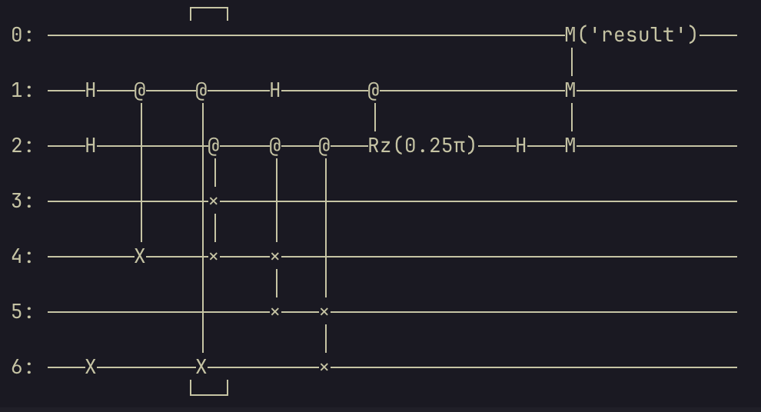
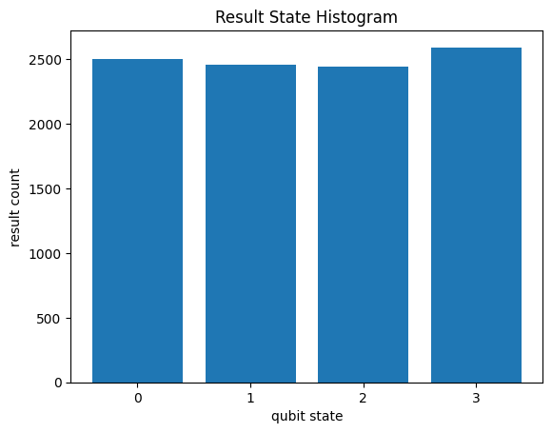
Shor’s Algorithm Circuit for N = 15, a = 2
Circuit is slightly optimized by ignoring the first step of the oracle

Slide 18
Shor’s Algorithm Circuit for N = 15, a = 2
Compiling this to the “CZTargetGateset” (cirq) gives a depth of 59.
This gateset has GR gates, CZ gates and PhaseXZ gates
  This is still more generic than what is supported
If we disallow parallel gate execution, the depth goes up to ~90.

Slide 19
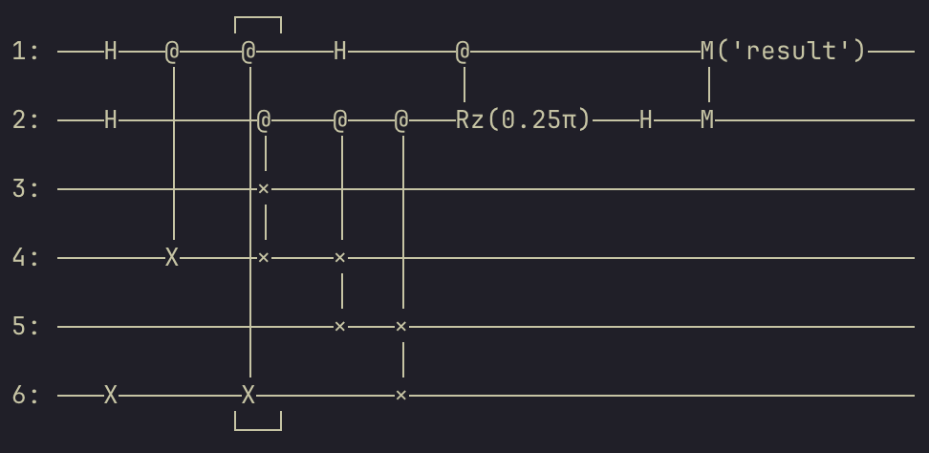
Shor’s Algorithm Circuit for N = 15, a = 2
Since we have 6 qubits in the circuit, we first start with the [[8, 6, 2]] code to analyse the depth/operations needed
The codeqraft compiler required making an API call and the compiler wasn’t open-source

Slide 20
Compilation to [[8, 6, 2]] Code
Ignoring FT and assuming all-to-all connectivity, we get a circuit with 686 gates (on compilation with superstaq).
Out of this, 219 are CZ, 254 are GR and 213 are Rz gates.

Slide 21
Caveats
All-to-all connectivity assumption
Sub-optimal compilation pipeline (superstaq <-> cirq <-> qiskit)
Would it be possible to get access to the non-free trial of superstaq?
Suggestions for optimal compilation pipeline are welcome

Slide 22
Next Steps
Impose connectivity constraints
Look at the tradeoff on converting
[[8, 6, 2]] -> 2 x [[6, 4, 2]] -> 3 x [[4, 2, 2]]

Slide 23
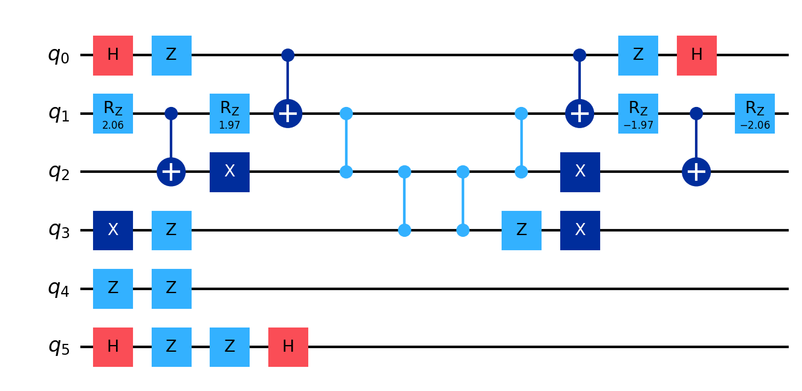
Physical Error Rate Requirements for Iceberg
Executed circuit C followed by C^\dag (with optimizations off)
The output should be the all-0 state

Slide 24
Physical Error Rate Requirements for Iceberg
Used a Pauli noise model with equal probabilities of X, Z and Y.
Qubit initialization error probability (reset) = 3%
Qubit readout error probability (measure) = 3%
1-qubit gate error probability = 0.1%
2-qubit gate error probability = 1%
All error rates are multiplied with “alpha” to see how iceberg compares against physical compilation

Slide 25
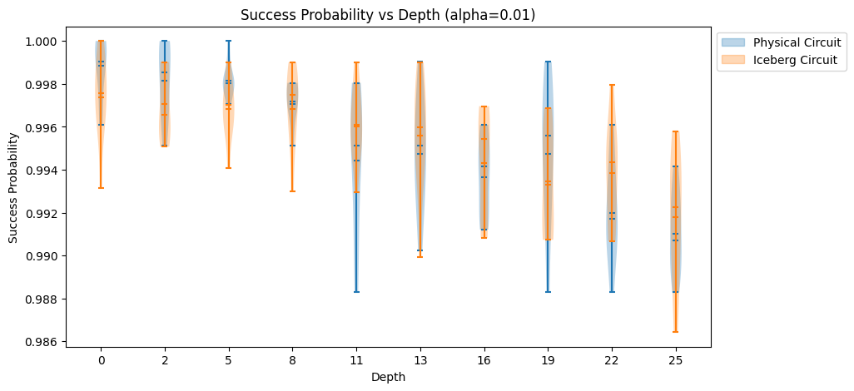
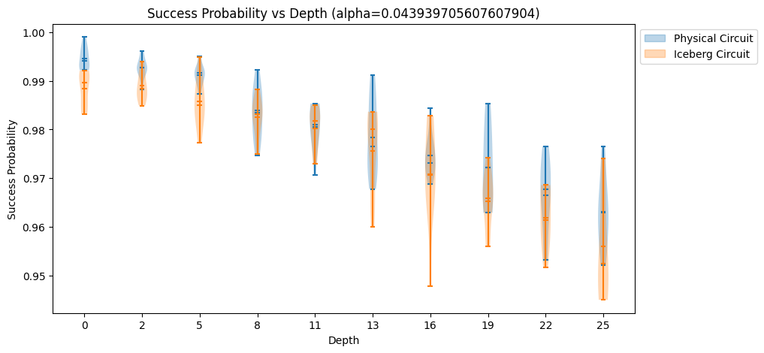
Physical Error Rate Requirements for Iceberg

Slide 26
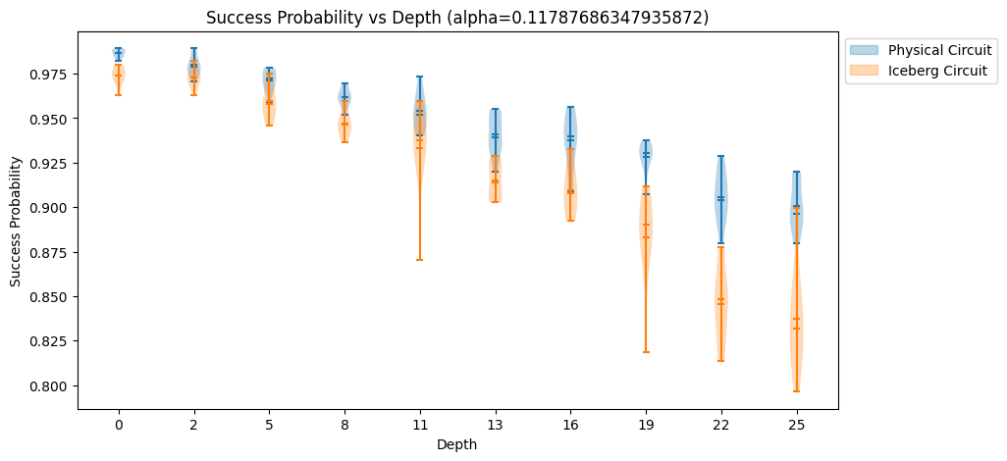
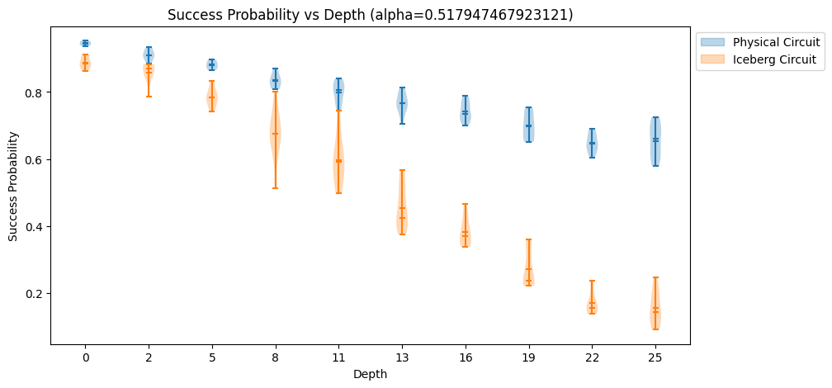
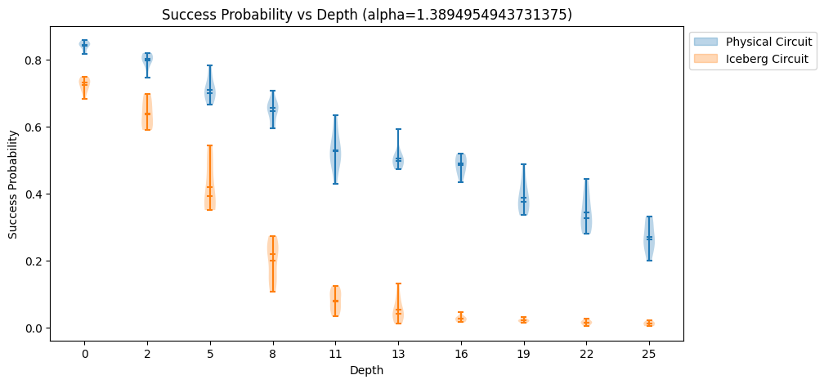
Physical Error Rate Requirements for Iceberg

Slide 27
Physical Error Rate Requirements for Iceberg
Iceberg begins underperforming physical compilation for
alpha > 0.04. This corresponds to the following error rates:
  Qubit initialization error probability (reset) = 0.12%
  Qubit readout error probability (measure) = 0.12%
  1-qubit gate error probability = 0.004%
  2-qubit gate error probability = 0.04%

Slide 28
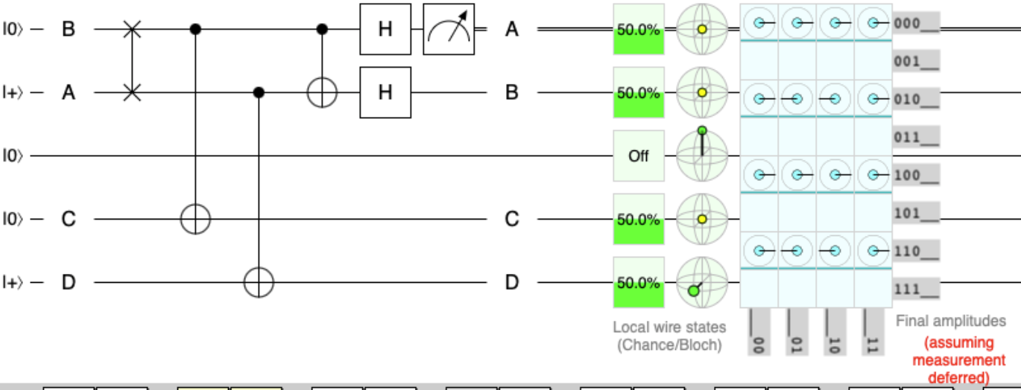
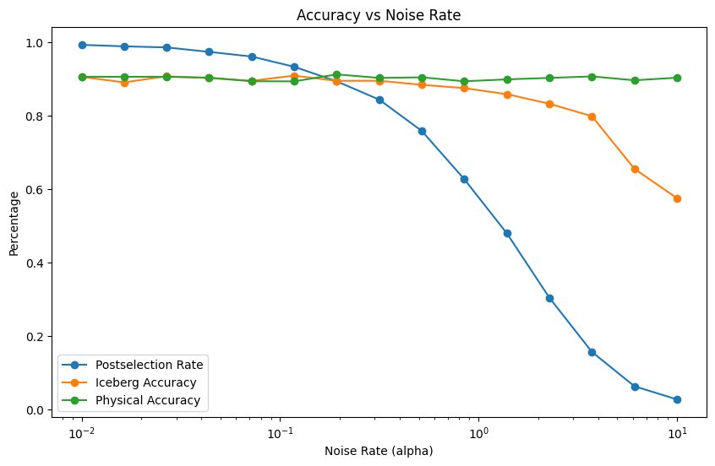
Implementing Hadamard Test using [[4, 2, 2]]

Slide 29
Questions
What about the movement that is needed for the final decoding step?
What is the difference between version 1 and 2 of the circuits?

Slide 30
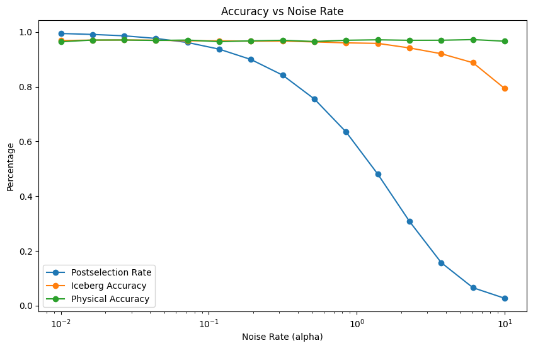
Correction/Update from Last Week
The output shown last week was an artifact of low shot rate coupled with low post-selection success

Slide 31
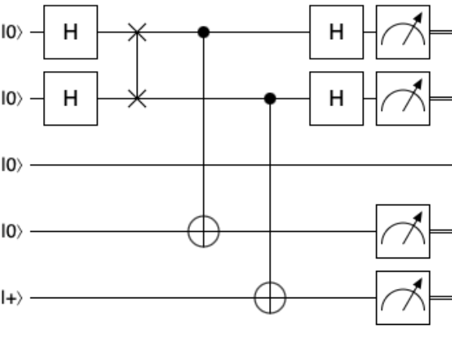
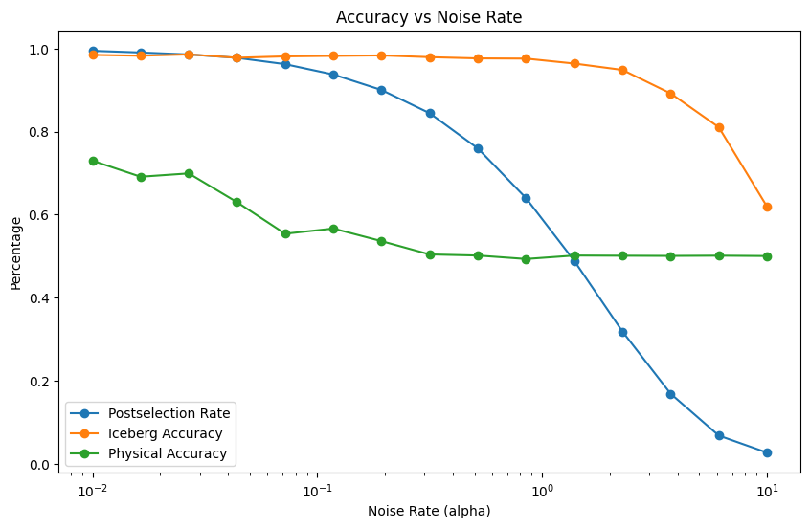
Second version of Hadamard Test
Expected output is uniform superposition over qubits 1, 3, 4 but qubit 2 is always in the 0 state.

Slide 32
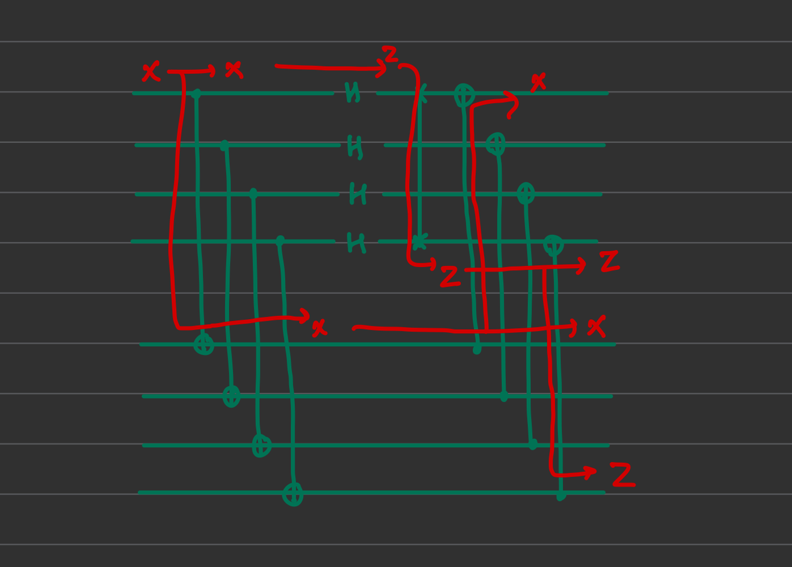
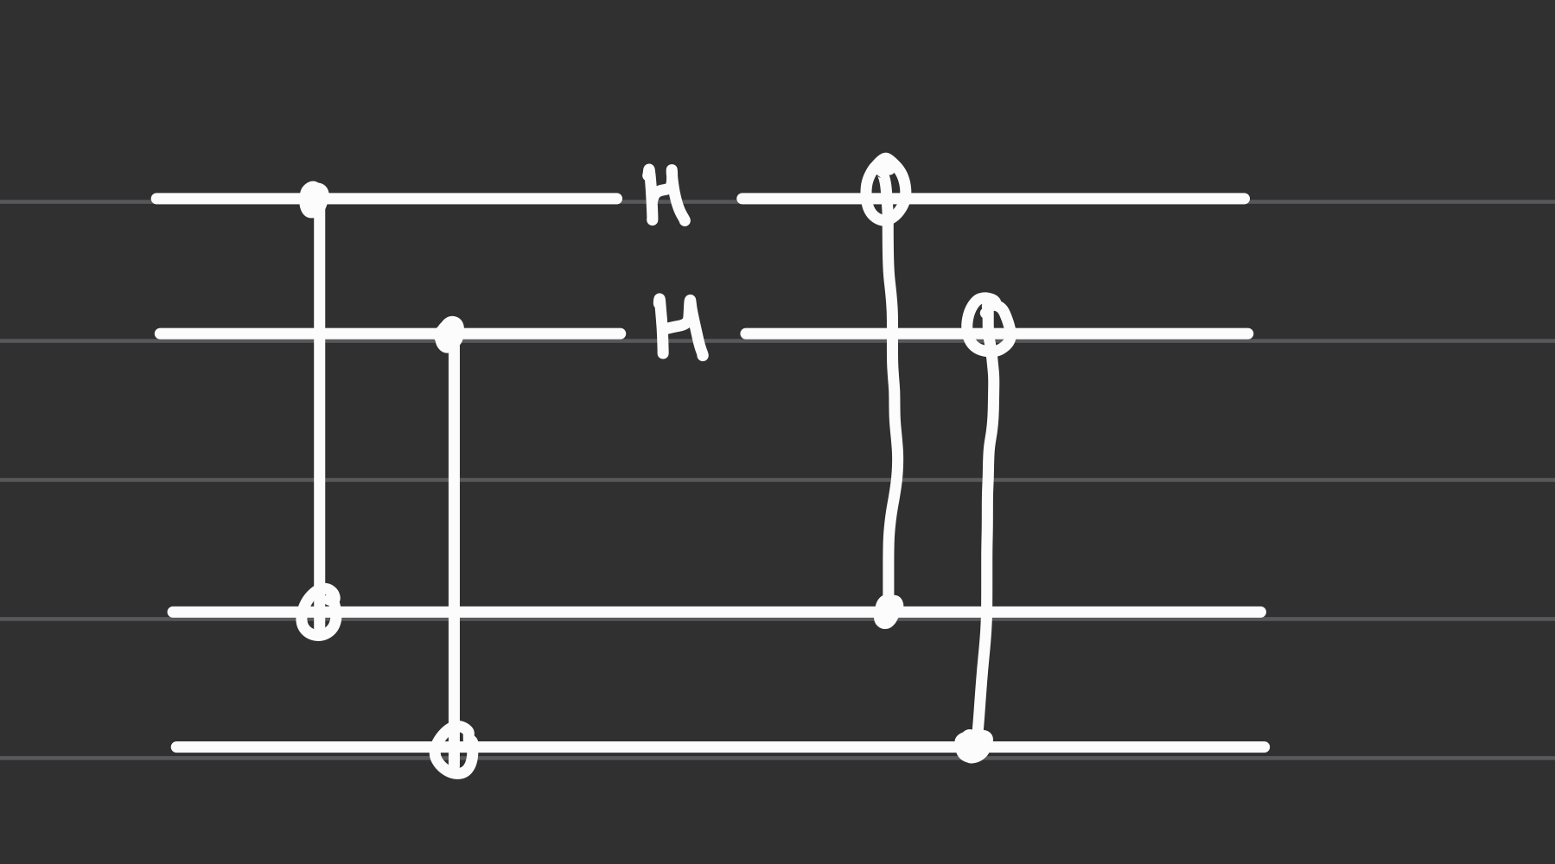
How to enforce Fault-Tolerance?

