Slide 1
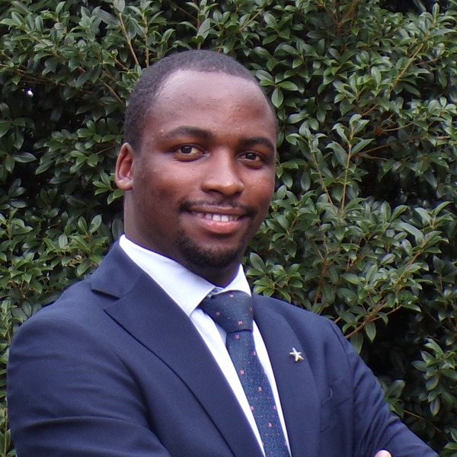




ENROLLING NOW · JULY–OCTOBER COHORT
USMLE
MON–SUN
Step 2 CK
4-month prep
· daily classes ·
Sharpen clinical reasoning. Move from facts to bedside decisions.
Allan Bakesiga, MD
MD (Makerere) · MScGH (Duke) · PGY-1 Neurology Resident, Creighton University
Teaching Assistant | Epidemiology & Biostatistics, Duke Global Health Institute
Mon–Sun
4 months
Step 1+2
Daily classes
Structured roadmap
Combined option
1
Daily classes
2
Active community
Monday to Sunday. Topic-by-topic flow that keeps you in the material every single day.
Off-class peer discussions, accountability, and rapid Q&A between sessions.
3
Textbook, Qbank & more
4
End-to-end mentorship
Full review of textbook, Qbank, and high-yield supplements, with practice questions in every session.
Guidance through the ECFMG application, CV, personal statement, interview prep, and the residency match.
WHAT WE COVER
Disciplines: Internal Medicine · Surgery · Pediatrics · Obstetrics & Gynecology · Psychiatry · Family Medicine
Systems: Cardiovascular · Gastrointestinal · Respiratory · MSK & Skin · Nervous & Behavioral · Endocrine · Reproductive & Pregnancy · Renal · Heme & Immune · Multisystem · Ethics & Patient Safety
Doing both Step 1 & 2?
Take the expedited combined prep — overlapping topics taught once, reinforced across both Steps. Save time, retain more.
SIGN UP HERE
forms.gle/Pj4tB985kpZGBKN59
Questions? Reach out to Allan:
allanbakesiga@gmail.com
+256 705 571 443
+1 984 710 2902
Scan to sign up

