Slide 1
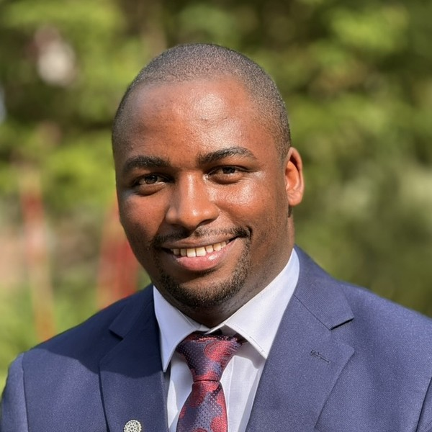
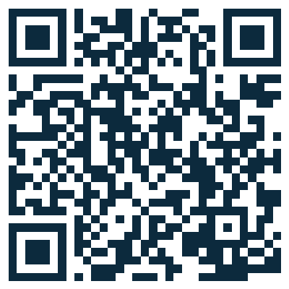
NEW INTAKE · OPEN NOW · LIMITED SLOTS
USMLE · STEP 1
LIVE DAILY
August Intake
AUGUST
10 PM EST · 5 AM EAT
Four months. The full First Aid blueprint. Live with Allan, every day.
new cycle begins
Allan Bakesiga, MD
MD (Makerere) · MScGH (Duke) · PGY-1 Neurology Resident, Creighton University
Live daily on Zoom · content review + question approach, every class
WHERE THE CLASS IS RIGHT NOW
Completed in June
DONE
Cardiovascular · Respiratory · Epidemiology & Biostatistics · General Pathology
Completed in July
DONE
Neurology (CNS) · Immunology
Loading this month
LIVE NOW
Hematology & Oncology · General Pharmacology
Still to come
NEXT
Renal · Reproductive · Endocrine · Gastrointestinal · Musculoskeletal, Skin & Connective Tissue · Behavioral Sciences · Biochemistry · Microbiology
THE CYCLE REPEATS
Join now for the modules running live this month. When the four-month blueprint comes back around, you cover every earlier chapter too, so you never miss a thing. And every single class is recorded on the dashboard from day one.
REGISTER AT THE DASHBOARD
bakesiga.github.io/usmle-dashboard
WhatsApp +256 705 571 443
Book a 1:1: calendly.com/allanbakesiga/30min
scan to register

