Slide 1
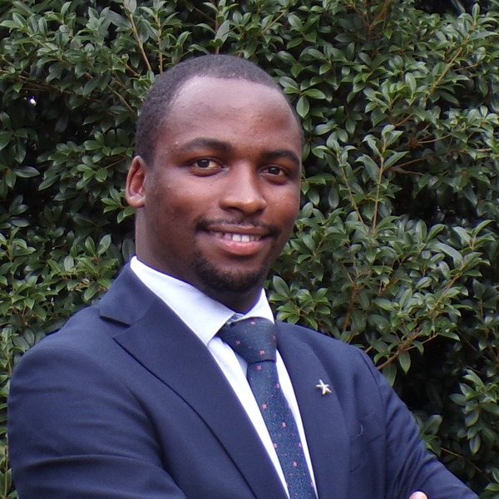
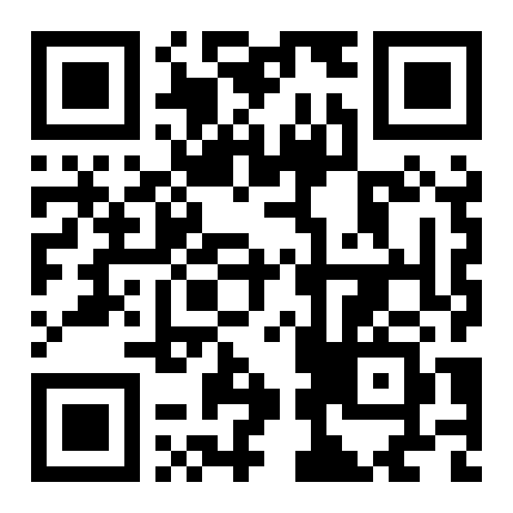



JUNE COHORT · SIGN UP · LIMITED SLOTS
USMLE · STEP 1 + STEP 2 CK
SAT
Info Session
MAY 9
11:00 AM EDT · 6:00 PM EAT
Bring your questions about the cohort. Open Q&A, no commitment.
60 min · open Q&A
Allan Bakesiga, MD
MD (Makerere) · MScGH (Duke) · PGY-1 Neurology Resident, Creighton University
Teaching Assistant | Epidemiology & Biostatistics, Duke Global Health Institute
WHAT WE'LL COVER · ~60 minutes
1
The residency journey
2
How the classes work
From MD to US residency: ECFMG eligibility, the exam timeline, and how the match cycle works.
Daily Mon–Sun sessions, 4-month roadmap, full textbook + Qbank walkthrough, office hours outside class.
3
Step 1 prep
4
Step 2 CK prep
Foundational sciences (Pathology, Physiology, Pharm, and the rest) across all the high-yield organ systems.
Clinical reasoning across Medicine, Surgery, Pediatrics, OB/GYN, Psychiatry, and Family Medicine — case-based.
JOIN THE ZOOM SESSION
Saturday, May 9, 2026
11:00 AM EDT · 6:00 PM EAT
duke.zoom.us/j/96991939005
Meeting ID: 969 9193 9005
scan to join
CAN'T MAKE IT? CONTACT ALLAN ANY TIME ON:
allanbakesiga@gmail.com
+256 705 571 443
+1 984 710 2902
Learn more about the cohort or sign up here:
bakesiga.github.io/usmle-dashboard

