Slide 1
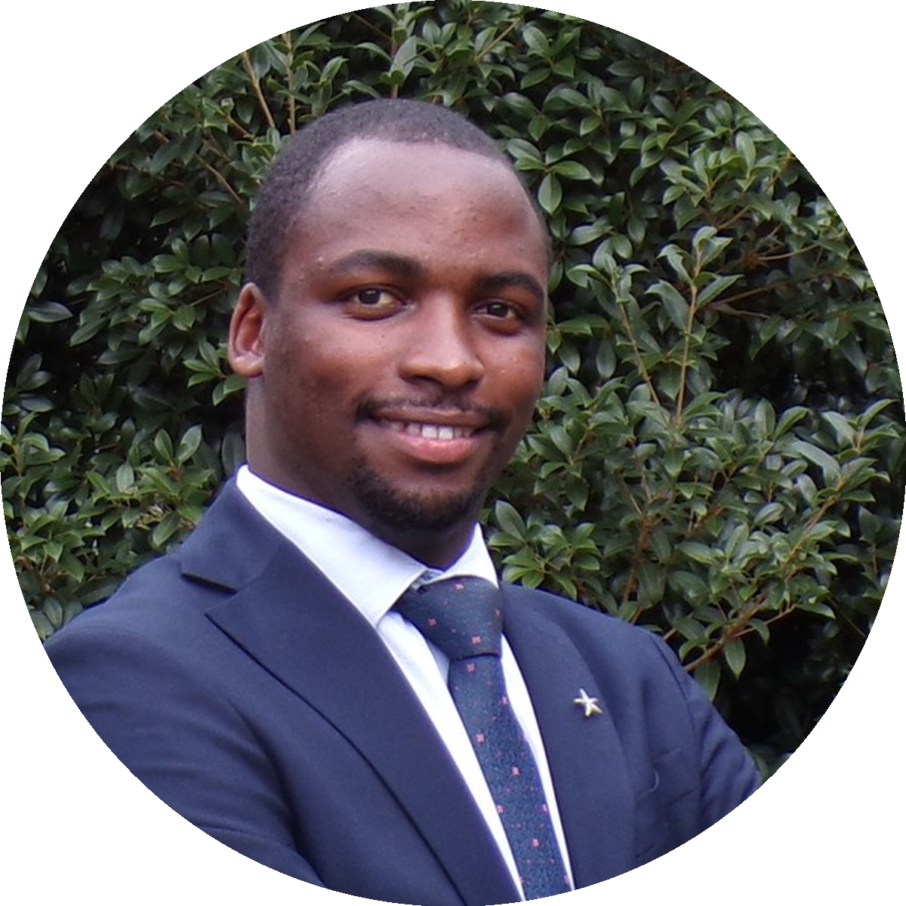
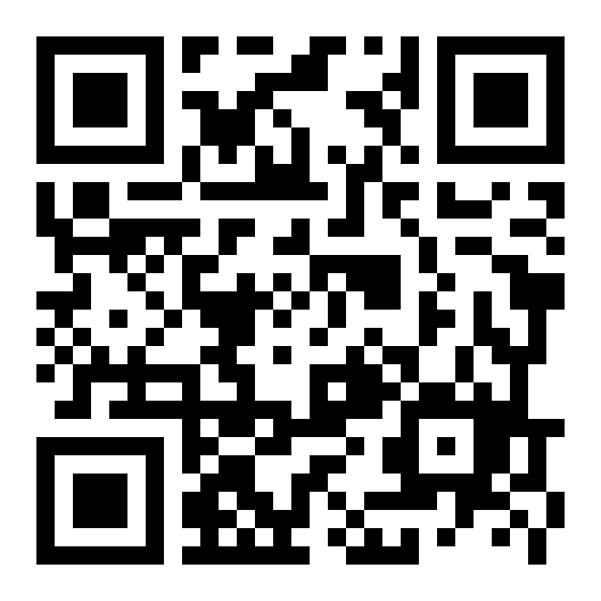



JUNE SCHEDULE · LIMITED SLOTS
STARTS JUNE 1
USMLE Step 1 · Daily, Mon to Sun
Allan Bakesiga
MD (Makerere) · MScGH (Duke)
Past TA · Epi & Biostats (Duke)
PGY-1 Neurology, Creighton
WHAT WE'RE COVERING IN JUNE
CARDIOVASCULAR
RESPIRATORY
10 days · Jun 1 – 10
8 days · Jun 11 – 18
01 Orientation, embryology & congenital heart defects
01 Embryology, surfactant & congenital anomalies
02 Anatomy & cardiac imaging
02 Anatomy & muscles of breathing
03 Cardiac output & PV loops
03 Lung volumes & ventilation
04 Heart sounds & murmurs
04 Gas exchange & V/Q mismatch
05 ECG & action potentials
06 CAD, IHD & myocardial infarction
05 Control of breathing & sleep apnea
07 Hypertension & atherosclerosis
06 Asthma & COPD
08 Heart failure & cardiomyopathies
07 Restrictive disease, ARDS, pneumonia
09 Endocarditis, myocarditis & vasculitis
08 TB, lung cancer & respiratory pharmacology
10 Cardiovascular pharmacology
EPI & BIOSTATS
GENERAL PATHOLOGY
4 days · Jun 19 – 22
8 days · Jun 23 – 30
01 Study designs, evidence & diagnostic testing
01 Cellular adaptations & apoptosis
02 Quantifying risk, transitions & survival analysis
02 Necrosis, ischemia & free radicals
03 Acute inflammation
03 Bias, confounding & effect modification
04 Chronic inflammation & repair
05 Neoplasia I — hallmarks & metastases
04 Statistical distributions, testing & CIs
06 Neoplasia II — oncogenes & TSGs
07 Neoplasia III — markers & aging
08 General pathology review
HIGH-YIELD MATERIAL + TEST QUESTIONS similar to exam day · every day
SIGN UP
Limited slots · June cohort
Or find the sign-up link on bakesiga.github.io/usmle-dashboard
allanbakesiga@gmail.com
+256 705 571 443
+1 984 710 2902
scan to sign up

