Slide 1
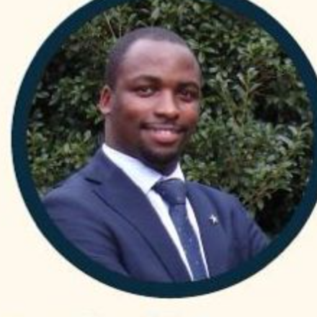
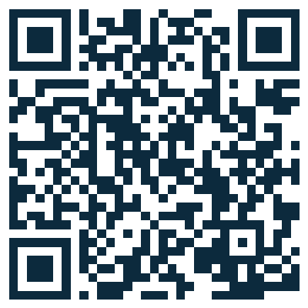
USMLE STEP 1 PREP
4-month cohorts with Allan
Allan Bakesiga
MD (Makerere) · MScGH (Duke) · PGY-1 Neurology, Creighton
Pass Step 1.
4-MONTH COHORT
All 16 First Aid chapters spread across 4 months. Every class blends content review with question approach.
DAILY LIVE ZOOM · 5:00 to 7:30 AM EAT
Live with Allan, every day.
FULL STEP 1 BLUEPRINT
· Cardiovascular
· Respiratory
· Epidemiology and Biostatistics
· General Pathology
· Renal
· Reproductive
· Endocrine
· Gastrointestinal
· Musculoskeletal, Skin, and Connective Tissue
· Neurology
· Hematology and Oncology
· Behavioral Sciences
· Biochemistry
· Microbiology
· Immunology
· Pharmacology
DAILY 1-PAGER + FLASHCARD DECK
Tied to First Aid 2025 page references.
DASHBOARD
WHATSAPP
1:1 MENTOR
RESIDENCY PATH
Daily outlines · resources
Daily reminders
Monthly Calendly call
ERAS · obs · J1/H1B
REGISTER AT THE DASHBOARD
bakesiga.github.io/usmle-dashboard
WhatsApp +256 705 571 443
Book a 1:1: calendly.com/allanbakesiga/30min

