Slide 1
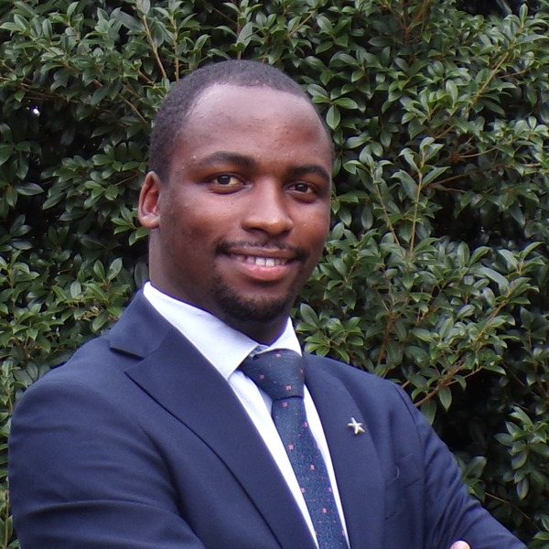
USMLE INFO SESSION · JUNE COHORT
Step 1 + Step 2 CK
Info Session
Bring your questions about the cohort. Open Q&A — no commitment.
Allan Bakesiga, MD
SAT
MD (Makerere) · MScGH (Duke)
MAY 9, 2026
PGY-1 Neurology Resident, Creighton University
11 AM EDT · 6 PM EAT
Teaching Assistant | Epi & Biostats, Duke Global Health Institute
Allan's USMLE Class · June Cohort
1 / 8

Slide 2
THE RESIDENCY JOURNEY · IMG PATH
From medical school to Match Day
ECFMG eligibility
USMLE Step 1
1
2
Medical school listed in the World Directory of Medical Schools with appropriate ECFMG Sponsor Note. Submit credentials to ECFMG.
Pass (currently reported as Pass / Fail). Required for ECFMG Certification.
USMLE Step 2 CK
English proficiency (OET Medicine)
3
4
Pass with a strong scaled score. Reported scores range 1–300 (mean ≈ 248). Required for ECFMG Certification.
Score 350+ on each of the 4 subtests within a single test administration.
ECFMG Certification
ERAS application
5
6
Issued after Step 1, Step 2 CK, OET, and verified medical credentials.
Apply through ERAS (opens early September). Personal statement, CV, LoRs, MSPE.
Interview season
NRMP Match Day
7
8
October to January. Programs review, interview, and rank applicants.
Submit rank-order list in late February. Match results in mid-March.
Source: ecfmg.org · USMLE.org · NRMP.org
Allan's USMLE Class · June Cohort
2 / 8

Slide 3
APPLICATION ROADMAP · MYINTEALTH → STEP 2 CK
From account to exam — 8 concrete steps
Establish MyIntealth account
p. 10
Confirm name of record
p. 12
1
2
Required first. Name as on passport, DOB, address, school info, plus identity verification. One MyIntealth ID, forever.
Must match your passport exactly. Different name on diploma → submit verification documentation.
Application for ECFMG Cert.
p. 21
Submit medical credentials
p. 34
3
4
Pay fee. Medical school must be in the World Directory with ECFMG Sponsor Note (Graduation Years: Current). Track in My Cases.
Final diploma + transcript (+ English translations). ECFMG verifies with the issuing institution before the application is accepted.
Receive your USMLE ID
p. 10
Apply for USMLE Step 1
p. 26
5
6
Since Jan 2026 USMLE Service Transition, FSMB issues this when you register for your first Step. View in My Profile.
Through FSMB. FSMB confirms with ECFMG that you're eligible. Students need school official to certify enrollment.
Take Step 1 · Pass / Fail
—
Apply for USMLE Step 2 CK
p. 26
7
8
USMLE shares the outcome directly with ECFMG. You don't need to forward the result yourself.
Same eligibility chain. Plan timing carefully — NRMP and GME programs have deadlines, and ECFMG warns slot availability isn't guaranteed.
Source: ECFMG 2026 Information Booklet (page references in upper right of each card).
Allan's USMLE Class · June Cohort
3 / 8

Slide 4
STEP 1 PREP
Foundational sciences. Pass / Fail.
WHAT'S TESTED
HIGH-YIELD CONTENT
Applying foundational science concepts
60–70%
Disciplines
Diagnosis
20–25%
Pathology · Physiology · Biochemistry · Pharmacology · Anatomy & Embryology · Microbiology · Immunology · Histology · Behavioral Sciences · Genetics
Communication & interpersonal skills
6–9%
Evidence-based medicine
4–6%
FORMAT
Organ systems
Question blocks
7
General Principles · Cardiovascular · Respiratory · GI · Renal/Urinary · Reproductive & Endocrine · MSK & Skin · Nervous & Behavioral · Heme & Immune · Biostats & Epi
Items (max)
280
Test day length
8 hours
Result
Pass / Fail
Our approach: master First Aid + UWorld with daily Mon–Sun reps over a 4-month roadmap.
Source: usmle.org Step 1 content outline + FA 2025
Allan's USMLE Class · June Cohort
4 / 8

Slide 5
STEP 2 CK PREP
Clinical knowledge. Scaled score 1–300.
WHAT'S TESTED
HIGH-YIELD CONTENT
Diagnosis
34–46%
Disciplines
Pharmacotherapy & management
26–38%
Internal Medicine (50–60%) · Surgery (25–30%) · Pediatrics (20–25%) · OB-GYN (10–20%) · Psychiatry (10–15%) · Family Medicine
Health maintenance & prevention
8–12%
Ethics / professionalism
5–7%
Patient safety / systems-based practice
5–7%
FORMAT
Organ systems & cross-cutting
Question blocks
8
Cardiovascular · GI · Respiratory · MSK & Skin · Nervous & Behavioral · Endocrine · Reproductive & Pregnancy · Renal · Heme & Immune · Multisystem · Ethics & Patient Safety
Items (max)
318
Test day length
9 hours
Score scale
1 – 300 (mean ≈ 248)
Our approach: case-based teaching across all disciplines, daily UWorld blocks, full FA 2025 mapping.
Source: usmle.org Step 2 CK content outline + FA 2025
Allan's USMLE Class · June Cohort
5 / 8

Slide 6
HOW THE CLASSES WORK · PART 1
Daily structure — Mon to Sun
Mon–Sun
4 months
Step 1 + 2
Daily classes
Structured roadmap
Combined option
1
2
3
4
Topic teaching
UWorld debrief
High-yield wrap
Office hours
30–45 min focused teaching mapped page-by-page to First Aid 2025.
Walk through the day's UWorld block with reasoning for every option.
5-minute mnemonic / pearls recap that you take into the next day.
Open Q&A outside class time for clarifying questions and weak areas.
Allan's USMLE Class · June Cohort
6 / 8

Slide 7
HOW THE CLASSES WORK · PART 2
4-month roadmap + end-to-end mentorship
Month 1
Month 2
Month 3
Month 4
Cardiovascular · Respiratory · General Pathology · Epi/Biostats
Endocrine · GI · Heme/Onc · Renal
Musculoskeletal · Neurology · Psychiatry · Reproductive
Immunology / Microbiology · Pharmacology · Behavioral · Mock blocks
END-TO-END MENTORSHIP
ECFMG application — credentials submission, sponsor notes, EPIC.
Personal statement & CV review, with iterative drafts.
Interview prep — mock interviews, IMG-specific Q&A, programs by signal.
ERAS / NRMP timeline coaching from application to rank list.
Combined Step 1 + Step 2 expedited track for efficient overlap.
Allan's USMLE Class · June Cohort
7 / 8

Slide 8
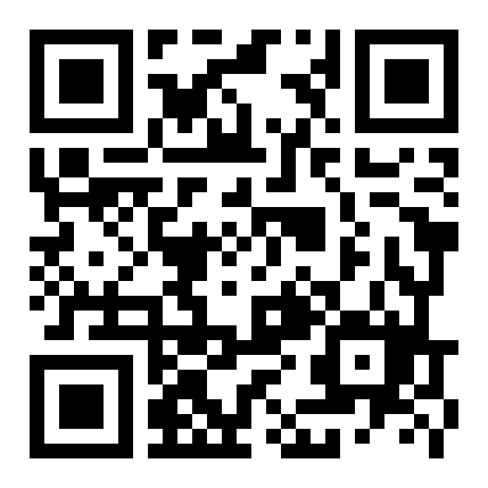
READY TO JOIN THE COHORT?
Sign up · Limited slots
bakesiga.github.io/usmle-dashboard
Or reach Allan directly:
allanbakesiga@gmail.com · WhatsApp +256 705 571 443 · Call +1 984 710 2902
Allan's USMLE Class · June Cohort
8 / 8

