Slide 1
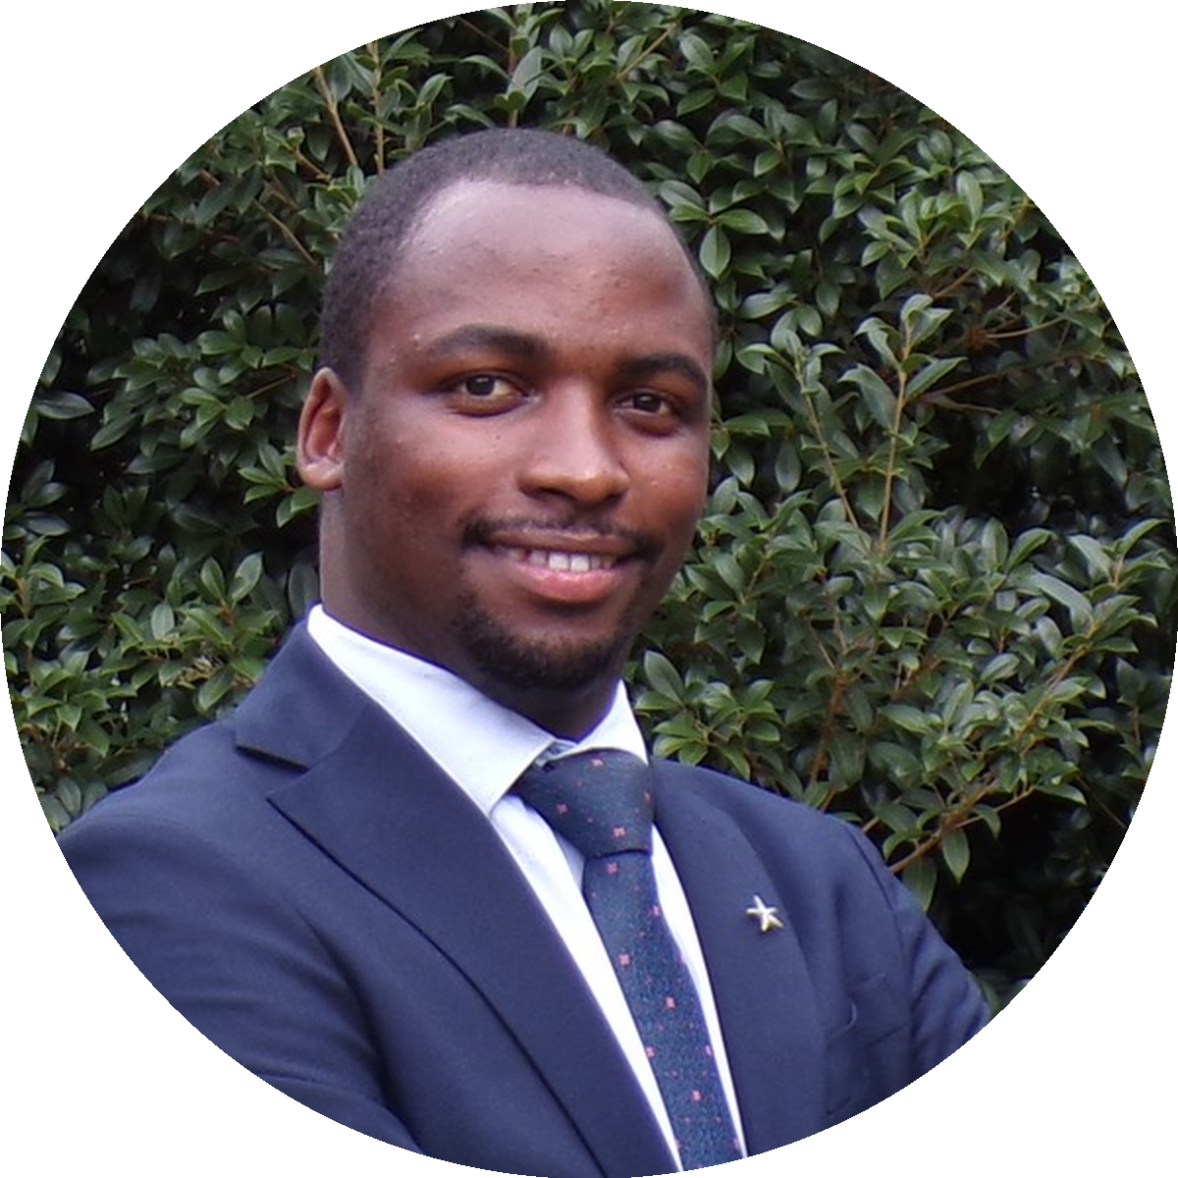
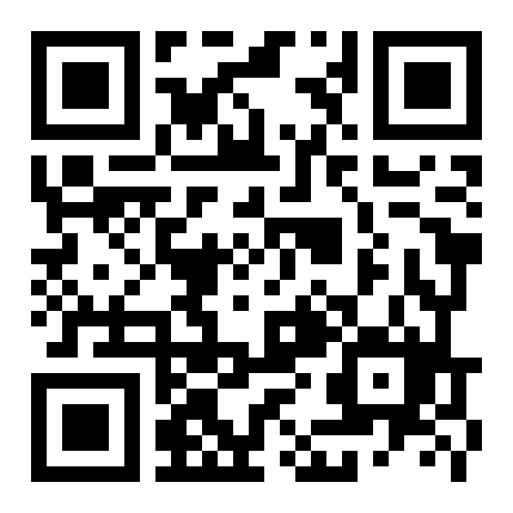
USMLE STEP 1 · JUNE COHORT
12
DAYS TO GO
Cohort starts June 1, 2026
Start your USMLE journey.
Daily live Zoom · Step 1 prep · coached by Allan.
Allan Bakesiga
MD (Makerere) · MScGH (Duke)
PGY-1 Neurology (Creighton)
Past TA, Epidemiology & Biostats, Duke Global Health
CARDIOVASCULAR
RESPIRATORY
10 days · Jun 1 — 10
8 days · Jun 11 — 18
EPI & BIOSTATS
GENERAL PATH
4 days · Jun 19 — 22
8 days · Jun 23 — 30
CLASS TIMES (DAILY)
5:00 – 7:30 AM EAT · 9:00 – 11:30 PM CST · 10:00 PM – 12:30 AM EST
LIMITED SEATS
Scan to enroll · pay by 30 May
bakesiga.github.io/usmle-dashboard

