Slide 1

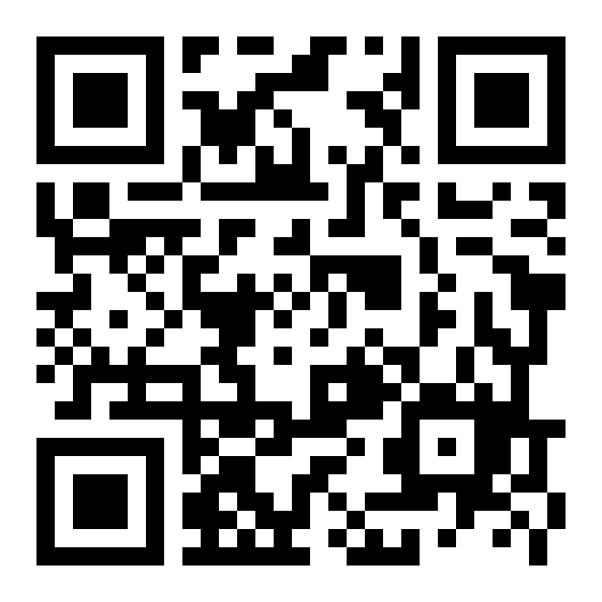
UNITED STATES MEDICAL LICENSING EXAMINATION
16 DAYS TO GO · JUNE 1
What is the USMLE?
Your path to US medical residency training.
Allan Bakesiga
MD (Makerere) · MScGH (Duke)
PGY-1 Neurology (Creighton)
WHAT IS IT?
A three-Step examination for medical licensure in the United States, sponsored by the FSMB and NBME. It assesses an examinee's ability to apply medical knowledge, concepts, and principles for safe and effective patient care.
WHO TAKES IT?
Medical students and graduates of US medical schools, and graduates of medical schools outside the US listed in the World Directory of Medical Schools. IMGs (International Medical Graduates, physicians whose medical degree was earned outside the US) register through ECFMG. Check your school at wdoms.org.
WHERE DOES IT LEAD?
State medical boards use USMLE results for physician licensure. For IMGs, Step 1 and Step 2 CK are required for ECFMG Certification, the gateway to ACGME-accredited US residency programs.
WHAT IS US RESIDENCY TRAINING?
Specialty training after medical school. The equivalent of a Master of Medicine (MMed) in a given specialty.
WHAT DO YOU NEED TO DO RIGHT NOW?
Start preparing for the USMLE exams with Allan!
bakesiga.github.io/usmle-dashboard

