Slide 1
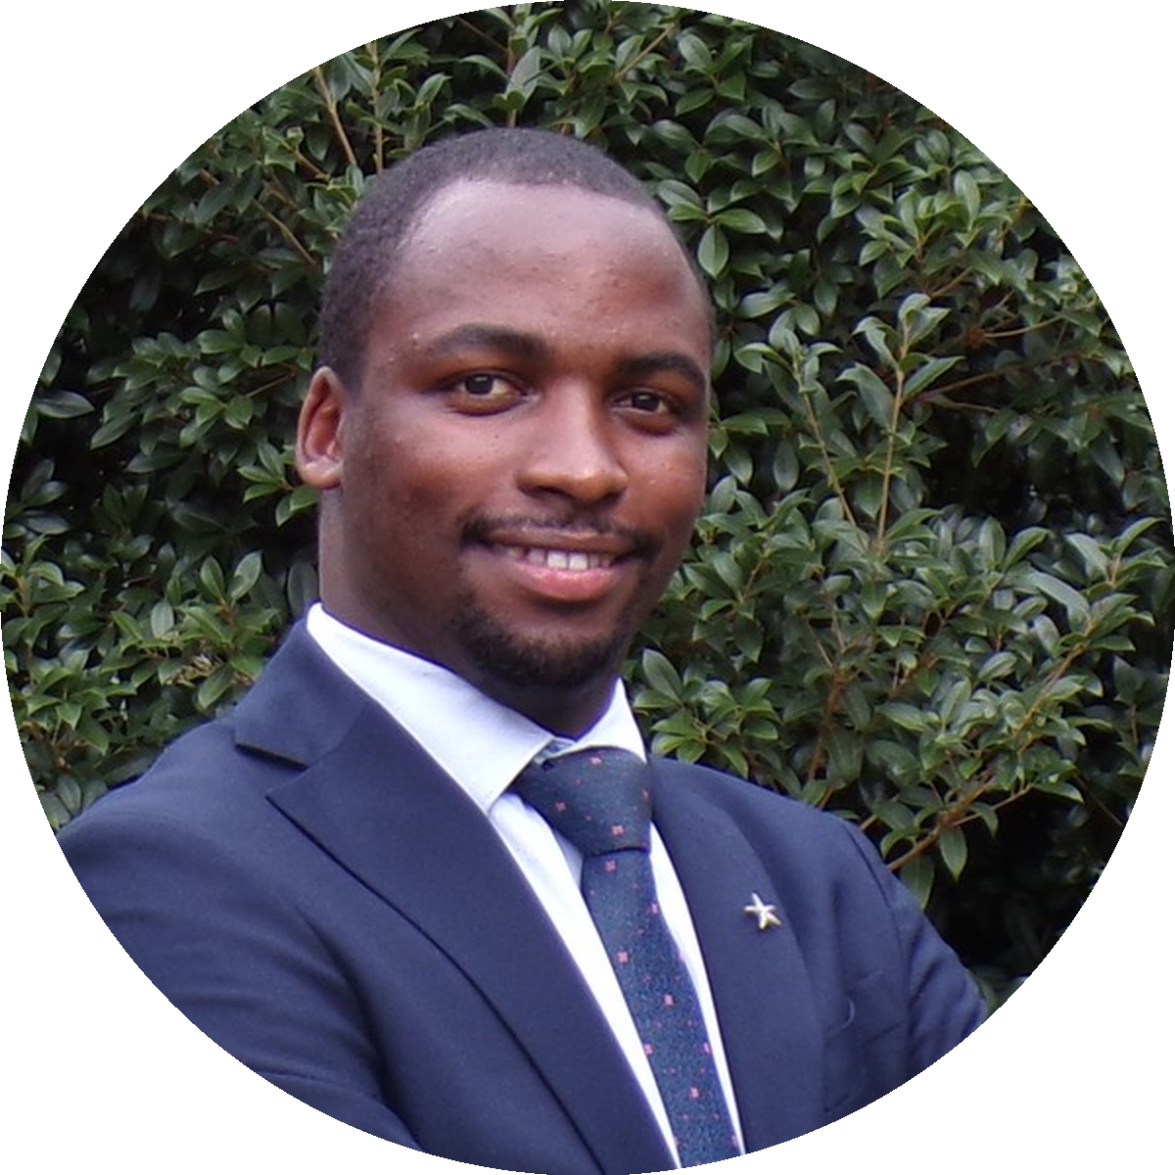
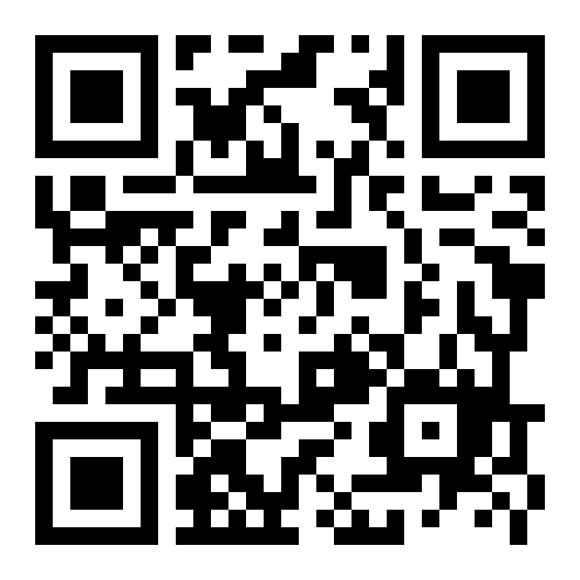
USMLE STEP 1 · JUNE OUTLINE
12 DAYS TO GO · JUNE 1
Allan Bakesiga
5:00 – 7:30 AM EAT
9:00 – 11:30 PM CST
10:00 PM – 12:30 AM EST
MD (Makerere) · MScGH (Duke)
PGY-1 Neurology (Creighton)
The full June outline
30 days · 4 subjects · day-by-day what we cover.
CARDIOVASCULAR
RESPIRATORY
10 days · Jun 1 – 10
8 days · Jun 11 – 18
01 Orientation, embryology & congenital heart
01 Embryology, surfactant & congenital anomalies
02 Anatomy & cardiac imaging
02 Anatomy & muscles of breathing
03 Cardiac output & PV loops
03 Lung volumes & ventilation
04 Heart sounds & murmurs
04 Gas exchange & V/Q mismatch
05 ECG & action potentials
06 CAD, IHD & myocardial infarction
05 Control of breathing & sleep apnea
07 Hypertension & atherosclerosis
06 Asthma & COPD
08 Heart failure & cardiomyopathies
07 Restrictive disease, ARDS, pneumonia
09 Endocarditis, myocarditis & vasculitis
08 TB, lung cancer & respiratory pharmacology
10 Cardiovascular pharmacology
EPI & BIOSTATS
GENERAL PATHOLOGY
4 days · Jun 19 – 22
8 days · Jun 23 – 30
01 Study designs, evidence & diagnostic testing
01 Cellular adaptations & apoptosis
02 Necrosis, ischemia & free radicals
02 Quantifying risk, transitions & survival analysis
03 Acute inflammation
04 Chronic inflammation & repair
03 Bias, confounding & effect modification
05 Neoplasia I: hallmarks & metastases
06 Neoplasia II: oncogenes & TSGs
04 Statistical distributions, testing & CIs
07 Neoplasia III: markers & aging
08 General pathology review
READY TO START?
Scan the QR or visit:
bakesiga.github.io/usmle-dashboard

