Slide 1
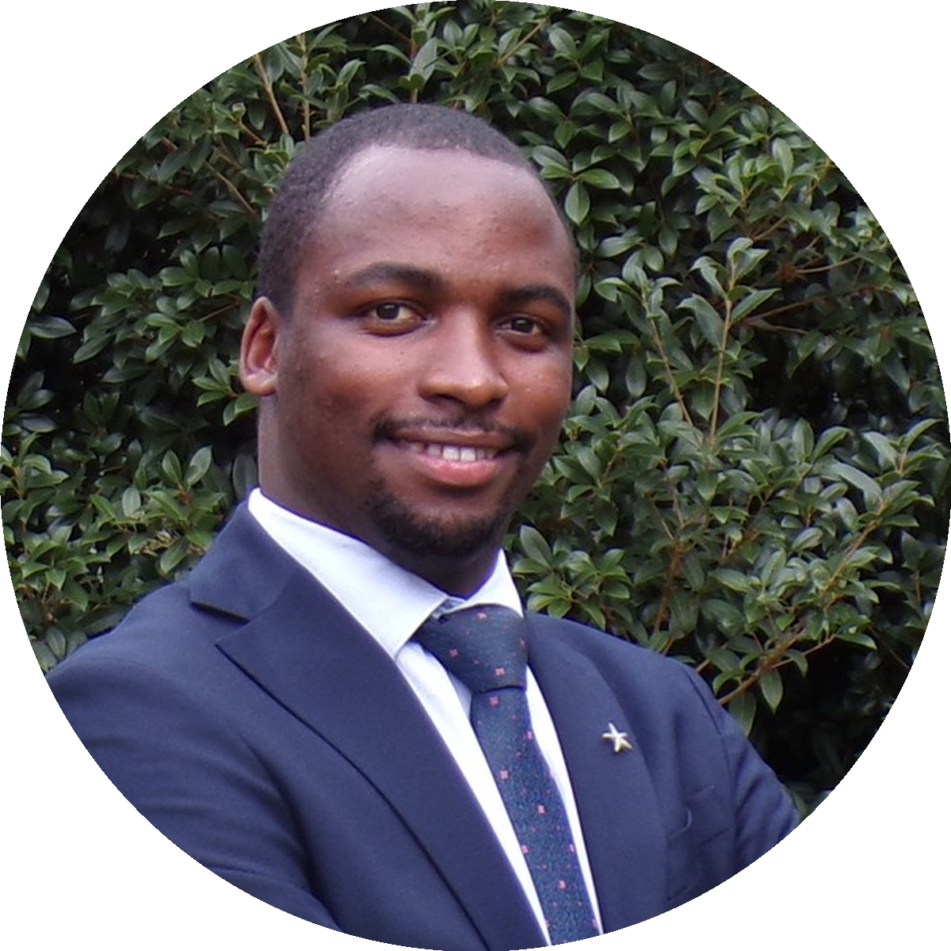
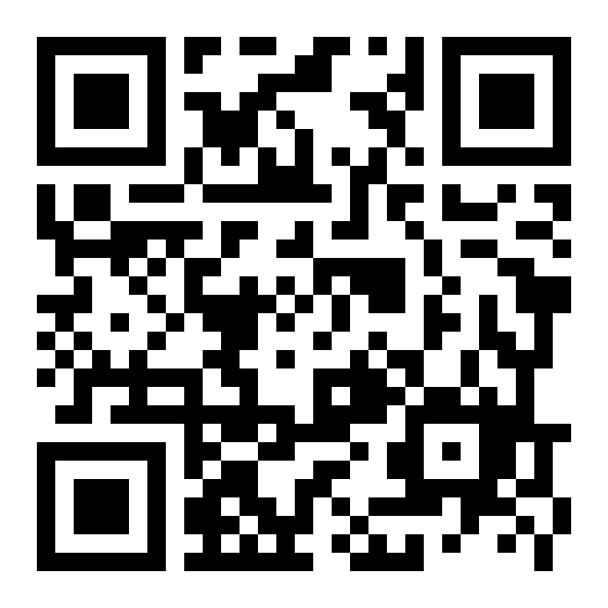
USMLE STEP 1 · WHAT WE'RE COVERING IN JUNE
12 DAYS TO GO · JUNE 1
June at a glance
30 days · 4 subjects · daily live Zoom classes.
5:00 – 7:30 AM EAT
9:00 – 11:30 PM CST
10:00 PM – 12:30 AM EST
Allan Bakesiga
MD (Makerere) · MScGH (Duke)
PGY-1 Neurology (Creighton)
CARDIOVASCULAR
RESPIRATORY
10 days · Jun 1 — 10
8 days · Jun 11 — 18
• ECG, action potentials & arrhythmias
• Lung volumes, V/Q & gas exchange
• Heart failure & cardiomyopathies
• Asthma & COPD
• CAD, MI & atherosclerosis
• TB, pneumonia & ARDS
• CV pharmacology
• Lung cancer & pulm pharmacology
EPI & BIOSTATS
GENERAL PATHOLOGY
4 days · Jun 19 — 22
8 days · Jun 23 — 30
• Study designs & diagnostic testing
• Cell injury, adaptation & apoptosis
• Risk, survival & transitions
• Acute & chronic inflammation
• Bias, confounding & effect modification
• Neoplasia, oncogenes & TSGs
• Distributions, hypothesis testing & CIs
• Tumor markers & aging
READY TO START?
Start preparing for the USMLE exams with Allan!
bakesiga.github.io/usmle-dashboard

