Slide 1
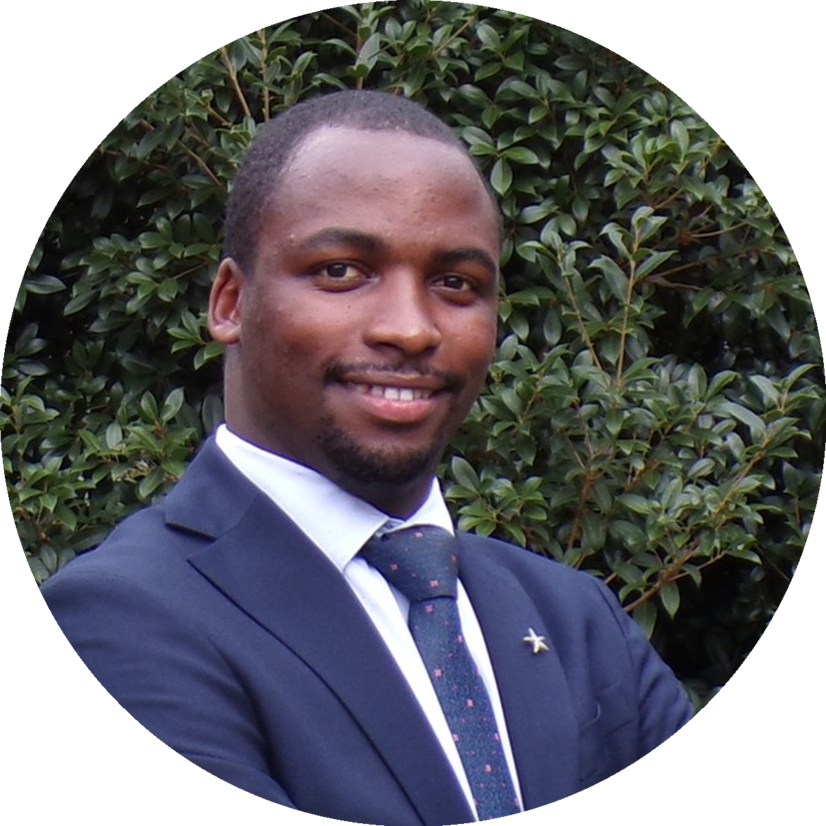
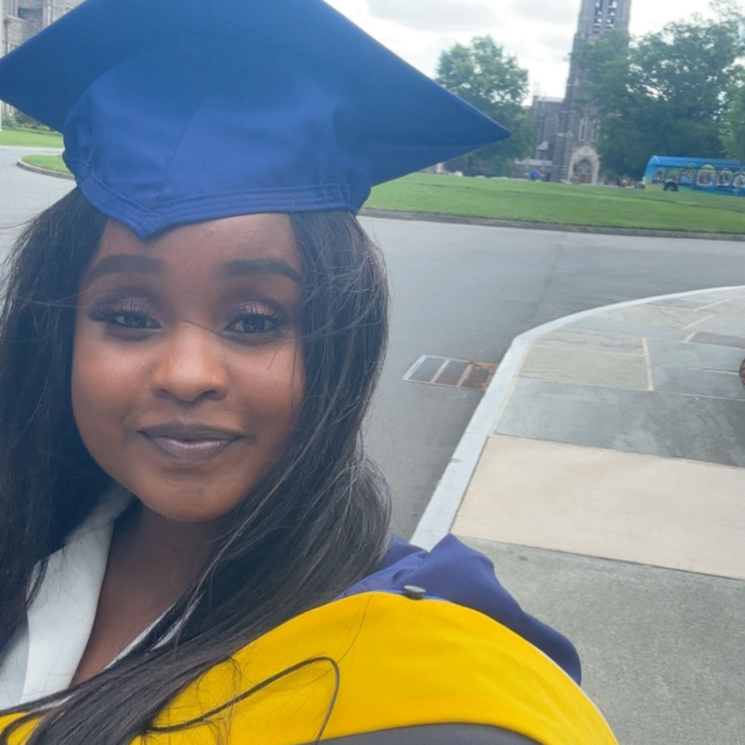
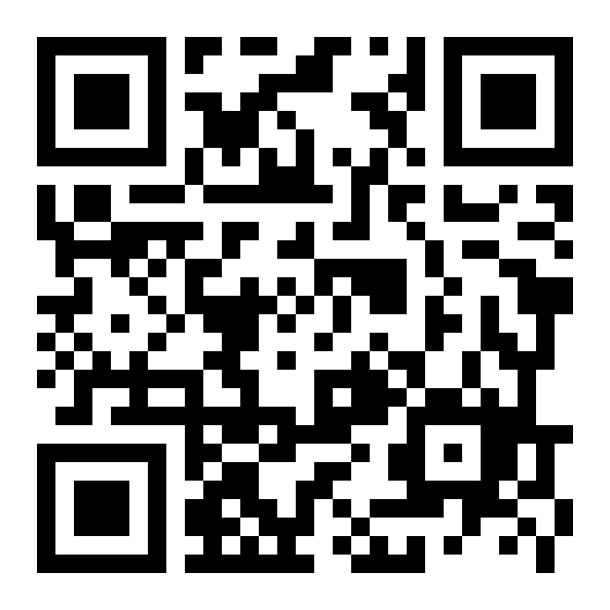
STUDENT SUCCESS · USMLE STEP 1
PASSED
COACHED
Feb – May 2026
Coached by
Allan Bakesiga
MD (Makerere)
MScGH (Duke)
PGY-1 Neurology
Creighton
STEP 1 · TESTED 5 MAY 2026
CONGRATULATIONS!
Dr. Rosemary Njambi Githinji
USMLE Step 1 Prep Cohort
“
Allan is the most patient teacher I have ever had. He breaks every concept down so clearly that even a non-medic could follow. I would not have passed Step 1 without him.
— Rosemary
YOU could be next.
Next cohort starts 1 June 2026
Daily live Zoom · Scan QR or visit:
bakesiga.github.io/usmle-dashboard

