Slide 1
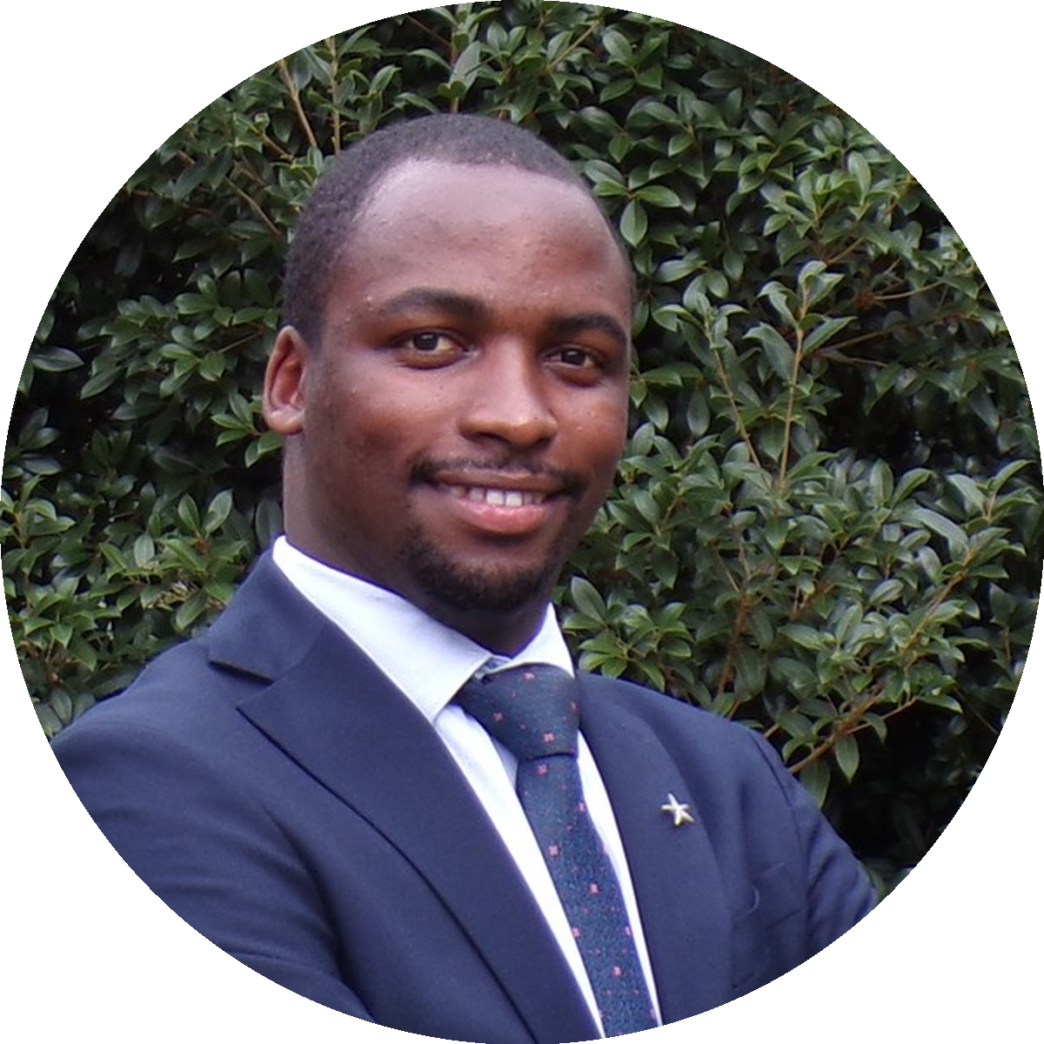
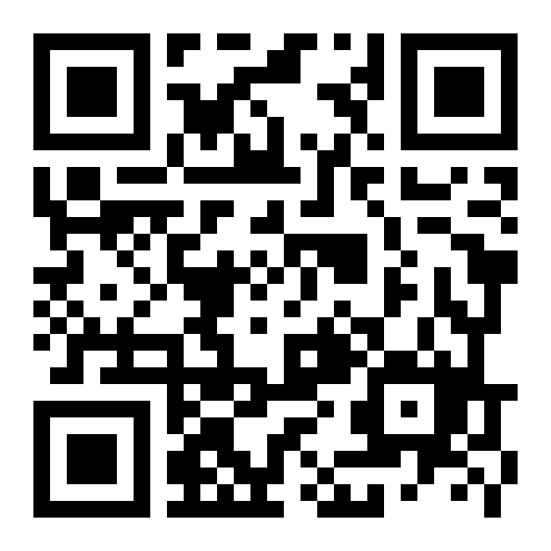



UNITED STATES MEDICAL LICENSING EXAMINATION
19 DAYS TO GO · LIMITED SLOTS
STEP 1.
JUNE 1.
Allan Bakesiga
MD (Makerere) · MScGH (Duke)
PGY-1 Neurology, Creighton
Daily live coaching, built around recommended materials and Q bank.
June curriculum mapped page-by-page to high-yield resources.
CARDIOVASCULAR
RESPIRATORY
10 days · Jun 1 – 10
8 days · Jun 11 – 18
EPI & BIOSTATS
GENERAL PATHOLOGY
4 days · Jun 19 – 22
8 days · Jun 23 – 30
MATERIALS → Q BANK → EXAM PATTERNS
Read · Apply · Master — every single day.
RESERVE YOUR SEAT
Limited slots · Lock yours by May 30.
or sign up at bakesiga.github.io/usmle-dashboard
scan to sign up
allanbakesiga@gmail.com
+256 705 571 443
+1 984 710 2902

