Slide 1
Cardiovascular Physiology Review
40 USMLE style vignettes · Days 4 to 6 wrap up
Allan Bakesiga, MD · USMLE Step 1 Cohort

Slide 2
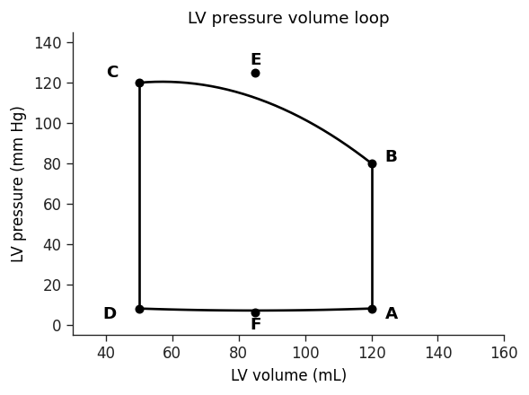
Question 1
A 34-year-old woman who recently moved to the United States from Russia presents with progressive weakness, shortness of breath on exertion, and difficulty breathing while lying flat. Cardiac auscultation at the apex reveals an opening snap followed by a low-pitched rumbling diastolic murmur. A labeled left ventricular pressure-volume loop is shown with six points marked A through F. Which of the six points corresponds most closely to the moment when the opening snap is generated?
A. Point A
B. Point B
C. Point C
D. Point D
E. Point E
F. Point F
USMLE Step 1 Prep · CVS Physiology

Slide 3
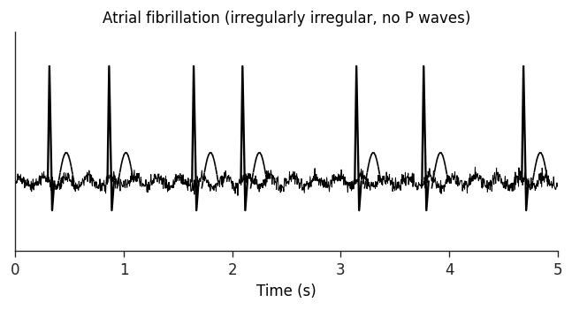
Question 2
A 56-year-old man arrives in the emergency department reporting that his heart feels fast and irregular. He denies chest pain, shortness of breath, or lightheadedness. He typically drinks alcohol only a few times per year, but the previous night he hosted his wife's birthday party and consumed a large quantity of alcohol. He has no other medical history and takes no medications. Pulse examination confirms an irregularly irregular rhythm at 138 beats per minute. Which of the following ECG tracings would most closely match this patient's rhythm?
A. Ventricular bigeminy: a normal sinus beat alternating with a wide-complex premature ventricular beat in a predictable pattern
B. Sustained ventricular tachycardia: monomorphic wide QRS complexes at a regular rapid rate
C. Atrial flutter with fixed AV conduction: saw-tooth flutter waves with a regular ventricular response
D. Atrial fibrillation: chaotic fibrillatory baseline with no discernible P waves and irregularly irregular narrow QRS intervals
E. AV nodal reentrant tachycardia: regular narrow QRS rhythm with P waves buried in or just after the QRS
USMLE Step 1 Prep · CVS Physiology

Slide 4
Question 3
A 65-year-old woman is brought to the hospital with sudden chest heaviness and shortness of breath that began one hour earlier. She has type 2 diabetes, obesity, and hypertension. Temperature is 36.7 C, blood pressure is 80/50 mm Hg, pulse is 110 per minute, and respirations are 20 per minute. Her extremities are cold and clammy with notable diaphoresis. ECG demonstrates ST-segment elevation in the lateral leads. Which combination of cardiac contractility, systemic vascular resistance, and pulmonary artery systolic pressure is most likely present in this patient?
A. Decreased contractility, decreased SVR, decreased PA systolic pressure
B. Decreased contractility, increased SVR, decreased PA systolic pressure
C. Decreased contractility, increased SVR, increased PA systolic pressure
D. Increased contractility, decreased SVR, decreased PA systolic pressure
E. Increased contractility, increased SVR, increased PA systolic pressure
USMLE Step 1 Prep · CVS Physiology

Slide 5
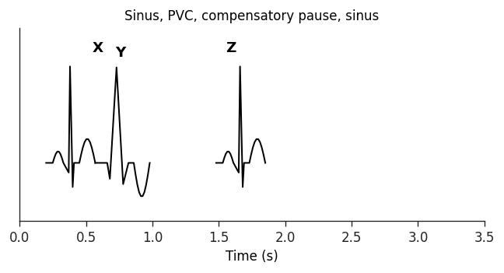
Question 4
A 45-year-old woman enrolled in a cardiovascular health study wears a continuous 24-hour ambulatory ECG monitor. Intermittent occurrences of a specific pattern were captured. Three beats are labeled: X is a normal sinus beat, Y is a wide-complex beat with a T wave deflected opposite to the QRS, and Z is the beat that follows a brief pause after Y. Which option best ranks the relative left ventricular end-diastolic volumes just prior to each of these three beats?
A. X = Y = Z (all three EDVs equal)
B. X > Y > Z (sinus beat highest, post-PVC beat lowest)
C. Y > X > Z (PVC has the highest EDV)
D. Y = Z > X (PVC and post-PVC both higher than sinus)
E. Z > X > Y (post-PVC beat highest, PVC lowest)
USMLE Step 1 Prep · CVS Physiology

Slide 6
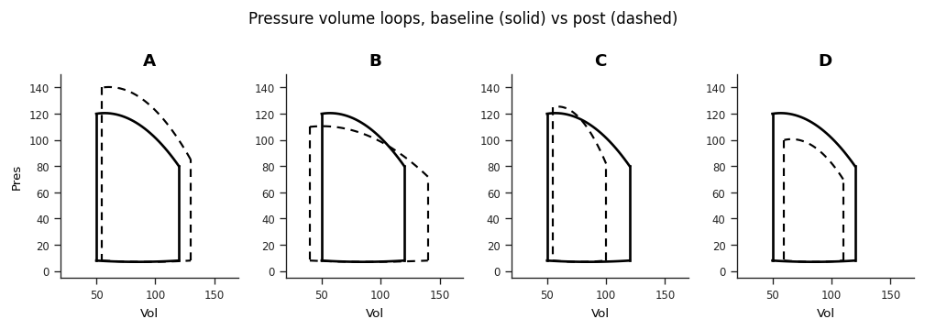
Question 5
A 44-year-old man is hospitalized after a motor vehicle collision with multiple injuries. A traumatic arteriovenous fistula has formed as a result of vascular trauma. Which of the following pressure-volume loop changes would most likely develop in his left ventricle as a result of this fistula? Each option shows a pair of loops where the solid line represents the preinjury state and the dashed line the postinjury state.
A. PV loop showing increased height with steeper end-systolic relationship and modest increase in stroke volume (positive inotrope pattern)
B. PV loop showing widened stroke volume with slightly lower peak pressure and leftward shift of end-systolic point (reduced afterload with increased preload)
C. PV loop showing higher peak pressure with reduced stroke volume (increased afterload pattern)
D. PV loop showing narrowed loop shifted leftward with reduced filling (decreased preload pattern)
USMLE Step 1 Prep · CVS Physiology

Slide 7
Question 6
A 4-week-old boy is scheduled for cardiac catheterization to close a patent ductus arteriosus. He was born at 26 weeks gestation following a placental abruption and has been in the neonatal intensive care unit since delivery. Pulse oximetry shows 99% saturation in both the right hand and the left foot. Echocardiography demonstrates a moderately sized PDA. Blood gases are sampled from several intracardiac and great-vessel locations before closure. Compared with a healthy newborn without a PDA, in which of the following locations would this patient's partial pressure of oxygen most likely be higher than normal?
A. Ascending aorta
B. Descending aorta
C. Left atrium
D. Pulmonary artery
E. Right atrium
USMLE Step 1 Prep · CVS Physiology

Slide 8
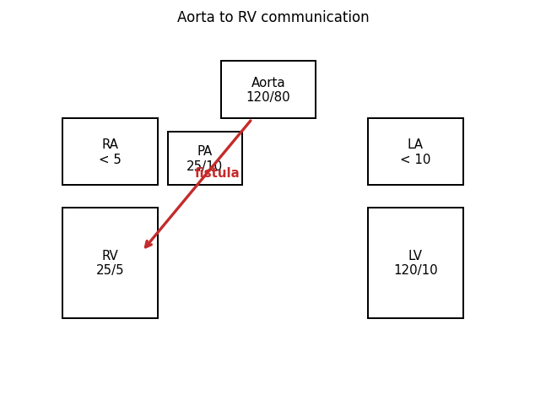
Question 7
A 32-year-old man is evaluated in the emergency department for fever, night sweats, and chills lasting several days. He recently used intravenous drugs and was previously healthy. Temperature is 38.3 C, blood pressure is 120/80 mm Hg, and pulse is 105 per minute and regular. Further workup demonstrates aortic valve endocarditis with an intracardiac abscess and a small fistula between the right ventricle and the aortic root that remains patent throughout the cardiac cycle. Doppler ultrasonography of the fistula is most likely to show which of the following flow patterns?
A. Continuous flow from the aortic root into the right ventricle across the full cardiac cycle
B. Flow from the aortic root into the right ventricle only during diastole
C. Flow from the aortic root into the right ventricle only during systole
D. Continuous flow from the right ventricle into the aortic root across the full cardiac cycle
E. Flow from the right ventricle into the aortic root only during diastole
F. Flow from the right ventricle into the aortic root only during systole
USMLE Step 1 Prep · CVS Physiology

Slide 9
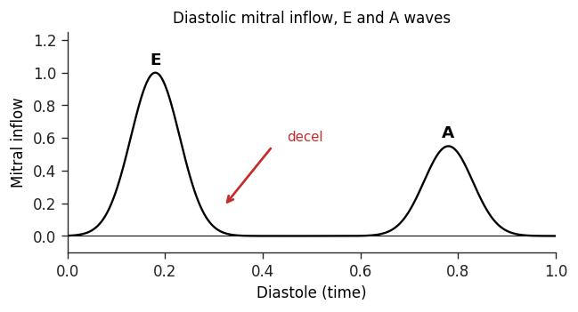
Question 8
A 52-year-old man comes to the office reporting two weeks of progressive shortness of breath and a dry cough. He has noticed reduced exercise tolerance that now limits his daily activities. A Doppler probe positioned at the cardiac apex captures the diastolic blood flow pattern across his mitral valve. The recording shows an early rapid filling peak (E wave) followed by a period of low flow (diastasis), then a second peak from atrial contraction (A wave), which ends as the mitral valve closes. An arrow on the tracing points to a position just after the E wave peak. The arrow location best corresponds to which of the following auscultation findings?
A. Fourth heart sound (S4)
B. Mid-systolic click
C. Second heart sound (S2)
D. Third heart sound (S3)
E. Aortic ejection click
USMLE Step 1 Prep · CVS Physiology

Slide 10
Question 9
Following the cardiac evaluation that suggested heart failure, the same 52-year-old man is examined further. Jugular venous pressure is elevated, breath sounds are decreased at the right lung base with dullness to percussion, and there is 2+ bilateral lower extremity pitting edema. Chest x-ray shows cephalization of the pulmonary vessels, Kerley B lines, and a right-sided pleural effusion. Thoracentesis is performed and the fluid is analyzed. Compared with plasma values, which of the following findings is most likely in this patient's pleural fluid?
A. High amylase content
B. High protein content (greater than serum)
C. High white blood cell count
D. Low glucose content
E. Low lactate dehydrogenase content
USMLE Step 1 Prep · CVS Physiology

Slide 11
Question 10
A 12-day-old girl is evaluated in the neonatal intensive care unit for a heart murmur. She was born at 25 weeks gestation and was admitted to the NICU for respiratory support. Her 21-year-old mother had preeclampsia during pregnancy. Cardiac examination reveals a continuous murmur at the left sternal border and bounding femoral and palmar pulses. Echocardiography confirms the diagnosis. Compared with a normal newborn, which of the following combinations of changes in left ventricular output, systemic vascular resistance, and left atrial filling is most likely present?
A. Decreased LV output, decreased SVR, decreased LA filling
B. Decreased LV output, decreased SVR, increased LA filling
C. Increased LV output, decreased SVR, increased LA filling
D. Increased LV output, increased SVR, increased LA filling
E. Increased LV output, increased SVR, decreased LA filling
USMLE Step 1 Prep · CVS Physiology

Slide 12
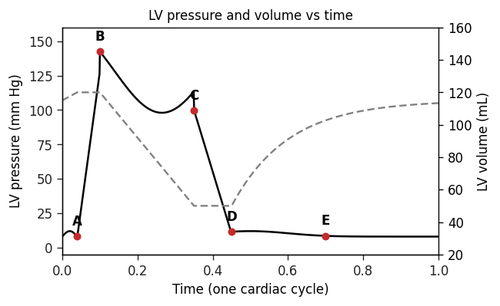
Question 11
A 34-year-old man comes to the clinic for evaluation of a heart murmur. He has no chest pain, palpitations, dizziness, or shortness of breath at rest. He exercises regularly without any abnormal symptoms. Cardiac auscultation in the second right intercostal space reveals an ejection click followed by a soft systolic murmur that radiates to the neck. A simultaneous tracing of left ventricular pressure and volume across one cardiac cycle is shown, with five labeled points (A, B, C, D, E) corresponding to specific moments in the cycle. Which of the labeled points corresponds to the opening of the valve most likely affected in this patient?
A. Point A
B. Point B
C. Point C
D. Point D
E. Point E
USMLE Step 1 Prep · CVS Physiology

Slide 13
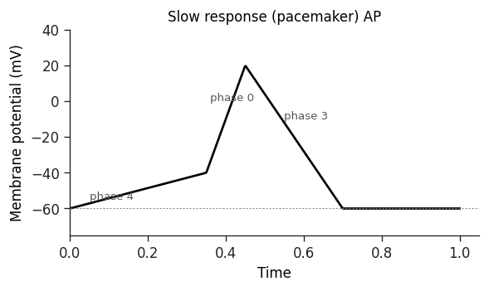
Question 12
A 43-year-old man is evaluated for episodes of palpitations that occur during periods of anxiety. He describes a sudden onset of pounding in the chest associated with lightheadedness and shortness of breath. He has never lost consciousness. He has no known heart disease and an unremarkable family history. After initial evaluation, he is started on verapamil and reports a clear reduction in the frequency of his palpitation episodes. A tracing of the electrical activity of a specific type of cardiac cell from this patient is shown. Which of the following effects would verapamil most likely have on these cells?
A. Decreased excitation-contraction coupling within the cell
B. Increased peak amplitude of the action potential
C. Lowered threshold potential for action potential initiation
D. Reduced refractory period after each action potential
E. Slowed spontaneous depolarization during phase 4
USMLE Step 1 Prep · CVS Physiology

Slide 14
Question 13
A 39-year-old man comes to the office reporting two weeks of progressive fatigue. He has no prior medical conditions but had a self-limited upper respiratory illness recently. He does not use tobacco, alcohol, or recreational drugs and has not traveled recently. Temperature is 37.2 C, blood pressure is 116/66 mm Hg, pulse is 100 per minute, and respirations are 20 per minute. Physical examination reveals bibasilar lung crackles. Echocardiography demonstrates no valvular abnormalities and provides the following measurements: left ventricular end-diastolic volume 125 mL, left ventricular end-systolic volume 75 mL. Based on these findings, which of the following statements about this patient is most accurate?
A. Cardiac output is 4 L/min
B. Cardiac output is 6 L/min
C. Left ventricular ejection fraction is 40%
D. Left ventricular ejection fraction is 60%
E. Stroke volume is 40 mL
F. Stroke volume is 60 mL
USMLE Step 1 Prep · CVS Physiology

Slide 15
Question 14
A 67-year-old man is brought to the emergency department by his son after a syncopal episode. The son was helping his father clean out the garage when the father said he felt dizzy. As the son was helping him into a chair, the patient lost consciousness. He awoke spontaneously about a minute later without disorientation or confusion. ECG demonstrates bradycardia with a regular rhythm and narrow QRS complexes. There is complete dissociation between the P waves and QRS complexes. Which of the following locations is most likely pacing this patient's ventricles?
A. Bundle of His
B. Left bundle branch
C. Left ventricular muscle
D. Purkinje fiber system
E. Sinoatrial node
USMLE Step 1 Prep · CVS Physiology

Slide 16
Question 15
A 44-year-old man comes to the office with progressive shortness of breath. He must now stop halfway up the stairs to his second-floor apartment to catch his breath. He has a history of nonischemic dilated cardiomyopathy and chronic heart failure with reduced ejection fraction. A new medication is initiated that improves his symptoms by increasing urine output and reducing peripheral vascular resistance. The drug works by inhibiting a metalloprotease, thereby prolonging the action of certain endogenous polypeptides. These polypeptides are most likely secreted by which of the following cell types?
A. Adrenal zona glomerulosa cells
B. Cardiomyocytes
C. Hepatic stellate cells
D. Myocardial Purkinje fibers
E. Renal juxtaglomerular cells
F. Vascular endothelial cells
USMLE Step 1 Prep · CVS Physiology

Slide 17
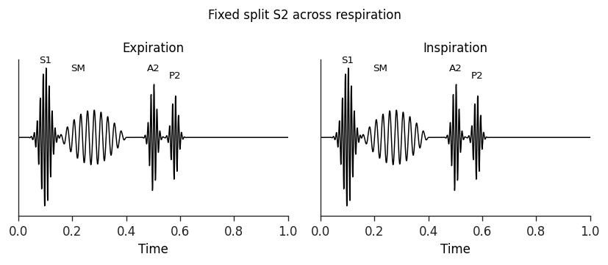
Question 16
A 14-year-old girl is brought to the office to establish medical care. Vital signs are within normal limits. Cardiac examination reveals a murmur best heard at the left upper sternal border. A phonocardiogram obtained at this location shows the following findings: S1, an early-peaking systolic ejection murmur (SM), and a second heart sound (S2) that splits widely into aortic (A2) and pulmonic (P2) components, with the split duration not changing between expiration and inspiration. This patient's murmur is most likely due to which of the following mechanisms?
A. Abnormal narrowing of the aortic valve (aortic stenosis)
B. Incomplete development of the ventricular septum (VSD)
C. Increased blood flow to the lungs across a normal pulmonic valve
D. Regurgitation of blood from the aorta into the left ventricle (aortic insufficiency)
USMLE Step 1 Prep · CVS Physiology

Slide 18
Question 17
A 38-year-old woman is evaluated for shortness of breath. Over the past several months she has had poor exercise tolerance that she initially attributed to deconditioning. Over the past several weeks her symptoms have worsened, and she is now short of breath even with mild exertion. There is no family history of heart disease. Right and left heart catheterization yields the following values: left ventricular end-diastolic pressure 10 mm Hg (normal 3 to 12), left ventricular peak systolic pressure 110 mm Hg (normal 100 to 140), and pulmonary capillary wedge pressure 36 mm Hg (normal less than 12). Which of the following is the most likely cause of this patient's symptoms?
A. Aortic stenosis
B. Cardiac tamponade
C. Dilated cardiomyopathy
D. Mitral stenosis
E. Restrictive cardiomyopathy
USMLE Step 1 Prep · CVS Physiology

Slide 19
Question 18
A 23-year-old man comes to the emergency department with sudden onset palpitations that began while he was at his desk at work. He has no known medical problems and does not use tobacco or recreational drugs. He drinks alcohol occasionally on weekends. Initial blood pressure is 110/70 mm Hg and pulse is 160 per minute and regular. Gentle massage applied just below the angle of the right mandible produces immediate improvement of his condition. His blood pressure is now 120/80 mm Hg and pulse is 75 per minute. Which of the following mechanisms is responsible for the improvement?
A. Decreased baroreceptor firing rate
B. Increased sympathetic output to the sinoatrial node
C. Increased systemic vascular resistance
D. Prolonged refractory period of the atrioventricular node
E. Prolonged refractory period of the ventricular myocardium
USMLE Step 1 Prep · CVS Physiology

Slide 20
Question 19
A 56-year-old man comes to the emergency department for palpitations that began several hours ago. He has not had similar symptoms before. He denies chest pain, shortness of breath, lightheadedness, or syncope. He drinks alcohol on weekends and does not use recreational drugs. There is no family history of heart disease. BP is 145/78 mm Hg and BMI is 40 kg/m2. ECG is shown (note: the strip demonstrates rapid regular atrial activity in a saw-toothed pattern with narrow QRS complexes and a regular ventricular response). He is medically managed in the ED and is then referred to the electrophysiology laboratory for radiofrequency catheter ablation to terminate his arrhythmia. The ablation procedure should create a conduction block through which of the following areas?
A. An accessory pathway that bypasses the atrioventricular node
B. The area of right atrium between the tricuspid valve annulus and the inferior vena cava (cavotricuspid isthmus)
C. The right ventricular outflow tract
D. The ostia of the pulmonary veins in the left atrium
E. The slow pathway of the atrioventricular node
USMLE Step 1 Prep · CVS Physiology

Slide 21
Question 20
A 69-year-old man is brought to the emergency department with sudden onset palpitations and dyspnea. His medical history includes hypertension and gastroesophageal reflux disease. ECG reveals a heart rate of 120 per minute with an irregularly irregular rhythm, narrow QRS complexes, and no organized P waves. Which of the following physiologic factors most likely determines the ventricular contraction rate in this patient?
A. Atrial muscle depolarization rate
B. Atrioventricular node refractory period
C. Bundle branch conductivity
D. Purkinje system pacemaker activity
E. Sinoatrial node discharge rate
F. Ventricular muscle refractory period
USMLE Step 1 Prep · CVS Physiology

Slide 22
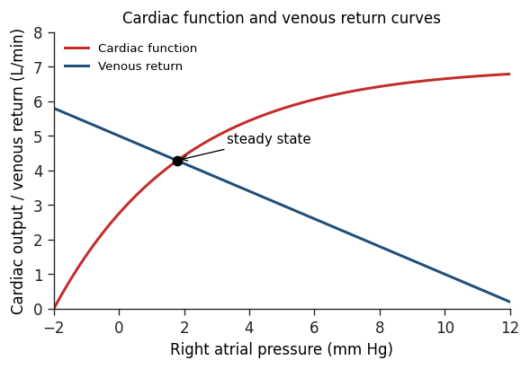
Question 21
A 24-year-old healthy woman participates in a pharmacologic clinical study. Various cardiovascular parameters are measured while she is resting in an upright position. Baseline values are plotted on a combined cardiac function curve (Frank-Starling curve) and vascular function curve (venous return curve), with cardiac output on the y-axis and right atrial pressure on the x-axis. She then receives a moderate dose of intravenous nitroglycerin by continuous infusion, and the measurements are repeated. Which of the following changes in the cardiac and vascular function curves is most likely to be observed?
A. Both curves shifted leftward (increased contractility, increased venous return)
B. Cardiac function curve shifted rightward (decreased contractility), vascular function curve shifted leftward
C. Both curves shifted rightward (decreased contractility, decreased venous return)
D. Cardiac function curve unchanged, vascular function curve shifted leftward (decreased venous return at any given RA pressure)
E. Cardiac function curve shifted leftward (increased contractility), vascular function curve shifted rightward (increased venous return)
USMLE Step 1 Prep · CVS Physiology

Slide 23
Question 22
A 50-year-old man comes to the emergency department for intermittent palpitations over the last 6 months. He describes the episodes as very uncomfortable and says they occur randomly, last for several hours, and resolve spontaneously or with sleep. The current episode began an hour ago and has been accompanied by lightheadedness. He has no medical history. Temperature is normal, blood pressure is 122/75 mm Hg, and BMI is 30. Chest examination reveals no murmurs and clear lung fields. There is trace peripheral edema. A cardiac rhythm strip obtained in the ED shows an irregularly irregular rhythm with no discernible P waves. Aberrant electrical activity in which of the following anatomic structures is the most likely trigger for this patient's condition?
A. Atrioventricular node
B. Crista terminalis
C. Papillary muscles
D. Pulmonary veins
E. Right ventricular outflow tract
F. Tricuspid valve annulus
USMLE Step 1 Prep · CVS Physiology

Slide 24
Question 23
A 20-year-old previously healthy woman is brought to the emergency department after a motor vehicle collision. She was a restrained rear-seat passenger when another car struck the side door. There was extensive damage to the vehicle, requiring prolonged extrication. On arrival, blood pressure is 90/60 mm Hg and pulse is 120 per minute. On physical examination she is alert but appears anxious, pale, and diaphoretic. There is no obvious head or neck injury. Lungs are clear bilaterally and auscultation reveals tachycardia. The abdomen is soft. Several actively bleeding lacerations are present on the lower extremities. X-rays show pelvic and left femoral shaft fractures. Which of the following combinations of cardiac contractility, baroreceptor firing rate, and atrial natriuretic peptide release is most likely present in this patient?
A. Increased contractility, increased baroreceptor firing, increased ANP release
B. Decreased contractility, increased baroreceptor firing, increased ANP release
C. Increased contractility, decreased baroreceptor firing, increased ANP release
D. Decreased contractility, increased baroreceptor firing, decreased ANP release
E. Increased contractility, decreased baroreceptor firing, decreased ANP release
F. Decreased contractility, decreased baroreceptor firing, decreased ANP release
USMLE Step 1 Prep · CVS Physiology
G. Decreased contractility, decreased baroreceptor firing, increased ANP release
H. Increased contractility, increased baroreceptor firing, decreased ANP release

Slide 25
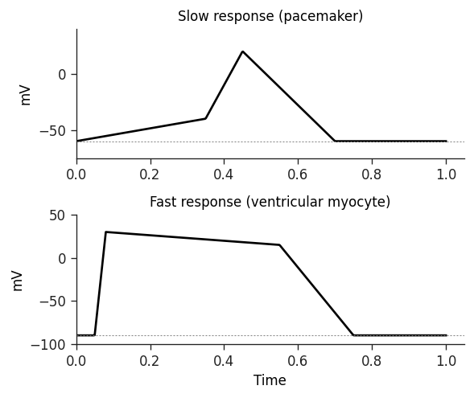
Question 24
A 62-year-old woman comes to the emergency department for palpitations and shortness of breath that began an hour ago. Her medical history includes hypertension, coronary artery disease, and paroxysmal atrial flutter. Blood pressure is 108/76 mm Hg and pulse is rapid. ECG shows atrial flutter with a ventricular rate of approximately 150 per minute. The estimated atrial rate based on the ECG flutter waves is 300 per minute. Which of the following is most likely responsible for the rate difference between the atria and the ventricles?
A. Calcium current within the atrioventricular node
B. Calcium current within the sinoatrial node
C. Sodium current within an atrioventricular accessory pathway
D. Sodium current within the atria
E. Sodium current within the ventricles
USMLE Step 1 Prep · CVS Physiology

Slide 26
Question 25
A 10-year-old boy is brought to the clinic by his parents due to chronic fatigue, shortness of breath, and failure to gain weight. The child was recently adopted from an orphanage in Asia. He weighs 20 kg (44.2 lb). Vital signs are within normal limits. Physical examination reveals a loud systolic murmur. Echocardiogram demonstrates pulmonic stenosis and a subaortic ventricular septal defect with rightward deviation of the origin of the aorta. The mother describes occasional episodes of severe dyspnea and cyanosis, during which the child quickly assumes a squatting position. Which of the following mechanisms during squatting relieves this child's symptoms?
A. Decreasing left ventricular workload
B. Decreasing pulmonary blood flow
C. Decreasing pulmonary vascular resistance
D. Improving lung compliance
E. Increasing systemic vascular resistance
USMLE Step 1 Prep · CVS Physiology

Slide 27
Question 26
A 32-year-old woman comes to the outpatient clinic with progressive shortness of breath for the past 6 months. She can now only walk 3 to 4 blocks on level ground before becoming short of breath. She also reports an occasional dry cough at night. She denies chest pain, palpitations, syncope, weight loss, or lower extremity swelling. She immigrated from Guatemala 8 years ago. Medical history is unremarkable. On examination she appears comfortable. Blood pressure is 128/75 mm Hg and pulse is 78 per minute. Peripheral pulses are full and symmetric. The lungs are clear. S1 is loud. With the patient in the left lateral decubitus position and breath held at the end of expiration, a mid- to end-diastolic murmur is heard. The remainder of the exam is unremarkable. Which of the following are the most likely left ventricular hemodynamic findings at rest in this patient (LV diastolic pressure, afterload, and contractility)?
A. Increased LV diastolic pressure, increased afterload, decreased contractility
B. Increased LV diastolic pressure, increased afterload, normal contractility
C. Normal LV diastolic pressure, normal afterload, decreased contractility
D. Normal LV diastolic pressure, normal afterload, normal contractility
USMLE Step 1 Prep · CVS Physiology

Slide 28
Question 27
A 70-year-old woman comes to the office due to progressive exertional dyspnea over the last year. She has no chest pain or lower extremity swelling. The patient has long-standing hypertension but has not always been adherent to her medical regimen. She is a lifetime nonsmoker. Blood pressure is 164/73 mm Hg and pulse is 88 per minute and regular. An S4 is heard on cardiac auscultation. The lungs are clear. Echocardiogram reveals left atrial enlargement, moderate concentric left ventricular hypertrophy, and a left ventricular ejection fraction of 67%. Which of the following changes in left ventricular compliance, angiotensin II signaling, and cardiac myosin heavy chain-beta expression are most likely to be seen in this patient?
A. Decreased LV compliance, increased angiotensin II signaling, increased beta-MHC expression
B. Decreased LV compliance, decreased angiotensin II signaling, increased beta-MHC expression
C. Decreased LV compliance, increased angiotensin II signaling, decreased beta-MHC expression
D. Increased LV compliance, increased angiotensin II signaling, increased beta-MHC expression
E. Increased LV compliance, increased angiotensin II signaling, decreased beta-MHC expression
F. Increased LV compliance, decreased angiotensin II signaling, decreased beta-MHC expression
USMLE Step 1 Prep · CVS Physiology

Slide 29
Question 28
A 33-year-old man comes to the office for fatigue and decreased exercise tolerance over the past 6 months. He was diagnosed with infective endocarditis in the setting of intravenous drug use a year ago and completed a course of antibiotic therapy. He has not used drugs since then. He has no other medical conditions and takes no medications. A cardiac murmur is heard on auscultation. Both carotid arteries demonstrate a rapid rise and fall of the arterial pulse. Partial compression of the femoral arteries by the stethoscope elicits a systolic-diastolic bruit. Which of the following sets of pressure findings is most likely to be observed during cardiac catheterization of this patient (aortic pressure / left ventricular pressure)?
A. Aortic 110/75, LV 160/20
B. Aortic 120/80, LV 120/10
C. Aortic 120/75, LV 120/30
D. Aortic 160/60, LV 160/20
E. Aortic 160/95, LV 160/10
USMLE Step 1 Prep · CVS Physiology

Slide 30
Question 29
A 55-year-old man is brought to the hospital immediately after a sudden collapse at home 20 minutes ago. The patient reported chest pain and then collapsed to the floor while trying to sit down. Medical history is significant for type 2 diabetes mellitus and hypertension. Temperature is 36.7 C, blood pressure is 80/50 mm Hg, pulse is 120 per minute, and respirations are 22 per minute. On examination the patient is in marked respiratory distress. Bilateral crackles are present. An S3 is audible. ECG reveals ST-segment elevation in leads V2 through V6. Which of the following hemodynamic changes (pulmonary capillary wedge pressure, central venous pressure, coronary perfusion pressure) is most likely present in this patient?
A. Decreased PCWP, decreased CVP, decreased coronary perfusion pressure
B. Decreased PCWP, increased CVP, decreased coronary perfusion pressure
C. Increased PCWP, decreased CVP, increased coronary perfusion pressure
D. Increased PCWP, increased CVP, decreased coronary perfusion pressure
E. Increased PCWP, increased CVP, increased coronary perfusion pressure
USMLE Step 1 Prep · CVS Physiology

Slide 31
Question 30
A 2-year-old previously healthy boy is brought to the emergency department for a 4-day history of poor feeding, diarrhea, and abdominal pain. He has had 5 to 7 watery bowel movements per day. Temperature is 36.8 C and blood pressure is 65/42 mm Hg. On physical examination he is lethargic with dry mucous membranes and sunken eyes. Lungs are clear to auscultation. No murmurs are heard. The abdomen is distended and tender with hyperactive bowel sounds. Which of the following changes is most likely present in this patient?
A. Extravasation of fluid from systemic capillaries
B. Increased arteriolar capacitance (vasodilation)
C. Increased central venous pressure
D. Increased ventilatory rate
E. Relaxation of venous smooth muscle
USMLE Step 1 Prep · CVS Physiology

Slide 32
Question 31
A 66-year-old man comes to the office for a follow-up appointment. He has a history of heart failure with reduced ejection fraction and continues to have persistent dyspnea despite taking maximum doses of his heart failure medications. He has had no lightheadedness or chest pain. Blood pressure is 133/72 mm Hg and pulse is 76 per minute. Physical examination reveals normal lung sounds and no lower extremity edema. His medical regimen is modified with the addition of a combination pill that inhibits neprilysin and blocks angiotensin II receptors. Which of the following is the most likely effect of this medication?
A. Decreased renal free-water reabsorption
B. Decreased venous compliance
C. Increased myocardial contractility
D. Increased peripheral arterial resistance
E. Increased urinary sodium excretion
USMLE Step 1 Prep · CVS Physiology

Slide 33
Question 32
A 46-year-old man comes to the office for an annual examination. He has an uncomfortable heartbeat sensation at night that he tries to relieve by sleeping on his right side. The patient has had mild shortness of breath with exertion over the last 6 months but no chest pain. He was told during a wellness check approximately 2 years ago that he had a heart murmur. He has no other medical problems. Physical examination reveals bounding femoral pulses and carotid pulsations accompanied by head bobbing. Which of the following is the most likely diagnosis?
A. Aortic regurgitation
B. Aortic stenosis
C. Atrial septal defect
D. Coarctation of the aorta
E. Mitral regurgitation
F. Mitral stenosis
USMLE Step 1 Prep · CVS Physiology
G. Pulmonary stenosis
H. Tricuspid regurgitation

Slide 34
Question 33
A 43-year-old man comes to the emergency department after experiencing 4 episodes of coffee-ground emesis that started earlier this morning. He also describes epigastric pain over the last 3 to 4 months that was relieved by over-the-counter antacids. He has no other past medical history. He has smoked a pack of cigarettes daily for the last 20 years but does not use alcohol or recreational drugs. Blood pressure is 70/40 mm Hg and pulse is 130 per minute and regular. Extremities are cool to the touch with loss of skin turgor. Intravenous access is obtained via 2 large-bore peripheral catheters and rapid infusion of 2 liters of normal saline is initiated. This intervention is most likely to increase which of the following hemodynamic parameters?
A. Aortic wall elasticity
B. Diastolic ventricular compliance
C. End-diastolic sarcomere length
D. Heart rate
E. Plasma renin activity
F. Total peripheral resistance
USMLE Step 1 Prep · CVS Physiology
G. Ventricular muscle contraction velocity

Slide 35
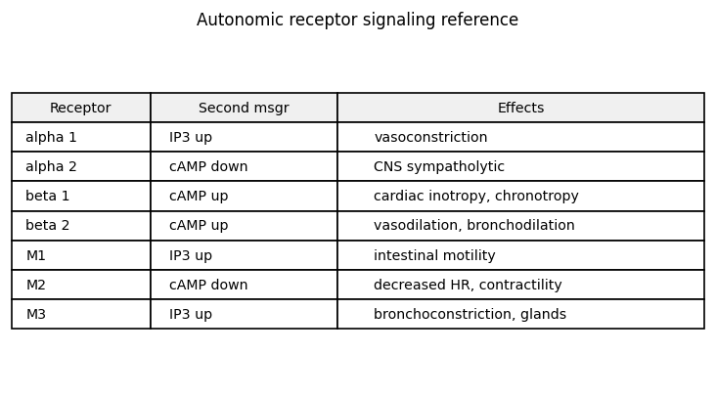
Question 34
A 44-year-old previously healthy woman comes to the emergency department for a 2-day history of left flank pain, dysuria, fever, and chills. Temperature is 38.9 C, blood pressure is 80/40 mm Hg, and pulse is 140 per minute and regular. Physical examination reveals left costovertebral angle tenderness. Laboratory studies show leukocytosis, pyuria, and bacteriuria. Empiric broad-spectrum antibiotics and IV fluids are administered. The patient remains persistently hypotensive, and an intravenous phenylephrine infusion is started. Several minutes later her heart rate decreases to 100 per minute. The infusion most likely induced which of the following intracellular changes in this patient (cyclic AMP level in ventricular myocytes, inositol trisphosphate level in vascular smooth muscle, inward calcium current in sinoatrial nodal cells)?
A. Decreased cAMP in ventricular myocytes, increased IP3 in vascular SM, decreased inward Ca current in SA nodal cells
B. Decreased cAMP in ventricular myocytes, decreased IP3 in vascular SM, no change in inward Ca current
C. Increased cAMP in ventricular myocytes, increased IP3 in vascular SM, increased inward Ca current in SA nodal cells
D. Increased cAMP in ventricular myocytes, no change in IP3, increased inward Ca current in SA nodal cells
E. No change in cAMP, decreased IP3 in vascular SM, decreased inward Ca current
USMLE Step 1 Prep · CVS Physiology

Slide 36
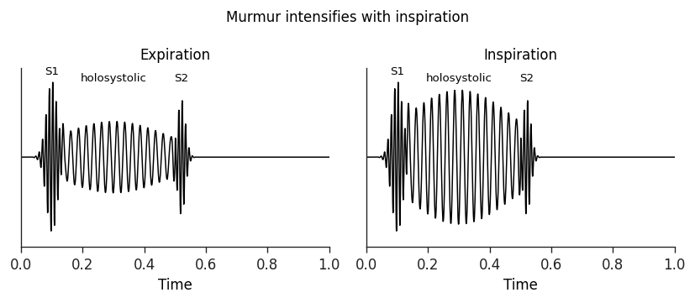
Question 35
A 35-year-old woman comes to the office for a follow-up appointment after recent hospitalization. She presented to the emergency department with fever and malaise, was diagnosed with infective endocarditis, and underwent a prolonged course of antibiotic therapy. Her last dose was 5 days ago. She has no fever or shortness of breath and has resumed her daily activities. Blood pressure is 128/72 mm Hg and pulse is 78 per minute. Auscultatory findings recorded at the left sternal border are shown in the phonocardiogram below. The strip shows a holosystolic murmur during the expiration phase that becomes notably louder and more prolonged during the inspiration phase. Which of the following is the most likely cause of the murmur depicted above?
A. Aortic stenosis
B. Mitral regurgitation
C. Mitral stenosis
D. Pulmonary regurgitation
E. Tricuspid regurgitation
USMLE Step 1 Prep · CVS Physiology

Slide 37
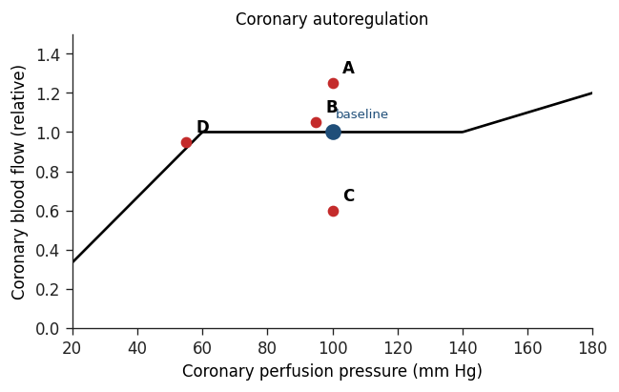
Question 36
Researchers are studying the coronary circulation in various healthy and diseased states using an experimental animal whose cardiovascular physiology is similar to that of humans. They measure blood flow and perfusion pressure in one of the epicardial coronary arteries (baseline measurement shown as a blue circle on a coronary blood flow versus perfusion pressure plot). They then clamp the artery to simulate 70% atherosclerotic stenosis and re-measure the blood flow and perfusion pressure distal to the lesion. Which of the following sets of changes is most likely observed once a steady state is achieved?
A. Increased perfusion pressure with increased blood flow distal to stenosis
B. Slight increase in blood flow at unchanged perfusion pressure
C. Decreased blood flow at unchanged perfusion pressure
D. Decreased perfusion pressure distal to stenosis with blood flow restored to near-baseline by autoregulation
E. Decreased perfusion pressure with collapsed blood flow
USMLE Step 1 Prep · CVS Physiology

Slide 38
Question 37
A 63-year-old man comes to the emergency department for dyspnea. Over the past several days he has experienced progressively worsening shortness of breath while walking his dog around the block. He could not breathe while lying in bed last night and fell asleep only after moving to a recliner. He had an acute myocardial infarction 2 years ago and has been nonadherent with his medications and follow-up appointments. Temperature is 36.7 C, blood pressure is 122/74 mm Hg, pulse is 94 per minute, and respirations are 22 per minute. Physical examination shows bibasilar lung crackles, jugular venous distension, and bilateral pitting edema in the lower extremities. Chest x-ray reveals cardiomegaly and pulmonary venous congestion. Which of the following factors is most likely contributing to this patient's symptoms?
A. Decreased arteriolar resistance
B. Decreased plasma renin activity
C. Decreased ventricular end-diastolic pressure
D. Increased plasma brain natriuretic peptide concentration
E. Increased sympathetic nervous system activity
USMLE Step 1 Prep · CVS Physiology

Slide 39
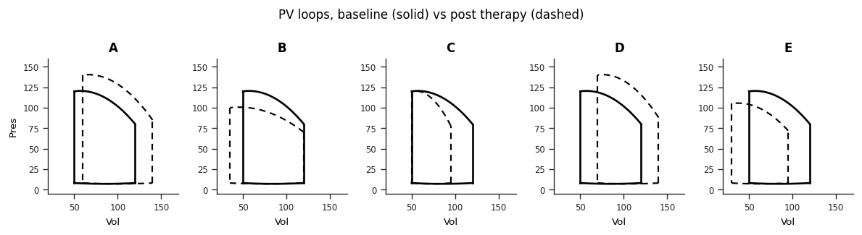
Question 38
A 45-year-old man comes to the emergency department with a 2-day history of dyspnea, orthopnea, and ankle swelling. This morning he also developed nausea, vomiting, and a headache. Blood pressure is elevated, and physical examination reveals pulmonary crackles and bilateral pitting edema to the knees. A sodium nitroprusside infusion is started. Which of the following left ventricular pressure-volume loop changes best represents the effect of this therapy? Solid loop = pre-therapy, dashed loop = during infusion.
A. Unchanged preload with increased stroke volume from a steeper end-systolic pressure-volume relationship (positive inotrope pattern)
B. Increased preload with increased stroke volume and modest rise in peak pressure (Frank-Starling response)
C. Increased preload and afterload with unchanged contractility (pure arterial and venous vasoconstrictor)
D. Decreased preload with mildly decreased stroke volume and modest reduction in afterload (predominantly venous vasodilator)
E. Decreased preload and afterload with stroke volume preserved (balanced arterial and venous vasodilator)
USMLE Step 1 Prep · CVS Physiology

Slide 40
Question 39
A 65-year-old man reports multiple episodes of lightheadedness while buttoning a tight shirt collar. During 2 episodes he passed out briefly but sustained no injuries. His blood pressure was 70/40 mm Hg and pulse was 45 per minute during one of the episodes. Past medical history is significant for hypertension and diet-controlled diabetes mellitus. He is a lifetime nonsmoker and drinks alcohol on social occasions. On physical examination, his blood pressure is 125/72 mm Hg and pulse is 76 per minute without orthostatic changes. Stimulation of afferent sensory fibers in which of the following nerves is most likely responsible for this patient's symptoms?
A. Accessory (CN XI)
B. Glossopharyngeal (CN IX)
C. Hypoglossal (CN XII)
D. Trigeminal (CN V)
E. Vagus (CN X)
USMLE Step 1 Prep · CVS Physiology

Slide 41
Question 40
A 17-year-old boy is brought to the emergency department after passing out. The patient was standing behind the dugout watching his friends play baseball when he suddenly felt warm and lightheaded. Then he remembers awakening on the ground. Bystanders reported that the patient was unresponsive for approximately 2 minutes. He feels fatigued but does not have chest pain or shortness of breath. He has no significant medical history and does not use alcohol or recreational drugs. Temperature is 36.7 C, supine blood pressure is 110/65 mm Hg, pulse is 84 per minute, and respirations are 16 per minute. Pulse oximetry is 100% on room air. The patient is awake and alert. Pupils are equal and reactive. Heart and lung examinations are normal. The abdomen is soft and nontender. Neurologic examination is normal. ECG is unremarkable. Which of the following is the most likely cause of this patient's syncope?
A. Increased automaticity of the Purkinje fibers (ventricular tachycardia)
B. Increased parasympathetic output to the heart (cardioinhibitory vasovagal response)
C. Increased sympathetic output to the small vessels
D. Reentry arrhythmia using the atrioventricular node (AVNRT)
E. Systolic anterior motion of the mitral valve (HCM)
USMLE Step 1 Prep · CVS Physiology

Slide 42
Answer Key
Answers 1 to 40 with explanations

Slide 43
Answer 1
Vignette: A 34-year-old woman who recently moved to the United States from Russia presents with progressive weakness, shortness of breath on exertion, and difficulty breathing while lying flat.
✓
Correct answer: D
The patient has mitral stenosis from prior rheumatic fever, far more common in regions with poor access to antibiotic treatment for streptococcal pharyngitis. The opening snap is generated when the thickened, fused mitral leaflets are forced apart by left atrial pressure rising above LV pressure during early diastole. On a PV loop, this transition is the bottom-left corner where the descending isovolumetric relaxation segment pivots into the rightward-moving filling segment. The four cardinal PV loop transition points are: mitral closure (end-diastole, bottom-right), aortic opening (start of ejection, top-right), aortic closure (end-systole, top-left), and mitral opening (start of filling, bottom-left). Point D matches this last transition.
Why other choices are wrong
A. End-diastole, where the mitral valve closes (this is when S1 is generated, not OS)
B. Aortic valve opening, normally silent
C. Aortic valve closure, which generates S2 not OS
E. Peak ejection pressure during systole, silent
F. A mid-filling location, not a valve event
USMLE Step 1 Prep · CVS Physiology

Slide 44
Answer 2
Vignette: A 56-year-old man arrives in the emergency department reporting that his heart feels fast and irregular.
✓
Correct answer: D
The scenario describes holiday heart syndrome: acute atrial fibrillation precipitated by binge alcohol intake. AF on ECG has three hallmark features: absent organized P waves replaced by chaotic fibrillatory undulations, irregularly irregular R-R intervals with no underlying repeating pattern, and a typically rapid uncontrolled ventricular response above 100 per minute. Mechanistically, foci of rapid atrial electrical activity (often originating near the pulmonary venous ostia) fire at 400 to 600 per minute. The AV node filters and transmits these impulses unpredictably to the ventricles. Common predisposing and triggering factors include age-related atrial remodeling, hypertension, valvular disease (especially mitral stenosis), hyperthyroidism, sympathetic surge from sepsis or stress, and excessive alcohol intake.
Why other choices are wrong
A. Ventricular bigeminy is regularly irregular: every sinus beat is followed by a PVC at a predictable interval, distinguishable from the chaotic AF pattern
B. VT shows wide QRS at a regular rapid rate, not narrow QRS irregularly spaced
C. Atrial flutter with fixed conduction produces a regular ventricular response despite the flutter waves
E. AVNRT is a regular tachycardia, not irregularly irregular
USMLE Step 1 Prep · CVS Physiology

Slide 45
Answer 3
Vignette: A 65-year-old woman is brought to the hospital with sudden chest heaviness and shortness of breath that began one hour earlier.
✓
Correct answer: C
Acute lateral wall STEMI with hypotension and cold clammy extremities indicates cardiogenic shock from left ventricular pump failure. Three concurrent hemodynamic changes follow. First, infarcted myocardium contracts poorly, so cardiac contractility falls. Second, the resulting drop in blood pressure unloads the carotid and aortic baroreceptors, removing tonic inhibition of sympathetic outflow. The sympathetic surge produces intense peripheral arteriolar vasoconstriction, raising systemic vascular resistance markedly (this is what makes the extremities cold and clammy). Third, the failing LV cannot eject enough blood forward, so LV end-diastolic pressure climbs and transmits retrograde through the left atrium into the pulmonary venous system, raising pulmonary capillary wedge pressure. To continue moving blood forward across the now higher pulmonary venous pressure, pulmonary artery systolic pressure must also rise. If the RV cannot generate this higher pressure, right ventricular failure follows.
Why other choices are wrong
A. Pattern fits warm distributive shock (sepsis) where SVR drops, not cardiogenic
B. Hypovolemic shock pattern with low filling pressures and increased SVR, but contractility and PA pressure are typically preserved or low
D. Increased contractility with this hypotension would not be expected
E. Increased contractility does not fit pump failure
USMLE Step 1 Prep · CVS Physiology

Slide 46
Answer 4
Vignette: A 45-year-old woman enrolled in a cardiovascular health study wears a continuous 24-hour ambulatory ECG monitor.
✓
Correct answer: E
Beat Y is a premature ventricular contraction, recognized on ECG by its wide QRS, oppositely-directed T wave, and the brief pause that follows. PVCs originate in ectopic ventricular foci with enhanced automaticity and depolarize the ventricles ahead of schedule, before the LV has finished its usual diastolic filling time. The EDV for beat Y is therefore reduced compared with a baseline sinus beat. The compensatory pause that follows occurs because the SA node continues firing on its own schedule, but the next sinus impulse arrives during the ventricular refractory period and is blocked. The next successfully conducted beat (Z) therefore has a longer diastolic filling interval than usual, producing a larger EDV. The forceful contraction generated by this larger preload is sometimes felt as a palpitation. The correct ranking is Z (post-PVC, longest fill time) greater than X (sinus, normal fill time) greater than Y (PVC, shortened fill time).
Why other choices are wrong
A. Ignores that PVC timing reduces filling time and the compensatory pause extends it
B. Reversed: Z should be highest, not lowest
C. PVC has reduced filling, not the highest EDV
D. Misses that the PVC has reduced EDV compared with the post-PVC beat
USMLE Step 1 Prep · CVS Physiology

Slide 47
Answer 5
Vignette: A 44-year-old man is hospitalized after a motor vehicle collision with multiple injuries.
✓
Correct answer: B
An arteriovenous fistula creates a low-resistance shortcut from the arterial side directly to the venous side, bypassing the high-resistance arteriolar bed. Three hemodynamic consequences follow. First, the parallel low-resistance pathway lowers overall systemic vascular resistance, so the LV ejects against less afterload. Second, blood returns rapidly to the right heart through the venous limb, raising venous return and increasing LV preload (the EDV grows). Third, the combination of less afterload and more preload increases stroke volume, widening the PV loop horizontally and producing a slightly lower peak ejection pressure. Baseline contractility is initially unchanged (the slope of the end-systolic pressure-volume relationship is preserved), although a sustained reflex may eventually adjust it. Large chronic AV fistulas can drive high-output heart failure if the LV cannot keep pace with the elevated venous return demand.
Why other choices are wrong
A. Steeper ESPVR with increased contractility describes a positive inotrope (such as digoxin), not the AV fistula effect
C. Higher afterload with reduced SV fits aortic stenosis or systemic vasoconstrictor, opposite of the AV fistula physiology
D. Reduced preload pattern matches a venodilator like nitroglycerin, not increased venous return from a fistula
USMLE Step 1 Prep · CVS Physiology

Slide 48
Answer 6
Vignette: A 4-week-old boy is scheduled for cardiac catheterization to close a patent ductus arteriosus.
✓
Correct answer: D
After birth, pulmonary vascular resistance normally falls and aortic pressure exceeds pulmonary arterial pressure throughout the cardiac cycle. When the ductus arteriosus fails to close (as is common in premature infants), this pressure gradient drives oxygenated blood from the descending aorta backward through the PDA into the main pulmonary artery, both during systole and diastole. The deoxygenated blood that the right ventricle normally ejects into the pulmonary artery (PaO2 around 40 mm Hg) gets mixed with this incoming oxygenated aortic blood, raising the measured PaO2 of pulmonary artery samples above the normal value. All other compartments retain their usual oxygen content: the aorta receives normally oxygenated blood from the LV, the left atrium continues to receive blood from the pulmonary veins (which is fully oxygenated regardless of shunt presence), and the right atrium receives systemic venous return that is upstream of the PDA shunt point. If the shunt later reverses (Eisenmenger physiology with elevated pulmonary pressures), aortic PaO2 could drop and the patient would become cyanotic, which is not described here.
Why other choices are wrong
A. The ascending aorta is upstream of the PDA shunt; its blood is normally oxygenated by the LV and is not affected
B. Descending aortic blood proximal to the shunt is also fully oxygenated, unchanged from normal
C. Left atrial blood comes from the pulmonary veins; flow volume is higher with left-to-right shunting, but the oxygen content per unit is unchanged
E. Right atrial blood is systemic venous return, upstream of where the PDA delivers oxygenated blood, so its PaO2 is unchanged
USMLE Step 1 Prep · CVS Physiology

Slide 49
Answer 7
Vignette: A 32-year-old man is evaluated in the emergency department for fever, night sweats, and chills lasting several days.
✓
Correct answer: A
Aortocavitary fistulas are a recognized but uncommon complication of bacterial endocarditis. Infection extends from the valve leaflet into the surrounding myocardial tissue, eventually eroding through and creating an abnormal channel between the aortic root and an adjacent chamber, in this case the right ventricle. The direction and timing of flow through any intracardiac shunt is determined by the pressure gradient between the two communicating chambers. Aortic root pressure is roughly 120 mm Hg in systole and remains around 80 mm Hg in diastole. Right ventricular pressure is roughly 25 mm Hg in systole and only about 2 mm Hg in diastole. Because aortic pressure greatly exceeds RV pressure throughout both phases of the cycle, blood shunts continuously from aorta to RV, generating a continuous murmur on auscultation. The same logic explains continuous flow through any other AV fistula or PDA where pressure differential persists across both phases.
Why other choices are wrong
B. Diastolic-only flow would be expected if aortic pressure exceeded RV pressure only in diastole, but the gradient persists during systole as well
C. Systolic-only flow would mean RV systolic pressure briefly exceeded aortic systolic, which is not the case
D, E, F. Pressure in the aortic root is higher than RV pressure throughout the cycle, so flow direction from RV to aorta is impossible
USMLE Step 1 Prep · CVS Physiology

Slide 50
Answer 8
Vignette: A 52-year-old man comes to the office reporting two weeks of progressive shortness of breath and a dry cough.
✓
Correct answer: D
The arrow marks the moment when early rapid passive filling of the LV abruptly decelerates. A third heart sound (S3) is generated by the sudden limitation of ventricular wall motion during this phase of passive filling. The sound is low-pitched and best heard with the bell of the stethoscope at the cardiac apex with the patient in the left lateral decubitus position. In healthy adults under 40 an S3 can be a normal finding. After age 40 an S3 implies abnormal LV cavity enlargement (eccentric hypertrophy), as occurs in chronic severe mitral regurgitation, chronic severe aortic regurgitation, or dilated cardiomyopathy. It may also be heard in high-output states (pregnancy, thyrotoxicosis). The patient's reduced exercise tolerance and dyspnea suggest cardiac dysfunction; combined with the late-life timing this S3 likely reflects a pathologic eccentric remodeling of the ventricle.
Why other choices are wrong
A. S4 is a low-frequency late-diastolic sound coinciding with atrial systole (the A wave), reflecting blood striking a stiff non-compliant ventricle. It precedes S1 and is associated with concentric LV hypertrophy
B. A mid-systolic click occurs in mitral valve prolapse, not during diastole
C. S2 marks the closure of the semilunar valves at the end of systole, not during diastolic mitral inflow
E. An aortic ejection click occurs in early systole at the start of ejection, not during diastole
USMLE Step 1 Prep · CVS Physiology

Slide 51
Answer 9
Vignette: Following the cardiac evaluation that suggested heart failure, the same 52-year-old man is examined further.
✓
Correct answer: E
Pleural effusions are classified as transudates or exudates using the Light criteria, which compare pleural protein and LDH to serum levels. A transudate forms when an imbalance in hydrostatic or oncotic forces drives fluid across an otherwise intact capillary membrane. In heart failure, elevated pulmonary venous and capillary hydrostatic pressure pushes a protein-poor and LDH-poor ultrafiltrate into the pleural space, so the fluid has low protein and low LDH relative to serum. An exudate forms when increased capillary permeability (infection, malignancy, inflammation) allows protein and large molecules to leak into the space, producing high protein and high LDH levels. Heart failure is the most common cause of transudative effusion; pneumonia, malignancy, tuberculosis, and rheumatologic disease are common causes of exudate. The Light criteria flag an effusion as exudative if pleural-to-serum protein ratio exceeds 0.5, pleural-to-serum LDH ratio exceeds 0.6, or pleural LDH is more than two-thirds of the upper limit of normal serum LDH.
Why other choices are wrong
A. High amylase suggests pancreatitis, pancreatic pseudocyst, or esophageal rupture
B. High pleural protein indicates an exudative process such as infection or malignancy, not a transudate from heart failure
C. High WBC content suggests a parapneumonic or malignant effusion, not transudate
D. Low pleural glucose is characteristic of bacterial infection or malignancy, where cells consume glucose
USMLE Step 1 Prep · CVS Physiology

Slide 52
Answer 10
Vignette: A 12-day-old girl is evaluated in the neonatal intensive care unit for a heart murmur.
✓
Correct answer: C
The continuous murmur, bounding peripheral pulses, and history of extreme prematurity point to a patent ductus arteriosus. Postnatally the ductus normally closes within hours to days as oxygenation rises and circulating prostaglandin levels fall; preterm infants frequently fail this closure. A persistent PDA provides a low-resistance shortcut from the aorta back into the pulmonary artery. Three integrated changes follow. First, the parallel low-resistance pulmonary pathway reduces overall systemic vascular resistance (the LV faces less downstream resistance). Second, the shunted blood traverses the pulmonary vasculature and returns through the pulmonary veins to the left atrium, increasing left atrial filling and LV preload. Third, the combination of reduced afterload and increased preload raises stroke volume and therefore LV output. The wide pulse pressure (high stroke volume + low diastolic from continuous aorta-to-PA runoff) accounts for the bounding pulses. If the shunt remains large and chronic, the volume-overloaded LV can eventually fail, at which point CO drops and SVR rises reflexively, and bounding pulses disappear.
Why other choices are wrong
A, B, D, E. PDA initially causes the triad of increased LV output, decreased SVR, and increased LA filling. Only option C captures all three. Reduced CO or increased SVR would represent later-stage decompensation or compensatory response after LV failure, neither of which is present in this acutely diagnosed infant
USMLE Step 1 Prep · CVS Physiology

Slide 53
Answer 11
Vignette: A 34-year-old man comes to the clinic for evaluation of a heart murmur.
✓
Correct answer: B
The clinical picture (asymptomatic young man, ejection click at the right second intercostal space, soft systolic murmur radiating to the neck) is most consistent with a bicuspid aortic valve, a common congenital abnormality often asymptomatic in young adulthood. The question asks where on the LV pressure tracing the aortic valve opens. Aortic opening occurs at the end of isovolumetric contraction, when LV pressure has risen high enough to exceed the central aortic pressure and forward ejection begins. On the LV pressure curve, this corresponds to the moment when LV pressure stops climbing in isolation and starts driving forward flow into the aorta, which is the inflection at the upper end of the isovolumetric contraction segment. This is point B. The opposite event (aortic closure at the end of ejection) marks point C, and the start and end of mitral filling correspond to D and E respectively.
Why other choices are wrong
A. This point marks atrial systole and the small ventricular volume rise it produces, immediately before mitral valve closure begins isovolumetric contraction
C. Aortic valve closure, where LV pressure has dropped below aortic pressure and isovolumetric relaxation begins
D. Mitral valve opens at the end of isovolumetric relaxation, marking the start of LV filling
E. Passive filling phase of diastole, no valve event
USMLE Step 1 Prep · CVS Physiology

Slide 54
Answer 12
Vignette: A 43-year-old man is evaluated for episodes of palpitations that occur during periods of anxiety.
✓
Correct answer: E
The patient's anxiety-provoked sudden palpitations with lightheadedness fit paroxysmal supraventricular tachycardia. PSVT typically arises from a reentrant circuit involving the AV node. The tracing shown is a pacemaker action potential of a slow-response tissue (SA or AV node), where the upstroke and resting potential both depend on slow inward L-type calcium current. Verapamil is a Class IV antiarrhythmic and an L-type calcium channel blocker. In slow-response tissue it produces two key effects: it slows the rate of phase 4 spontaneous depolarization (reducing the slope so threshold is reached later) and it slows the phase 0 upstroke. Together these reduce AV nodal conduction velocity and increase nodal refractoriness, breaking or preventing AV nodal reentrant circuits. This makes verapamil effective at terminating and preventing recurrent PSVT. The same calcium blockade in working ventricular myocytes would reduce inotropy by limiting calcium availability for contraction, but the question stem shows a nodal action potential, not a ventricular one.
Why other choices are wrong
A. Reducing excitation-contraction coupling does occur with verapamil in ventricular myocytes (reduced inotropy), but the tracing shown is a pacemaker AP from nodal tissue, where coupling and contractility are not relevant
B. Class I and IV agents do not raise AP amplitude; they generally reduce upstroke amplitude in their target tissue
C. Verapamil does not lower threshold; if anything it raises the threshold/decreases excitability in nodal cells
D. Verapamil increases nodal refractory period rather than reducing it; this is part of its therapeutic effect
USMLE Step 1 Prep · CVS Physiology

Slide 55
Answer 13
Vignette: A 39-year-old man comes to the office reporting two weeks of progressive fatigue.
✓
Correct answer: C
Three basic cardiac output relationships solve this question. Stroke volume equals end-diastolic volume minus end-systolic volume: 125 − 75 = 50 mL. Ejection fraction equals stroke volume divided by end-diastolic volume, multiplied by 100 to get a percentage: (50 / 125) × 100 = 40%. Normal LV ejection fraction is approximately 50% or greater, so 40% indicates reduced systolic function (heart failure with reduced ejection fraction). Cardiac output equals stroke volume multiplied by heart rate: 50 mL × 100 beats/min = 5 L/min, which is within the normal range. The patient has clinically masked systolic dysfunction: low stroke volume is being temporarily compensated by an elevated heart rate to maintain cardiac output, but symptoms (fatigue, crackles) are emerging. The recent viral upper respiratory illness raises suspicion for postviral nonischemic dilated cardiomyopathy or myocarditis.
Why other choices are wrong
A. Cardiac output is 5 L/min (50 × 100), not 4
B. Cardiac output is 5 L/min, not 6
D. 60% would represent a preserved EF; this patient is at 40%
E. Stroke volume is 50 mL (125 - 75), not 40
F. Stroke volume is 50 mL, not 60
USMLE Step 1 Prep · CVS Physiology

Slide 56
Answer 14
Vignette: A 67-year-old man is brought to the emergency department by his son after a syncopal episode.
✓
Correct answer: A
Complete dissociation of P waves from QRS complexes defines third-degree (complete) AV block. The SA node continues to fire at its intrinsic rate (around 60 to 100 per minute), generating P waves, but no impulses reach the ventricles because the block is somewhere between the atria and the ventricular conducting system. The ventricles are then paced by whichever latent pacemaker lies just below the block. Each level of the conduction system has a progressively slower intrinsic rate and produces a different QRS morphology. A junctional/His bundle escape rate is around 40 to 60 per minute and produces a narrow QRS because the impulse still travels through the normal bundle branches and Purkinje system to depolarize the ventricles synchronously. A more distal escape from the bundle branches or Purkinje system fires at 25 to 40 per minute and produces a wide QRS because at least one ventricle is depolarized cell-to-cell rather than through the rapid conduction system. The narrow-QRS escape in this patient places the block at the AV node or in the upper His bundle, with His bundle cells driving the ventricles.
Why other choices are wrong
B. A pacemaker in the left bundle branch would produce a wide QRS because impulse spread would not use both ventricles' rapid conduction system simultaneously
C. Ventricular muscle itself does not normally exhibit pacemaker automaticity at meaningful rates
D. Purkinje system escape produces a wide QRS at a slower rate (25 to 40 per minute), not the narrow QRS shown
E. SA node pacing would give a normal sinus rhythm with each P wave followed by a QRS, not the dissociation seen here
USMLE Step 1 Prep · CVS Physiology

Slide 57
Answer 15
Vignette: A 44-year-old man comes to the office with progressive shortness of breath.
✓
Correct answer: B
The medication described is a neprilysin inhibitor (sacubitril, typically combined with the angiotensin receptor blocker valsartan as ARNI therapy). Neprilysin is a membrane-bound metalloprotease that degrades several endogenous vasoactive peptides, the most clinically important of which are the natriuretic peptides. Atrial natriuretic peptide (ANP) is secreted by atrial cardiomyocytes in response to atrial stretch, and B-type natriuretic peptide (BNP) is secreted by ventricular cardiomyocytes in response to myocardial wall stress. Both are released as the failing heart is volume- and pressure-loaded. Once released, ANP and BNP bind natriuretic peptide receptors on target tissues, activate guanylate cyclase, raise intracellular cGMP, and produce: renal afferent arteriolar dilation with efferent constriction (increased GFR), inhibition of sodium reabsorption in the collecting duct, inhibition of renin and aldosterone secretion (counteracting RAAS), and systemic arteriolar vasodilation. Inhibiting neprilysin prolongs the half-life of endogenously secreted ANP and BNP, amplifying these beneficial effects in heart failure.
Why other choices are wrong
A. Zona glomerulosa cells secrete aldosterone; their secretion is suppressed (not enhanced) by neprilysin inhibition, indirectly via the ANP/BNP effect on RAAS
C. Hepatic stellate cells regulate local sinusoidal blood flow but have no significant role in systemic neurohormonal regulation of heart failure
D. Purkinje fibers conduct electrical impulses and do not have endocrine function
E. Juxtaglomerular cells secrete renin; this is the RAAS axis that ARNI inhibits indirectly, not the natriuretic peptide axis it enhances
F. Endothelial cells release vasoactive mediators like NO and endothelin but are not the target of neprilysin therapy
USMLE Step 1 Prep · CVS Physiology

Slide 58
Answer 16
Vignette: A 14-year-old girl is brought to the office to establish medical care.
✓
Correct answer: C
A widely split, fixed S2 combined with a soft early-systolic ejection murmur over the left upper sternal border is the classic auscultatory signature of an atrial septal defect. Left atrial pressure is normally slightly higher than right atrial pressure because the thin-walled right atrium is more compliant; an ASD therefore creates a left-to-right shunt at the atrial level. This shunt delivers extra blood volume to the right atrium and right ventricle on every cardiac cycle. The murmur itself is not produced by flow across the ASD (low velocity, no turbulence, silent) but by the increased volume of blood traversing the normal pulmonic valve, generating a pulmonic flow ejection murmur. The wide and fixed splitting of S2 reflects two changes: the increased RV volume delays pulmonic valve closure (widening the A2-P2 gap), and because the chronically elevated RV venous return is supplied partly by the shunt rather than by inspiration-dependent venous return, the normal inspiratory widening of the split disappears (it is now fixed across the respiratory cycle). A larger ASD can also generate a soft diastolic rumble at the lower left sternal border from increased tricuspid flow, not seen here.
Why other choices are wrong
A. Aortic stenosis would produce a crescendo-decrescendo murmur at the right upper sternal border with possible paradoxical splitting of S2, not wide fixed splitting at the left upper sternal border
B. A VSD typically produces a holosystolic murmur at the left lower sternal border due to a high-pressure shunt; splitting of S2 may widen but is not usually fixed because RV volume does not increase as constantly as with an ASD
D. Aortic insufficiency causes a decrescendo diastolic murmur, not a systolic murmur, and does not produce fixed splitting of S2
USMLE Step 1 Prep · CVS Physiology

Slide 59
Answer 17
Vignette: A 38-year-old woman is evaluated for shortness of breath.
✓
Correct answer: D
Pulmonary capillary wedge pressure approximates left atrial pressure: the catheter occludes a distal pulmonary artery branch, creating a static column of blood between the tip and the left atrium so that the measured pressure tracks LA pressure. In healthy hearts, LA pressure equals LV end-diastolic pressure during diastole, because the open mitral valve presents minimal resistance to flow between the two chambers. This patient has a normal LVEDP (10) but a markedly elevated PCWP (36), creating a large diastolic pressure gradient between the left atrium (high) and the LV (normal). The only way to develop this gradient is mechanical obstruction at the mitral valve: stenosis. In mitral stenosis (most commonly from prior rheumatic fever), thickened and partially fused leaflets restrict flow during diastole. Blood backs up into the LA, raising LA pressure (and PCWP) while the LV is partially shielded from the elevated upstream pressures. Symptoms reflect both reduced forward flow (exertional dyspnea, fatigue) and pulmonary congestion from elevated pulmonary venous and capillary pressures.
Why other choices are wrong
A. Aortic stenosis would raise LV peak systolic pressure substantially above the normal aortic systolic pressure, often well over 200, which is not seen here
B. Tamponade equalizes diastolic pressures across all four chambers; LVEDP and PCWP would both be elevated to similar values, not the discrepant pattern shown
C. Dilated cardiomyopathy raises LVEDP as the failing LV cannot accept normal venous return; PCWP rises in parallel, producing no LA-LV gradient
E. Restrictive cardiomyopathy also elevates LVEDP from impaired diastolic filling, again producing a parallel rise in PCWP without the large gradient seen here
USMLE Step 1 Prep · CVS Physiology

Slide 60
Answer 18
Vignette: A 23-year-old man comes to the emergency department with sudden onset palpitations that began while he was at his desk at work.
✓
Correct answer: D
The clinical picture (sudden onset of a rapid regular narrow-complex tachycardia in a young patient, terminated by carotid sinus massage) is consistent with paroxysmal supraventricular tachycardia, most commonly AV nodal reentrant tachycardia. The reentrant circuit cycles through the slow and fast pathways within or near the AV node. Carotid sinus massage compresses the carotid sinus, which contains stretch-sensitive baroreceptors. This mechanically increases baroreceptor afferent firing, which is interpreted by central brainstem cardiovascular centers as elevated blood pressure. The reflex response is increased parasympathetic outflow via the vagus nerve to the heart and decreased sympathetic outflow. Parasympathetic effects on the AV node include slowing of conduction velocity and lengthening of the refractory period. The longer refractory period prevents the reentrant impulse from completing its circuit, breaking the tachycardia and restoring sinus rhythm. Other vagal maneuvers (Valsalva, cold water immersion, gagging) work by the same mechanism.
Why other choices are wrong
A. Carotid sinus massage INCREASES baroreceptor firing, not decreases it
B. Sympathetic output is reduced (not increased) by the vagal reflex triggered here; increased sympathetic activity would speed AV node conduction and prolong the arrhythmia
C. SVR drops modestly with the parasympathetic reflex; the relevant target is the AV node, not the vasculature
E. Vagal innervation of the ventricular myocardium is sparse and does not significantly affect ventricular refractoriness
USMLE Step 1 Prep · CVS Physiology

Slide 61
Answer 19
Vignette: A 56-year-old man comes to the emergency department for palpitations that began several hours ago.
✓
Correct answer: B
The ECG description (rapid, regular atrial activity in a saw-toothed flutter wave pattern with narrow QRS complexes and a regular ventricular response) is diagnostic of typical atrial flutter. The atrial rate is around 300 per minute; ventricular rate depends on AV nodal conduction ratio (often 2:1 giving 150, or 3:1 giving 100, or 4:1 giving 75). Typical atrial flutter is sustained by a single large reentrant circuit that travels counterclockwise around the right atrium, passing through the cavotricuspid isthmus (the narrow band of atrial tissue bounded by the tricuspid valve annulus and the inferior vena cava). This isthmus is the obligate slow-conduction segment of the circuit; interrupting it with a linear lesion blocks the reentry and abolishes the arrhythmia. Radiofrequency ablation across the cavotricuspid isthmus is highly effective for typical atrial flutter, with success rates exceeding 90%. The procedure is mapped under fluoroscopy or with electroanatomic guidance.
Why other choices are wrong
A. Accessory pathway (bundle of Kent) ablation targets atrioventricular reciprocating tachycardia in Wolff-Parkinson-White syndrome, characterized by a short PR and delta wave, not seen in atrial flutter
C. The RV outflow tract is the site of origin for idiopathic ventricular tachycardia, presenting with wide QRS and uniform morphology
D. Pulmonary vein ostia are the ectopic trigger sites for atrial fibrillation; pulmonary vein isolation is the ablation strategy for symptomatic AF, which has irregularly irregular R-R intervals and no organized atrial activity
E. The slow pathway of the AV node is the target for AVNRT ablation, which presents as narrow regular tachycardia with retrograde P waves, not the saw-tooth flutter pattern
USMLE Step 1 Prep · CVS Physiology

Slide 62
Answer 20
Vignette: A 69-year-old man is brought to the emergency department with sudden onset palpitations and dyspnea.
✓
Correct answer: B
The ECG findings define atrial fibrillation: irregularly irregular R-R intervals, absent organized P waves, and rapid disorganized fibrillatory atrial activity that proceeds at 400 to 600 per minute. The atria fire chaotically, and the ventricles are protected from this barrage by the filtering function of the AV node. Each impulse that reaches the AV node leaves it in a refractory state for a finite period, during which subsequent atrial impulses cannot be transmitted. The number of impulses that successfully cross to the ventricles per unit time, and therefore the ventricular contraction rate, is determined by how long the AV node remains refractory between successful conductions. Untreated AF typically conducts to give a ventricular rate of 90 to 170 per minute. Pharmacologic therapy that prolongs AV node refractoriness (beta-blockers, non-dihydropyridine calcium channel blockers, digoxin) slows the ventricular rate. Atrial rate, SA node activity, and bundle/Purkinje properties do not gate ventricular response in AF.
Why other choices are wrong
A. Atrial depolarization is occurring at 400 to 600 per minute, but the ventricles cannot follow this rate because the AV node filters the impulses
C. Bundle branch conductivity affects QRS width and morphology (wide QRS in bundle branch block), not the ventricular rate
D. Purkinje pacemaker activity emerges only when the SA and AV nodes are completely silent (severe bradycardia); it does not determine the rate in fast-conducting AF
E. The SA node is bypassed in AF; the atria fibrillate from ectopic foci independent of SA node firing
F. Ventricular refractoriness allows much faster rates than seen here (up to 300 in VT); it is not the rate-limiting factor in AF
USMLE Step 1 Prep · CVS Physiology

Slide 63
Answer 21
Vignette: A 24-year-old healthy woman participates in a pharmacologic clinical study.
✓
Correct answer: D
These coupled curves describe the steady-state interaction between the heart and the vasculature. The cardiac function curve maps cardiac output against right atrial pressure (preload) at constant contractility; shifts left or right reflect changes in inotropy. The vascular function curve maps venous return against right atrial pressure at constant blood volume and venous tone; shifts left or right reflect changes in either total blood volume or unstressed/stressed venous capacitance. Nitroglycerin is primarily a venodilator: it relaxes venous smooth muscle, expanding venous capacitance. As a result, more blood pools in the now-larger venous reservoir, less blood reaches the right atrium at any given right atrial pressure, and the mean systemic filling pressure (the x-axis intercept of the venous return curve, the pressure at which net venous return is zero) drops. The vascular function curve shifts leftward. The cardiac function curve is unchanged because nitroglycerin has no direct inotropic effect. A new intersection point develops at a lower right atrial pressure and lower cardiac output. This effect underlies the use of nitroglycerin to relieve symptoms in conditions of elevated preload (acute pulmonary edema, anginal preload reduction).
Why other choices are wrong
A. Leftward shift of the cardiac function curve indicates increased contractility (e.g. digoxin), and rightward shift of vascular function curve indicates increased venous return (e.g. fluid bolus). Nitroglycerin does neither
B. Rightward shift of cardiac function curve fits a negative inotrope (e.g. verapamil); nitroglycerin does not depress contractility
C. Decreased contractility plus decreased venous return is not the nitroglycerin pattern; pure venodilation leaves contractility unchanged
E. Increased contractility plus increased venous return describes exercise, not nitroglycerin
USMLE Step 1 Prep · CVS Physiology

Slide 64
Answer 22
Vignette: A 50-year-old man comes to the emergency department for intermittent palpitations over the last 6 months.
✓
Correct answer: D
The intermittent self-resolving episodes of irregularly irregular palpitations with no organized P waves on the rhythm strip define paroxysmal atrial fibrillation. The development of AF requires both a substrate (electrical remodeling of the atrial myocardium, with shortened refractory periods and heterogeneous conduction) and a trigger (a discrete focus of aberrant electrical activity that initiates the chaotic atrial rhythm). The most common anatomic source of these triggering foci is the muscular sleeves of myocytes that extend from the left atrium into the proximal pulmonary veins. These sites are prone to spontaneous ectopic firing, particularly under conditions of increased atrial stretch, sympathetic surge, or after alcohol exposure. Each ectopic discharge can initiate a new round of AF in the remodeled atrium. Catheter ablation that electrically isolates the pulmonary vein ostia from the rest of the left atrium (pulmonary vein isolation) is the cornerstone of invasive therapy for symptomatic paroxysmal AF, as it interrupts the trigger-to-substrate pathway.
Why other choices are wrong
A. AV nodal reentry causes AVNRT with regular narrow QRS tachycardia, not irregularly irregular AF
B. The crista terminalis can be involved in atrial flutter reentry, which shows saw-tooth flutter waves and a regular ventricular response, not irregular AF
C. Papillary muscles can give rise to idiopathic ventricular tachycardia (wide QRS, monomorphic), not AF
E. RV outflow tract is another idiopathic VT origin, not AF
F. The cavotricuspid isthmus near the tricuspid annulus is the atrial flutter reentry site, not AF
USMLE Step 1 Prep · CVS Physiology

Slide 65
Answer 23
Vignette: A 20-year-old previously healthy woman is brought to the emergency department after a motor vehicle collision.
✓
Correct answer: E
Hypotension and tachycardia in the setting of multiple lacerations and pelvic fracture (a common source of severe internal bleeding) indicate hypovolemic shock from acute hemorrhage. Three integrated changes follow. First, the loss of intravascular volume reduces arterial blood pressure, which mechanically reduces stretch on the carotid and aortic baroreceptors and lowers their afferent firing rate. The brainstem cardiovascular control center interprets reduced baroreceptor input as low blood pressure and removes the tonic inhibition it normally places on sympathetic outflow; sympathetic activity to the heart and vasculature rises while parasympathetic outflow falls. Second, increased sympathetic input to the ventricular myocardium increases cardiac contractility via beta-1 receptor activation (the same input also raises heart rate at the SA node and constricts peripheral vessels to maintain BP). Third, atrial natriuretic peptide is normally released by atrial cardiomyocytes in response to atrial wall stretch. With acute volume loss, atrial stretch falls and ANP release drops. The integrated profile in hemorrhagic shock is therefore: increased contractility, decreased baroreceptor firing, and decreased ANP release.
Why other choices are wrong
A, F, G, H. Baroreceptor firing is inversely related to cardiac contractility because reduced baroreceptor input releases sympathetic outflow that drives inotropy; combinations where both move in the same direction are physiologically inconsistent
B. Loss of volume reduces atrial stretch and therefore ANP secretion; increased ANP would only occur with hypervolemia
C, D. Same atrial stretch reasoning rules out increased ANP in this setting
USMLE Step 1 Prep · CVS Physiology

Slide 66
Answer 24
Vignette: A 62-year-old woman comes to the emergency department for palpitations and shortness of breath that began an hour ago.
✓
Correct answer: A
Atrial flutter generates atrial impulses at approximately 300 per minute through a large reentrant circuit, most commonly traversing the cavotricuspid isthmus. If every atrial impulse were transmitted directly to the ventricles, the ventricular rate would also reach 300, leaving inadequate diastolic filling time and producing hemodynamic collapse. The AV node prevents this by acting as a rate-limiting filter. AV nodal myocytes are slow-response tissue, meaning their phase 0 upstroke is driven by the slow inward L-type calcium current rather than the fast inward sodium current that powers atrial and ventricular myocyte depolarization. The slow calcium-dependent upstroke means each AV nodal cell requires more time to depolarize and to recover. The result is decrementally slower conduction and a long refractory period, so only a fraction of the rapid atrial impulses (commonly 1 in 2, giving the typical 2:1 flutter with ventricular rate 150) reach the ventricles. The same mechanism limits ventricular rate in atrial fibrillation, where atrial rates can reach 500 to 600 per minute.
Why other choices are wrong
B. The SA node also uses slow calcium current for its action potential, but it is suppressed during atrial flutter; the relevant filter is downstream at the AV node
C. An accessory pathway (bundle of Kent in Wolff-Parkinson-White) bypasses the AV node and uses fast sodium channels, so it does NOT slow rapid atrial rates; if present it can paradoxically allow dangerous rates to reach the ventricles
D, E. Fast sodium channels in the atria and ventricles enable rapid impulse conduction, the opposite of the slow buffering effect needed; they cannot account for the AV slowing
USMLE Step 1 Prep · CVS Physiology

Slide 67
Answer 25
Vignette: A 10-year-old boy is brought to the clinic by his parents due to chronic fatigue, shortness of breath, and failure to gain weight.
✓
Correct answer: E
The four anatomic features (VSD, overriding aorta, pulmonic stenosis, RV hypertrophy) define Tetralogy of Fallot. The pulmonic stenosis creates fixed resistance to forward flow into the pulmonary artery, so the RV preferentially diverts deoxygenated blood across the VSD into the overriding aorta and out to the systemic circulation. The result is hypoxemia, especially during exertion or stress (Tet spells), when the right-to-left shunt worsens. The magnitude of right-to-left shunting depends on the ratio of pulmonary vascular resistance to systemic vascular resistance. If SVR rises relative to PVR, blood is forced from the high-pressure systemic side back into the lower-pressure pulmonary circulation, increasing pulmonary flow and improving oxygenation. Squatting compresses the femoral arteries and abdominal aorta, mechanically raising SVR within seconds. This restored SVR/PVR ratio drives more RV output into the lungs, raises arterial oxygen content, and aborts the Tet spell. Caregivers of infants who cannot squat can mimic the effect by holding the child in a knee-to-chest position.
Why other choices are wrong
A. LV workload is not significantly altered by squatting; the relevant change is at the systemic vasculature, not the LV
B. Pulmonary blood flow INCREASES with squatting, not decreases; this is part of why it works
C. PVR is largely fixed in this patient by the structural pulmonic stenosis; squatting does not change PVR
D. Lung compliance is not significantly altered by squatting; if anything, compressing the chest in the position slightly reduces lung volumes
USMLE Step 1 Prep · CVS Physiology

Slide 68
Answer 26
Vignette: A 32-year-old woman comes to the outpatient clinic with progressive shortness of breath for the past 6 months.
✓
Correct answer: D
The combination of immigration from Latin America, slowly progressive exertional dyspnea, a loud S1, and a mid- to late-diastolic apical murmur best heard in the left lateral decubitus position is classic for mitral stenosis from chronic rheumatic heart disease. The key insight for this question is that the LV itself is upstream of the mitral obstruction in a hemodynamic sense: the obstruction is at the inflow to the LV, not in the LV or beyond it. In mild-to-moderate MS at rest, the LV receives a restricted but still tolerable volume of blood; LV end-diastolic pressure is normal (and may even be slightly low because of impaired filling), afterload is normal (no systemic resistance change), and contractility is normal (the muscle itself is intact). What is abnormal is upstream: left atrial pressure is elevated, generating the diastolic pressure gradient that drives blood across the stenotic valve. With exertion the higher cardiac output demand exposes the limitation, producing dyspnea. As MS becomes severe over years, LV filling can become persistently inadequate, sometimes reducing CO enough to trigger reflex increases in contractility, and eventually leading to disuse atrophy of the LV. The absence of volume-overload signs in this patient (no JVD, no edema, no crackles) supports preserved LV mechanics at rest.
Why other choices are wrong
A. Reduced LV contractility implies primary LV systolic dysfunction (e.g. ischemic or dilated cardiomyopathy), not MS where the LV muscle is uninvolved
B. Increased LV diastolic pressure with normal contractility describes a primary LV diastolic dysfunction (e.g. hypertensive heart disease, amyloidosis); in MS the LV is protected from elevated upstream pressures because the obstruction is at the valve
C. Reduced LV contractility is not a feature of MS; this fits dilated CMP
USMLE Step 1 Prep · CVS Physiology

Slide 69
Answer 27
Vignette: A 70-year-old woman comes to the office due to progressive exertional dyspnea over the last year.
✓
Correct answer: A
The clinical picture (chronic uncontrolled hypertension, S4 on auscultation, preserved ejection fraction with concentric LVH on echo) is heart failure with preserved ejection fraction from hypertensive heart disease. Three integrated changes accompany this remodeling. First, chronic pressure overload drives the cardiomyocyte to add new contractile units (sarcomeres) in PARALLEL with existing ones, thickening the wall without enlarging the chamber. The contractile protein composition shifts toward greater expression of beta-myosin heavy chain (the slower, more energy-efficient isoform that predominates in pressure-overloaded ventricles). Second, the thickened wall is less compliant: it resists distension during diastole, raising LVEDP for any given filling volume. The S4 reflects this stiff wall, generated when atrial systole forces blood into a non-compliant LV. Third, the reduced stroke volume and renal perfusion that follow from impaired filling activate the renin-angiotensin-aldosterone system. Angiotensin II signaling rises, producing systemic vasoconstriction, sodium retention via aldosterone, and additional myocyte remodeling. Over time the RAAS activation contributes to further fibrosis and decompensation, completing the maladaptive loop in HFpEF.
Why other choices are wrong
B, C, E, F. These combinations mix changes that are not internally consistent for pressure-overload concentric remodeling, where compliance falls, RAAS activity rises, and contractile protein expression shifts toward the beta isoform together
D. Increased LV compliance with up-regulated beta-MHC fits volume-overload eccentric hypertrophy (e.g. chronic AR or MR), not pressure-overload concentric LVH
USMLE Step 1 Prep · CVS Physiology

Slide 70
Answer 28
Vignette: A 33-year-old man comes to the office for fatigue and decreased exercise tolerance over the past 6 months.
✓
Correct answer: D
The bounding rapid rise-fall arterial pulse (Corrigan pulse) and the systolic-diastolic femoral bruit elicited by partial compression (Duroziez sign), arising in a patient with recent infective endocarditis, are characteristic of chronic aortic regurgitation. Endocarditis-induced cusp damage allows blood to flow back into the LV throughout diastole. Four hemodynamic consequences explain the cath numbers. First, aortic diastolic pressure falls steeply because blood continuously runs off backward through the incompetent valve (so aortic pressure 60 here, much lower than the normal 80). Second, the LV receives both normal mitral inflow AND the regurgitant volume in diastole, so LV end-diastolic pressure rises (20 here versus a normal 10). Third, the LV undergoes eccentric hypertrophy over time to accommodate the chronically larger preload, raising stroke volume substantially. Fourth, the high stroke volume ejected into a more compliant aorta produces a high peak aortic systolic pressure (160 here, versus a normal 120). The widened pulse pressure (160 minus 60 = 100) is what produces the bounding peripheral findings. LV systolic pressure equals aortic systolic pressure because the valve still opens normally during ejection (no obstruction to outflow).
Why other choices are wrong
A. LV systolic pressure greater than aortic systolic pressure indicates a pressure gradient across the aortic valve in systole, i.e. aortic stenosis (not regurgitation)
B. Normal aortic and LV pressures, no abnormality, inconsistent with the exam findings
C. Normal aortic pressure with mildly elevated LVEDP fits compensated systolic or diastolic dysfunction without volume overload
E. Hypertensive picture with mildly elevated systolic aortic pressure and normal LVEDP, no regurgitation, fits chronic hypertension
USMLE Step 1 Prep · CVS Physiology

Slide 71
Answer 29
Vignette: A 55-year-old man is brought to the hospital immediately after a sudden collapse at home 20 minutes ago.
✓
Correct answer: D
Anterior wall ST-elevation MI involving leads V2-V6 indicates extensive damage to the LAD territory and the anterior LV. The hypotension, pulmonary crackles, and S3 establish acute LV failure with cardiogenic shock. The hemodynamic profile reflects three failures. First, the infarcted LV cannot eject enough blood forward, so LV end-diastolic pressure rises and transmits retrograde through the left atrium into the pulmonary venous bed, raising PCWP and producing pulmonary congestion (the crackles). Second, the same LV failure backs up further into the right heart over time, raising central venous pressure as right ventricular function deteriorates or as the elevated pulmonary pressures challenge the RV. Third, coronary perfusion pressure equals aortic diastolic pressure minus left ventricular end-diastolic pressure. In this patient, aortic diastolic is low (hypotension) AND LVEDP is high (failing LV), so the gradient driving blood through the coronary circulation in diastole is markedly compressed, lowering coronary perfusion pressure. This sets up a vicious cycle: reduced coronary flow worsens myocardial ischemia, which worsens contractility, which deepens the shock.
Why other choices are wrong
A. Pattern fits hypovolemic or distributive shock (low filling pressures and reduced perfusion)
B. Decreased PCWP with increased CVP suggests obstructive shock (e.g. pulmonary embolism or tension pneumothorax) where forward flow to the left heart is blocked
C. Decreased CVP and increased CPP are not consistent with cardiogenic shock
E. Increased CPP would not be seen with hypotension; CPP requires adequate aortic diastolic pressure
USMLE Step 1 Prep · CVS Physiology

Slide 72
Answer 30
Vignette: A 2-year-old previously healthy boy is brought to the emergency department for a 4-day history of poor feeding, diarrhea, and abdominal pain.
✓
Correct answer: D
The combination of prolonged diarrhea, dry mucous membranes, sunken eyes, hypotension, and lethargy indicates hypovolemic shock from gastrointestinal fluid losses. The downstream physiologic chain proceeds as follows. Hypovolemia reduces cardiac output and tissue perfusion. Tissues respond to hypoperfusion by switching from aerobic to anaerobic metabolism, generating lactic acid. The accumulating lactic acid (along with bicarbonate losses in stool that contribute additional metabolic acidosis) lowers blood pH. Peripheral and central chemoreceptors detect the acidosis and trigger increased ventilatory rate, blowing off CO2 to generate a compensatory respiratory alkalosis that partially restores pH. The increased ventilatory rate is the only listed acute compensatory change. Alongside this, the same low cardiac output triggers baroreflex-mediated sympathetic activation, producing arteriolar vasoconstriction (reducing arteriolar capacitance, the opposite of choice B), venous smooth muscle contraction (the opposite of E), and a fall in CVP because the central venous compartment loses volume (opposite of C). Choice A (capillary extravasation) is not a feature; intravascular fluid is conserved in this state.
Why other choices are wrong
A. Capillary fluid extravasation is a feature of distributive shock (sepsis, anaphylaxis), not hypovolemia where the body actively reabsorbs interstitial fluid into capillaries to expand the intravascular space (reverse Starling)
B. Arteriolar capacitance decreases due to vasoconstriction in hypovolemic shock, not increases
C. Central venous pressure drops with volume loss; it would only rise in cardiogenic or obstructive shock
E. Venous smooth muscle contracts (does not relax) in hypovolemic shock, reducing venous capacitance to maintain venous return
USMLE Step 1 Prep · CVS Physiology

Slide 73
Answer 31
Vignette: A 66-year-old man comes to the office for a follow-up appointment.
✓
Correct answer: E
The combination pill described is sacubitril plus valsartan (ARNI therapy), now standard for HFrEF after the PARADIGM-HF trial. Sacubitril inhibits neprilysin, the metalloprotease that breaks down circulating ANP and BNP (and also angiotensin II, among other peptides). By inhibiting neprilysin, sacubitril prolongs the half-life of these natriuretic peptides. ANP and BNP bind natriuretic peptide receptors on target tissues, activate guanylate cyclase, and raise intracellular cGMP, producing four key effects: dilation of renal afferent arterioles with constriction of efferent arterioles (raising GFR), inhibition of sodium reabsorption in the collecting duct (driving natriuresis and accompanying diuresis), inhibition of renin and aldosterone secretion (counteracting RAAS), and systemic arteriolar vasodilation. The dominant clinical result is increased urinary sodium excretion (and accompanying free water excretion), reducing intravascular volume, ventricular preload, and pulmonary congestion. Because neprilysin also degrades angiotensin II, blocking neprilysin without addressing angiotensin would allow harmful angiotensin II accumulation. The ARB component (valsartan) blocks angiotensin II receptors to prevent this off-target effect.
Why other choices are wrong
A. Free water reabsorption is blocked by V2 receptor antagonists (e.g. tolvaptan) acting on collecting duct aquaporins; ARNI primarily drives sodium and accompanying water excretion, not pure aquaresis
B. ANP and BNP relax vascular smooth muscle, so venous compliance INCREASES with ARNI (not decreases)
C. ARNI improves cardiac performance by reducing afterload and volume overload, but it does not directly increase contractility
D. ARNI causes vasodilation and reduces peripheral arterial resistance, not increases it
USMLE Step 1 Prep · CVS Physiology

Slide 74
Answer 32
Vignette: A 46-year-old man comes to the office for an annual examination.
✓
Correct answer: A
The combination of an uncomfortable awareness of the heartbeat (often perceived worse in left lateral decubitus position, here mitigated by sleeping on the right side), bounding femoral pulses, head bobbing (de Musset sign), and visible carotid pulsations forms the classic constellation of chronic aortic regurgitation. The pathophysiology: incompetent aortic valve leaflets allow blood to flow backward from the aorta into the LV throughout diastole. The LV dilates and undergoes eccentric hypertrophy to accommodate the chronically larger preload, generating an increased stroke volume to compensate. The resulting wide pulse pressure (high systolic from large SV, low diastolic from backward runoff) produces the bounding peripheral findings: Corrigan pulse (visible quick rise and fall of carotid), water-hammer pulse, head bobbing from momentum transfer to the skull, even rhythmic pulsations of the liver, spleen, and fingertips. The blowing early diastolic decrescendo murmur of AR is best heard at the left sternal border in the third or fourth intercostal space.
Why other choices are wrong
B. Aortic stenosis produces pulsus parvus et tardus (small, slow-rising pulses), not bounding pulses, due to reduced and delayed forward stroke volume
C. ASD causes a left-to-right intracardiac shunt with hyperdynamic right heart impulse but does not alter peripheral pulse character
D. Coarctation produces upper-extremity hypertension with diminished or delayed femoral pulses (brachial-femoral delay), the opposite of bounding femoral pulses
E. Mitral regurgitation typically preserves normal peripheral pulses in chronic compensated cases
F. Mitral stenosis reduces stroke volume and produces small-volume peripheral pulses, not bounding ones
G. Pulmonary stenosis is a right-sided lesion and does not produce systemic bounding pulses
H. Tricuspid regurgitation is right-sided and does not affect arterial pulses
USMLE Step 1 Prep · CVS Physiology

Slide 75
Answer 33
Vignette: A 43-year-old man comes to the emergency department after experiencing 4 episodes of coffee-ground emesis that started earlier this morning.
✓
Correct answer: C
The patient is in hypovolemic shock from an upper GI bleed (coffee-ground emesis from oxidized hemoglobin and the prior history of peptic ulcer disease are characteristic). Acute volume loss leaves the ventricles underfilled and reduces cardiac output. Rapid infusion of crystalloid restores intravascular volume, which immediately raises venous return to the right heart and, through the pulmonary circulation, raises LV preload. The increased filling stretches the LV during diastole, lengthening the cardiomyocyte sarcomeres at end-diastole. This is the direct mechanical link to the Frank-Starling mechanism: longer sarcomere length up to an optimal point increases the number of actin-myosin cross-bridges that can form during the next contraction, producing a larger stroke volume on the next beat. The net effect is increased CO with a single dose of fluid, restoring perfusion pressure. The other listed parameters either do not respond to fluid loading or move in the opposite direction (sympathetic withdrawal after volume restoration reduces HR, TPR, contractility, and renin release).
Why other choices are wrong
A. Aortic wall elasticity is an intrinsic property of the aortic media; it is not altered by fluid administration
B. Diastolic compliance is determined by myocardial properties (collagen content, hypertrophy, infiltrative disease); it is not affected by crystalloid
D. Heart rate FALLS once fluid resuscitation lowers sympathetic drive; it does not increase
E. Plasma renin activity FALLS after volume restoration; it would have been elevated during shock
F. Total peripheral resistance DROPS as sympathetic vasoconstriction recedes after fluid restoration
G. Contractility falls as sympathetic activity decreases with restored perfusion
USMLE Step 1 Prep · CVS Physiology

Slide 76
Answer 34
Vignette: A 44-year-old previously healthy woman comes to the emergency department for a 2-day history of left flank pain, dysuria, fever, and chills.
✓
Correct answer: A
Phenylephrine is a pure alpha-1 adrenergic agonist. The direct effect of phenylephrine on vascular smooth muscle is alpha-1 receptor activation, coupled to Gq, which activates phospholipase C and raises inositol trisphosphate (IP3) and diacylglycerol. The rise in IP3 releases sarcoplasmic Ca into the cytoplasm, producing smooth muscle contraction and systemic vasoconstriction. The resulting rise in arterial blood pressure stretches baroreceptors in the carotid sinus and aortic arch, triggering the baroreceptor reflex. The brainstem responds by increasing parasympathetic outflow via the vagus to the heart and decreasing sympathetic outflow. At the heart, two changes follow: reduced beta-1 stimulation lowers cAMP in ventricular myocytes (reducing contractility and indirectly slowing the heart), and increased M2 muscarinic stimulation at the SA node lowers cAMP and reduces the inward Ca current that drives phase 4 spontaneous depolarization, slowing nodal firing. The net result on the SA node is the bradycardia observed. So all three changes occur simultaneously: ventricular cAMP drops (baroreflex), vascular IP3 rises (direct alpha-1 effect), SA nodal inward Ca current falls (baroreflex).
Why other choices are wrong
B. No change in IP3 ignores the direct alpha-1 effect on vascular smooth muscle that is the entire pharmacologic mechanism of phenylephrine
C. Both cAMP and inward Ca increased would be the SYMPATHETIC response (e.g. an epinephrine bolus), not the parasympathetic-dominant baroreflex response to the BP rise here
D. Increased cAMP in cardiac tissue would be expected with sympathetic activation, not the baroreflex response to phenylephrine-induced BP elevation
E. Decreased IP3 in vascular smooth muscle contradicts the direct alpha-1 mechanism of phenylephrine
USMLE Step 1 Prep · CVS Physiology

Slide 77
Answer 35
Vignette: A 35-year-old woman comes to the office for a follow-up appointment after recent hospitalization.
✓
Correct answer: E
Two features narrow the differential: the murmur is holosystolic (filling the entire systole between S1 and S2), and it becomes louder during inspiration. Holosystolic murmurs are produced by three conditions: mitral regurgitation, tricuspid regurgitation, and ventricular septal defect. Among these, only tricuspid regurgitation predictably increases in intensity with inspiration. This is Carvallo sign and reflects respiratory physiology: during inspiration the negative intrathoracic pressure increases venous return to the right heart, raising RV preload and stroke volume, which in turn increases the regurgitant volume crossing the incompetent tricuspid valve per beat. Mitral regurgitation often shows minimal respiratory variation or even slight diminution with inspiration because left ventricular filling actually drops slightly during inspiration (pulmonary venous return is briefly diverted to expand pulmonary capacitance). VSD murmurs also typically show no respiratory variation. TR most often arises from chronically elevated pulmonary pressures (functional TR) or, in this patient with prior IE, from direct valve damage from the infection (a common complication of right-sided endocarditis in IV drug users). It is best heard at the left lower sternal border (third or fourth intercostal space, where this strip was recorded).
Why other choices are wrong
A. Aortic stenosis produces a mid-systolic ejection (crescendo-decrescendo) murmur at the right upper sternal border, not a holosystolic murmur
B. MR is holosystolic but is best heard at the apex (not LSB) and does not significantly increase with inspiration
C. MS produces a diastolic murmur with an opening snap, not a holosystolic murmur
D. Pulmonic regurgitation creates an early diastolic murmur (not holosystolic), starting at S2
USMLE Step 1 Prep · CVS Physiology

Slide 78
Answer 36
Vignette: Researchers are studying the coronary circulation in various healthy and diseased states using an experimental animal whose cardiovascular physiology is similar to that of humans.
✓
Correct answer: D
Coronary autoregulation maintains relatively constant myocardial blood flow across a wide range of perfusion pressures (approximately 60 to 160 mm Hg). The mechanism: the resistance vessels of the coronary circulation (the arterioles, downstream of the epicardial arteries) tone up or down in response to changes in distal perfusion pressure or local metabolic demand. When a significant epicardial stenosis (e.g. 70%) is introduced, perfusion pressure distal to the lesion immediately drops because of the resistance the stenosis adds. The drop in distal flow initially reduces oxygen delivery to the myocardium downstream, creating local ischemia and accumulation of vasodilator metabolites: adenosine (from ATP breakdown when oxygen falls below demand), nitric oxide (from endothelial production in response to shear stress and metabolic signals), and other mediators. These vasodilators relax the downstream arterioles, lowering arteriolar resistance and partially restoring distal blood flow despite the persistently low perfusion pressure. The new steady state therefore shows lower perfusion pressure distal to the stenosis with blood flow nearly restored to baseline (point D). The autoregulatory reserve is exhausted once arterioles reach maximal dilation; beyond that, further decreases in perfusion pressure lead to a steep drop in flow and produce angina or ischemia.
Why other choices are wrong
A, B, C. All of these scenarios fail to account for the drop in perfusion pressure that necessarily occurs distal to a stenosis (point B is close but understates the pressure drop and the autoregulatory recovery)
E. Total collapse of flow occurs only when autoregulatory reserve is exhausted (extreme stenosis or very low aortic pressure); a 70% stenosis at normal aortic pressure remains within autoregulation range
USMLE Step 1 Prep · CVS Physiology

Slide 79
Answer 37
Vignette: A 63-year-old man comes to the emergency department for dyspnea.
✓
Correct answer: E
The patient has acute decompensation of chronic heart failure (post-MI HFrEF with ongoing maladaptive remodeling and now overt congestion). Heart failure is fundamentally a neurohormonal disease: an initial drop in cardiac output triggers compensatory activation of the sympathetic nervous system and the renin-angiotensin-aldosterone system, both intended to maintain perfusion in the short term but ultimately accelerating cardiac deterioration over time. Increased sympathetic outflow does several things acutely: it raises heart rate and contractility (positive chronotropy and inotropy), constricts peripheral arterioles to maintain blood pressure, and constricts venous capacitance vessels to push more blood centrally (raising preload). Over months and years, however, sustained sympathetic drive becomes deleterious: chronic catecholamine exposure causes myocyte hypertrophy and apoptosis, fibrosis, downregulation of beta-receptors, and progressive cavity remodeling. The peripheral vasoconstriction also raises afterload, increasing the workload on an already failing ventricle. This is why beta-blockers (which oppose chronic sympathetic activation) have a mortality benefit in HFrEF despite their initial negative inotropic effect. The same logic explains why ACEI/ARB/MRA and ARNI all target the RAAS arm. So among the listed options, the increased SNS activity is the dominant maladaptive driver of this patient's symptoms.
Why other choices are wrong
A. Arteriolar resistance INCREASES in HF (due to sympathetic and RAAS activation), not decreases
B. Plasma renin activity INCREASES in HF as the kidneys sense reduced perfusion; this is part of RAAS activation, not opposite
C. Ventricular end-diastolic pressures are ELEVATED in decompensated HF (this is the source of pulmonary and systemic congestion), not decreased
D. BNP does rise as a counter-regulatory response to myocardial stretch, but it has BENEFICIAL effects (vasodilation, natriuresis, opposing RAAS); it does not contribute to symptoms
USMLE Step 1 Prep · CVS Physiology

Slide 80
Answer 38
Vignette: A 45-year-old man comes to the emergency department with a 2-day history of dyspnea, orthopnea, and ankle swelling.
✓
Correct answer: E
Sodium nitroprusside is a short-acting, potent vasodilator that releases nitric oxide spontaneously in the bloodstream, dilating both arteries and veins simultaneously (balanced vasodilator effect). In acute hypertensive heart failure, this combined effect produces three changes on the LV pressure-volume loop. First, venous dilation increases venous capacitance, reducing venous return and lowering LV preload; on the loop this shifts the end-diastolic point leftward to a lower EDV. Second, arterial dilation reduces systemic vascular resistance, lowering the afterload against which the LV must eject; on the loop this lowers the peak systolic pressure during ejection. Third, contractility (the slope of the end-systolic pressure-volume relationship) is unchanged. The net result is that stroke volume is preserved at a much lower LV pressure, dramatically reducing the LV pressure-volume area (work per beat) and the myocardial oxygen demand. This is exactly what is needed in acute decompensated heart failure with hypertension: reduced congestive symptoms (from lowered preload) and a less strained ventricle (from lowered afterload), without sacrificing cardiac output. The balanced vasodilator profile distinguishes nitroprusside from primarily venous dilators like nitroglycerin (which mostly reduce preload) and primarily arterial dilators like hydralazine (which mostly reduce afterload).
Why other choices are wrong
A. Unchanged preload with steeper ESPVR is the pattern of a positive inotrope (digoxin, dobutamine), not nitroprusside
B. Increased preload and stroke volume describes a Frank-Starling response to volume loading, not pharmacologic vasodilation
C. Increased preload and afterload with unchanged contractility is the pattern of a pure vasoconstrictor (phenylephrine), the opposite of nitroprusside
D. Mildly reduced preload with little afterload change describes pure venous dilators (nitroglycerin, isosorbide mononitrate), not nitroprusside
USMLE Step 1 Prep · CVS Physiology

Slide 81
Answer 39
Vignette: A 65-year-old man reports multiple episodes of lightheadedness while buttoning a tight shirt collar.
✓
Correct answer: B
The patient has carotid sinus hypersensitivity. Mechanical pressure from a tight shirt collar transiently compresses and deforms the carotid sinus (a dilated segment of the proximal internal carotid artery just above the carotid bifurcation). The carotid sinus contains stretch-sensitive baroreceptors that fire when arterial wall tension rises. In carotid sinus hypersensitivity these baroreceptors over-respond to compression, generating an exaggerated afferent signal that triggers a profound vagally-mediated reflex: increased parasympathetic outflow to the heart causes bradycardia and reduced AV conduction, and reduced sympathetic outflow causes vasodilation and reduced peripheral resistance. The combined hypotension and bradycardia drops cerebral perfusion and causes syncope. The carotid sinus afferent pathway runs through the Hering nerve, which joins the glossopharyngeal nerve (cranial nerve IX) and projects to the nucleus tractus solitarius in the medulla. The efferent limb returns via the vagus nerve (CN X) to the heart and peripheral vasculature. So the AFFERENT side of the carotid sinus reflex is glossopharyngeal.
Why other choices are wrong
A. Accessory nerve (CN XI) innervates sternocleidomastoid and trapezius muscles, has no role in baroreceptor signaling
C. Hypoglossal nerve (CN XII) controls tongue motor function, no autonomic role
D. Trigeminal nerve (CN V) carries facial sensation and motor to mastication muscles, no baroreceptor function
E. The vagus nerve carries the AFFERENT signal from the AORTIC ARCH baroreceptors (different from the carotid sinus) and the EFFERENT limb of the carotid sinus reflex; for the carotid sinus afferent, the answer is glossopharyngeal
USMLE Step 1 Prep · CVS Physiology

Slide 82
Answer 40
Vignette: A 17-year-old boy is brought to the emergency department after passing out.
✓
Correct answer: B
The clinical picture (young patient, prolonged standing in warm weather, classic prodrome of warmth and lightheadedness, brief loss of consciousness with rapid recovery, normal exam and ECG afterward) is characteristic of vasovagal syncope, a form of reflex syncope. The mechanism involves aberrant autonomic reflex output triggered by various stimuli: prolonged standing, emotional stress, pain, heat, dehydration, and visual triggers (blood, needles) can all activate it. Once triggered, the brainstem cardiovascular center generates a combined effector response. The cardioinhibitory limb is increased parasympathetic outflow via the vagus nerve to the SA and AV nodes, producing profound bradycardia and reduced contractility. The vasodepressor limb is decreased sympathetic outflow to the systemic vasculature, producing vasodilation of venous capacitance vessels (reducing preload) and peripheral arterioles (reducing afterload). Both effects together drop cardiac output sharply, cerebral perfusion falls, and consciousness is briefly lost. Once the patient becomes recumbent, gravity is no longer pulling blood pool away from the brain, the reflex resolves, and the patient awakens rapidly. The dominant change responsible for the bradycardia and hypotension is the parasympathetic surge to the heart.
Why other choices are wrong
A. Purkinje automaticity drives ventricular tachycardia, usually arising in patients with ischemic or structural heart disease (not normal adolescents); VT is also less likely to produce a vagal prodrome and quick spontaneous recovery
C. INCREASED sympathetic output to small vessels would CAUSE vasoconstriction and RAISE blood pressure, the opposite of what is needed to produce syncope; the vasodepressor limb of vasovagal syncope is DECREASED sympathetic output, not increased
D. AVNRT causes a regular narrow-complex tachycardia, often without syncope; if syncope did occur it would be without the warmth/lightheadedness prodrome typical of vasovagal
E. SAM of the mitral valve is a feature of hypertrophic cardiomyopathy, but exertional syncope from outflow obstruction would not show this classic vasovagal prodrome and the patient has a normal cardiac exam and ECG
USMLE Step 1 Prep · CVS Physiology

