Slide 1
Analyzing Pizza order Data Trends with SQL

Slide 2




Introduction
In this presentation, we will explore the fascinating world of pizza order through the lens of SQL analysis. We'll delve into the pizzaDB to uncover valuable insights about our business. By querying data on pizzas, pizza types, and orders, we'll identify trends, discover customer favorites, and make data-driven decisions to optimize operations and boost profits.

Slide 3


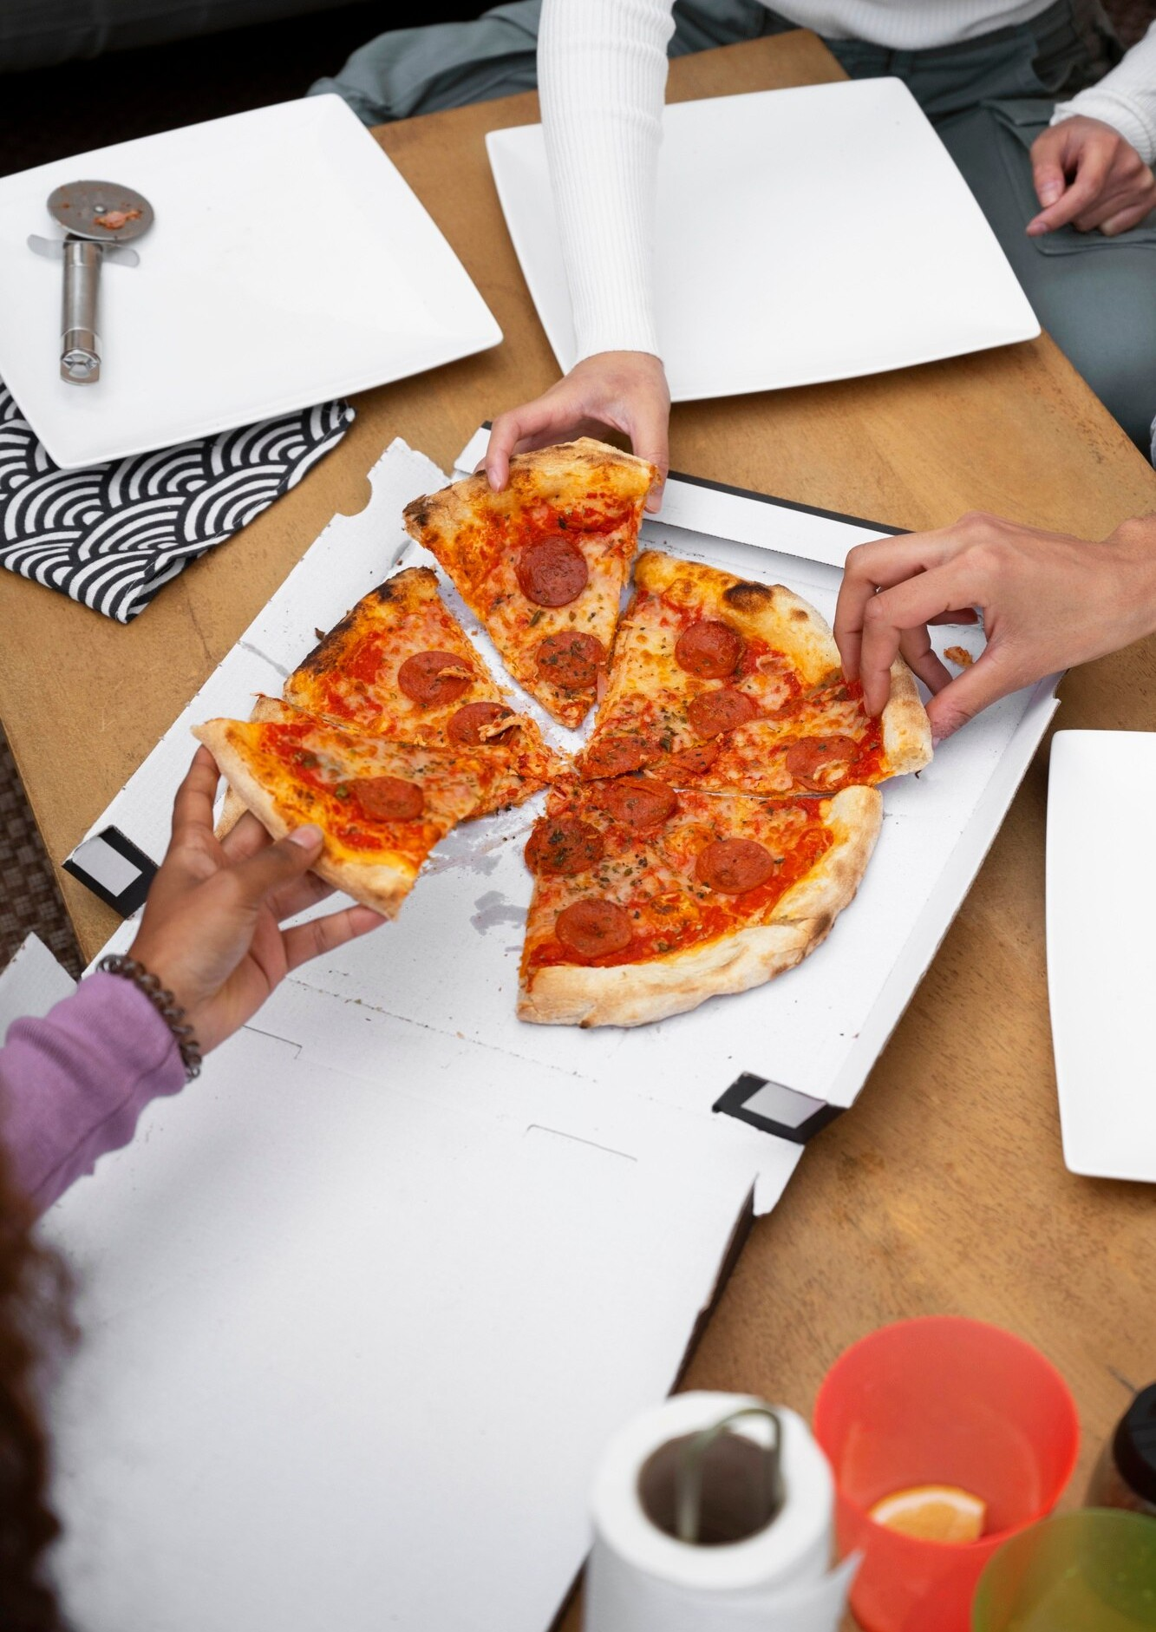

Total Orders and Revenue
A total of 21,350 orders were placed.
The total revenue generated from pizza sales was $817,860.05.

Slide 4



Most Expensive Pizza
The most expensive pizza on the menu is priced at $35.95.
This pizza is likely to have a higher profit margin due to its premium ingredients.

Slide 5

Most Popular Pizza Size
Large (L) is the most commonly ordered pizza size, accounting for 18,526 orders.

Slide 6

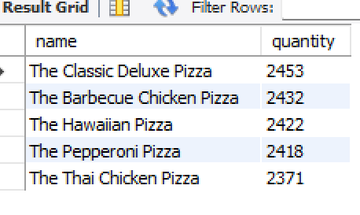

Top 5 Most Ordered Pizza Types
The Classic Deluxe Pizza is the most ordered pizza type, with 2,453 orders.
The top 5 most ordered pizza types are all relatively close in popularity.

Slide 7

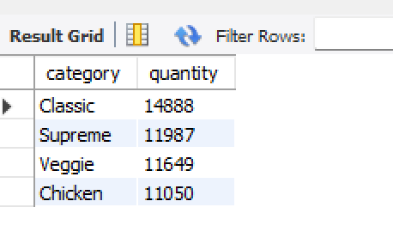

Total Quantity of Each Pizza Category Ordered
Classic pizzas are the most ordered category, with 14,888 total pizzas sold.
All categories have a significant number of orders, indicating a diverse customer base.

Slide 8


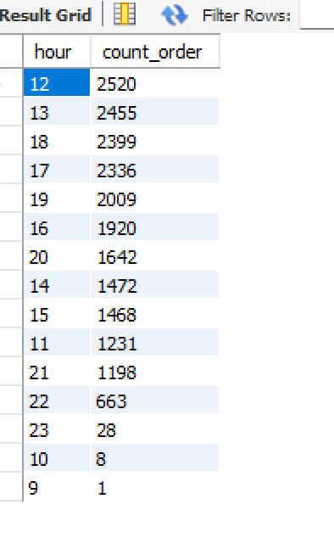

Distribution of Orders by Hour
The peak hours for ordering pizzas are between 12 and 13.

Slide 9

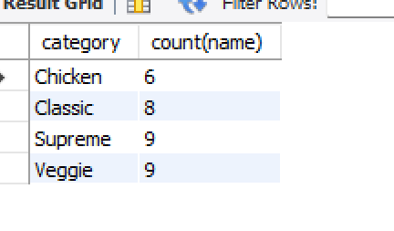
Category-wise Distribution of Pizzas

Slide 10

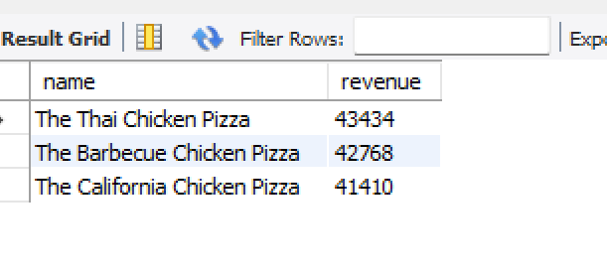
Top 3 Most Ordered Pizza Types by Revenue
The Thai Chicken Pizza generates the most revenue

Slide 11


Conclusion
In conclusion, leveraging SQL for pizza order analysis provides valuable insights for strategic decision-making. By understanding customer behavior and market trends, businesses can drive sustainable growth and competitive advantage

Slide 12


Thanks!
Do you have any questions?
bakhshil559@gmail.com
+92 3014522953

