Slide 1
Walmart Sales Data Analysis
Exploring Sales Trends, Product Trends and Sales Strategies
Presented by: Bakhshial

Slide 2


Introduction
Aim: To explore Walmart sales data and understand top-performing branches, products and sales trends.
Dataset: Obtained from the Kaggle Walmart Sales Forecasting Competition.
Focus: Optimizing sales strategies based on data insights.

Slide 3

Data Wrangling and Feature Engineering
Cleaned data: Ensured no NULL values.
Added columns:
time_of_day (Morning, Afternoon, Evening)
day_name (Day of the week)
month_name (Month of the year)

Slide 4

Exploratory Data Analysis (EDA)
Objective: Answer key business questions related to product performance, sales trends, and customer behavior.
Focus Areas:
Product Analysis
Sales Analysis
Customer Analysis

Slide 5

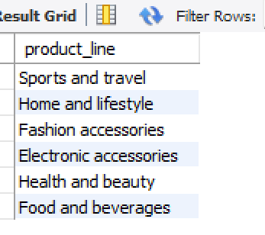

Product Analysis
Unique Product Lines:
Most Common Payment Method:
Result: Cash is the most common payment method.

Slide 6
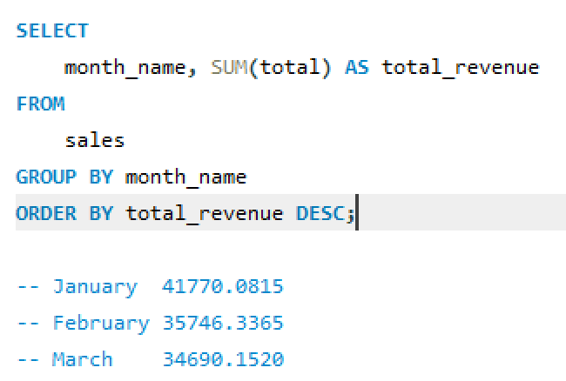
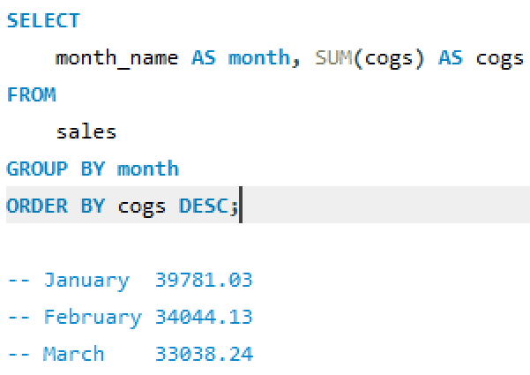
Product Analysis
Monthly Revenue:
Month with Largest COGS:

Slide 7
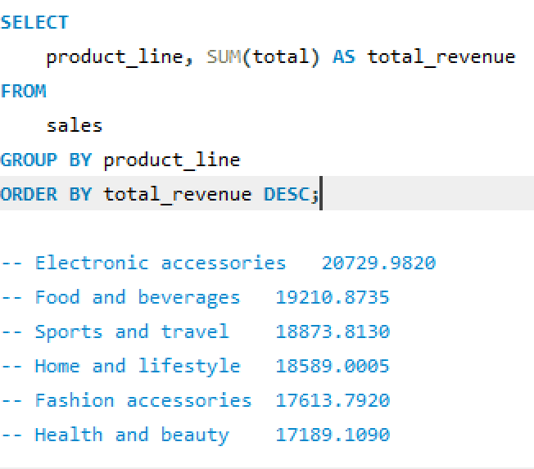
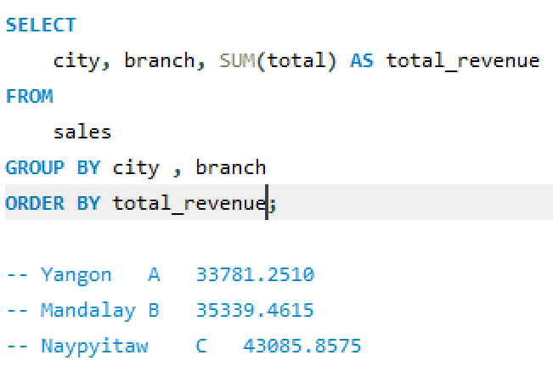
Product Analysis
Largest Revenue Product Line:
City with Largest Revenue:

Slide 8

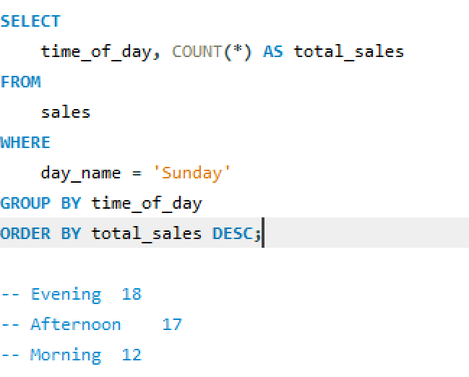
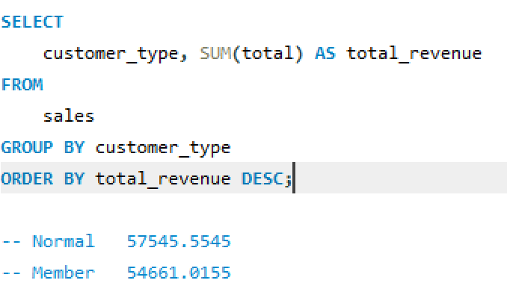
Sales Analysis
Sales by Time of Day per Weekend:
Revenue by Customer Type:

Slide 9
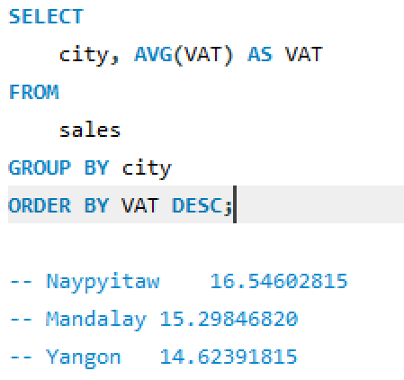
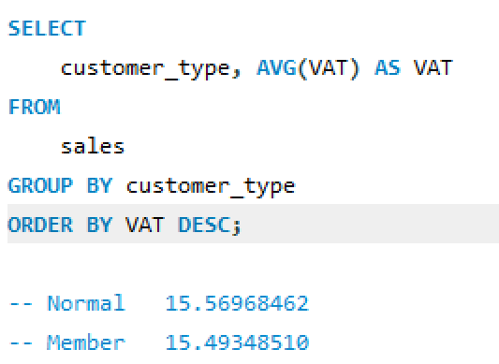
Sales Analysis
City with Largest VAT:
Customer Type with Highest VAT:

Slide 10
CONCLUSION
In conclusion, the comprehensive analysis of Walmart sales data using MySQL has provided valuable insights for informed decision-making and strategic planning.

Slide 11

Thanks!
ANY QUESTIONS?
bakhshil559@gmail.com
+92 3014522953

