Slide 1

Uncovering Layoff Patterns: A SQL Analysis

Slide 2

Introduction
After cleaning the data from the world_layoffs database, we can now perform Exploratory Data Analysis (EDA) to gain insights into the layoffs. This presentation will explore various aspects of the data, including:
Basic Statistics
Layoffs by Industry and Country
Layoffs by Year, Month, and Stage
Trends Over Time
Relationships Between Variables

Slide 3
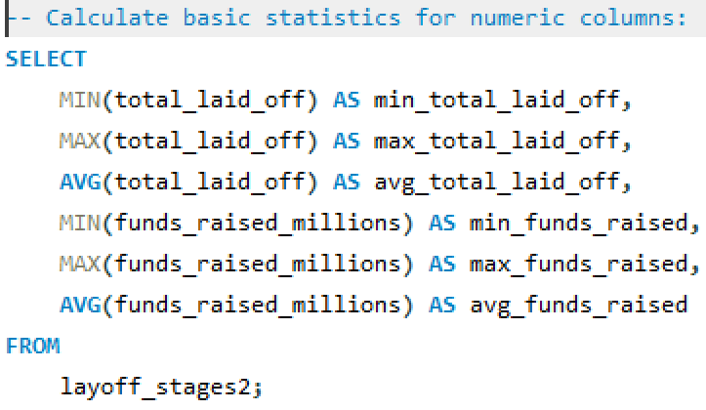

Basic Statistics

Slide 4
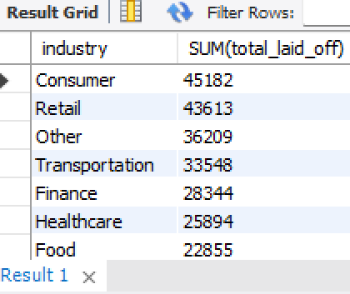
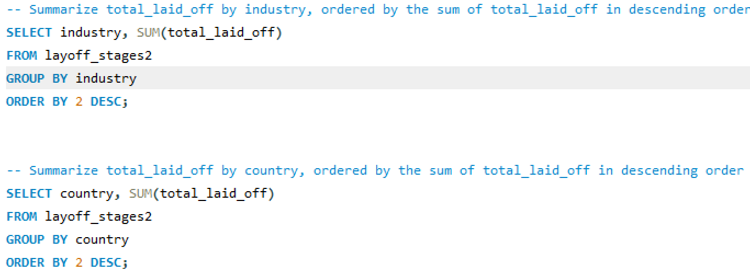
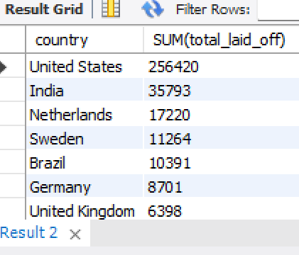
We can group and sum the total_laid_off by industry and country to identify the industries and countries most affected by layoffs.
This can be visualized using bar charts to see which industries and countries have the highest total layoffs.
Layoffs by Industry and Country

Slide 5
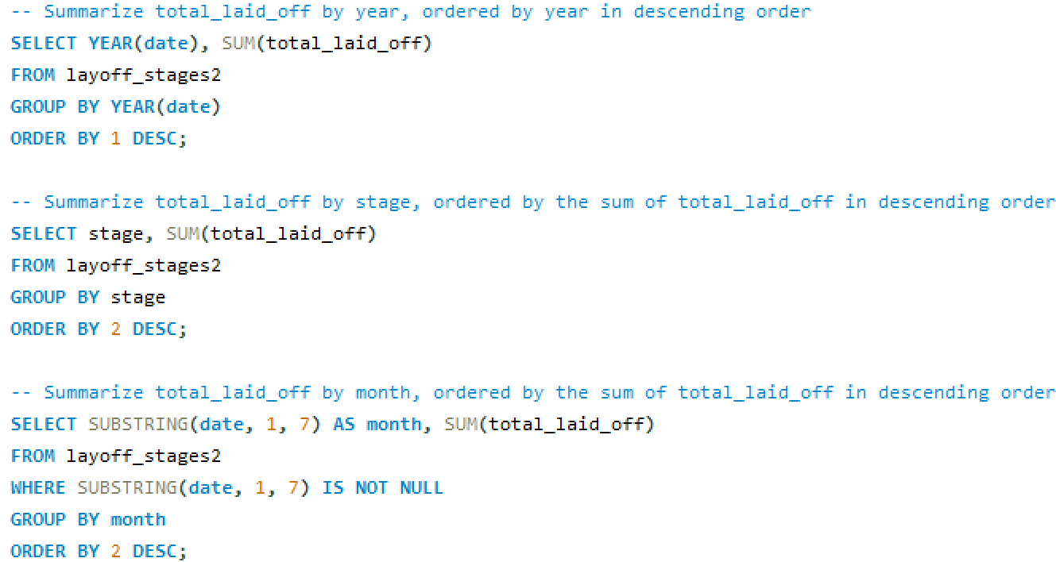
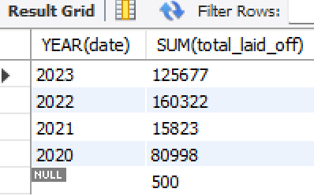
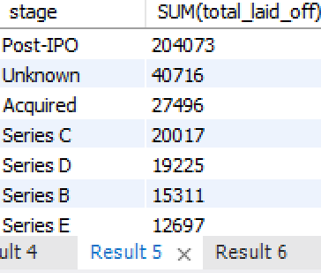
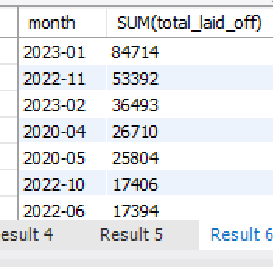
Layoffs by Year, Month, and Stage

Slide 6

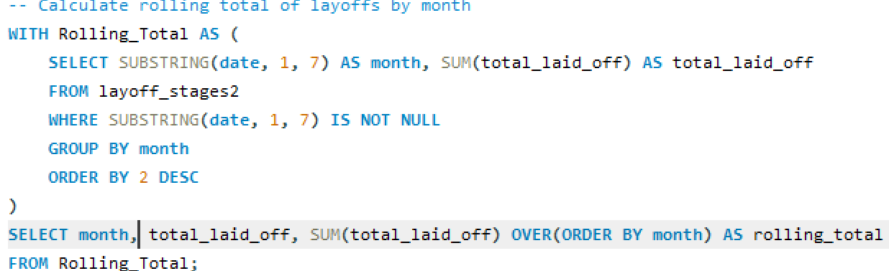
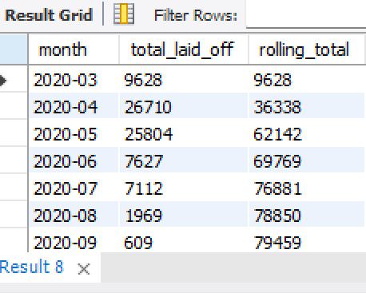
Trends Over Time

Slide 7

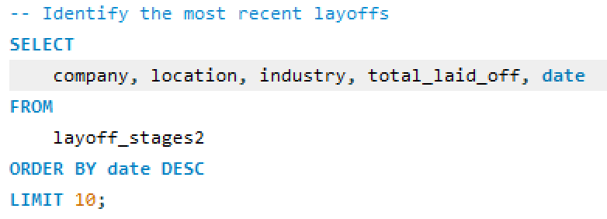
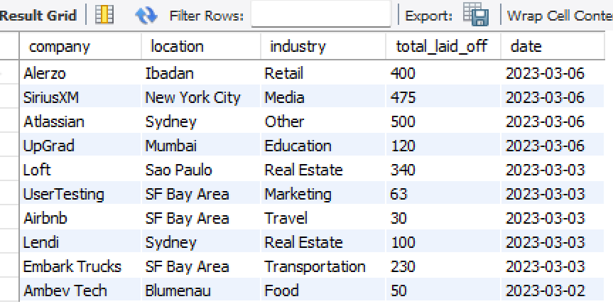
Identifying Recent Layoffs and Top Layoff Companies

Slide 8

Conclusion
By performing Exploratory Data Analysis, we have gained valuable insights into the provided layoff data. This helps us understand factors that influence layoffs, identify trends, and predict future events.

Slide 9
Thanks!
Do you have any questions?
bakhshil559@gmail.com
+92 0314522953

