Slide 1

TimeTable
Management

Slide 2


OUR TEAM
Supervisor: Mamoon Rasheed
GL: Bakhshullah Wahid
Rahat Manzoor
Robina Muhammed Karim
Abdul Wahab

Slide 3
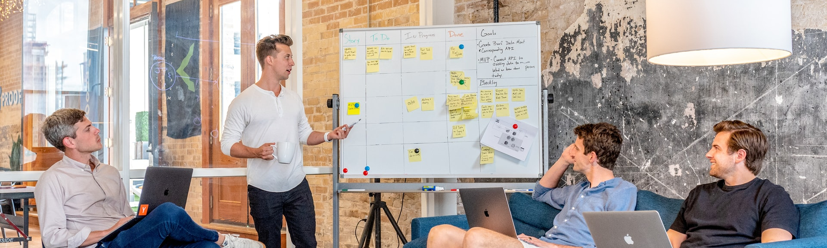
Motivation
"Timetable management is critical for educational institutions, yet manual processes often lead to conflicts and inefficiencies. To tackle this, we propose an Automated Timetable Management System. It streamlines scheduling, minimizes conflicts, and optimizes resource allocation."

Slide 4
Introduction
Our system ensures class schedules are conflict-free and resources are efficiently allocated, making timetable creation effortless. Experience a seamless educational environment for both students and educators with our revolutionary tool.

Slide 5
Problem
University Timetabling
Examination Timetabling
School Timetabling
Sport Timetabling

Slide 6

Background of project
Effective timetable management is essential for educational institutions, yet manual processes often result in inefficiencies and errors. To overcome these challenges, we propose leveraging technology to streamline scheduling, minimize conflicts, and enhance overall efficiency.

Slide 7

Signifient Of Project
"This project is pivotal for optimizing timetable management in educational institutions. By tackling issues like class conflicts and mismanagement, the proposed system enhances efficiency, optimizes resource utilization, and fosters a better learning environment for both students and educators."

Slide 8
Research and Planning
Market analysis
requirement gathering
project planning.

Slide 9
Development
Designing
Coding
integration.

Slide 10
Testing and Quality Assurance
Unit testing
system testing
bug fixing

Slide 11
Deployment and Launch
Deployment preparation
user training
launch event.

Slide 12
Schedule | Requirement Gathering & Analysis | Designing | Implementation | Test & Evaluation
June 2024
1 - 15 July 2024
16 - 30 July 2024
August 2024
September 2024
October 2024
November 2024
December 2024
Notes:
Links:
https://www.pexels.com/photo/man-in-black-suit-jacket-wearing-white-headphones-3779414/

Slide 13
THANK YOU!

