Slide 1
Independent project presentation - DB design
Bakhtiyar Garashov

Slide 2

Overview
The main idea of project is analysis global nuclear power plants dataset for all countries. Nuclear Power plant accidents are not very frequent, but can be cause serious health issues. There must be continued plans created to provided a quick response to a unfortunate nuclear plant accident.

Slide 3

According to Nuclear Regulatory Commission (NRC) people must live at least 80 miles radius from the plant. Therefore, we will apply this distance to find dangerous buffer zones around plants. Also, we will analyze minimum distance between major roads and plants in case of emergency.

Slide 4
Database structure
Table 1: nuclear_power_plants (will has geometry column)
Fields: id, country_id, name, total_power, type, status,power_cat, built_year, operation_start_date, lon, lat, geom.
Table 2: world_countries (imported from shapefile)
Fields id, country_name, shape, object_id.
Table 3: population
Fields: id, country_id, country_name, population
In table 2 (world_countries) id field will be primary key for creating connection between population and nuclear_power_plants.

Slide 5
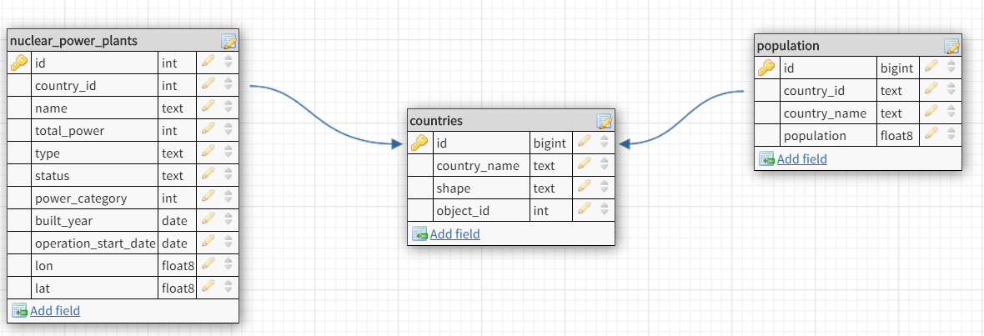
Database schema
Created by: https://app.dbdesigner.net/

Slide 6
PostGIS functions
Function: AddGeometryColumn (varchar table_name, varchar column_name, integer srid, varchar type, integer dimension, boolean use_typmod=true);
Description: Adds a geometry column to an existing table of attributes. The schema_name is the name of the table schema. The srid must be an integer value reference to an entry in the SPATIAL_REF_SYS table. The type must be a string corresponding to the geometry type, eg, 'POLYGON’ or 'MULTILINESTRING' .
Function: ST_Buffer(geometry g1, float radius_of_buffer )
Description: Returns a geometry/geography that represents all points whose distance from this Geometry/geography is less than or equal to distance. Geometry: Calculations are in the Spatial Reference System of the geometry.
Function: ST_Distance(geometry g1, geometry g2);
Description: For geometry types returns the minimum 2D Cartesian (planar) distance between two geometries. For geography types defaults to return the minimum geodesic distance between two geographies in meters

Slide 7
Web map service (WMS)
Web Map Service Interface Standard (WMS) provides a simple HTTP interface for requesting geo-registered map images from one or more distributed geospatial databases.
Layer groups:
World country borders shapefile
World countries (WGS84) shapefile
Major roads shapefile
Zoom levels:
Zoom level 1: All nuclear power plants on the global map.
Zoom level 2: Maximum number of population density inside a buffer zone.

Slide 8
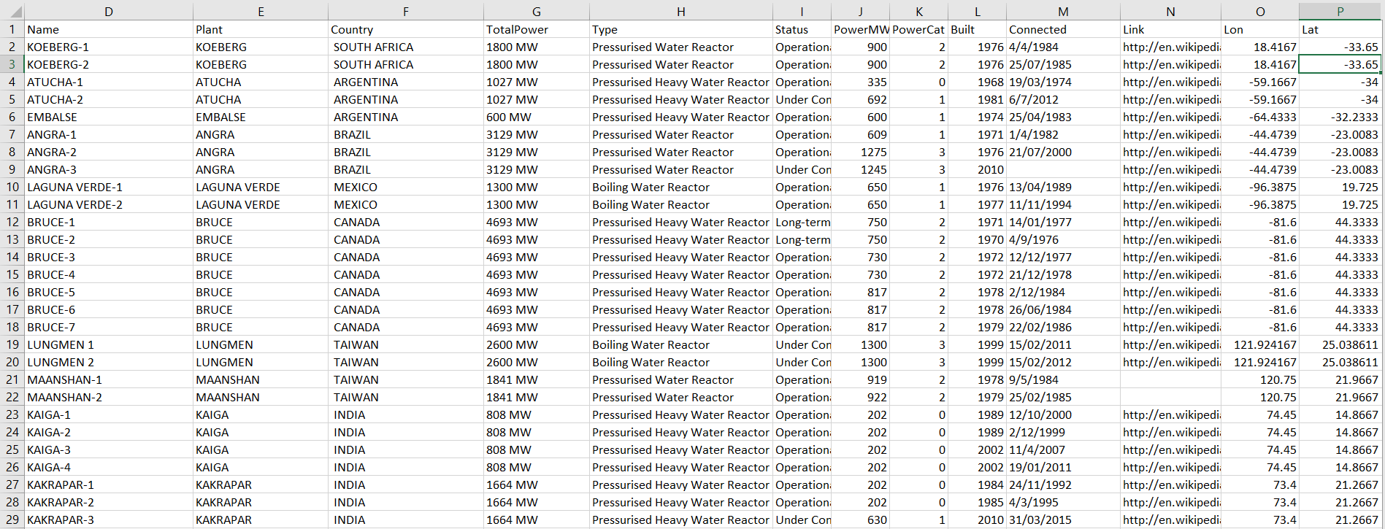
Data sources:
https://datashare.is.ed.ac.uk/handle/10283/2464?show=full
https://www.world-nuclear.org/information-library/facts-and-figures/reactor-database.aspx

Slide 9
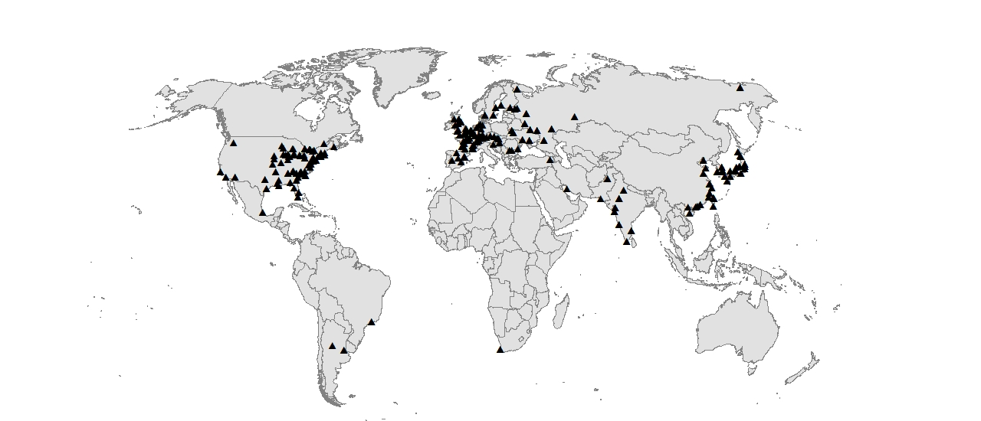
All (512) nuclear power plants

