Slide 1
Pilot analysis — methods + results (Stage 10, N=92)
Step-by-step: normalized topic probabilities → EDA → measurement indices → inference (levels, arcs, macro axes, CV)
How to read this deck
This is a pilot/instrument-calibration study. The goal is not “p < .05”, but a clean, auditable measurement pipeline and stable directional evidence that guides the larger corpus study.
Each stage shows:
• 1–2 plots
• a small data table
• a short interpretation note (what it means / what to do next)
Key headline (pilot):
Reach (log #ratings) shows clearer thematic signal than mean rating.
Quality (rating) relates most to payoff/safety, less to baseline explicitness/negative affect.
Arcs suggest “late crisis” can be part of higher-rated books (timing matters).
All effects are standardized (beta on z-scored outcome/predictor). Interpret directions + uncertainty; this is a pilot.
Notes:
## Notes [Sources] - Internal pilot outputs (N=92): combined_report_assets/*.png, taxonomy_report_assets/*.png, inference CSV tables. [/Sources]

Slide 2
0) Pipeline map (stages and deliverables)
Four layers, kept separate to avoid confusion
Data prep
EDA
Measurement
Inference
Topic probs
(normalized)
Contracts
Topic leaderboard
Taxonomy groups
Diversity
Composites → indices
CORE gating
PCA + stability
Levels + arcs
Macro axes
CV sanity
What gets saved (audit + appendix + publication-ready)
Each stage writes CSV tables + plots into named subfolders:
• data_prep/: normalized probs + contracts
• eda_topics/: topic leaderboards + micro-drivers
• eda_taxonomy/: group shares, subgroup effects, diversity
• measurement/: composite registry, pipeline audits, indices, arcs
• inference/: level effects, arc effects, macro axes, CV summaries
This makes it easy to (a) audit, (b) build appendix tables, (c) reuse plots in a paper.
Next slides: one stage at a time — plot(s) + small table + short interpretation.
Notes:
## Notes [Sources] - Internal pipeline design and outputs; paths/results structure described in Stage10 notebooks and markdown summaries. [/Sources]

Slide 3
1) Data prep: normalized topic probabilities
The biggest early bug was non-normalized book-level probabilities
Contract checks (after normalization)
Short note
If sums vary (e.g., 0.62–0.73), then indices become partly “missing mass” artifacts.
Normalization makes indices comparable across books and makes arc contrasts interpretable.
Unit
Check
Result
Book probs
sum per book
≈ 1.00 / 1.00 / 1.00
Segment probs
sum per segment
≈ 1.00 / 1.00 / 1.00
Coverage
books × topics
92 × 368 (no duplicates)
Practical rule for the big corpus
Always save a probability-contract CSV next to topic probabilities.
If contract fails: stop the pipeline and fix upstream — do not “patch” downstream indices.
Recommended: treat ultra-small probabilities as noise only after normalization (thresholds become meaningful).
Everything downstream assumes normalized probabilities (sum≈1).
Notes:
## Notes [Sources] - Sanity checks on book_topic_probs.parquet and tertile_topic_probs.parquet; normalization contracts stored in bundle outputs. [/Sources]

Slide 4
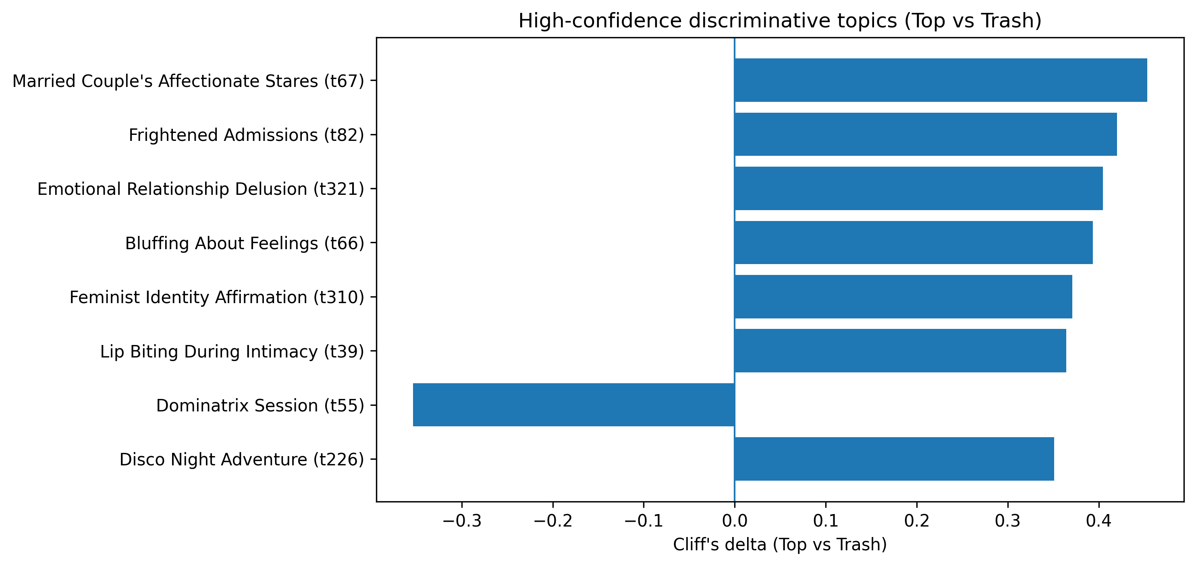
2) Topic-level EDA: single topics distinguishing tiers
Use effect sizes (Cliff’s δ) to find patterns, not “final claims”
Top vs Trash topic effects (Tier 1 high-confidence)
Top 5 examples (from leaderboard)
Topic (short)
δ
Married Couple's Affectionate Stares
0.45
Frightened Admissions
0.42
Emotional Relationship Delusion
0.40
Bluffing About Feelings
0.39
Feminist Identity Affirmation
0.37
Short interpretation
Topic-level signals are “micro evidence.”
We use them to:
• sanity-check the taxonomy
• find candidate mechanisms
• generate hypotheses for composites
Next: aggregate into taxonomy groups and composites to reduce noise.
Topic-level results are exploratory; stability improves after aggregation + CORE gating.
Notes:
## Notes [Sources] - topic_leaderboard_* CSV outputs from 01_topic_analysis_v2 (normalized). - Plot: combined_report_assets/topic_tier1_effects.png. [/Sources]

Slide 5
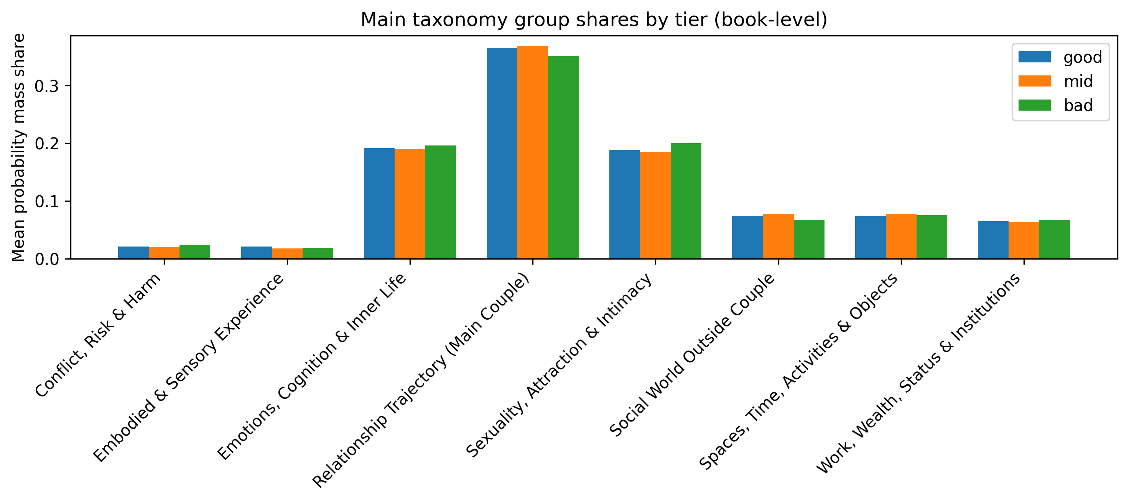
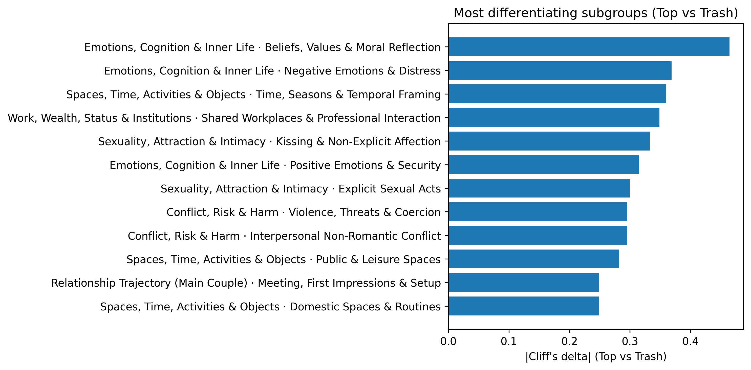
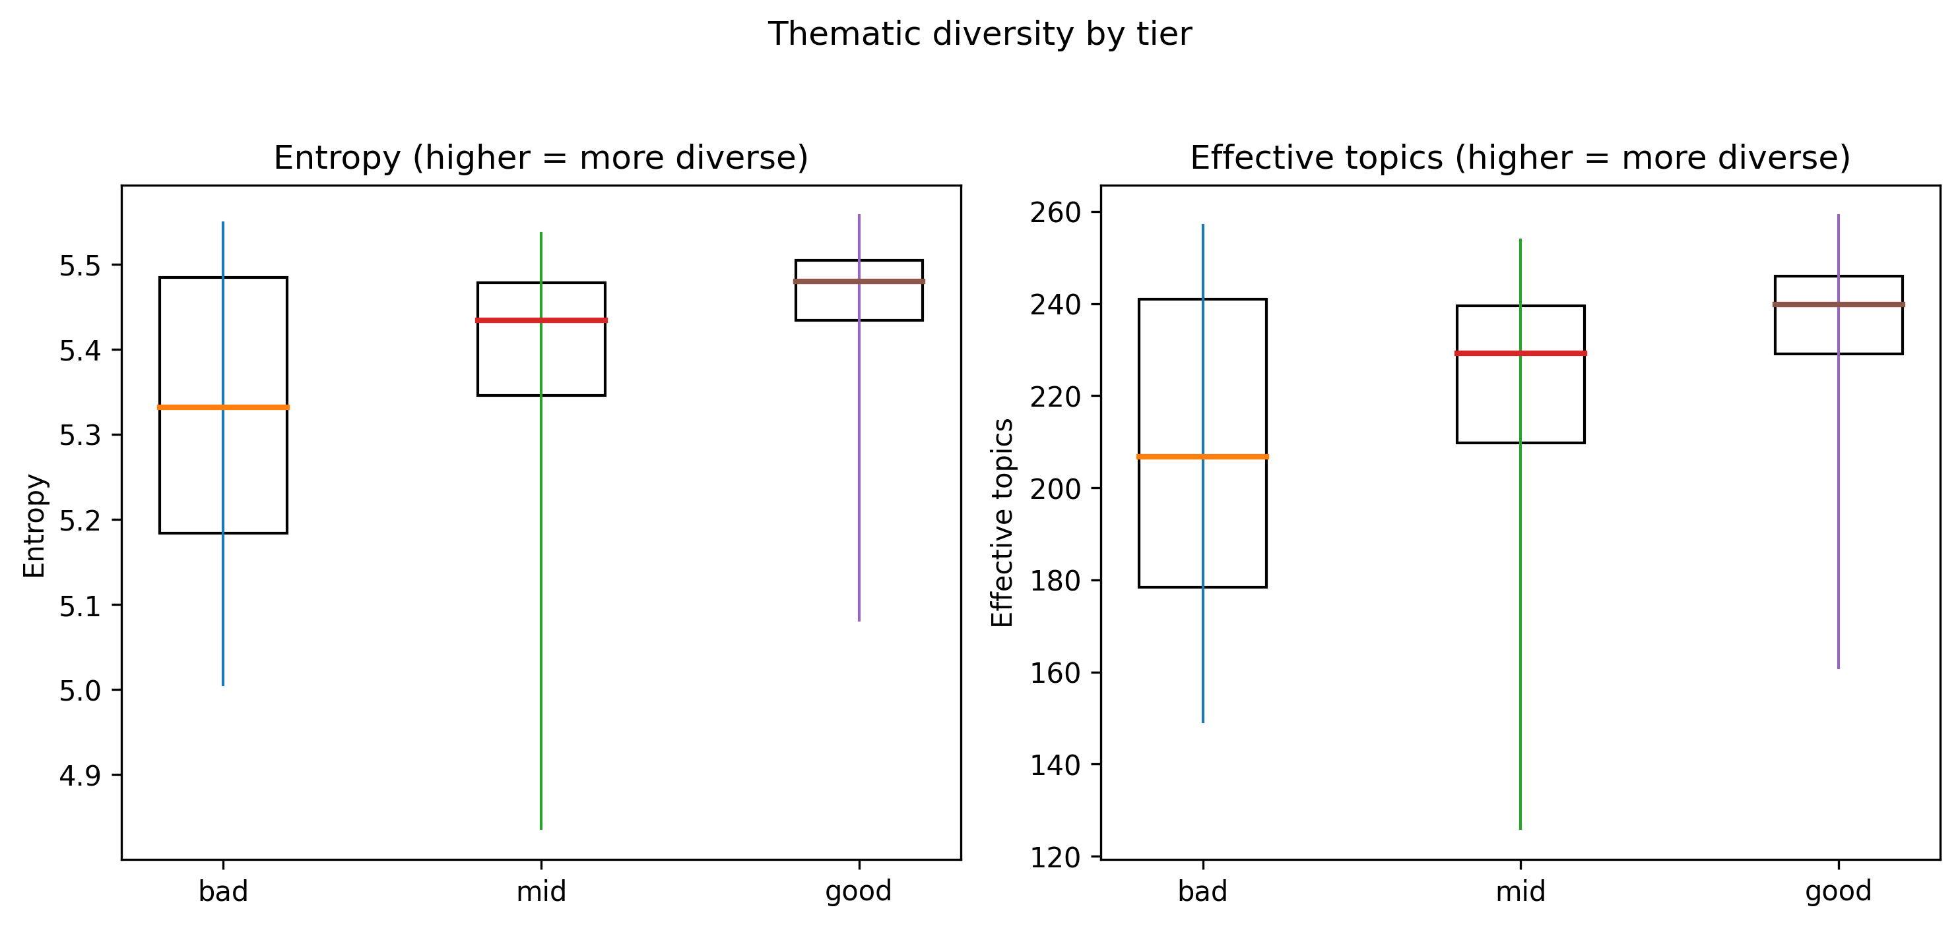
3) Taxonomy EDA: group allocation + subgroup drivers + diversity
Group shares are probability-mass allocations (sum to 1 per book)
Main group shares by tier
Most differentiating subgroups
Diversity by tier
Short interpretation
At the big-bucket level, differences are modest (expected).
Subgroups sharpen the story:
• Top: more “values/reflection” + work/social embedding
• Trash: more distress/threat texture
Diversity increases slightly from bad → good (entropy/effective topics).
This stage is descriptive; inference happens after measurement gating.
Notes:
## Notes [Sources] - Plots: taxonomy_report_assets/figA_*.png, figB_*.png, figC_*.png (generated from subgroup/main-group CSV outputs). - Tables: main_group_comparisons.csv, subgroup_comparisons.csv, diversity_metrics_by_book.csv. [/Sources]

Slide 6
4) Measurement: composites → indices (auditable + gated)
CORE composites are used for main inference; exploratory composites stay separate
What gets exported (measurement bundle)
CORE vs EXPLORATORY
For each composite we export:
• membership (topics included)
• pipeline audit (counts at each filter stage)
• diagnostics (coverage, PCA, stability)
Then build:
• book indices (raw + z)
• segment indices (begin/middle/end)
• arc contrasts (end−begin, middle−begin)
Key rule: no outcome-driven selection.
Short note (why gating matters)
Sparse/unstable composites inflate variance and make everything look “non-significant.”
CORE gating makes inference cleaner:
• fewer, more reliable predictors
• clearer interpretation
• better reproducibility
Measurement outputs are appendix-ready (auditable CSVs).
Notes:
## Notes [Sources] - composite_registry.csv, pipeline_audit.csv, composite_diagnostics.csv, membership tables, book_indices_*.csv, segment_indices_*.csv, arc_contrasts_*.csv. [/Sources]

Slide 7
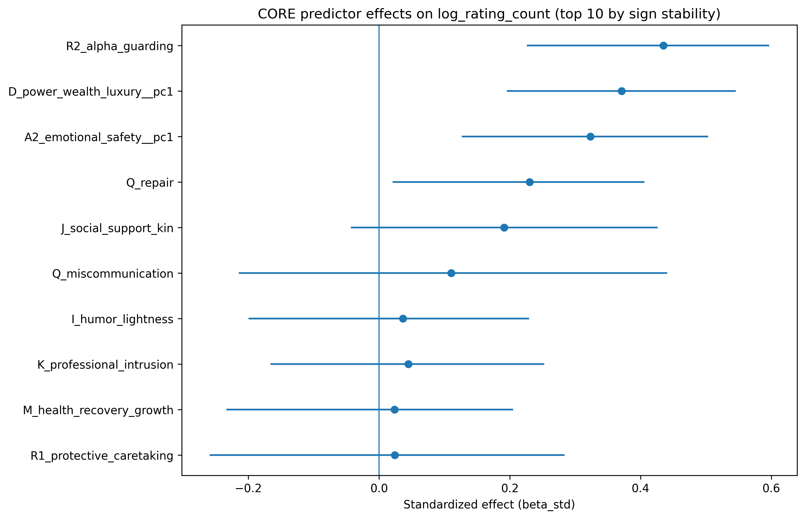
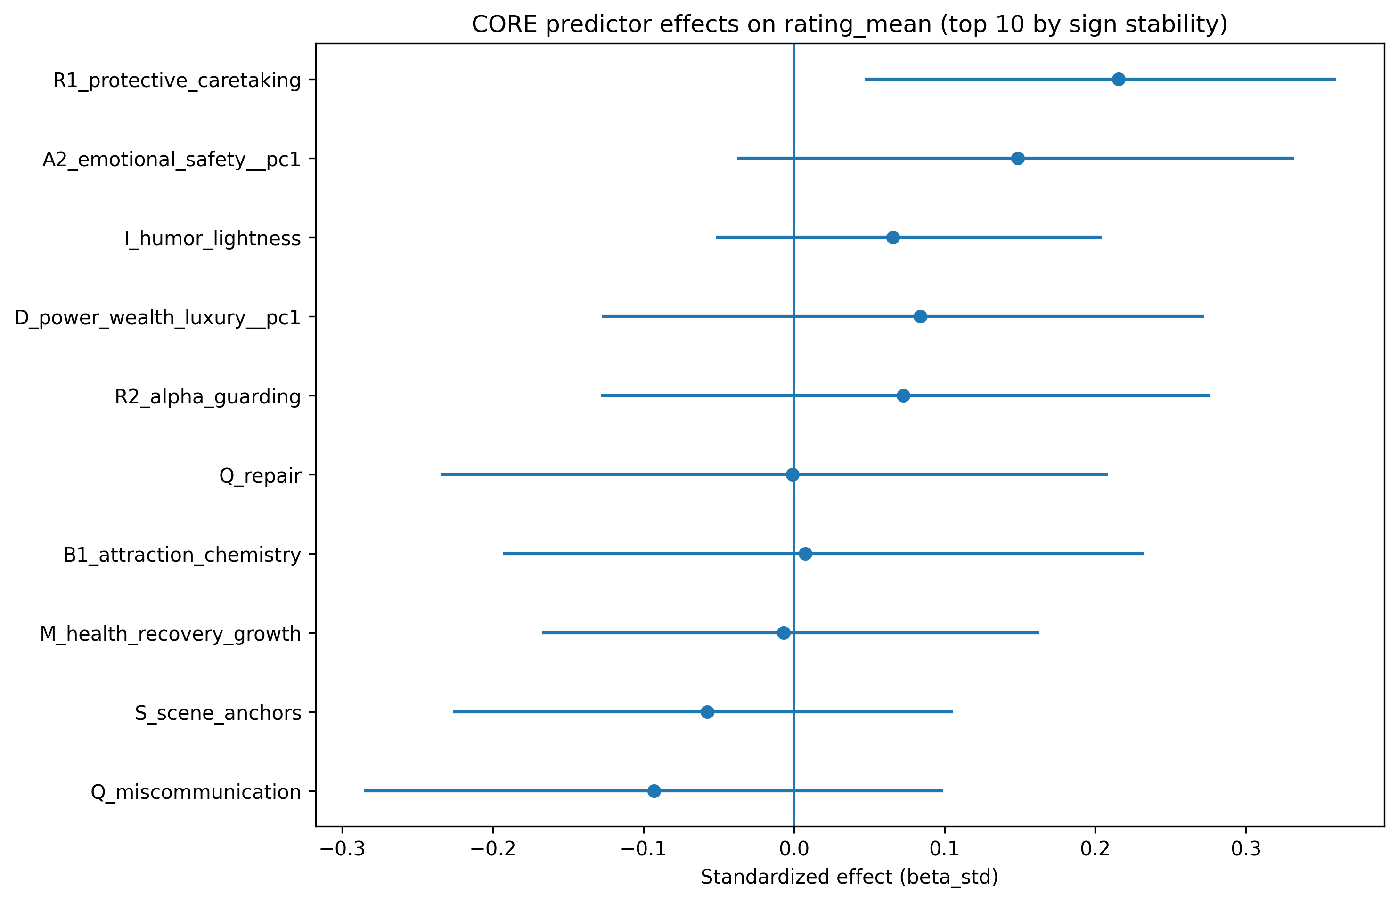
5) Inference: CORE indices (level effects)
Two outcomes: reach vs perceived quality
Reach channel: log(n_ratings)
Quality channel: rating_mean (control reach)
Reach shows clearer thematic signal than mean rating in this pilot (N=92).
Notes:
## Notes [Sources] - Plots: combined_report_assets/core_log_rating_count.png and core_rating_mean.png. - Tables: inference_level_effects_core.csv, top10_core_level_*.csv. [/Sources]

Slide 8
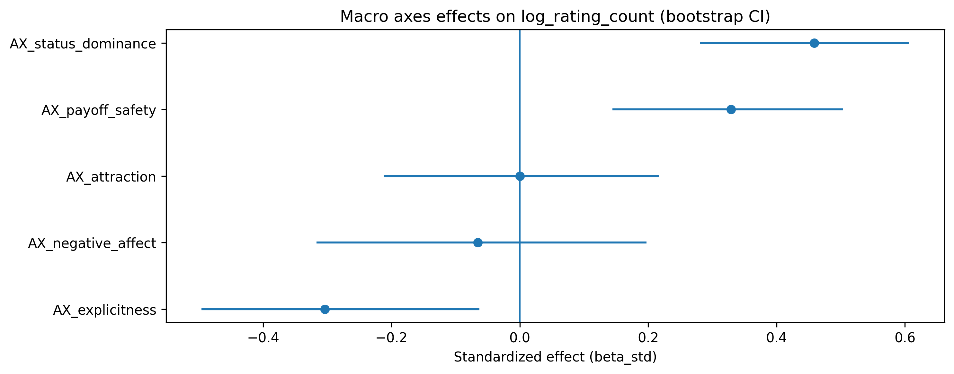
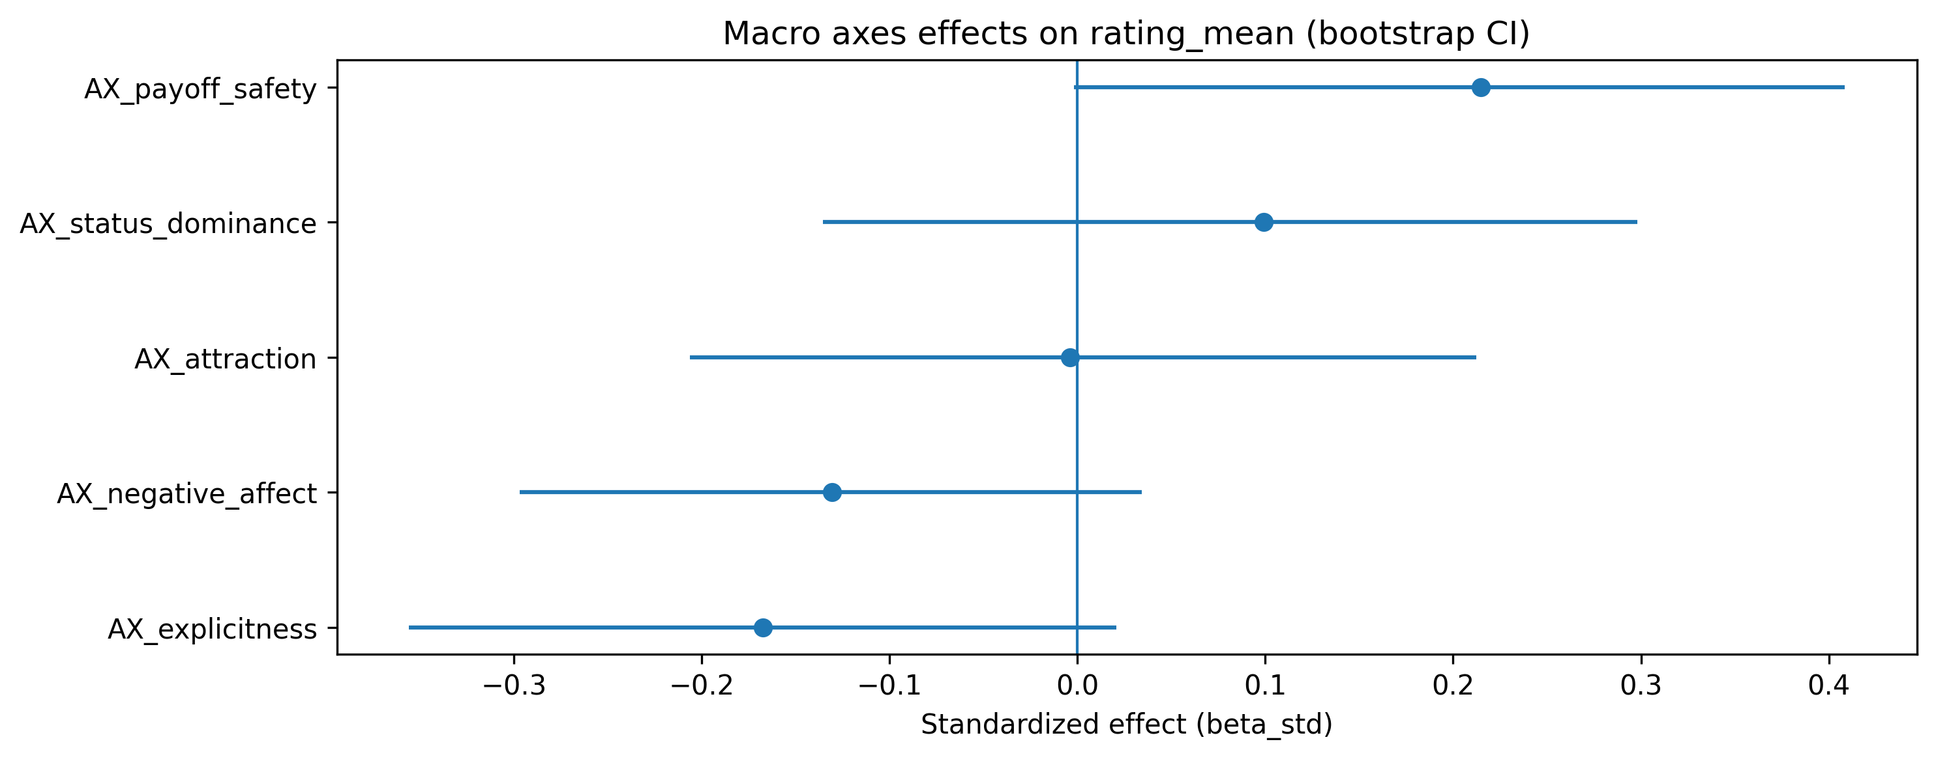
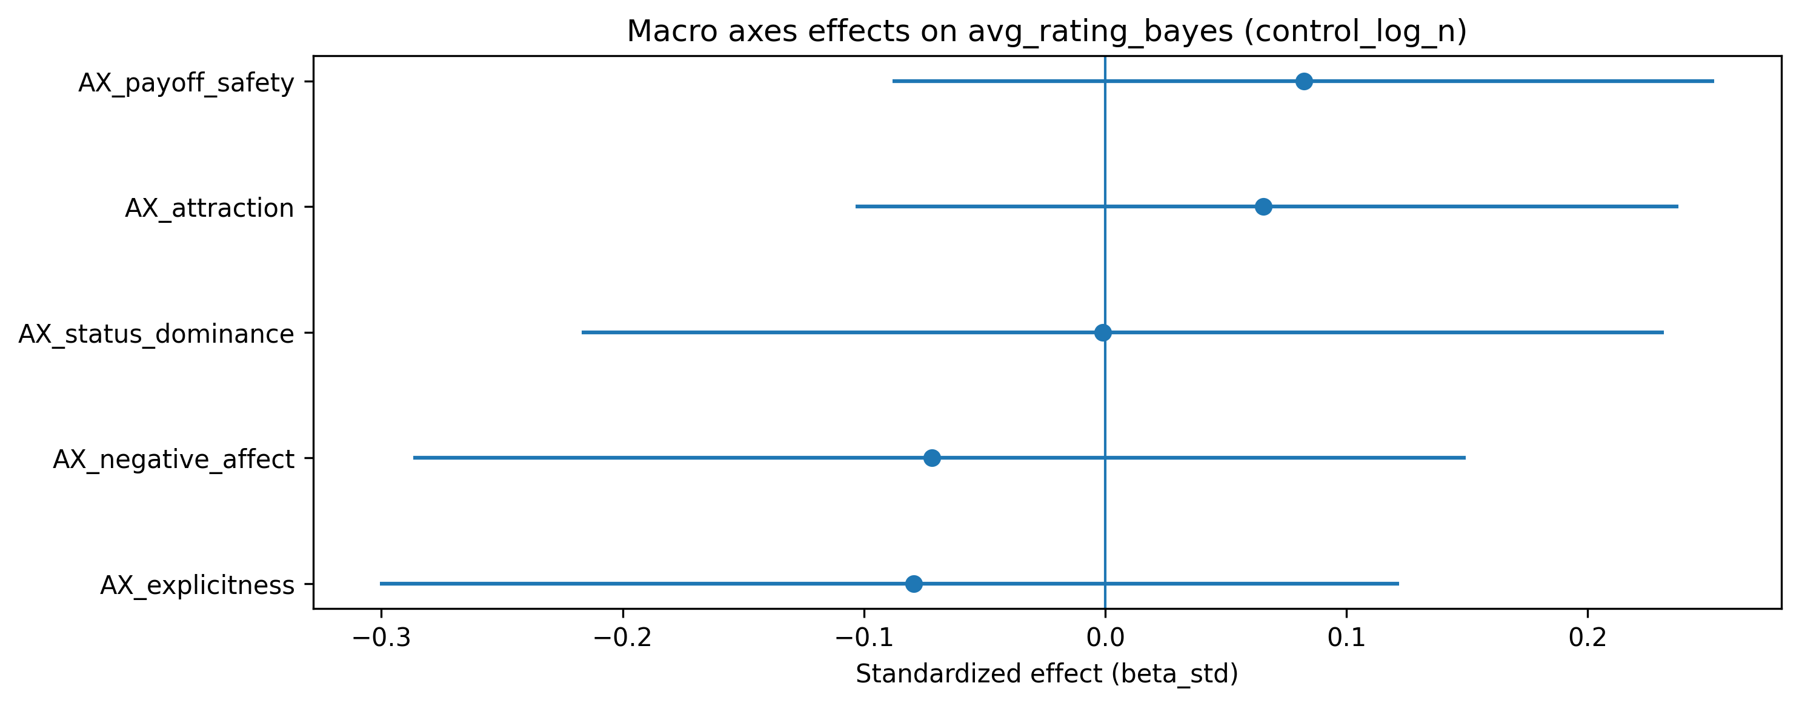
6) Macro axes: cleaner high-level interpretation
Axes separate chemistry from explicitness; payoff/safety stays distinct
Reach (log n ratings)
Quality (rating_mean, control reach)
Quality (avg_rating_bayes, control reach)
Short “two channels” summary
Reach channel (visibility): strongest positives tend to be Status/Dominance + Payoff/Safety.
Quality channel (ratings): strongest positive tends to be Payoff/Safety; Explicitness/Negative Affect often lean negative once reach is controlled.
Why macro axes help: fewer predictors → less variance → clearer story at small N.
Macro axes are designed for communication and robustness, not micro-detail.
Notes:
## Notes [Sources] - macro_axes_definition.csv; inference_macro_level_effects.csv; inference_macro_level_effects_avg_rating_bayes.csv. - Plots: combined_report_assets/macro_*.png. [/Sources]

Slide 9
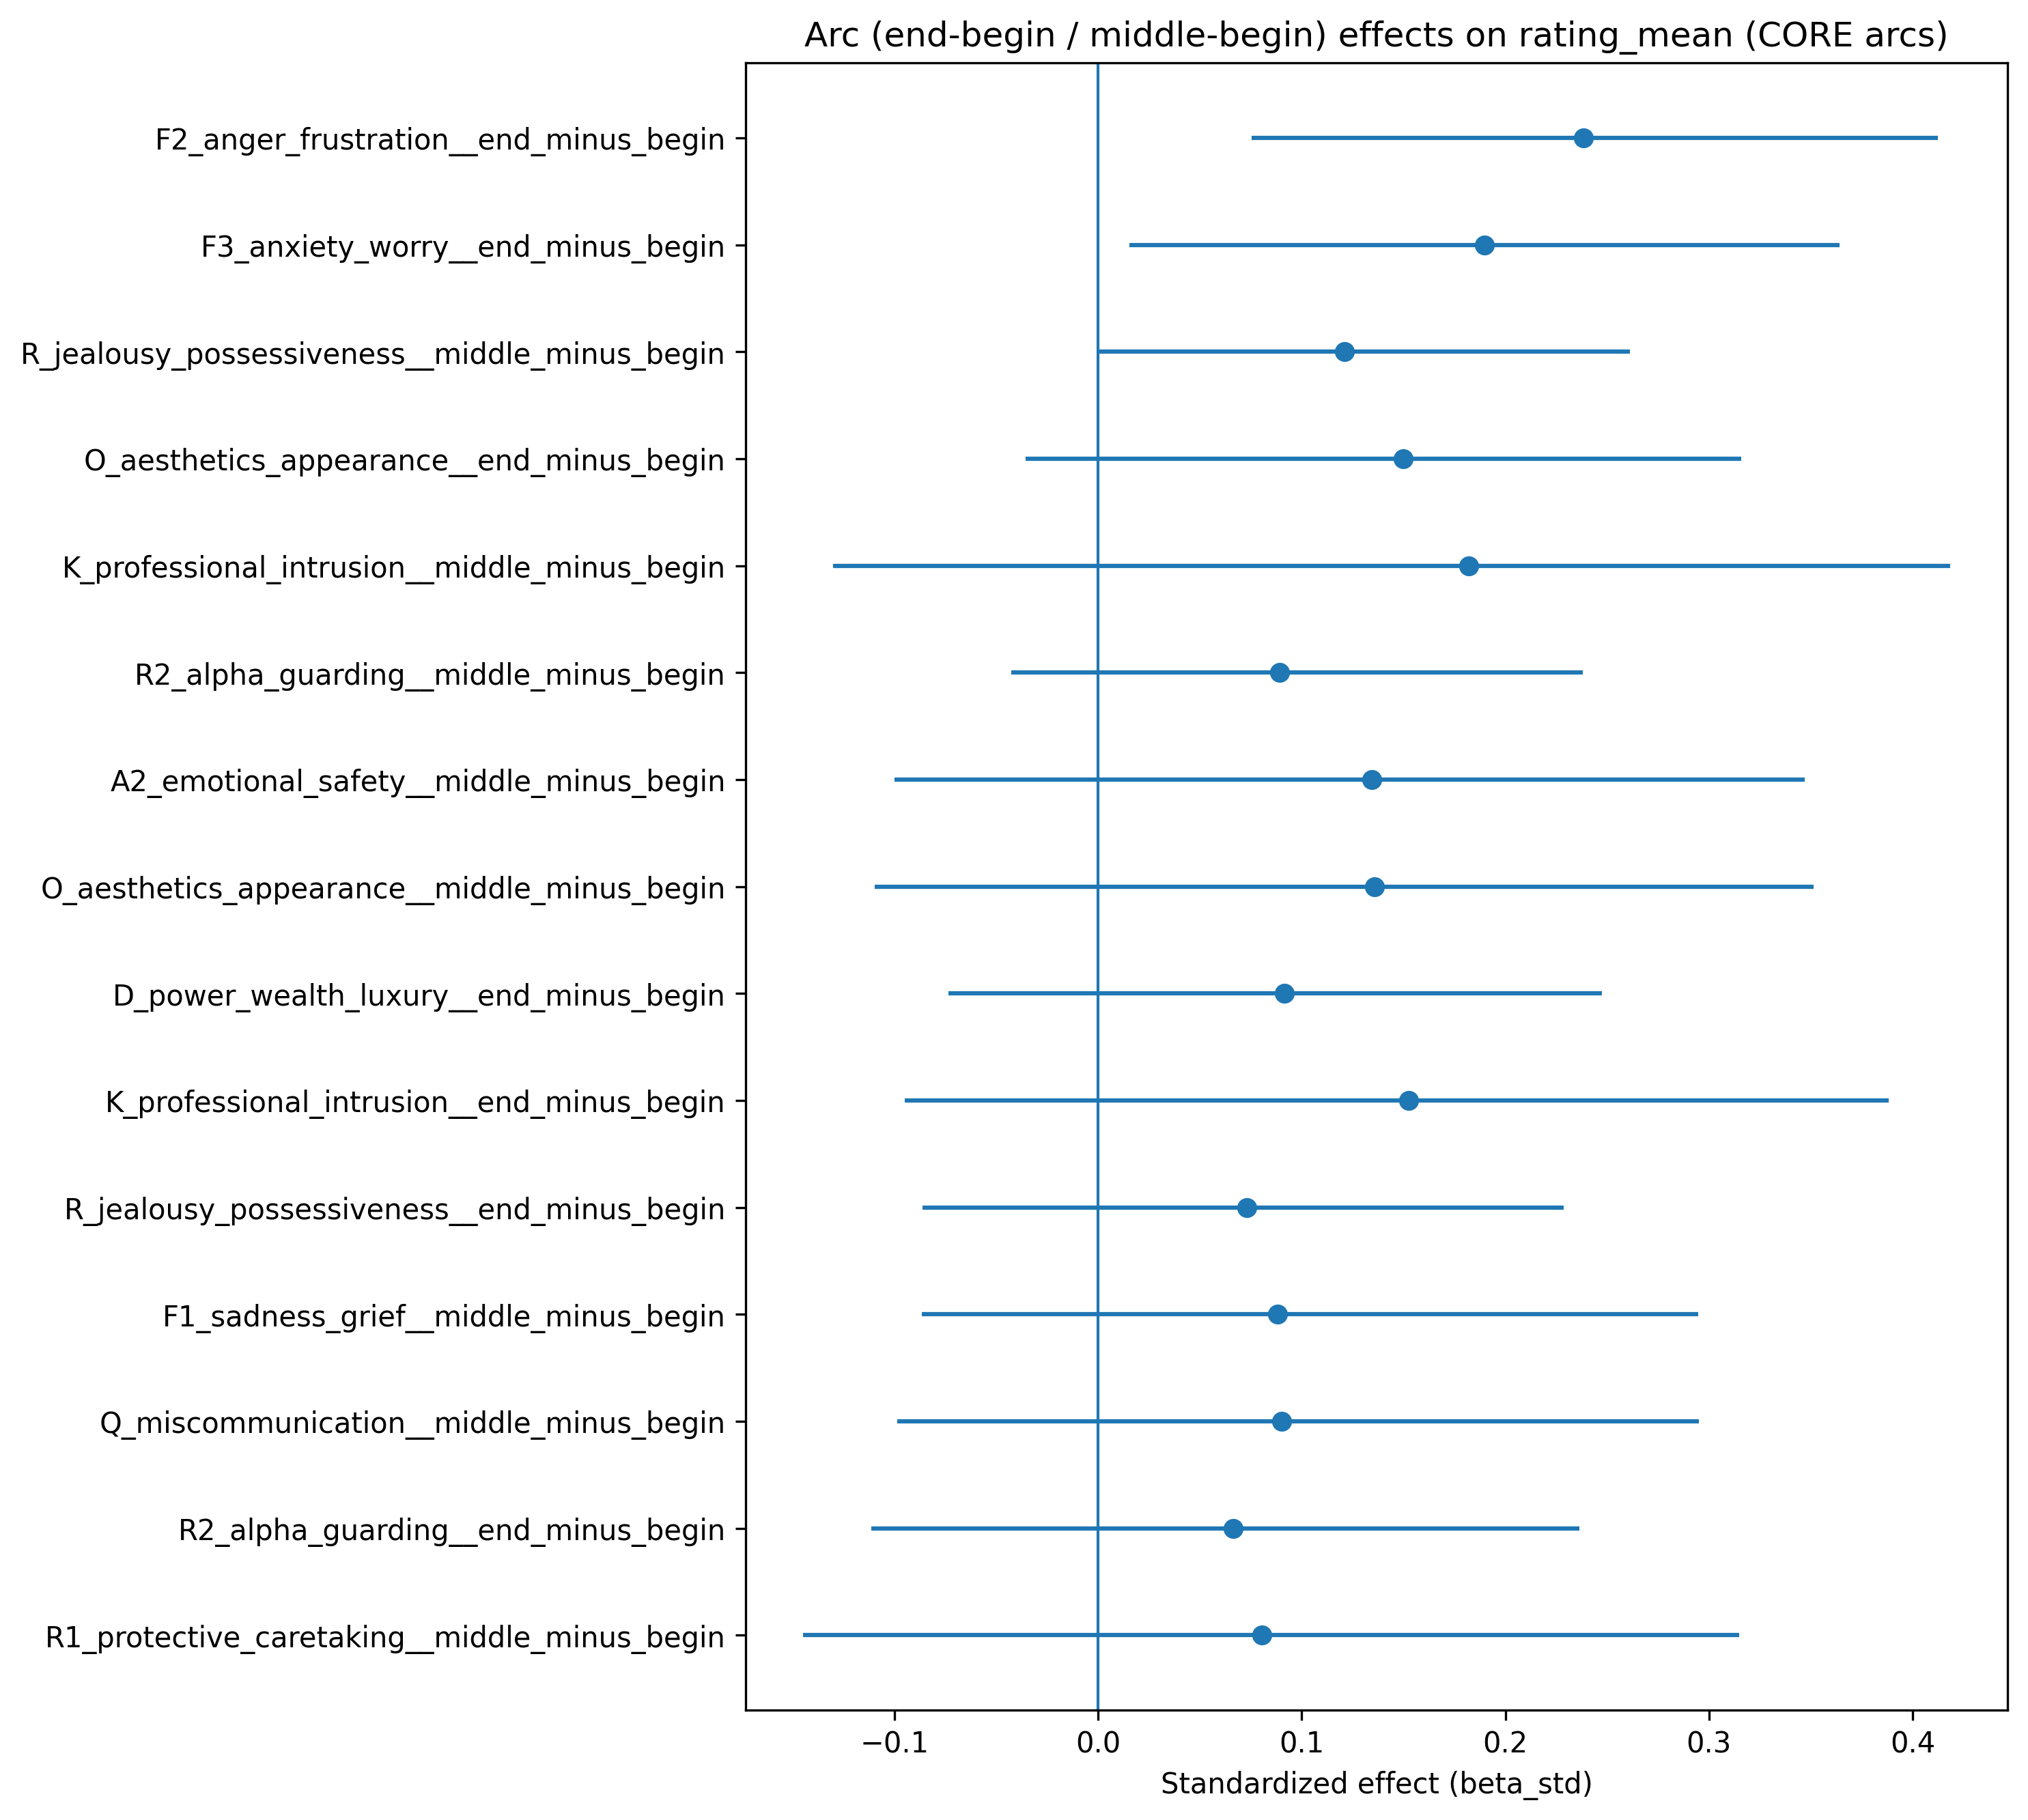
7) Arc effects: timing matters (end−begin, middle−begin)
Avoid conditional END variants; treat arcs as planned measures
Core arc effects (rating_mean)
Short interpretation
Some negative-affect “end minus begin” deltas correlate positively with ratings in this pilot.
Best reading: not “more misery is better,” but “a structured late crisis can be part of a satisfying arc.”
Next step for big corpus: trajectory features with finer bins (slope, peak position), Topics-over-Time style.
Arc signals are about *shape*, not just average level.
Notes:
## Notes [Sources] - inference_arc_effects_core.csv; arc_contrasts_sum.csv. - Plot: combined_report_assets/arc_core_rating_mean.png. [/Sources]

Slide 10
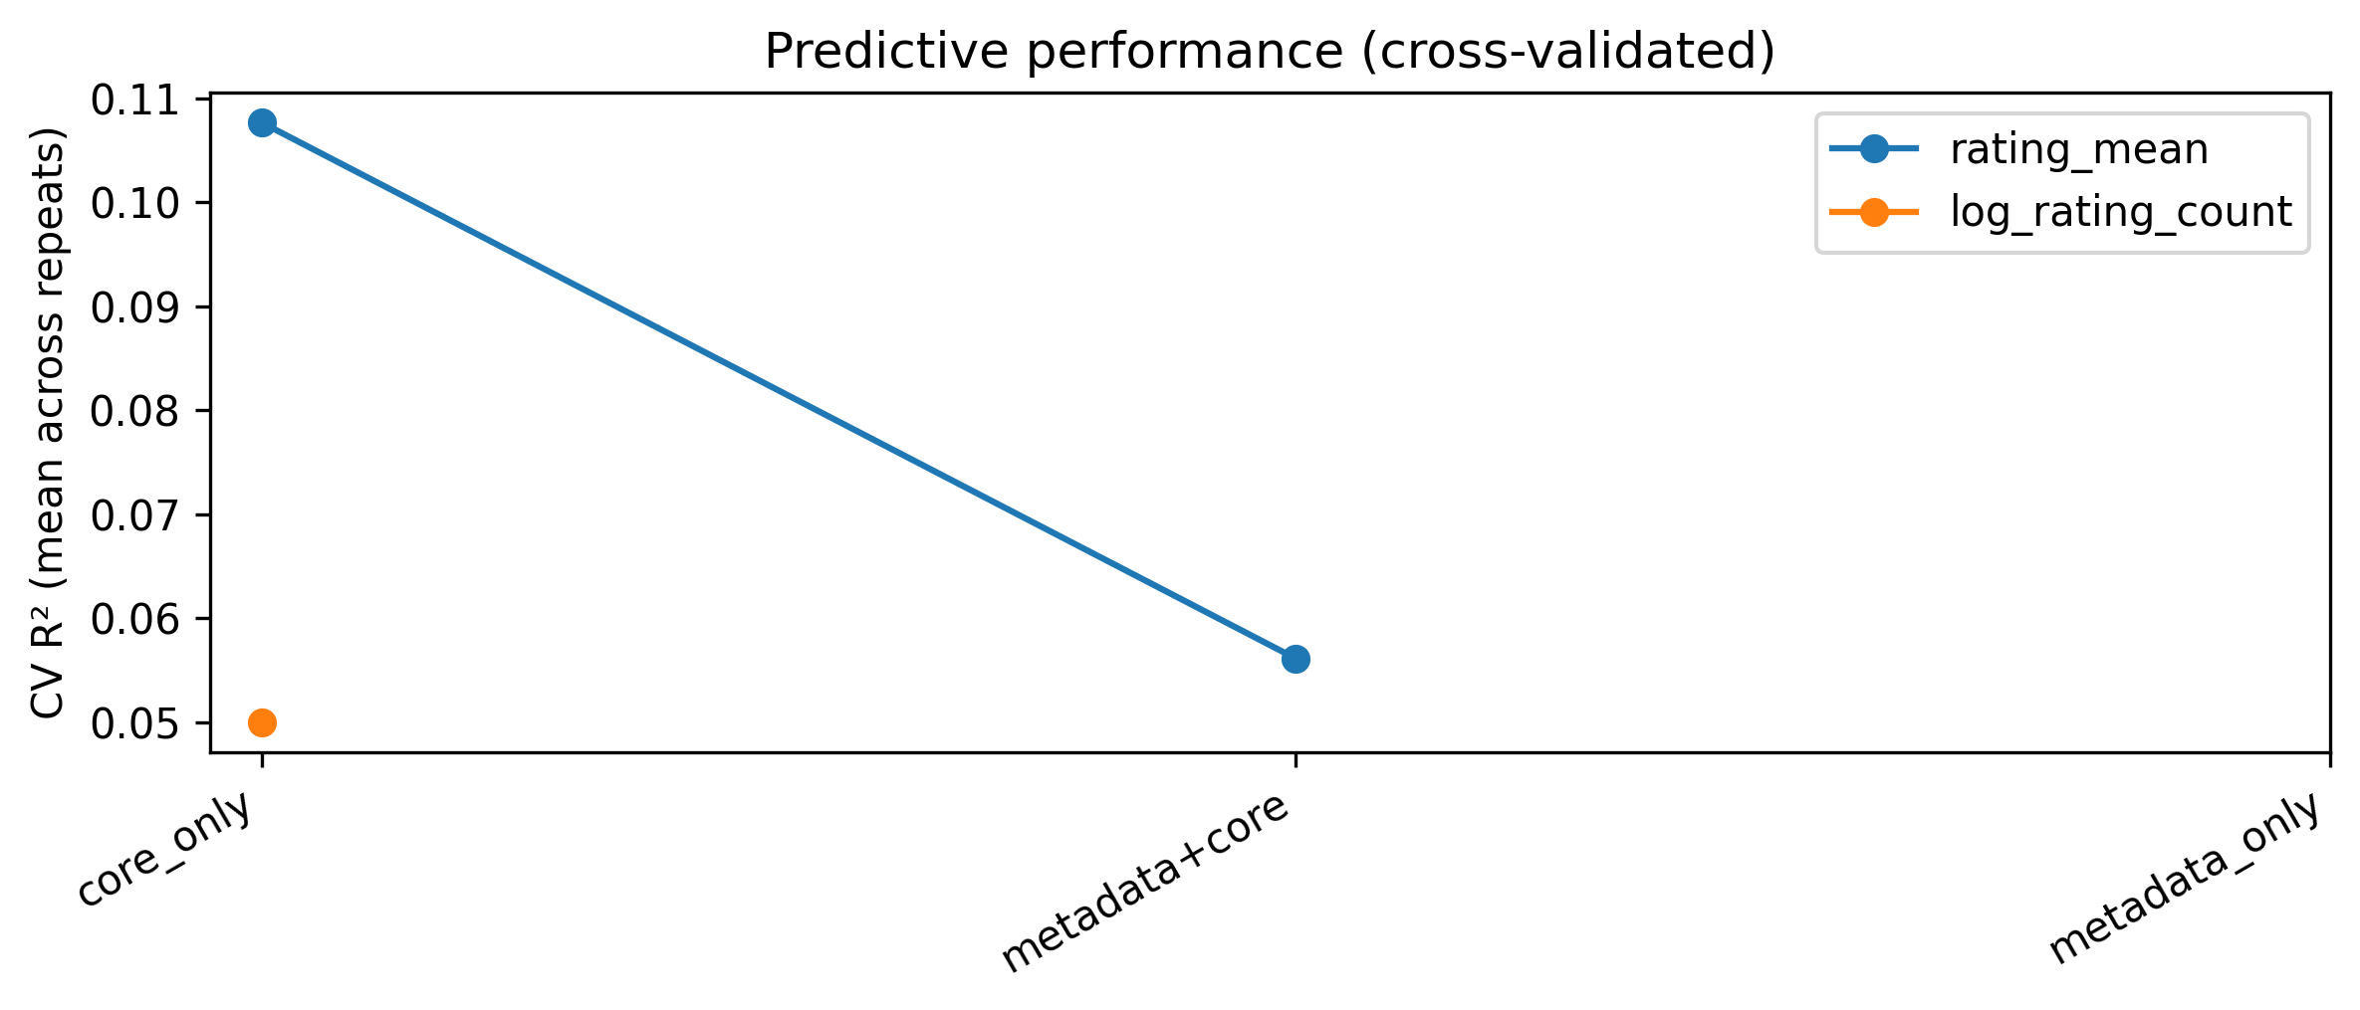
8) Predictive sanity check (CV)
Pilot reality check: what adds out-of-sample signal?
Cross-validated performance summary
Short interpretation
With N=92, rating_mean is dominated by metadata/market factors.
Themes add modest signal for reach (log n ratings).
This is an expected pilot outcome: measurement works, but subtle quality effects need larger N and/or shrinkage models.
Big-corpus plan: keep CORE gating + macro axes, add trajectory features, use shrinkage (ridge/Bayes), and report effect sizes + sign stability.
CV outputs are saved as CSV + plots for auditing and paper appendices.
Notes:
## Notes [Sources] - cv_repeats_summary.csv; predictive_cv_single_run.csv; plot combined_report_assets/cv_performance.png. [/Sources]

Slide 11
9) What this pilot gives us (and what to do next)
Concrete refinements for the larger corpus run
Checklist
Keep (locked-in):
• normalized probability contracts
• auditable measurement bundle (membership + audits + CORE gating)
• two-channel framing: Reach (log n ratings) vs Quality (avg_rating_bayes / rating_mean)
• macro axes for robust interpretation
Add for big corpus:
• finer narrative bins → trajectory features (slope, peak, curvature)
• shrinkage models (ridge/Bayesian partial pooling) for many predictors
• bootstrap sign stability as primary “trend” metric
Deliverables:
• appendix CSV tables (auditable)
• publication-ready plots (consistent style)
Pilot bottom line: the instrument is working; larger N is the lever that will separate subtle quality effects from market reach.
Notes:
## Notes [Sources] - Summary is synthesized from the pilot’s EDA + measurement + inference outputs (all internal). [/Sources]

