Slide 1
Ce:YAG laser control system and user interface via Raspberry-Pi

Slide 2
MAin components
Ce:YAG laser diode
Raspberry PI 3
Display
Software

Slide 3
Server
WiringPI
events
Application
PWM signal
External circuit
(PWM to Analog signal)
Diode
Control

Slide 4
SOftware
Single web server apache2:
- Serves GUI
- handles inputs by executing C code when HTTP request is recieved (probably from PHP scripts)
Outputs:
- C scripts "WiringPi”

Slide 5
Main functionalities
Turn on/off laser diodes
Calculate toxicity with different ratio
Operation time
Diodes feedback(damy)
Total working hours for laser
Doctors profiles and information about operations time

Slide 6
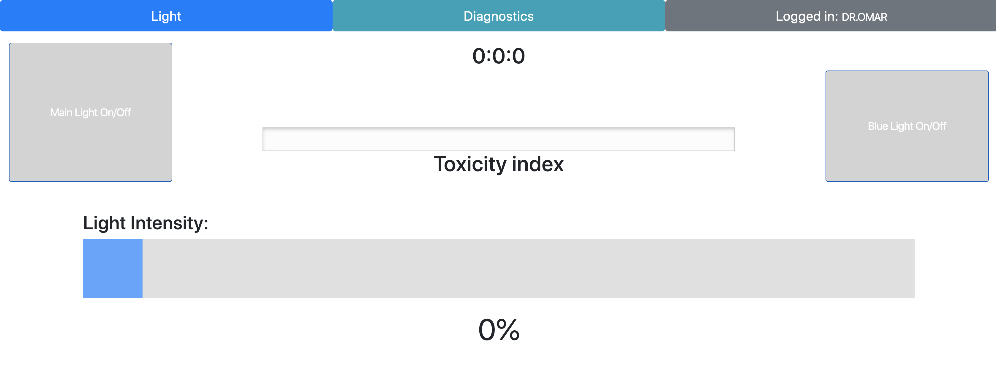
GUI

Slide 7
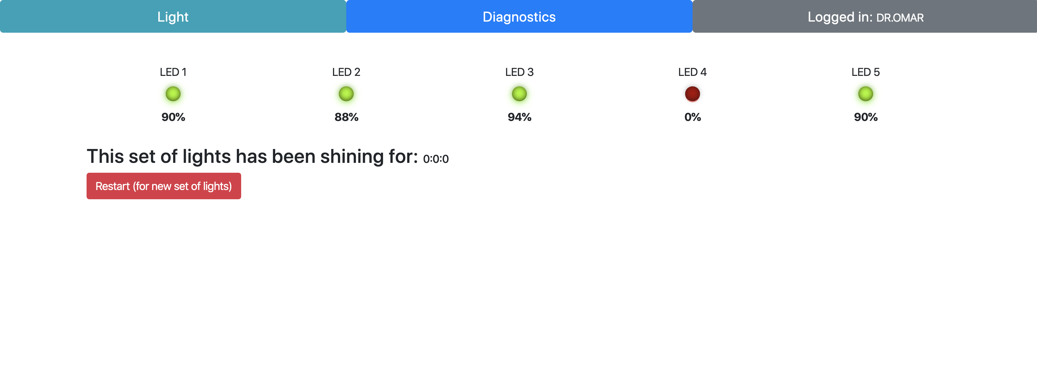

Slide 8
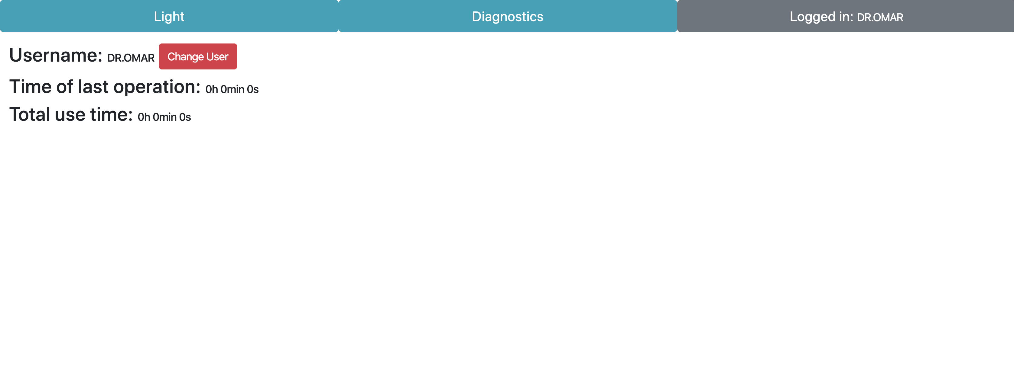

Slide 9
