Slide 1
Ce:YAG laser control system and user interface via Raspberry-Pi

Slide 2
MAin components
Ce:YAG laser diode
Raspberry PI 3
Display
Software

Slide 3

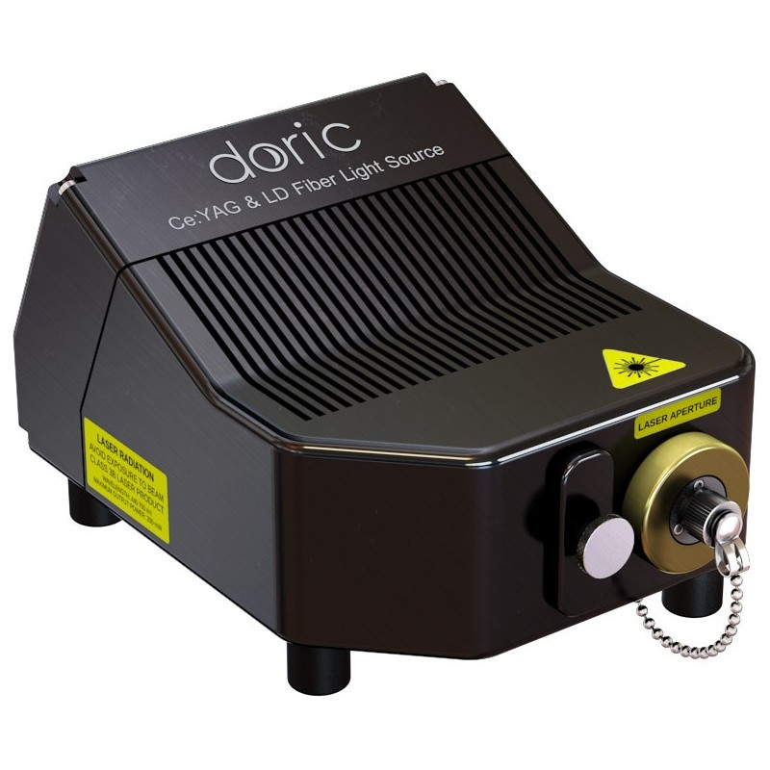
Ce:YAG + Laser Diode Optical Head

Slide 4
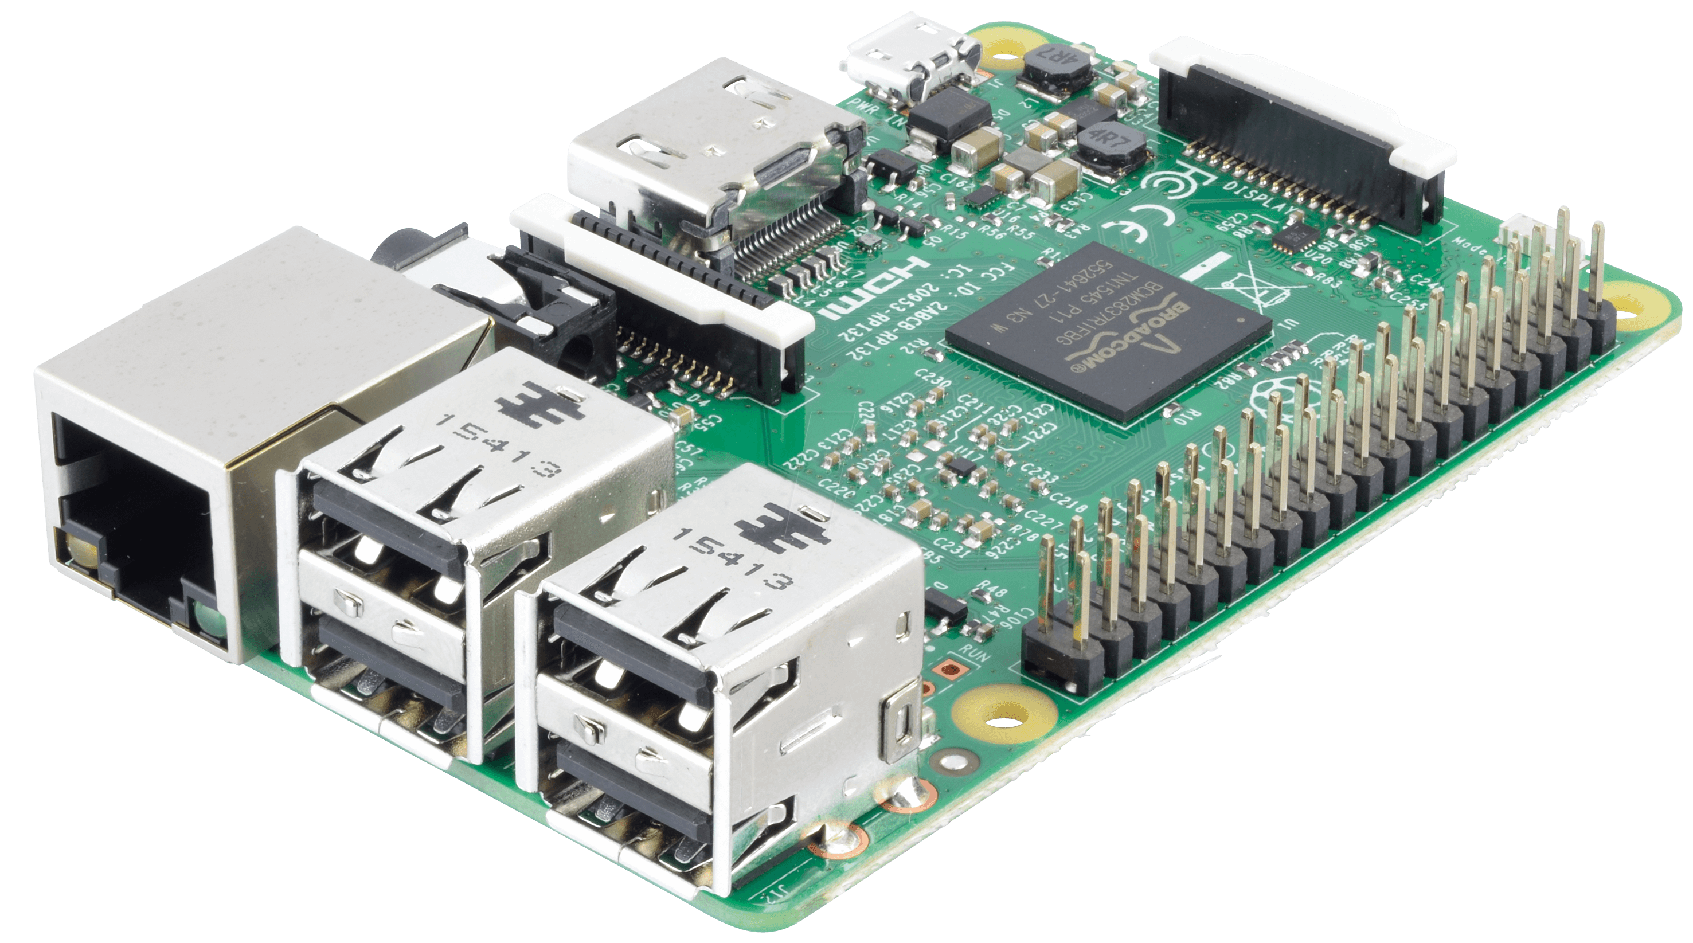
raspberry pi 3

Slide 5

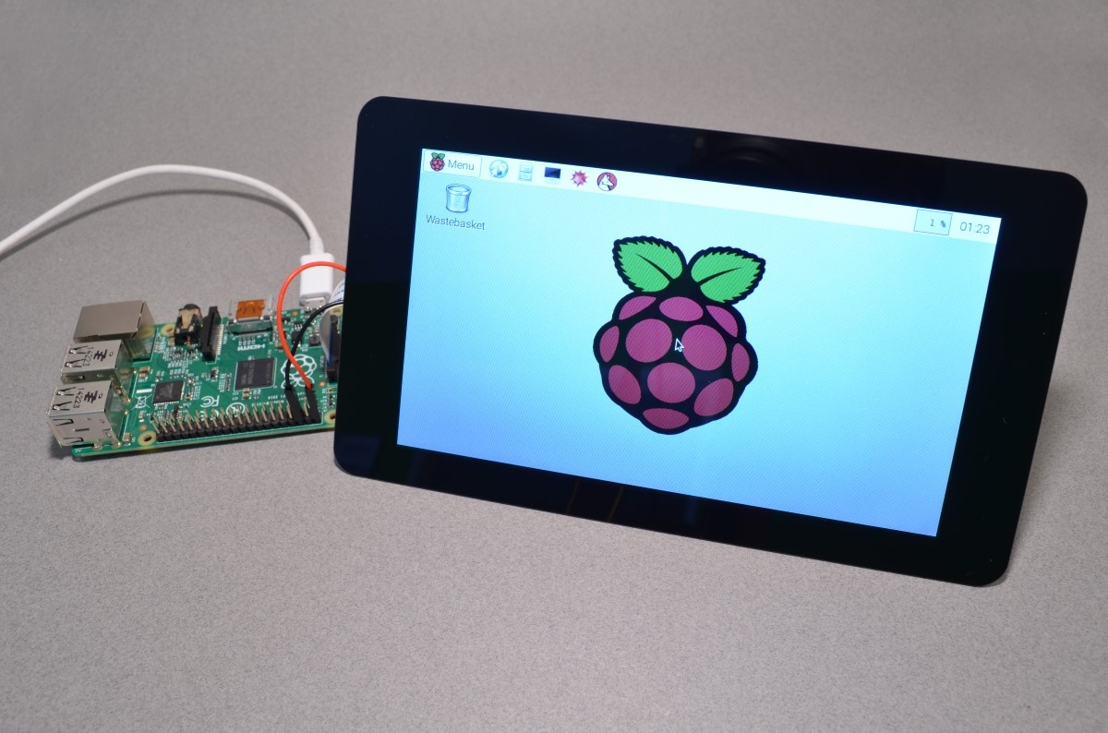
Raspberry pi Display

Slide 6
Server
WiringPI
C-script
events
GUI
PWM signal
External circuit
(PWM to Analog signal)
Diode
Control

Slide 7
SOftware
Single web server apache2:
- Serves GUI
- handles inputs by executing C code when HTTP request is recieved (probably from PHP scripts)
Outputs:
- C scripts "WiringPi”

Slide 8
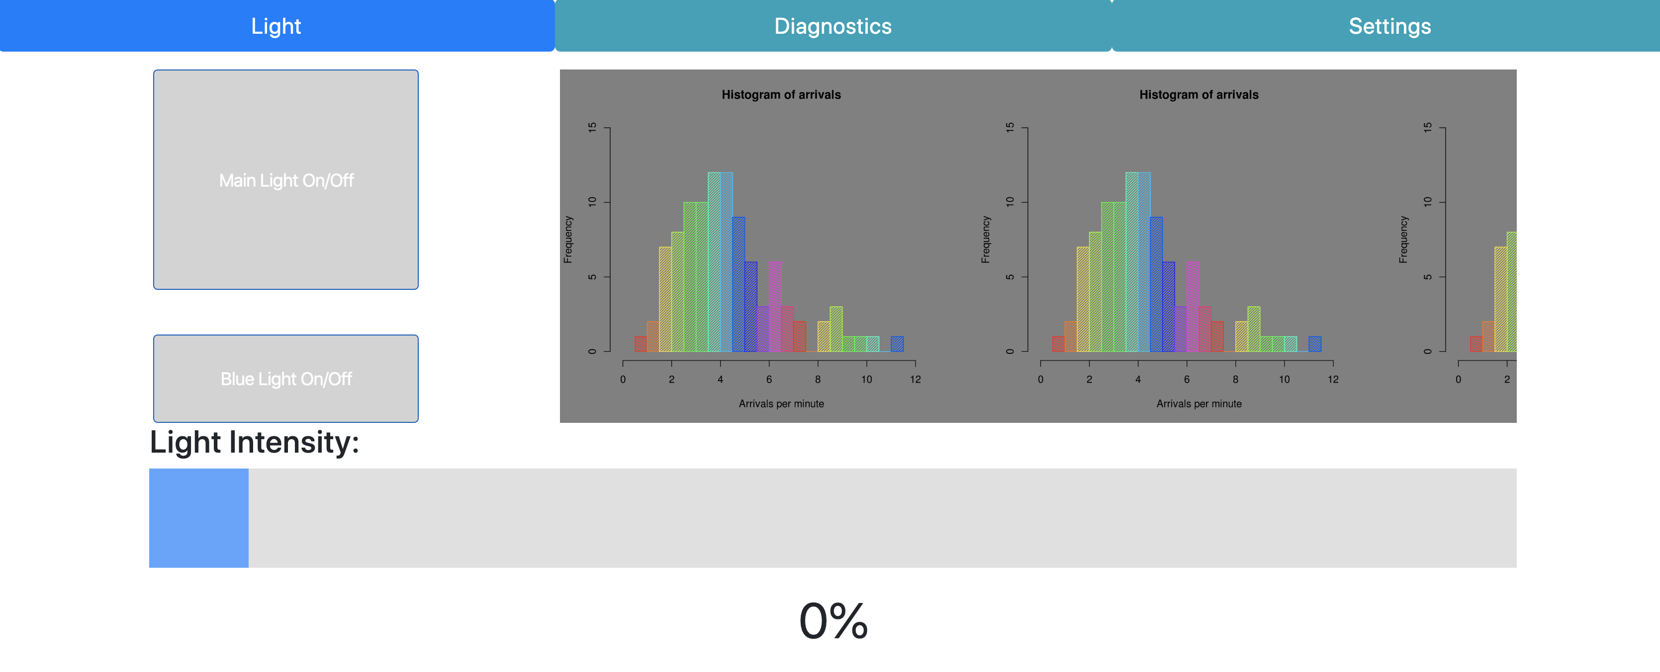
GUI

