Slide 1


Getting Started with ESP32 Sayyidul Aulia Alamsyah, S.T., M.T. Electrical Engineering Program – Electronics Engineering Faculty of Engineering Universitas Negeri Surabaya
Microprocessor Laboratory
A8 Building 4th Floor
Faculty of Engineering
Universitas Negeri Surabaya
Aslab Training

Slide 2
Reference
https://randomnerdtutorials.com/getting-started-with-esp32/
Aslab Training

Slide 3
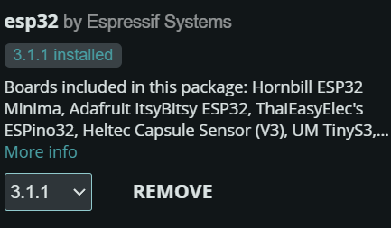
Requirement
Arduino IDE
Esp32 in Boards Manager
Aslab Training

Slide 4
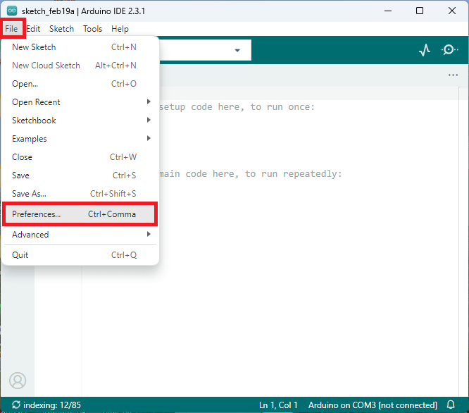
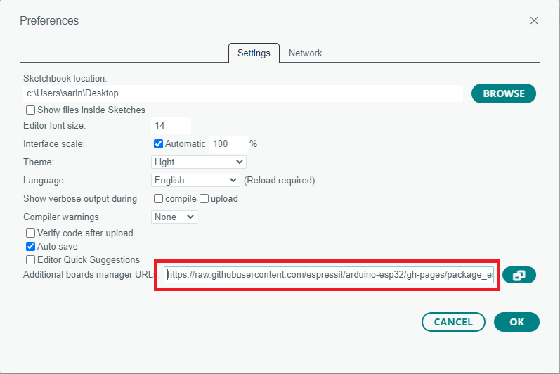
Add ESP32 Board
https://raw.githubusercontent.com/espressif/arduino-esp32/gh-pages/package_esp32_index.json
Aslab Training

Slide 5
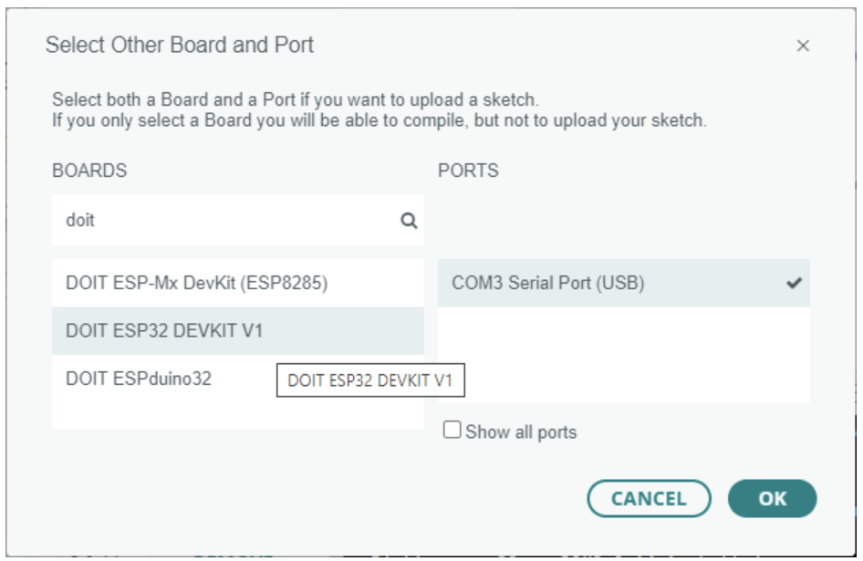
USB Driver
https://randomnerdtutorials.com/install-esp32-esp8266-usb-drivers-cp210x-windows/
Aslab Training

Slide 6
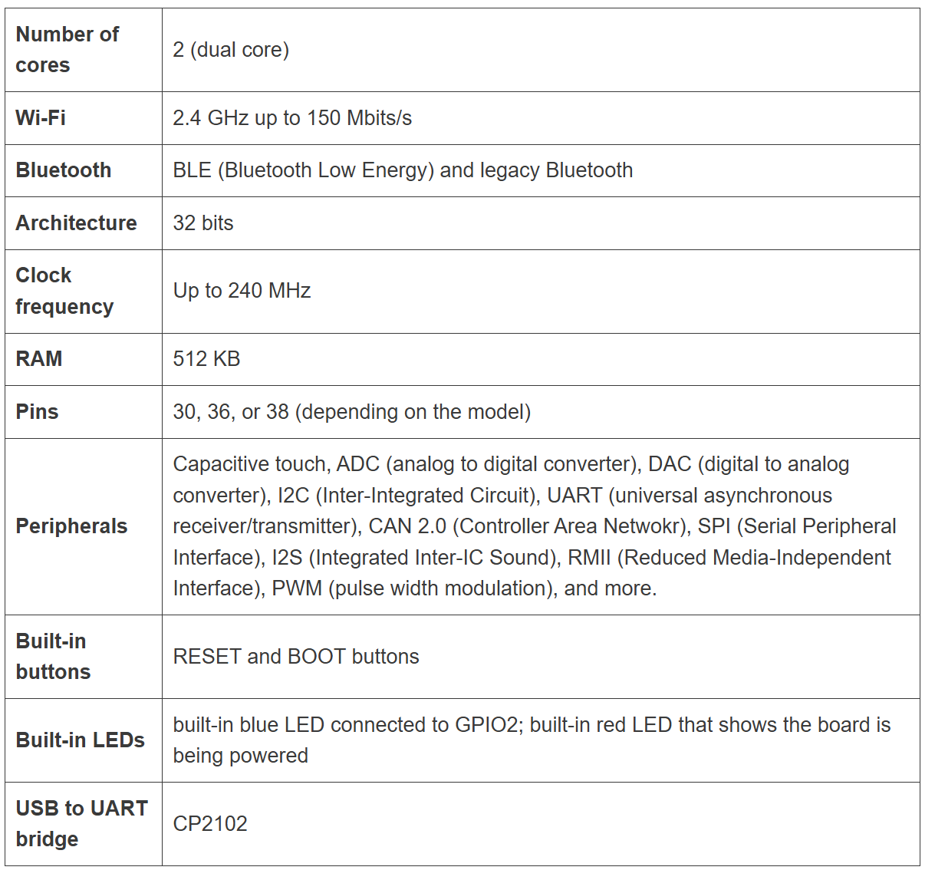
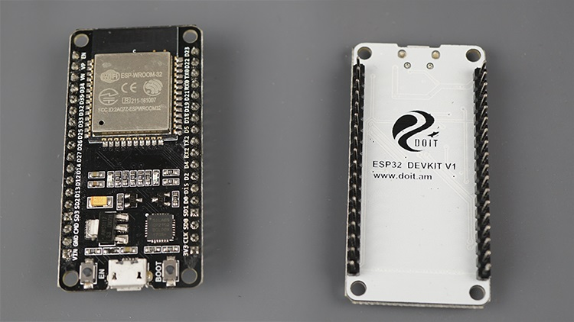
Specifications
Aslab Training

Slide 7
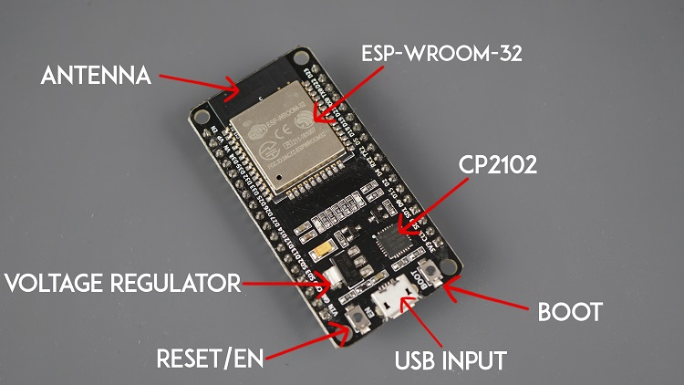
Specifications
Aslab Training

Slide 8
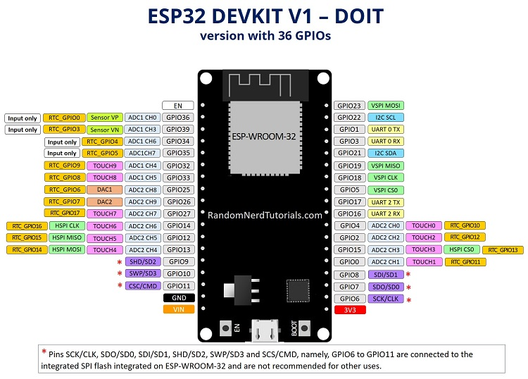
Specifications
Aslab Training

Slide 9
Project
Digital Input Output
Web Server
Sistem IoT
ESP-NOW
Aslab Training

Slide 10
Digital Input Output
Aslab Training

Slide 11
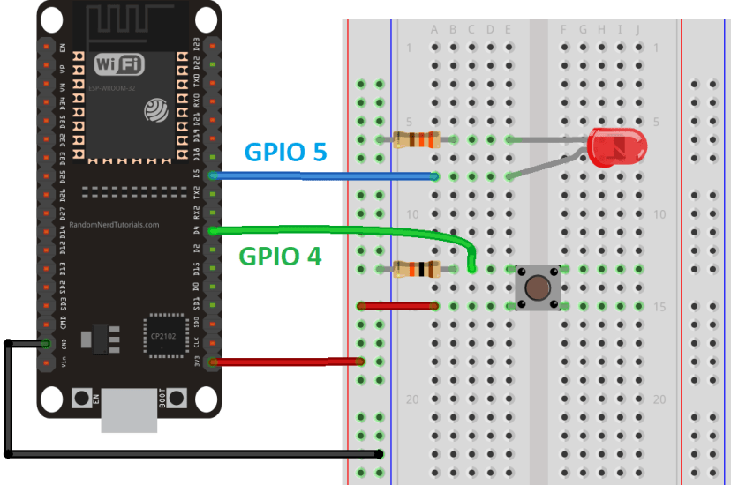
Digital Input Output
Aslab Training

Slide 12
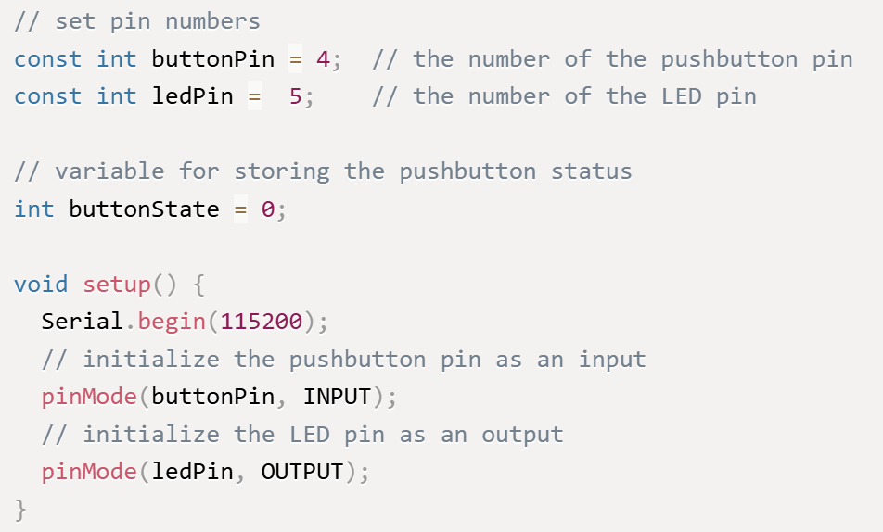
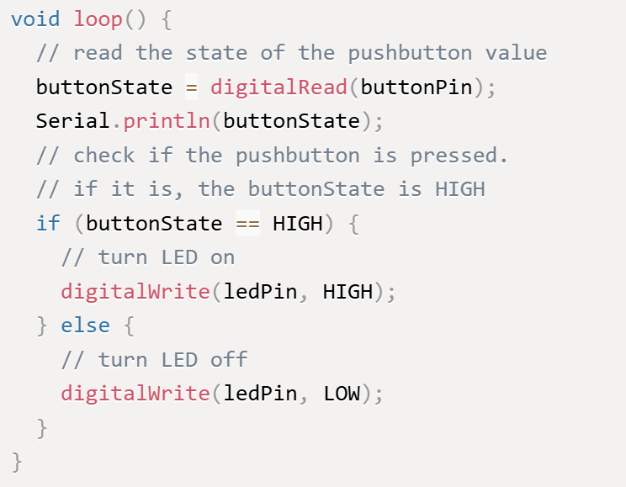
Digital Input Output
Aslab Training

Slide 13
Web Server
Aslab Training

Slide 14
Web Server
Aslab Training

Slide 15
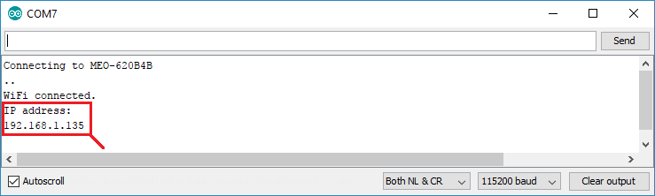
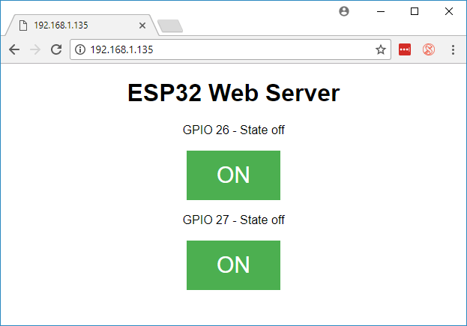
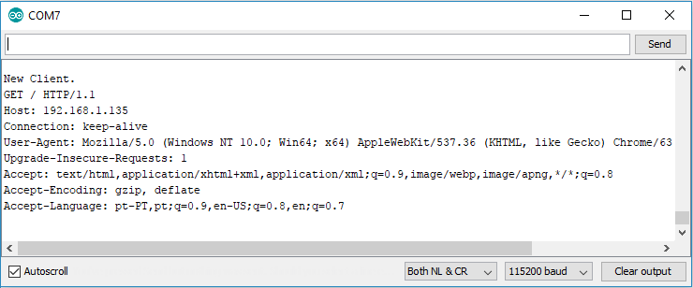
Web Server
Aslab Training

Slide 16
Sistem Iot
Aslab Training

Slide 17
ESP-NOW
Aslab Training

Slide 18
Thank You…!
Aslab Training

