Slide 1
OOP Final: E Commerce
Teacher: Yusif Yusifov
Student: Said Gulizada

Slide 2

Contents
Inheritance
Interface
Polymorphism
Interactivity

Slide 3
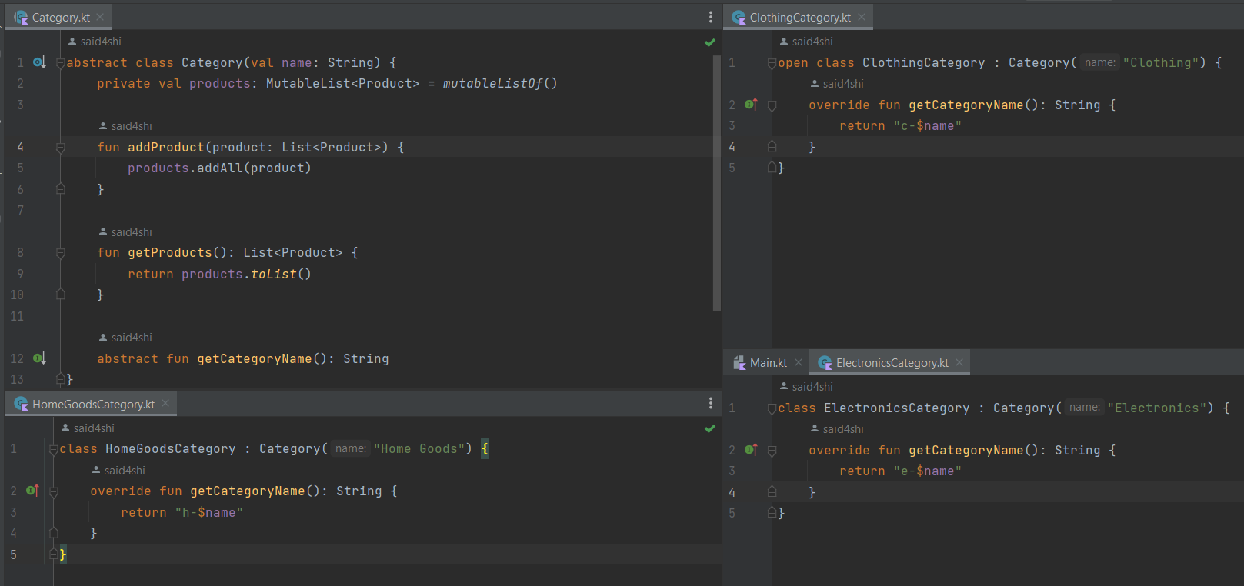
Inheritance
Inheritance is one of the key concepts in object-oriented programing. It involves avoiding code-repetition, especially where different classes have common features and all the classes belong to the same type.
The “ElectronicsCategory”, “ClothingCategory”, and “HomeGoodsCategory” classes now inherit from the Category class in my project.

Slide 4
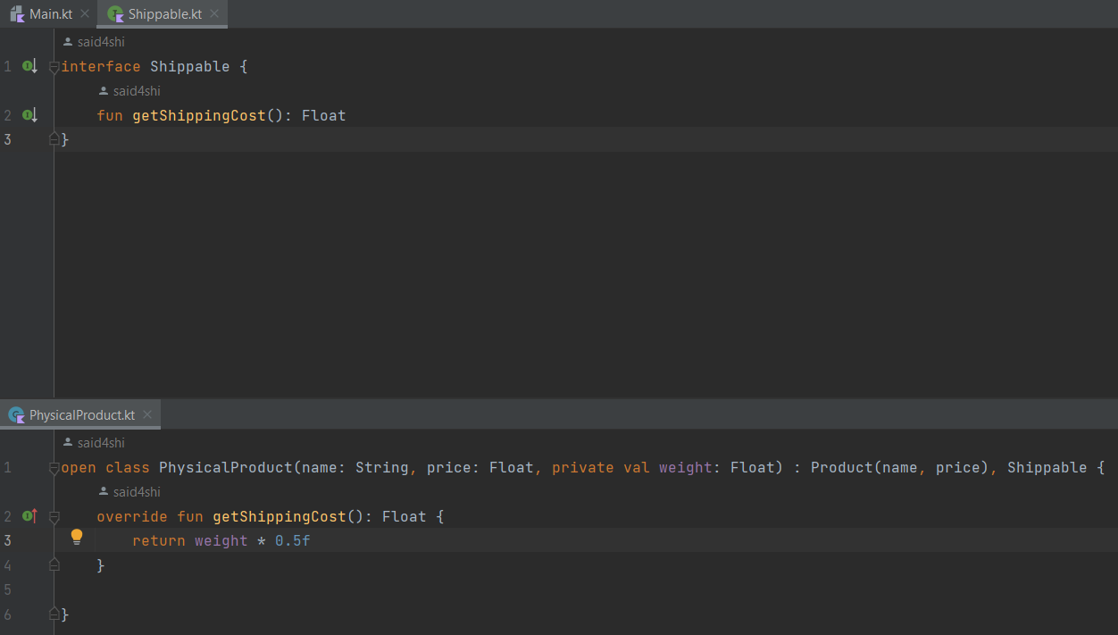
Interface
The interface is a construct that defines a contract for classes to adhere to. It specifies a set of methods and properties that a class implementing the interface must provide.
An interface can contain method declarations, property declarations, and default implementations of methods. However, it cannot contain state (fields or properties with backing fields).
The Shippable interface defines a contract for products that can be shipped. It declares a single method getShippingCost() that calculates the cost of shipping the product.

Slide 5
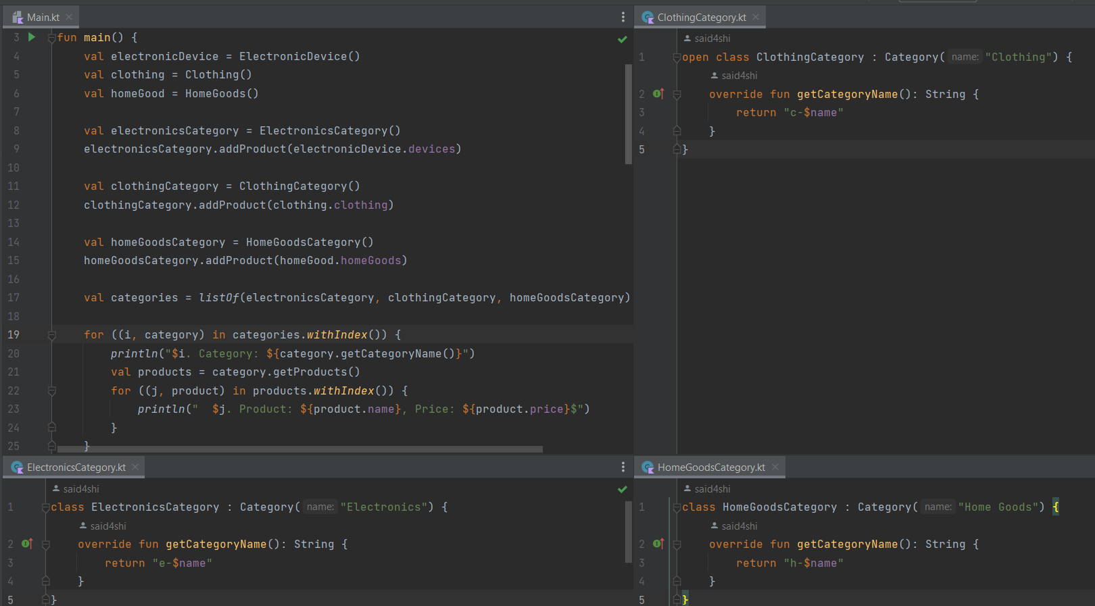
Polymorphism
Polymorphism is a fundamental concept in object-oriented programming that allows objects of different types to be treated as objects of a common superclass or interface. It enables the same code to be used with different types of objects, providing flexibility and extensibility in your code.
Polymorphism promotes code reusability, modularity, and flexibility in object-oriented systems. It allows you to write generic code that can work with objects of different types, making your code more adaptable to changes and easier to maintain.

Slide 6
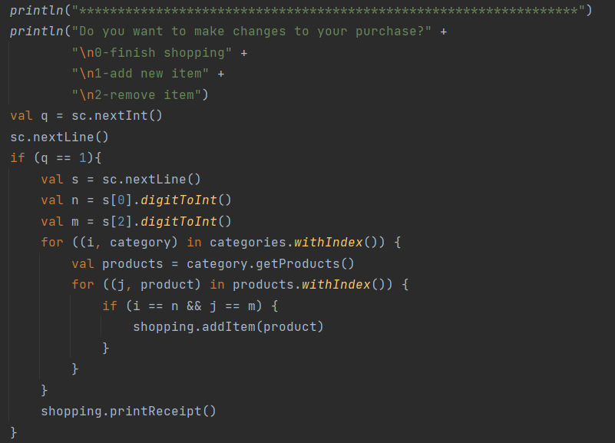
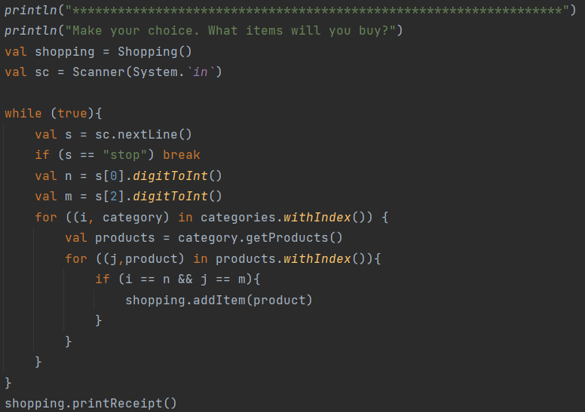
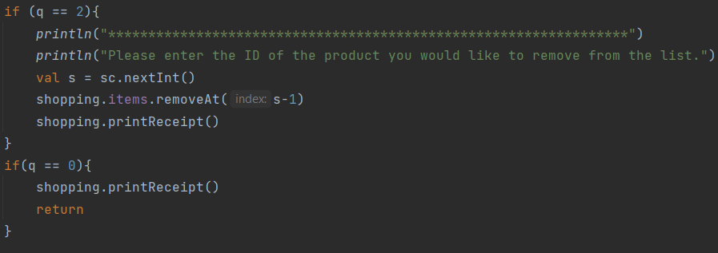
Interactivity
Firstly customers do shopping and get receipt.
Then they see menu which it is consist of finish, add and remove.
The user selects what they want and completes the purchase.

Slide 7
Thanks for attention

