Slide 1
Fetal Health Classification
Machine Learning — Evaluation Project
Group 16: Junior Nfor & Bakwowi Junior
TH Deggendorf · Summer Semester 2026
01/20

Slide 2
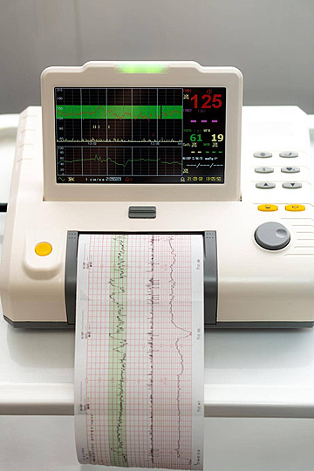
Motivation
Cardiotocography (CTG) records fetal heart rate and uterine contractions during pregnancy; the standard, low-cost, non-invasive tool obstetricians use to monitor fetal wellbeing in real time.
Problem: correctly separating Normal from Suspect and Pathological patterns matters clinically; missed distress signals can lead to preventable stillbirth or birth injury, while false alarms drive unnecessary interventions such as emergency C-sections.
CTG traces are still interpreted manually today, and inter-clinician agreement is known to be limited; creating a natural opening for a consistent, data-driven decision-support classifier.
Goal: given 21 diagnostic features automatically extracted from a CTG recording, predict whether the fetal state is Normal, Suspect, or Pathological.
Challenge: the dataset is imbalanced; most recordings are Normal, making standard accuracy a misleading metric.
02/20

Slide 3
Data - Overview
Source: Kaggle Fetal Health Dataset
Citation: Ayres-de-Campos, D., Bernardes, J., Garrido, A., Marques-de-Sá, J. and Pereira-Leite, L. (2000), Sisporto 2.0: A program for automated analysis of cardiotocograms. J. Matern. Fetal Med., 9: 311-318. https://doi.org/10.1002/1520-6661(200009/10)9:5<311::AID-MFM12>3.0.CO;2-9
Samples: 2,126 CTG (Cardiotogram) recordings
Features: 21 (signal + histogram statistics)
Classes: 3
Missing values: 0
Number of duplicate rows: 13
Feature groups:
FHR (Fetal Heart Rate) baseline, accelerations, fetal movement, uterine contractions
Decelerations: light / severe / prolongued
Short- & long-term variability measures
FHR (Fetal Heart Rate) histogram statistics (width, min/max, mode, mean, median, variance…)
Target feature → fetal_health
1 → Normal
2 → Suspect
3 → Pathological
03/20

Slide 4
Data - Sample
baseline value | accelerations | prolongued_decelerations | abnormal_short_term_variability | mean_value_of_short_term_variability | histogram_mean | fetal_health
120.0 | 0.000 | 0.0 | 73.0 | 0.5 | 137.0 | 2.0
132.0 | 0.006 | 0.0 | 17.0 | 2.1 | 136.0 | 1.0
133.0 | 0.003 | 0.0 | 16.0 | 2.1 | 135.0 | 1.0
134.0 | 0.003 | 0.0 | 16.0 | 2.4 | 134.0 | 1.0
134.0 | 0.001 | 0.002 | 26.0 | 5.9 | 107.0 | 3.0
04/20

Slide 5
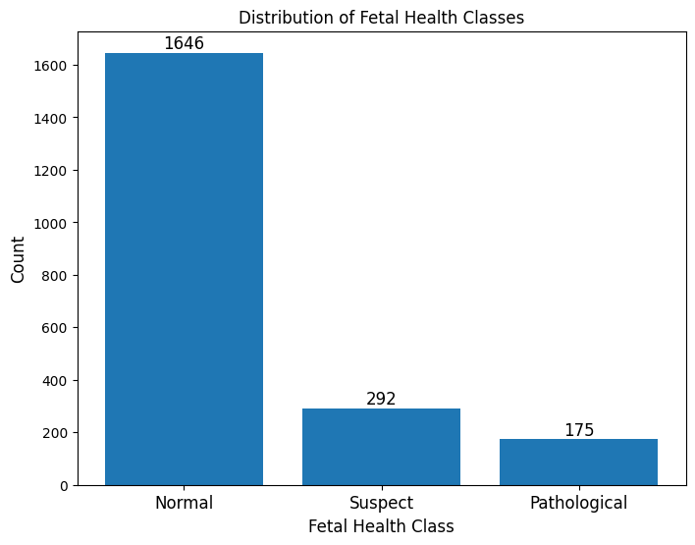
Data – Class Distribution
The dataset is significantly imbalanced. Most recordings are Normal.
Directly motivates macro-F1 as the evaluation metric. Accuracy alone is misleading.
A stratified train/test split ensures both sets preserve the original class proportions.
Oversampling minority classes was assessed to counteract the heavy dominant class bias.
05/20

Slide 6
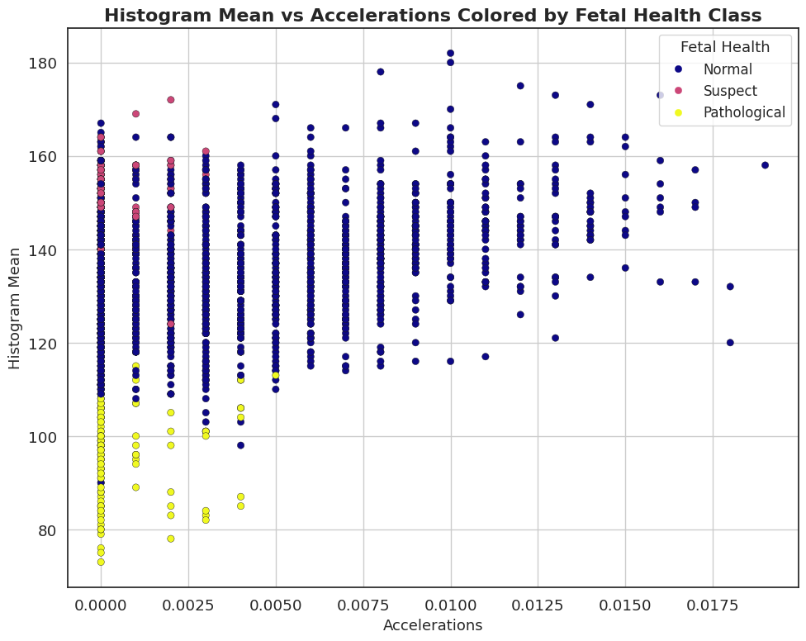
Data – Feature Exploration and Class Separability
Pathological cases are clearly separated in most features.
The Suspect class overlaps heavily with Normal in several features; The main source of classification difficulty.
06/20

Slide 7
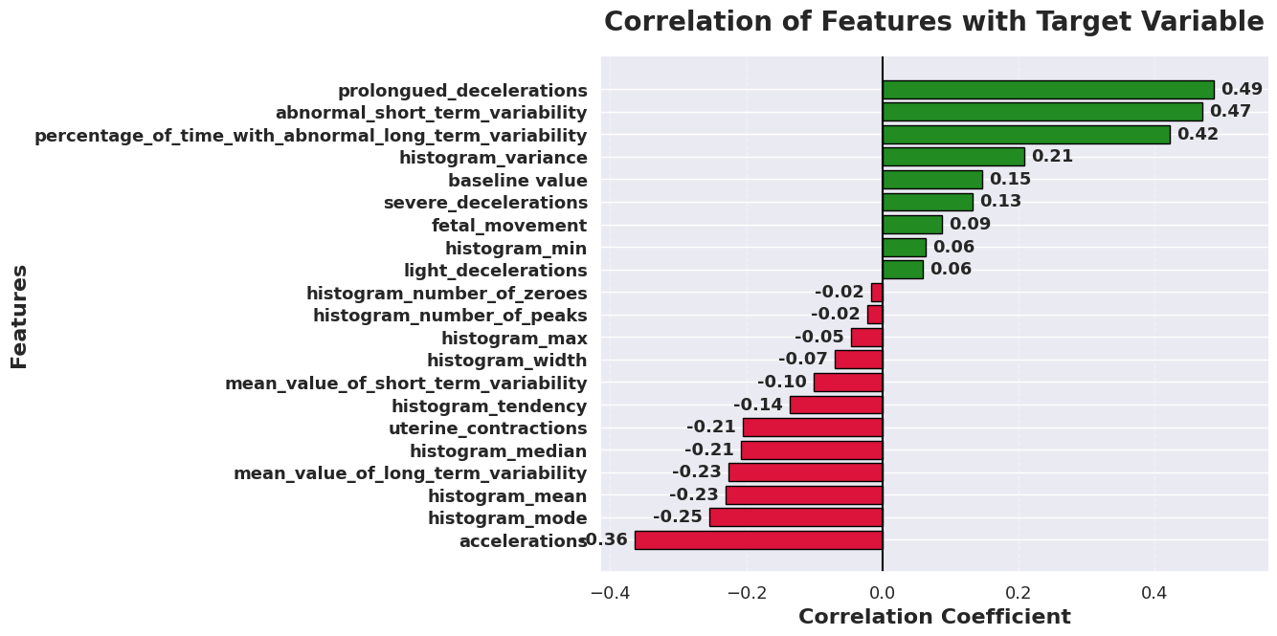
Data – Feature-Target Correlations
several features have low correlation → motivates feature selection
07/20

Slide 8
Method – Pipeline Architecture
Data
Cleaning
Train / Test
Split 80/20
Scaling
(StandardScaler)
→
→
Model
Selection
Feature
Selection
GridSearchCV
& Evaluation
→
Data Cleaning
13 duplicates removed (Now 2113 samples).
No features with missing values.
No removal of outliers
08/20

Slide 9
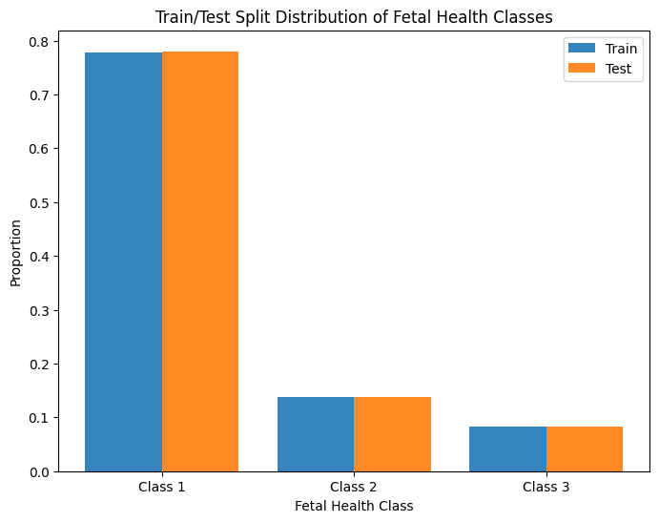
Method – Stratified Train/Test Split
Split ratio: 80% training (1690 samples) · 20% test (423 samples).
Stratified by target class. Class proportions are preserved in both sets.
Test set is touched exactly once which is after all tuning is complete.
09/20

Slide 10
Method – Classifiers Selected
Base Classifiers
KNN (KNearestNeighbours):
Tunned Hyperparameter: n_neighbours
Logistic Regression (LogReg):
Tunned Hyperparameter:
C (Regularization strength)
l1_ratio
Advanced Classifiers
Support Vector Classifier (SVC):
Tunned Hyperparameters:
C → [0.1, 1, 10, 100]
Gamma → [“Scale”, “auto”, 0.01, 1]
Kernel → [“rbf”, “linear”, “poly”, “sigmoid”]
Random Forest Classifier (RFC):
Tunned Hyperparameters:
n_estimators → [100, 200, 300]
max_depth → [None, 5, 10, 20]
min_sample_split → [2, 5, 10]
max_features →[“sqrt”, “log2”]
10/20

Slide 11
Method – Feature Selection
Sequential Feature Selector (SFS), forward direction. Adds the single best feature at each step.
Fixed classifier inside SFS (fixed params). Avoids the cost of nested hyperparameter tuning.
Grid searches over n_features_to_select: [5, 10, 15, 20].
RFC uses RFECV instead which leverages the tree's built-in feature importance scores directly.
11/20

Slide 12
Method – Cross-Validation & Hyperparameter Tunning
GridSearchCV with StratifiedKFold (5-fold outer CV).
SFS uses 3-fold inner CV. Kept lower to limit computation time.
Scoring metric: macro-F1. Treats all three classes equally regardless of size.
Results: CV mean and std on training data, final score on held-out test set.
Why macro-F1?
With 1,646 Normal vs 175 Pathological samples, accuracy is misleading. Macro-F1 treats all three classes equally.
Handling Class Imbalance
Both SMOTE (Synthetic Minority Oversampling Technique) and class_weight="balanced" were evaluated. SMOTE consistently outperformed class weighting across all models.
12/20

Slide 13
Results – Model Comparison
All models trained with the same pipeline: scaling → feature selection → GridSearchCV (5-fold, macro-F1).
Model | Best Params | #_Selected Features | CV F1 (mean, std) | Test F1 (macro) | Test Accuracy
KNN | k=3 | 10 | 0.8588, 0.0237 | 0.8676 | 0.9338
Logistic Regression | C=10, l1_ratio=0 | 20 | 0.7091, 0.0259 | 0.7804 | 0.8723
SVC | C=100, gamma=0.1, Kernel=“rbf” | 20 | 0.8431, 0.0293 | 0.8830 | 0.9385
RFC | Max_depth=None, max_features=“sqrt, min_samples_split=2, n_estimators=100 | 18 | 0.8963, 0.0201 | 0.8867 | 0.9362
13/20

Slide 14
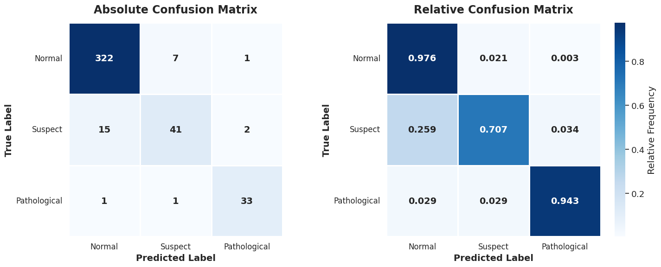
Results – Best Model
Confusion matrix of RFC on the held-out test set.
Key observation: Most errors involve the Suspect class; confused with both Normal and Pathological.
14/20

Slide 15
Results – Why RFC outperformed the others
Non-linear boundaries: The Normal/Suspect boundary is non-linear; RFC models it naturally through recursive splits without shape assumptions.
Feature interactions: RFC captures combinations feature at every split; LogReg treats each feature independently.
Ensemble stability: Averaging across hundreds of trees cancels individual errors.
No distributional assumptions: Skewed, non-Gaussian features do not affect tree splits; Logistic Regression and SVC often perform better when features have more regular distributions.
Outlier robustness: Splits are threshold-based, not distance-based, so retained outliers do not distort RFC the way they distort KNN and SVC.
15/20

Slide 16
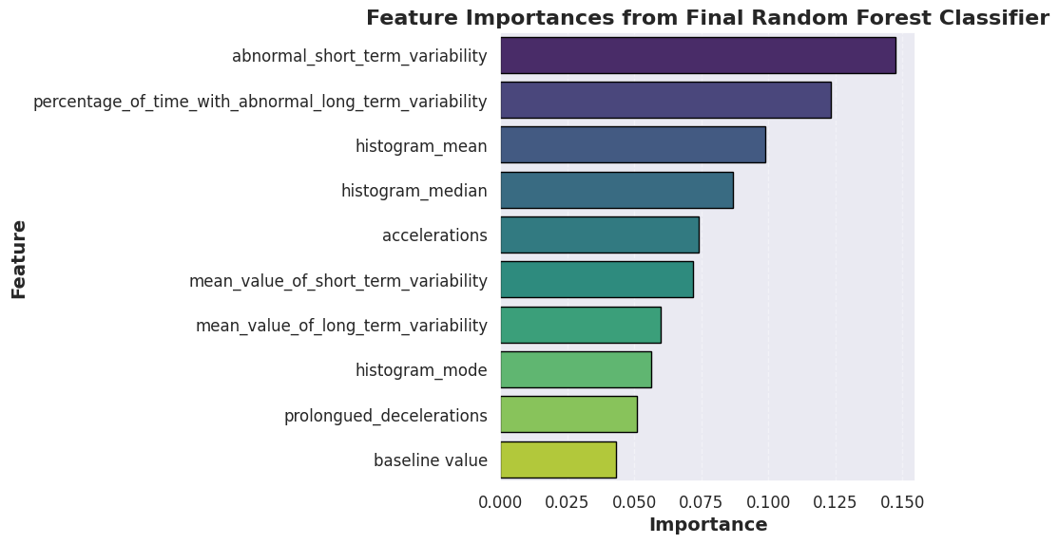
Results – Why RFC outperformed the others
16/20

Slide 17
Discussion
Advanced classifiers (RFC, SVC) outperformed base classifiers across all metrics confirming that the Normal/Suspect boundary requires non-linear modelling.
The Suspect class remained the hardest across all four models.
KNN overfitting (train F1 rising toward 1.0, val F1 = 0.859) at k=1 was the clearest example of how hyperparameter tuning directly impacts generalisation.
Placing SMOTE inside the CV pipeline was critical; applying it before splitting would have inflated CV scores by leaking synthetic samples into the validation folds.
17/20

Slide 18
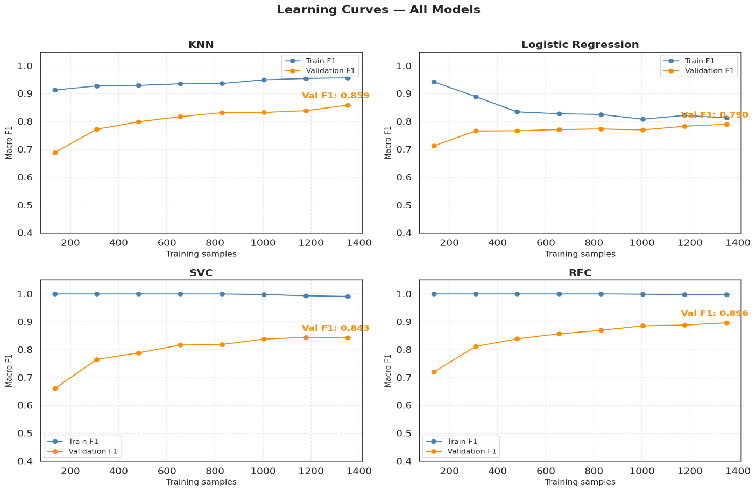
Discussion
The learning curves had not plateaued; more real data could further improve minority class performance, particularly for Pathological.
18/20

Slide 19
Summary
Dataset of 2,126 CTG recordings, 21 features, 3 imbalanced classes; macro-F1 chosen as the evaluation metric.
Data cleaning: 13 duplicate rows removed, outliers retained as potential pathological indicators.
Feature selection reduced 21 features to N most informative; SFS for KNN, LogReg, SVC; RFECV for RFC.
Advanced classifiers (RFC, SVC) outperformed base classifiers (KNN, LogReg) across all metrics.
Best model: RFC ; Test F1 = [0.8867] · CV F1 = [mean=0.8963, std=0.0201].
Main challenge: Suspect class; highest inter-class confusion across all models.
19/20

Slide 20
Thank You – Questions?
20/20

