Slide 1

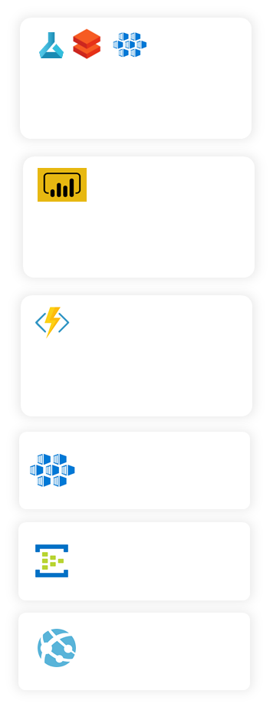

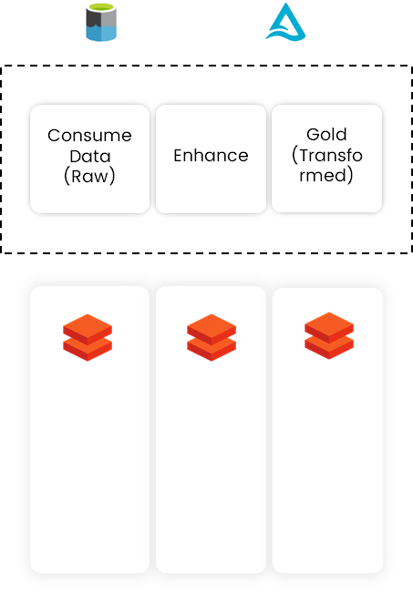
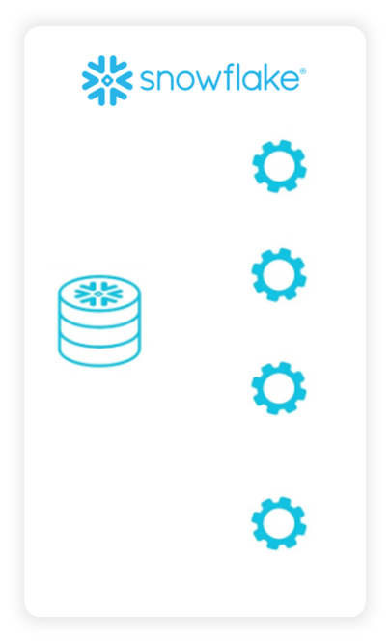

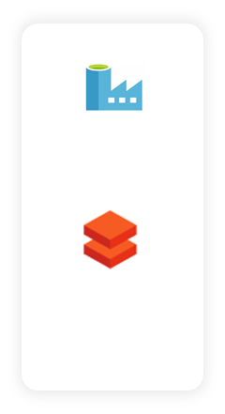




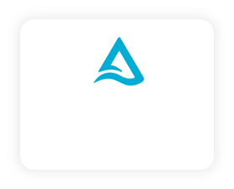
Data Sources
Extraction
Transformation
Data Warehouse
Deliver
Batch Processing
ADLS Gen 2
Delta Lake
Azure ML, Databricks, AKS
Data Science – Build, Train & Deploy models.
Data Scientists, Data Analysts
File Server
ADF
Connectors
Data Science
Power BI
Canned/ Self Service Dashboards & Reports.
Business Users
File Server
BI & Analytics
Databricks
Custom Connectors
Azure
Data bricks
Azure
Data bricks
Azure
Data bricks
Azure Functions
File Delivery to Downstream systems.
Data
Warehouse
Downstream Systems
Self-service Queries
Spark data Quality Check
Spark
Spark
AKS
Data as service Api Layer
File Server
Speed Processing
API
ETL
Event Hub
Pub/ Sub Interface
Device Apps
Real time /
Streaming Data
(IOT etc)
Azure Web
Apps
Delta Lake
(real time storage)
Events Hub
Data Catalog, Data Security (AAD), Workflow Orchestration (ADF), Monitoring, Audit controls

