Slide 1
Fact Checking Health Claims Using Transformers and RAG Techniques
Guided By:
Mrs. Babisha A, M.E
Assistant Professor
Department Of Artificial Intelligence & Data Science
Panimalar Institute Of Technology
Batch No: 22
Team Members:
Balamurugan K (211521243030)
Dinesh S (211521243049)
Lakshmi Kanth R (211521243095)

Slide 2
Abstract
Develop an AI-based system using Transformers and Retrieval-Augmented Generation (RAG) to verify the accuracy of medical claims from user-provided text inputs.
The system extracts medical entities from the input text using NLP techniques and queries trusted databases like PubMed, WHO, and UMLS to retrieve relevant information for fact-checking.
It categorizes the claims as "Factual," "False," or "Insufficient Evidence," providing users with real-time verification based on evidence-backed sources.
This solution aims to reduce the spread of medical misinformation, enhancing the reliability of health-related content on digital platforms.

Slide 3
Literary Survey
S. No | Year | Title | Author | Merits | Demerits
1. | 2020 | HealthFC: A Benchmark Dataset for Medical Fact-Checking | M. Kotonya, F. Toni | Provides a labeled dataset for medical misinformation detection | Limited coverage of diseases and treatments
2. | 2021 | PubHealth: A Dataset for Evidence-Based Fact-Checking in Healthcare | W. Zhong, M. Enayet | Includes detailed evidence for health-related claims | Requires high-quality training data for accuracy
3 | 2022 | Transformer-based NLP Models for Health Misinformation Detection | A. Gupta, R. Sharma | Improves classification of misinformation over traditional ML models | Struggles with complex claims needing external evidence
4 | 2023 | Integration of BioBERT and Knowledge Graphs for Fact-Checking | K. Wang, L. Chen | Improves interpretability and reasoning in fact-checking models | Requires extensive knowledge base updates
5 | 2024 | Proposed System: Fact-Checking Medical Claims Using BioBERT + RAG + LLM | Dinesh S, Bala Murugan K, Lakshmi Kanth R | Combines entity extraction, evidence retrieval, and contextual explanations for accurate verification | Requires cloud-based infrastructure for scalability

Slide 4
Existing System
Health claims are traditionally verified manually by medical professionals using research papers and clinical trials, making the process slow and resource-intensive.
Some automated tools use general NLP models like BERT, which are not specifically trained for medical contexts, leading to reduced accuracy in understanding complex medical terminology.
Most current systems do not directly utilize clinical trials or systematic reviews, instead relying on general scientific publications or user-generated content, which may not be reliable for accurate medical verification.

Slide 5
Proposed System
Utilizes BioBERT for entity extraction and RAG (Retrieval-Augmented Generation) for retrieving and verifying medical claims against credible sources.
Expands sources to include PubMed, WHO, and UMLS for comprehensive medical information retrieval, with user feedback incorporated to improve classification accuracy over time.
BioBERT identifies key medical entities within user-submitted claims.
RAG retrieves relevant information from trusted databases and RoBERTa assesses the evidence to confirm or refute the claim.
The system classifies claims as Factual, False, or Inconclusive, and provides real-time results through a web interface.

Slide 6
System Requirements
Hardware Requirements:
Processor: Intel i5/i7 or Ryzen 5/7
RAM: Minimum 8GB
Storage: At least 100GB SSD
GPU: NVIDIA RTX 2060 or higher
Software Requirements:
Programming Language: Python 3.8+
Libraries: TensorFlow, PyTorch, Hugging Face Transformers
Database: PostgreSQL or MongoDB
Cloud Services: AWS/GCP for scalable deployment

Slide 7
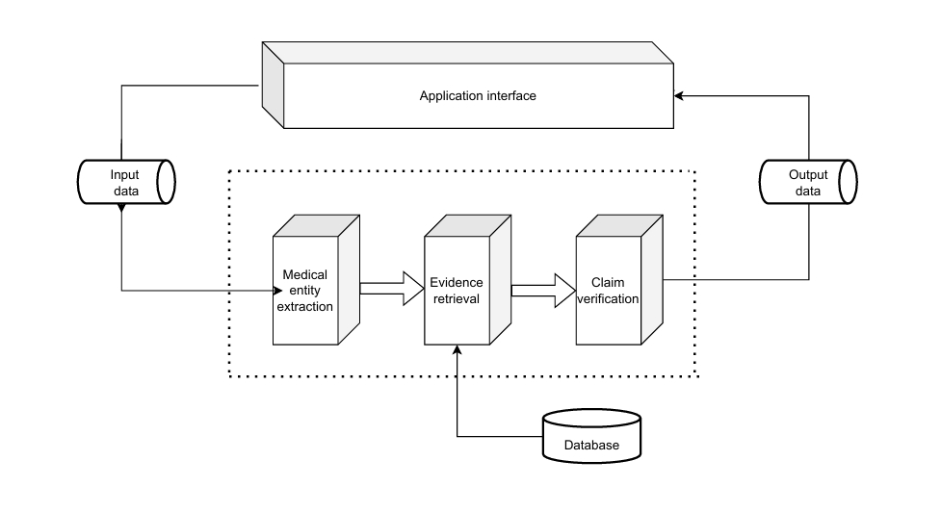
System Architecture

Slide 8
List of Modules
User Input Processing Module
Medical Entity Extraction Module
Evidence Retrieval Module
Claim Verification Module
Contextual Explanation Module
User Interface Module

Slide 9
Algorithm
BioBERT: Input Processing and Medical Entity Extraction
RAG Model: Evidence Retrieval
RoBERTa: Claim Verification and Classification
LLM: Contextual Explanation
Frontend Module: User Interface and Output Generation

Slide 10
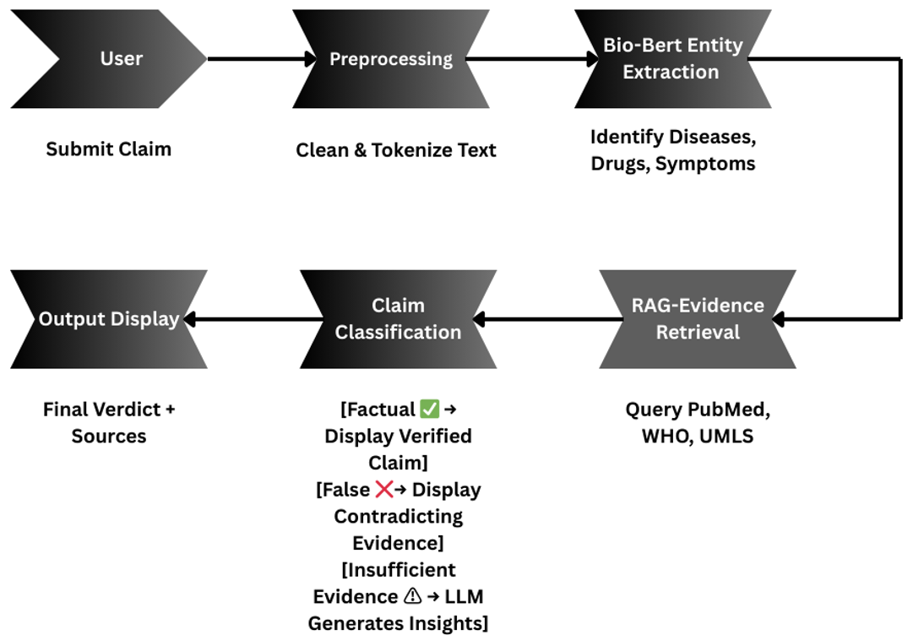
Workflow Diagram

Slide 11
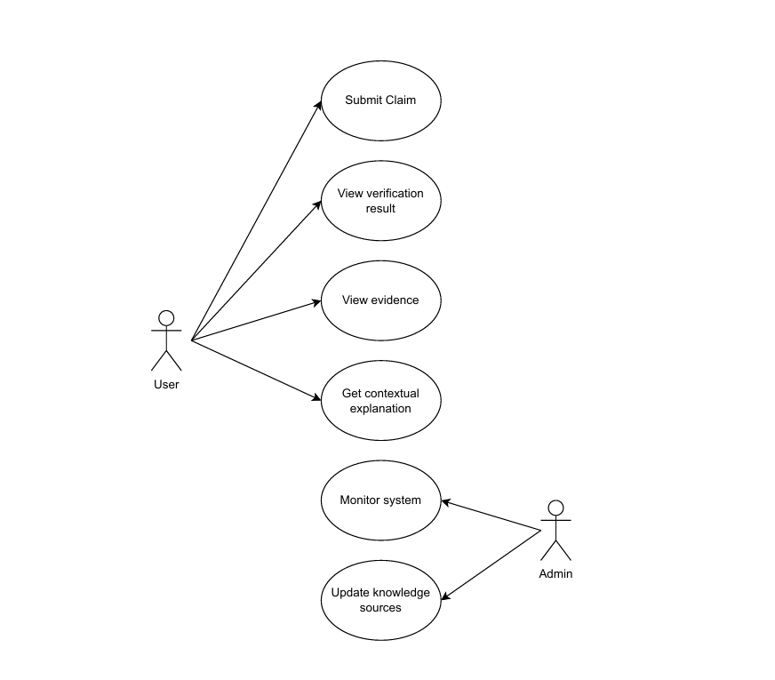
Use-case Diagram

Slide 12
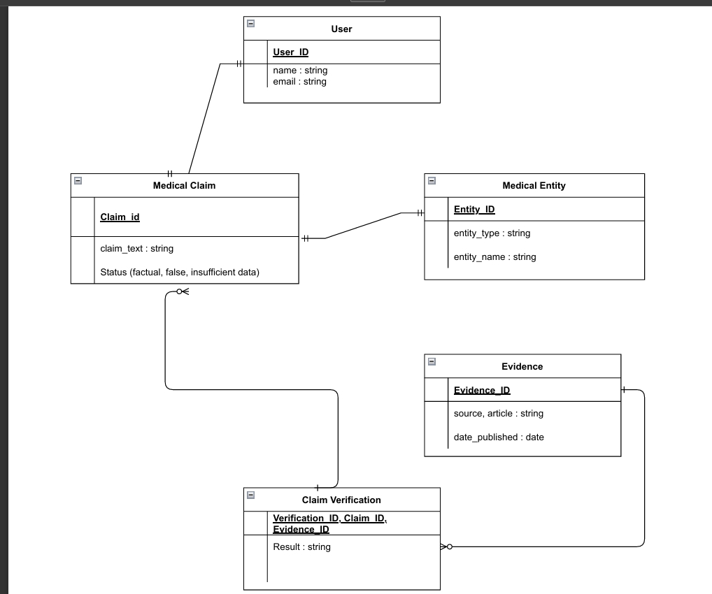
Class Diagram

Slide 13
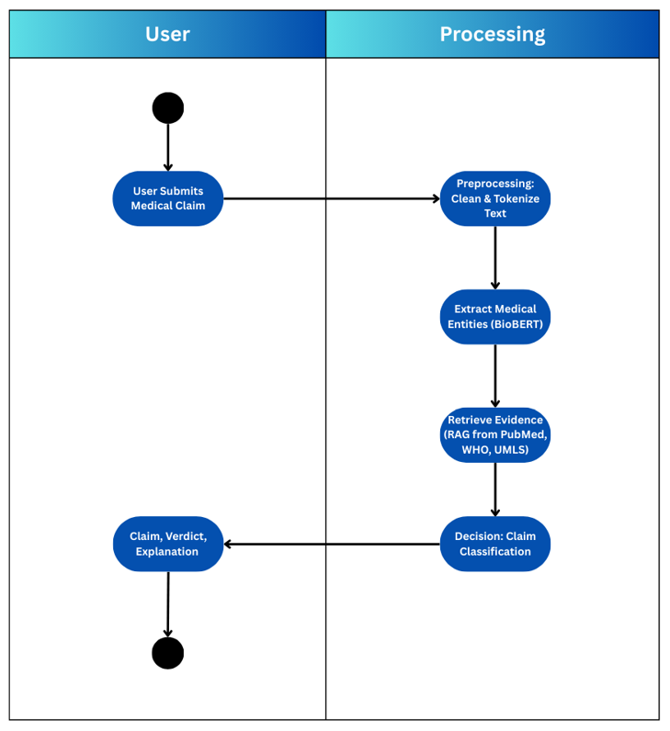
Activity Diagram

Slide 14
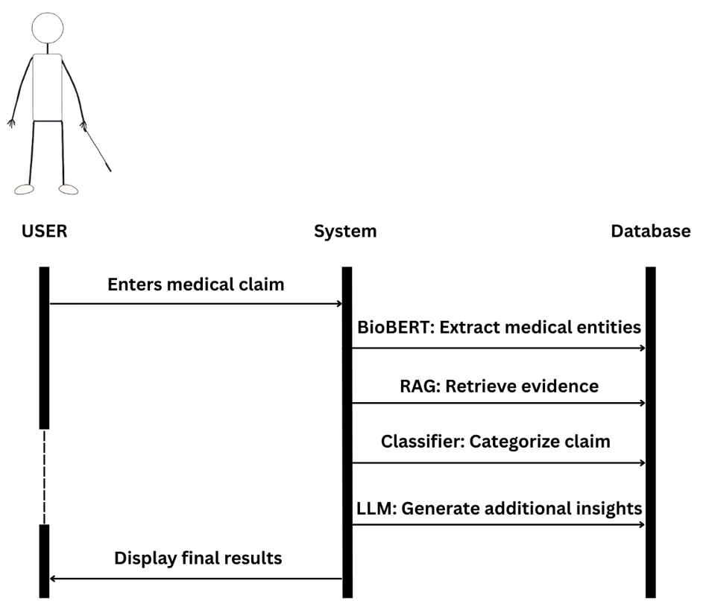
Sequence Diagram

Slide 15
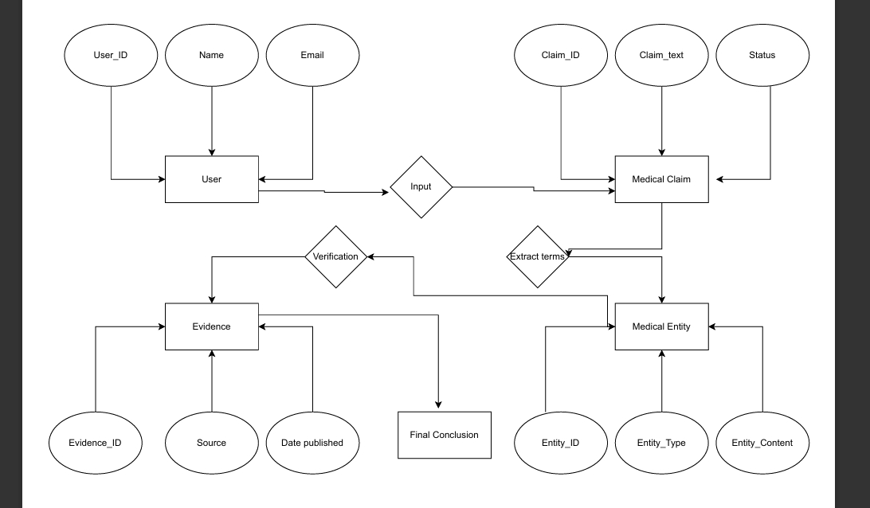
Entity Relationship Diagram

Slide 16
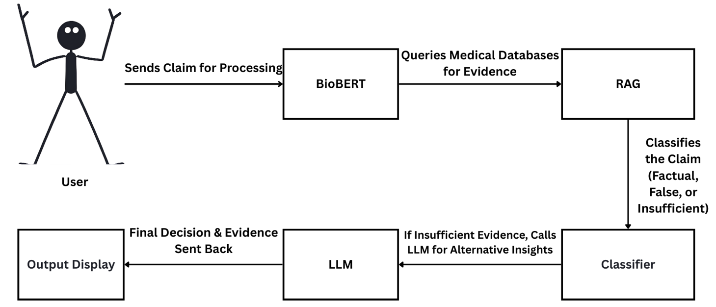
Collaboration Diagram

Slide 17
Advantages
Automation – Reduces manual effort in fact-checking
High Accuracy – Uses domain-specific NLP models
Scalability – Can verify multiple claims simultaneously
Evidence-Based – Retrieves real-time data from trusted sources
User-Friendly – Provides clear classifications with sources

Slide 18
Future Enhancements
Multilingual Support – Expand to non-English medical claims
Integration with Health Apps – API support for mobile health applications
Integration with social media – Real time detection of false health claims in social media
Blockchain for Data Integrity – Secure and transparent medical data verification

Slide 19
Conclusion
The AI-based system using Transformers and RAG ensures accurate verification of medical claims by extracting entities and retrieving evidence from trusted databases like PubMed, WHO, and UMLS. By categorizing claims as "Factual," "False," or "Insufficient Evidence," it helps reduce medical misinformation and enhance the credibility of health content on digital platforms.

Slide 20
References
Schroff, F., Kalenichenko, D., & Philbin, J. (2015). FaceNet: A Unified Embedding for Face Recognition and Clustering. Proceedings of the IEEE Conference on Computer Vision and Pattern Recognition (CVPR).
T. Lee, A. Smith, and B. Zhang, "AI for Drug Discovery," Published: 2022, Published in Nature Medicine (Springer).
S. Lee, Y. Liu, and T. Tan, "BioBERT for Clinical Text Analysis," Published: 2021, Published in IEEE International Conference on Bioinformatics and Biomedicine (BIBM).
L. Chen, M. Zhou, and J. Li, "Explainable AI in Healthcare," Published: 2020, Published in IEEE Transactions on Artificial Intelligence.
Kumar, B. Sharma, and S. Agarwal, "Transformer Models in Medical NLP," Published: 2021, Published in NeurIPS Workshop on Healthcare AI.
Singh, J. Lee, and P. Gupta, "Advances in BioBERT," Published: 2023, Published in International Conference on Natural Language Processing (ICON).
S. Kumar, A. Ranjan, and B. Patel, "Evidence Extraction for Medical Fake News Detection," Published: 2023, Published in Conference on Empirical Methods in Natural Language Processing (EMNLP).
N. Patel, J. Ranjan, and M. Chen, "Natural Language Processing for Healthcare Reports," Published: 2020, Published in IEEE Transactions on Computational Biology and Bioinformatics.
L. Zhao, P. Singh, and A. Kumar, "Fact-checking Automation Using AI," Published: 2024, Published in ACM International Conference on Information and Knowledge Management (CIKM).

Slide 21
Thank you

