Slide 1
Fact-Checking Health Claims Using Transformers and RAG Techniques

Slide 2
ABSTRACT
Develop an AI-based system using Transformers and Retrieval-Augmented Generation (RAG) to verify the accuracy of medical claims from user-provided text inputs.
The system extracts medical entities from the input text using NLP techniques and queries trusted databases like PubMed, WHO, and UMLS to retrieve relevant information for fact-checking.
It categorizes the claims as "Factual," "False," or "Insufficient Evidence," providing users with real-time verification based on evidence-backed sources.
This solution aims to reduce the spread of medical misinformation, enhancing the reliability of health-related content on digital platforms.

Slide 3
OBJECTIVE
To develop an AI-based system that verifies the accuracy of medical claims using Transformer models and evidence-based retrieval techniques.
To extract and analyze medical entities from user-provided text and cross-check them against trusted databases like PubMed, WHO, and UMLS.
To provide real-time feedback categorizing claims as "Factual," "False," or "Insufficient Evidence," aiming to reduce the spread of medical misinformation.

Slide 4
EXISTING SYSTEM
Health claims are traditionally verified manually by medical professionals using research papers and clinical trials, making the process slow and resource-intensive.
Some automated tools use general NLP models like BERT, which are not specifically trained for medical contexts, leading to reduced accuracy in understanding complex medical terminology.
Most current systems do not directly utilize clinical trials or systematic reviews, instead relying on general scientific publications or user-generated content, which may not be reliable for accurate medical verification.

Slide 5
PROPOSED SYSTEM
Deep Learning Models
Utilizes BioBERT for entity extraction and RAG (Retrieval-Augmented Generation) for retrieving and verifying medical claims against credible sources.
Data Integration
Expands sources to include PubMed, WHO, and UMLS for comprehensive medical information retrieval, with user feedback incorporated to improve classification accuracy over time.
Methodology
BioBERT identifies key medical entities within user-submitted claims.
RAG retrieves relevant information from trusted databases and assesses the evidence to confirm or refute the claim.
The system classifies claims as Factual, False, or Inconclusive, and provides real-time results through a web interface.
Advantage
Enhanced verification accuracy through BioBERT and RAG, real-time processing, and ongoing improvement with user feedback.

Slide 6
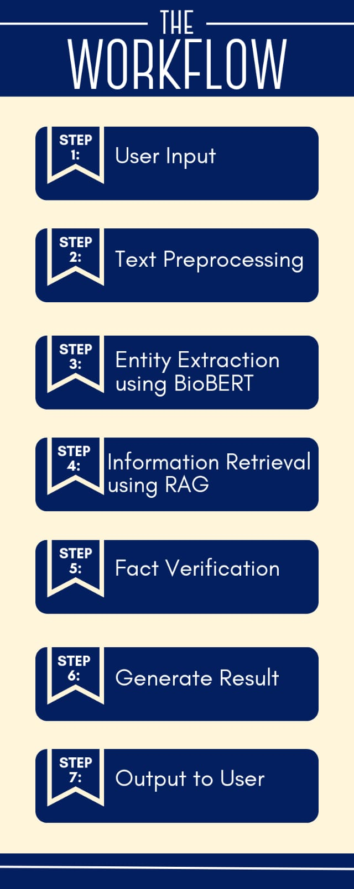

Slide 7
LITERATURE SURVEY
HealthFC: Verifying Health Claims with Evidence-Based Medical Fact-Checking by Juraj Vladika, Phillip Schneider, and Florian Matthes. It consists of 750 health-related claims in both German and English, labeled for veracity by medical experts and backed with evidence from systematic reviews and clinical trials.
Retrieval Augmented Generation (RAG) and Beyond: A Comprehensive Survey on How to Make your LLMs use External Data More Wisely by Siyun Zhao et al and Beyond
BIORAG: A RAG-LLM Framework for Biological Question Reasoning by Chengrui Wang et al. This paper introduces a novel RAG framework tailored for biological question reasoning, which could be adapted for medical fact-checking.
Natural Language Processing (NLP) to Facilitate Abstract Review in Medical Research: The Application of BioBERT to Exploring the 20-Year Use of NLP in Medical Research delves into the use of NLP techniques, specifically BioBERT, to streamline the process of abstract review in medical research. It highlights how NLP has evolved over the past two decades to assist in extracting, summarizing, and verifying information from medical literature.

Slide 8
HARDWARE & SOFTWARE REQUIREMENTS
Hardware Requirements:
Processor: High-performance CPU (e.g., Intel i7 or higher) or GPUs for training and inference of deep learning models.
RAM: At least 16 GB (32 GB recommended) to handle large datasets, especially for processing and running BioBERT-based models.
Storage: Minimum 500 GB of SSD storage for datasets, pre-trained models, and database integration.
Software Requirements:
TensorFlow or PyTorch for deep learning model development and training.
Transformers library from HuggingFace for accessing pre-trained models like BioBERT.
Flask or Django for web application development and API handling.
SQLAlchemy for database integration and management.
BeautifulSoup or Requests for web scraping (if necessary) for gathering data.

Slide 9
CONCLUSION
Use of Transformer Models: The tool utilizes BioBERT, a transformer-based model, for accurate entity extraction and validation of medical claims, offering superior understanding of medical language and context.
Integration with Knowledge Databases: By connecting to authoritative databases like PubMed, WHO, and UMLS, the system ensures access to reliable and up-to-date medical information for fact-checking.
Scalability and Adaptability: The system is designed to be scalable, with potential for future extensions, such as incorporating additional external knowledge sources or handling multi-modal data.
Long-Term Applicability: The tool is built to adapt to emerging misinformation tactics, ensuring its relevance and effectiveness in addressing future challenges in the medical information domain.

Slide 10
THANK YOU

