Slide 1
Balamurugan K
Naan_Mudhalvan Final project

Slide 2
Text2Pix: Bridging Worlds with StabilityAI’s
Diffusion Model

Slide 3
AGENDA
Problem Statement
Project Overview
End Users
Data Flow
Implemented Techniques
Solution and its Value Proposition
The Wow in the Solution
Modeling
Result

Slide 4

PROBLEM STATEMENT
The current creative process for generating images often relies on artistic skill, existing references, or time-consuming software. This can be a barrier for people who lack artistic ability, have limited access to visual references, or need to rapidly brainstorm visual concepts.

Slide 5
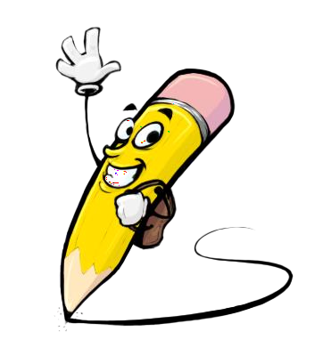
PRoject OVERVIEW
My project aims to explore cutting-edge techniques in artificial intelligence to generate realistic images from textual descriptions. Leveraging the power of StabilityAI's diffusion model, we're diving into the realm of natural language understanding and image synthesis to bridge the gap between text and visual content seamlessly.

Slide 6
END USERS
Graphic Designers
Product Developers
Writers & Illustrators
Marketing Professionals
Architects & Interior Designers
Scientists & Researchers
E-commerce Businesses

Slide 7
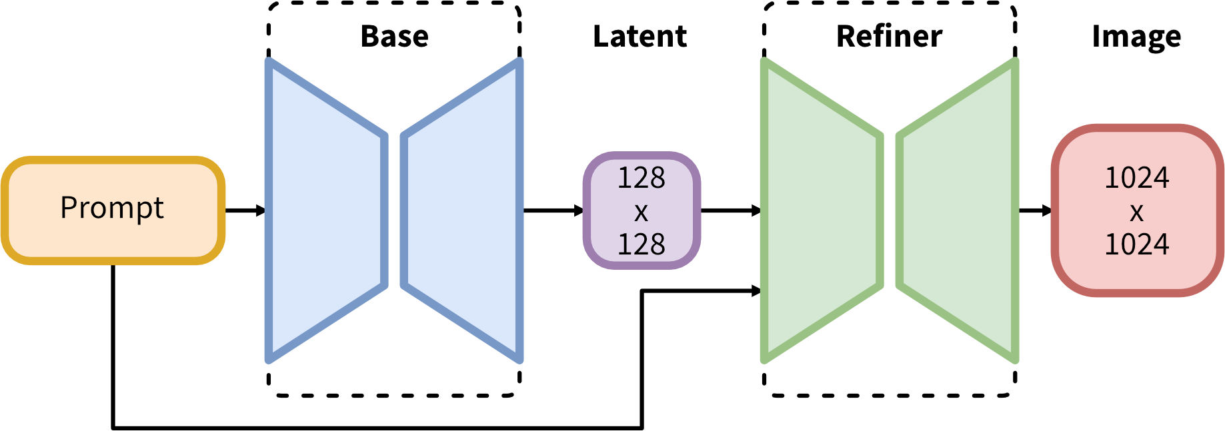
DATA FLOW

Slide 8
IMPLEMENTED TECHNIQUES
Transformers for Text Encoding
Variational Autoencoder for Latent Space
U-Net with ResNet Backbone for Image Denoising

Slide 9

SOLUTION AND ITS VALUE PROPOSITION
Develop an advanced text-to-image generation system leveraging StabilityAI's diffusion model. This system will employ cutting-edge natural language processing algorithms to accurately understand textual descriptions and translate them into high-fidelity images. By integrating the diffusion model, which excels in generating diverse and realistic images, the system will ensure that the generated visuals align closely with the semantic content of the input text.

Slide 10

THE WOW IN THE SOLUTION
The "wow" factor in the solution lies in its ability to seamlessly translate textual descriptions into highly realistic and visually compelling images, thanks to the integration of StabilityAI's diffusion model.
The text-to-image generation solution offers a transformative approach to content creation and visualization
3/21/2024 Annual Review

Slide 11
MODELING
Latent Diffusion Model
StabilityAI Diffusion Model
Prompt Engineering
Tokenization
Attention Mechanism

Slide 12
RESULT
The project on text-to-image generation using StabilityAI's diffusion model represents a significant advancement in the field of artificial intelligence and visual content creation. By seamlessly translating textual descriptions into highly realistic and visually compelling images, our solution offers transformative possibilities across various domains

