Slide 1
TITLE OF THE PROJECT
CRIME RECORD MANAGEMENT SYSTEM

Slide 2
Abstract
Crime Record Management System (CRMS) is a database-driven solution designed to assist law enforcement agencies in efficiently storing, managing, and retrieving crime-related data. The system provides a structured platform for police officers to log crime reports, track investigations, store offender details, and manage case statuses. By leveraging DBMS concepts, the system ensures data integrity, security, and quick access to critical information. The database is designed to store essential records such as crime incidents, offender profiles, investigation progress, and legal proceedings. Through role-based access control, sensitive data is protected while ensuring authorized personnel can access relevant information. This project demonstrates the practical application of database management techniques in a real-world scenario, contributing to better crime management and public safety.

Slide 3
Literature Review
Year | Authors | Title of the Paper | Algorithm/ Methodologies/ Techniques | Findings
2021 | A. Sharma, R. Kumar | Design and Implementation of Crime Record Management System Using Relational Database | Used MySQL as the DBMS backend. Developed with PHP and HTML for the frontend. Applied Entity-Relationship (ER) modeling for database design | Used MySQL as the DBMS backend. Developed with PHP and HTML for the frontend. Applied Entity-Relationship (ER) modeling for database design
2023 | S.Banerjee, P. R. Sinha | A Secure and Scalable Crime Data Management System Using DBMS and Web Technologies | Utilized PostgreSQL for database. Integrated Django web framework (Python). Employed role-based access control (RBAC) and encryption for data security | Achieved high scalability in handling large datasets of crime records.

Slide 4
Problem(s) Identified
Design and develop a Crime Record Management System using DBMS concepts to efficiently store, manage, and retrieve crime-related data for law enforcement agencies.
The system should allow police officers to log crime reports, track investigations, store offender details, and manage case statuses.
The database will store critical data such as crime records, offender profiles, investigation details, and legal proceedings

Slide 5
Proposed Solution
Entity-Relationship (ER) Model – Defines entities such as Crimes, Officers, Offenders, and Case Reports, along with their relationships.
Normalization – Eliminates redundant data by structuring tables efficiently.
SQL Queries – Used for inserting, updating, deleting, and retrieving crime data.
Transactions – Ensures the integrity of operations using ACID properties (Atomicity, Consistency, Isolation, and Durability).
Triggers & Constraints – Maintain data consistency and integrity (e.g., ensuring case numbers are unique).

Slide 6
Objectives
Crime records are crucial for law enforcement agencies in their daily operations.
Traditional methods of maintaining crime data involve manual record-keeping, which is prone to data loss, inefficiency, and errors.
This project introduces a Crime Record Management System (CRMS) that leverages DBMS technology to improve crime data storage and retrieval.
The system aims to streamline crime tracking, offender profiling, and investigation management, ensuring seamless access to information.

Slide 7
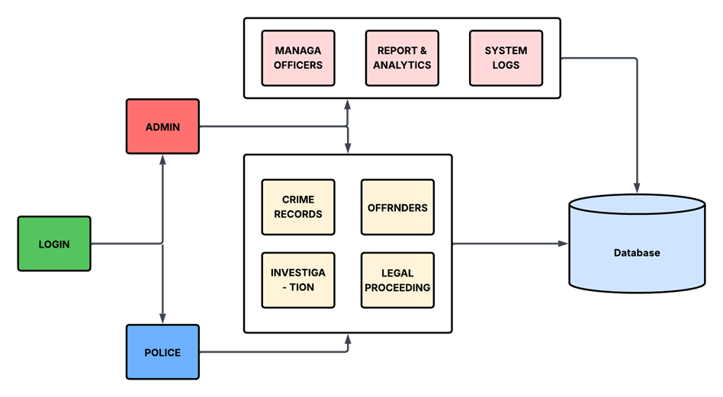
Architecture Diagram
.

Slide 8
Architecture Diagram Explanation
Login Module
Enables secure access for Admin and Police users.
Admin Panel
Manages officer records
Views system logs
Analyzes reports and crime data
Police Panel
Enters and manages crime records
Updates investigation progress
Handles offender details
Manages legal proceedings
Centralized Database
Stores all system data including crimes, users, logs, and legal records.

Slide 9
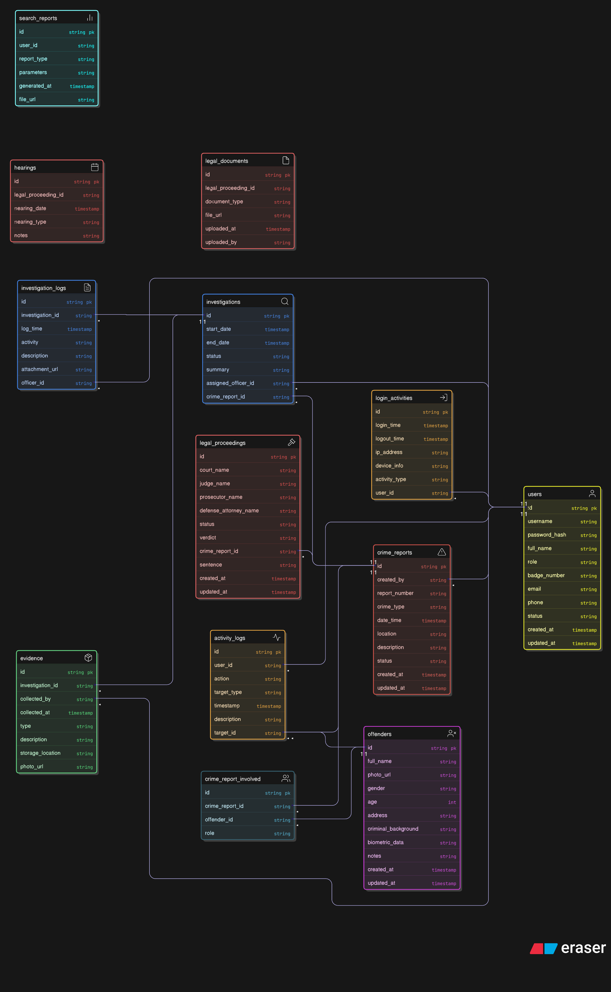
Schema Diagram

Slide 10
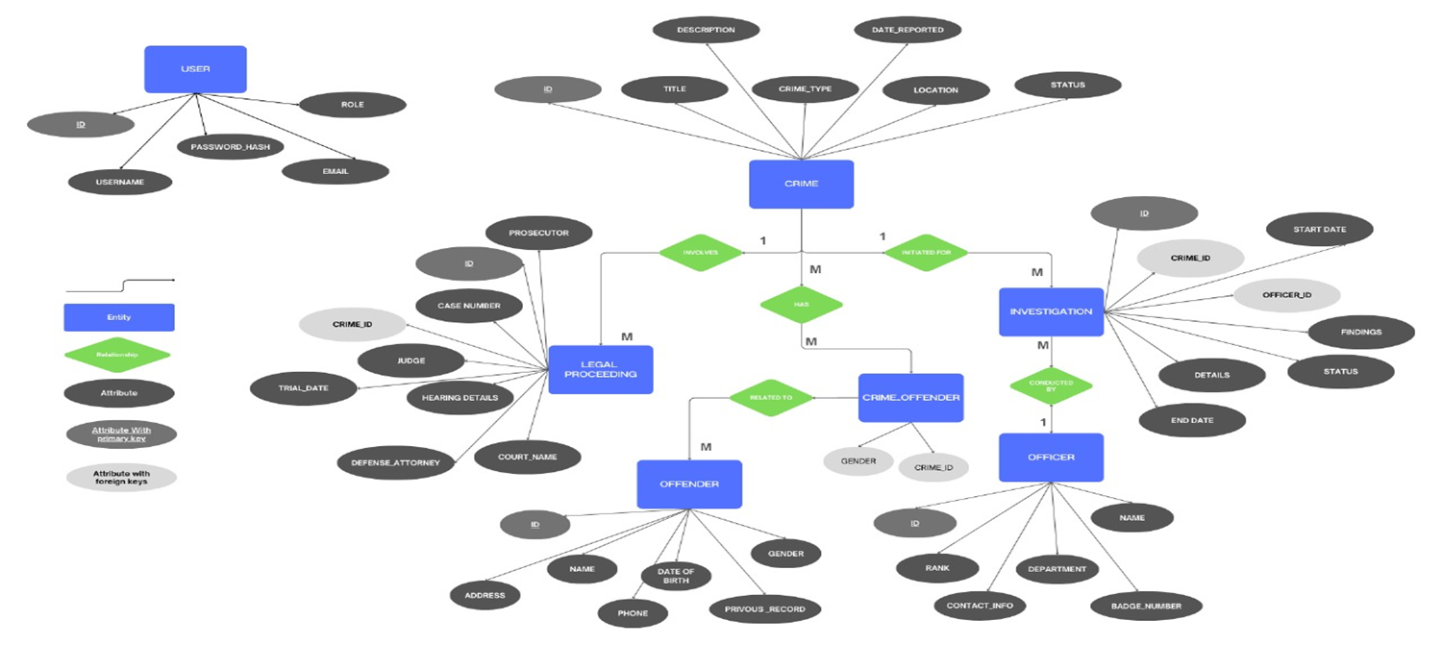
ER diagram

Slide 11
Software Description
The Crime Record Management System (CRMS) is a web-based application developed using Flask (a Python web framework) and SQLite (a lightweight database). It allows police officers to log crime reports, track investigations, store offender details, and update case statuses. The system provides a user-friendly interface, ensuring secure, accurate, and efficient management of crime data. All records are stored in a structured database, enabling easy retrieval, search, and modification. The software enhances crime data accessibility and supports better decision-making for law enforcement agencies.

Slide 12
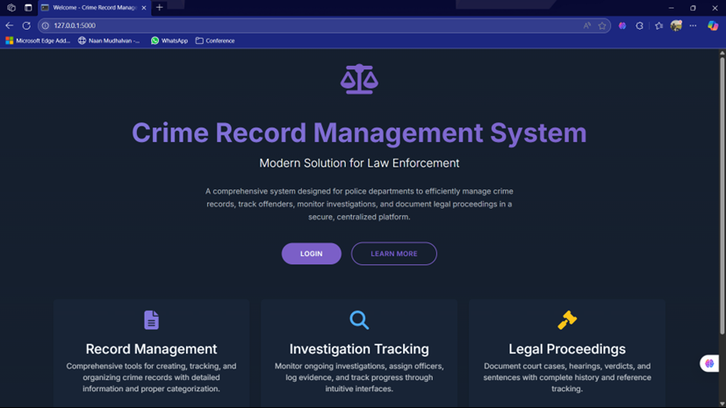
Results & Discussion

Slide 13
Results & Discussion
The Crime Record Management System (CRMS) was successfully developed and tested using Flask and SQLite. The system allows users to efficiently log new crime reports, update investigation progress, store offender profiles, and monitor case statuses. It provides a secure login system for authorized personnel, ensuring data confidentiality and integrity. During testing, the system showed fast data retrieval, accurate record updates, and smooth navigation through different modules. Overall, the CRMS simplifies crime data handling, improves operational efficiency for law enforcement, and demonstrates the effectiveness of using DBMS concepts in real-world applications.

Slide 14
Conclusion
The Crime Record Management System (CRMS) is a well-structured, database-driven solution aimed at modernizing the way law enforcement agencies manage and access crime-related information. Traditional manual systems often suffer from inefficiencies, data loss, and security risks, which hinder effective crime tracking and investigation. CRMS addresses these challenges by offering a centralized, web-based platform that ensures secure data entry, structured storage, and efficient retrieval of crime reports, offender details, investigation records, and legal proceedings. This shift from paper-based to digital management significantly enhances the reliability, accessibility, and speed of operations in police departments.

Slide 15
Reference
Elmasri, R., & Navathe, S. B. (2017). Fundamentals of Database Systems (7th ed.). Pearson Education.
Silberschatz, A., Korth, H. F., & Sudarshan, S. (2019). Database System Concepts (7th ed.). McGraw-Hill Education.
Flask Documentation – https://flask.palletsprojects.com
SQLite Documentation – https://www.sqlite.org/docs.html
Bootstrap Documentation – https://getbootstrap.com
Python Official Documentation – https://docs.python.org

